Slide 1
Exploring Microsoft
Access 2010
by Robert Grauer, Keith Mast, Mary Anne Poatsy
Chapter 2 Relational Databases and Queries
Notes:
In this chapter, you will be learning the basic principles of table and query design.
You will also learn how to use tables and forms to input data, and how to create queries and reports to extract information from a database in a useful and organized way.

Slide 2
Objectives
Design data
Create tables
Understand table relationships
Share data with Excel
Establish table relationships
Create a single-table query
Specify criteria for different data types
Notes:
The objectives of this chapter include to:
design data.
create tables, including specifying criteria for different data types.
develop a deeper understanding of table relationships and how to establish table relationships.
share data with Excel.
create a single-table query.
The list of objectives are continued on the next slide.

Slide 3
Objectives (continued)
Copy and run a query
Use the Query Wizard
Create a multi-table query
Modify a multi-table query
Notes:
Objectives also include to:
copy and run a query.
use the Query Wizard.
create and modify a multi-table query.

Slide 4
Table Design: Designing Data
Table Definition – Revised
Input vs. Output in Design
Notes:
Developing a good database design begins with creating well-designed tables. Tables provide the framework for all of the activities you perform in a database. If the tables are poorly-designed, the database will be as well. In the first chapter, we defined tables as collections of records. Here we expand the definition.
A table is a storage location in a database that holds related information. A table consists of records, and each record is made up of one or more fields.
Often, we have to look at the database (or table) from the results, instead of just how the data will be entered by the user. As an example, imagine if you were creating a table of your family and friends, so that you send them holiday, birthday and anniversary cards in a timely fashion. Would you need to separate the address into the fields street number, street name, apartment or floor number, etc.? Of course not. All you would need is street address.
A utility company, on the other hand, would need that kind of detail to determine where outages are located and how widespread the outage might be. They would need to know the street name, and separately, the street number and/or apartment complex and number to determine how widespread the outage might be.
As a result, we must sometimes look at the end—the output that is needed from the tables, rather than just looking at how we will input the raw data.

Slide 5
Designing Fields Guidelines
Include the necessary data
Design for now and the future
Store data in its smallest parts
Add calculated fields to a table
Design to accommodate date arithmetic
Link tables using common fields
Notes:
As mentioned in Chapter 1, there are two methods for creating databases: from the data out to the information (bottom up), and from the information back down to the data (top down).
These are the six guidelines you should use when designing fields:
Include the necessary data
Design for now and the future
Store data in its smallest parts
Add calculated fields to a table
Design to accommodate date arithmetic
Link tables using common fields
We will learn more about each of these guidelines on the following slides.

Slide 6
Include Necessary Data
Determine what data is necessary
Create a rough draft of reports that may be needed
Create tables based on fields necessary for reports
Notes:
One method to determine the data that will be necessary for your tables is to create a rough draft of the reports (the output) you need. Then, create the tables that will contain the fields necessary to create those reports.
Ask yourself what information you will be expecting from your database, and then determine what data will be required to produce that information.

Slide 7
Design for Now and the Future
Organizations evolve over time
Databases should evolve with the organization
Anticipate future needs of the organization
Build flexibility into system to satisfy future needs
Notes:
Organizational requirements evolve over time and their information databases must evolve with the organization.
When designing a database, you should try to anticipate the future needs of the organization and build flexibility into the system to satisfy those demands.
Caution should be exercised, though, when adding fields because there are costs associated with each additional field. These costs include the time an employee will need to enter and maintain the data, and the increased storage space necessary.

Slide 8
Store Data in Smallest Possible Pieces
Creating a name field with the entire name in it violates good database design and reduces the usefulness of the data
Divide data into the smallest pieces that you’re going to need to access
Example: Prefix, FirstName, LastName, Suffix
Provide flexibility for the user
Notes:
There is nothing more annoying to a user than to only be given the option to sort a named list by the first name. A combined field with the entire name in one field makes sorting by last name impossible and inflexible. It also violates database principles and reduces the usefulness of the data.
If you’re going to need to access first names (Bob, Carol, Ted, Alice, etc), last names (Grater, Gallagher, Shank, etc.) and/or prefixes (Mr., Mrs., Ms., etc.), then you should create separate fields for each piece of data. With separate fields for each piece of name data, you can sort by last name and then by first name. For example, if you’re going to send out letters to your customers, you may want to be able to address them as Dear Ted or Dear Mr. Grater. Either way, you’ll need to create separate fields for each piece of data.
On the next slide, we’ll look at how an address can be designed.

Slide 9
Calculated Fields in a Table
Produce a value from an expression or function that references one or more existing fields
Access 2010 allows the user to store calculated fields
Can be a benefit or a potential problem
Exercise caution when using calculated (derived) fields
Notes:
Calculated fields produce a value from an expression or function that references one or more existing fields.
In Access 2010, you can store calculated fields in a table. A typical example of a calculated field that you might want to store in a table is in a payroll database.
Be careful using this feature. It violates conventional database principles, which avoid storing data that can be derived from other fields. In this case, multiplying the two fields—Hours and PayRate—would result in GrossPay. This can be useful in certain circumstances, such as accessing the derived data in queries, forms and reports, without additional calculations being required. However, it also increases the size of the database slightly. The benefits may outweigh the drawback. It’s a decision that the database designer would need to make looking forward to future use/need of the derived field.

Slide 10
Design to Accommodate Date Arithmetic
Calculated fields can also create date/time data
Plenty of examples available for using date/time date arithmetic
Notes:
Examples of why you would want to store calculated fields using date arithmetic are plentiful. For example, you can calculate:
the amount of time an employee has been an employee from the hire date.
a person’s current age from a birth date.
how long a customer has been a customer, which may affect their interest rates or affect their cost of service.

Slide 11
Link Tables Using Common Fields
Tables may be joined based on a common field
Join lines are created
Manually by the user, or
Automatically by Access when two fields in separate tables share the same name between two related tables
Avoid Data redundancy errors
The unnecessary storage of duplicate data in two or more tables
Notes:
When creating tables, keep in mind that the tables you’re creating will be joined to other tables using relationships based on common fields. You can draw lines (join lines) between fields to create joined fields, but Access will automatically create join lines when two tables use the same name for a common field. For example, a Customer table uses CustomerID as its primary key and the Payroll table also uses CustomerID, but as the foreign key.
Data redundancy is the unnecessary storage of duplicate data in two or more tables. Although a certain amount of data redundancy is inevitable, it should be kept to a minimum. The common fields between tables represent data redundancy, but you don’t want to add fields to multiple tables when you can join the tables and avoid data redundancy. Data redundancy can severely affect the integrity of your data, creating unreliable data.

Slide 12
Creating Tables
Create fields in Design View
Import data from another database or application
Examples: Excel spreadsheets or Word text files
Enter data directly into rows in Datasheet view
Notes:
Access provides several methods for creating tables. Before creating your first table, you must begin with a blank database. One of the differences between Access and other Microsoft applications is that Access will first ask you to save your blank database to a specific storage location.
You can use an existing database, and then create or modify existing tables. To create a table, create the fields in Design View.
You can import data from another database or application, such as Excel or text files. Or, you can enter table data into a new row in the Datasheet view, which is the least desirable and least accurate method.
No matter how your tables are created, you can always modify them later.

Slide 13
Creating Fields in Tables
Field names should be meaningful
Rules for naming fields:
Length can be up to 64 characters
Can include letters, numbers and spaces
Access uses CamelCase notation
Use uppercase letters for each first letter of each new word
Example: ProductCost
Notes:
You already know that each field in a table has a field name associated with it to identify the data contained within the field. The name should be meaningful to the data contained.
Names can be up to 64 characters in length and can include letters, numbers, and spaces. If possible, however, spaces should be avoided as they may cause problems when creating other objects based on tables. Conventionally, names should begin with a letter, but after the first letter, both letters and numbers can be used.

Slide 14
Field Data Types
Every field has a data type
Determines:
The type of data that can be entered
The operations that can be performed on that data
Access recognizes 10 data types
Notes:
Every data field has a data type associated with it. This indicates the type of data that the field can hold. Access recognizes 10 data types.
The data type determines the type of data that can be entered and the types of operations that can be performed on the data.

Slide 15
Access Data Types
Number
Text
Memo
Date/Time
Currency
Yes/No
OLE
AutoNumber
Hyperlink
Attachment
Notes:
Access data types include:
Numbers—contain a value that can be used in calculations.
Text—stores alphanumeric data, including special characters.
Memo fields—store up to 65,536 characters, used to hold descriptive data.
Date/Time—holds dates or times and can be used in date arithmetic.
Currency—used for monetary values.
Yes/No—assumes only two values Yes/No, True/False, On/Off (also known as Boolean values).
OLE fields—contain objects created by other applications, such as spreadsheets, pictures, sounds or graphics.
AutoNumber—a special data type used to assign the next consecutive unique number each time a record is added.
Hyperlinks—store Web addresses (URLs) or the path to a folder or file.
Attachment fields—used to store multiple images, spreadsheet files, Word documents, and other types of supported files.

Slide 16
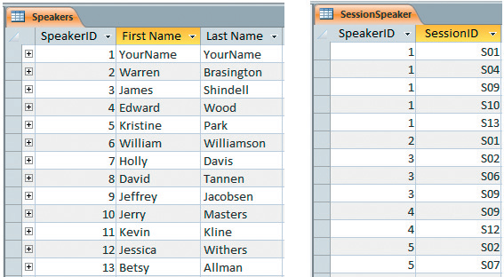
Foreign Key Review
A field in one table that is also a primary key of another table
SpeakerID is the primary key of the Speakers
SpeakerID is the foreign key in the SessionSpeaker table (duplicates are allowed)
Notes:
As defined in Chapter 1, a foreign key is a field in one table that is also a primary key of another table. For example, CustomerID is the primary key in the Customers table, but in a related table, such as Loans, the CustomerID would be the foreign key.
We use primary and foreign keys to relate tables, so that we can access information by joining the two or more tables.

Slide 17
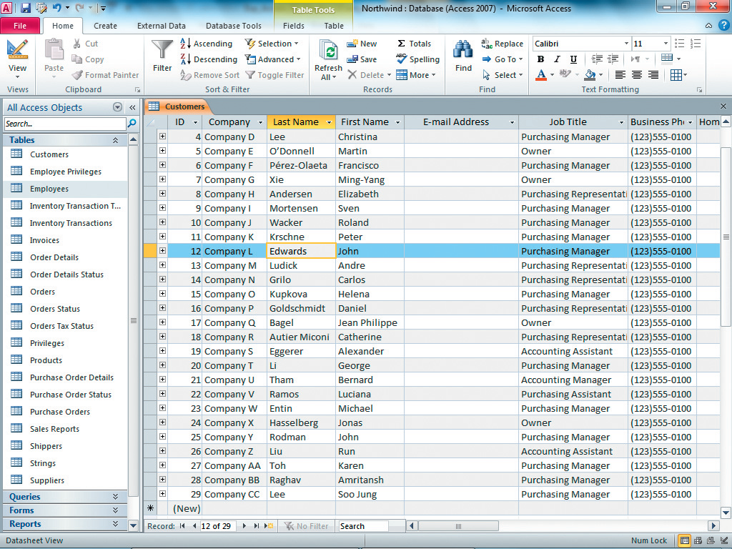
Using Table Views
Datasheet View
Active record
Notes:
As you learned in Chapter 1, you can create relationships between tables. You can use the Datasheet, which resembles an Excel spreadsheet, to view to add, edit and delete records. The active record will have a gold border on the record selector on the left side of each record.

Slide 18
Using Table Views
Design View
PivotTable
PivotChart
Notes:
Design view is where you can create and modify table structures by adding and editing fields and by setting field properties. To toggle between Datasheet and Design views, click the Home tab and then click View in the Views group, or you can right-click on the table tab again and choose another view from the shortcut menu.
In addition to the Datasheet and Design views, you can also use the PivotTable and PivotChart view. The PivotTable view provides a method to summarize and organize data in a summary view. The PivotChart view displays a chart for the respective PivotTable view.

Slide 19
Work with Field Properties
Field property
Text data type
Number data type
Caption property
Validation rule
Notes:
A field’s Data Type determines the type of data that can be entered and the operations that can be performed on that data.
Field Properties are the characteristics of a field that determine how the field looks and behaves.
Text Data types can store either text or numerical characters, holding up to 255 characters. However, you can limit the characters by reducing the field size property, such as using 2 characters for a state’s abbreviation.
Number Data types can store only numerical data. You can set the Format Field property to Currency to display the field contents with dollars and cents.
The Caption property is used to create a more readable label that will appear in the top row in the Datasheet view and in forms and reports. It overrides the field name, so if your field name is LN, you can set the Caption property to Last Name, which is a bit more user friendly.
To help improve the integrity of your data, you can set the Validation Rule property to restrict data entry in a field. This will ensure that the correct type of data is entered or that the data does not violate other enforced properties.
The rest of the field properties are set to defaults for each data type, but they can be modified.

Slide 20
Access Field Properties
Field Size
Format
Input Mask
Caption
Default Value
Validation Rule
Validation Text
Notes:
Access Table Property Types include many options.
Field size determines the maximum number of text characters or the format of a numeric field.
Format changes the way a field is displayed or printed, but does not affect the stored values. For example, the > character converts lowercase letters to uppercase letters.
Input Mask simplifies data entry by providing literal characters that are types for every entry. For example, a Social Security number would be displayed to the user with hyphens.
Caption as previously discussed, provides a label used in Datasheet view or in reports.
Default values automatically enter a predetermined value for a field each time a new record is added to a table. For example, FL could be entered into a state’s field if most of your employees live in Florida.
We’ve already looked at what a Validation Rule can be used for, but Validation Text specifies the error message displayed to the user when the rule has been violated.
More property types continue on the next slide.

Slide 21
Access Field Properties (continued)
Required
Allow Zero Length
Indexed
Expression
Result Type
Notes:
The Required property indicates that a value for this field must be entered. A primary key field would be one that would require a value.
The Allow Zero Length enables text or memo strings of zero length.
The Indexed property increases the efficiency of a search on the designated field.
The Expression property is used for calculated fields only. You will need to enter the expression you want Access to evaluate.
The Result Type property is also used for calculated fields only. This will format the results of a calculated field.

Slide 22
Understanding Table Relationships
Efficiently combine data from related tables
Create queries, forms, and reports
Notes:
We’ve already looked at the concept of Relationships; here we will look at benefits of a relationship. A relationship between two tables efficiently combines data from related tables for the purpose of creating queries, forms, and reports. Primary and foreign keys play an important role in creating relationships.
It is helpful, when creating relationships, to keep your join lines from crossing. It makes relationships easier to read and maintain.

Slide 23
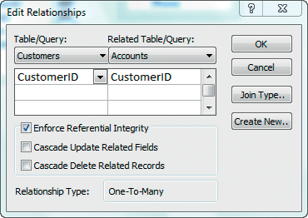
Establishing Referential Integrity
Edit Relationships dialog box
Select Enforce Referential Integrity checkbox
Notes:
When creating relationships in Access, the Edit Relationships dialog box appears. The first checkbox, Enforce Referential Integrity, should be checked in most cases. When referential integrity is enforced, it prohibits the user from entering a foreign key value in a related table unless the primary key value already exists in the primary table. It also prohibits the user from deleting a record from one table when there are related records in other tables.

Slide 24
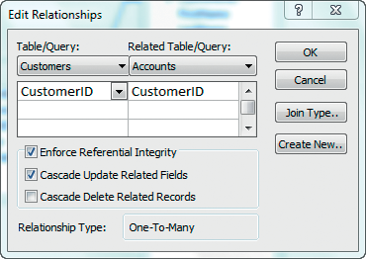
Set Cascade Options
Cascade Update Related Fields
Cascade Delete Related Records
Click Enforce Referential Integrity
Click Cascade Update in
case the primary key changes
Click Cascade Delete with caution
Notes:
There are two additional options in the Edit Relationships Dialog box: Cascade Update Related Fields and Cascade Delete Related Records.
The Cascade Update Related Fields option specifies that when the primary key is modified in a primary table, Access will automatically update all foreign key values in a related table.
The Cascade Delete Related Records option specifies that when the primary key is deleted in a primary table, Access will automatically delete all records in related tables that reference the primary key. This is an option that should be used with extreme caution. Fortunately, Access will give you a warning first and allow you to reverse the action if you don’t want to follow through with the action. For example, if a branch at the bank closes, and not all of the accounts have been moved to other branches, deleting all of the branch’s records would be problematic.

Slide 25
Indexing to Retrieve Data Quickly
Provides quick sorting based on the primary key
Provides quick retrieval of data based on the primary key
Notes:
Setting the Indexed Property provides quick sorting in primary key order and quick retrieval based on the primary key.
As a general rule, indexed fields are usually foreign keys and are numeric, which helps to speed the indexing process.
For non-primary key fields, it is sometimes beneficial to set the Indexed property to Yes (Duplicates OK).

Slide 26
Options on External Data Tab
Import & Link
Export
Collect Data
Web Linked Lists
Click Excel to import
spreadsheet data
External Data Tab
Notes:
Most companies use Excel spreadsheets to store at least some types of data. Often, this data can be more efficiently managed in an Access database, and Access provides a wizard to guide you through the process of importing data from Excel.
Import & Link brings data into an Access database. Data sources that can be used include: Excel, Access (from other Access files), ODBC Databases, Text files, XML files, and others.
Export sends a portion of a database to other applications. For example, you could use part of a database to use with Word’s Mail Merge feature to create letters and envelopes to your clients or to create an Excel file for someone unfamiliar with Access.
Collect Data allows you to create an email mail merge to send emails to your clients and then use Access to manage client responses.
Web Linked Lists is a process that might be used when away from your home or office if an Internet connection is unavailable.

Slide 27
Import Data from Excel
Click Browse to find
a spreadsheet
Decide what you want
to do with the data
Notes:
After you select an Excel workbook and accept the default option, import the source data into a new table in the current database, and then click OK. The Import Spreadsheet Wizard dialog box launches and displays a list of the worksheets in the specified workbook.

Slide 28
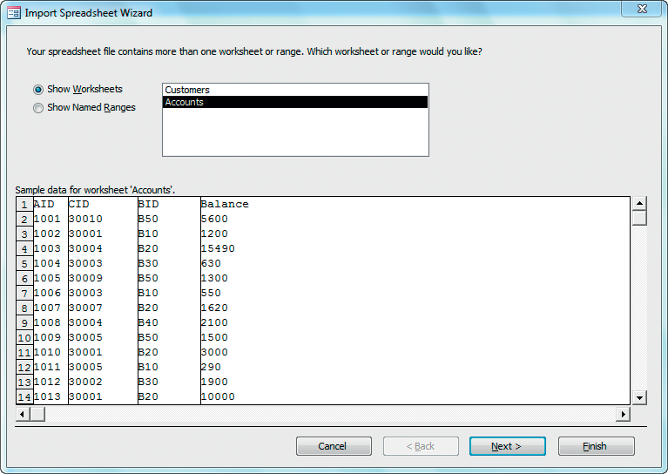
Import Data from Excel (continued)
Choose the worksheet
to import
Preview of the
worksheet data
Click Next to continue
Notes:
Choose the worksheet to import. The bottom of the Import Spreadsheet Wizard dialog box displays a preview of the data stored in the specified worksheet.

Slide 29
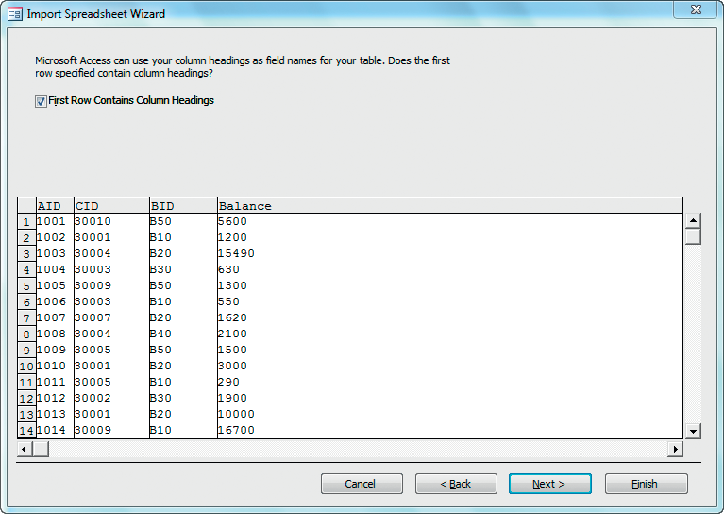
Import Data from Excel (continued)
Column headings
Click Next to continue
Notes:
Next, the Wizard will ask you if you want to use your column headings as field names. Although a well-designed spreadsheet may include descriptive column headings, not all spreadsheets are ready to import. You may want to revise the spreadsheet before importing it.
The second window of the Import Spreadsheet Wizard dialog box contains a check box that enables you to convert the first row of column headings to field names in Access.

Slide 30
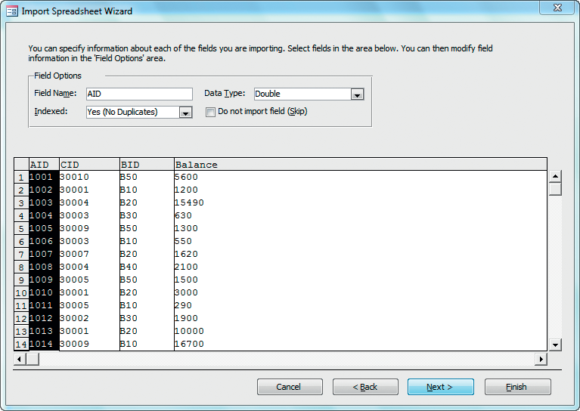
Import Data from Excel (continued)
Change Indexed property to Yes (No Duplicates)
Click Next to continue
Notes:
The third window of the Import Spreadsheet Wizard dialog box enables you to specify field options. In this example, the AID field will become the primary key, so you’ll need to set the Indexed Property to Yes (No Duplicates).
To modify the field options of the other fields, select the Field Name column heading, and then make your changes. Not all Access table properties are supported by the wizard, so you will need to open the table in Design view after importing it to make additional field property changes.

Slide 31
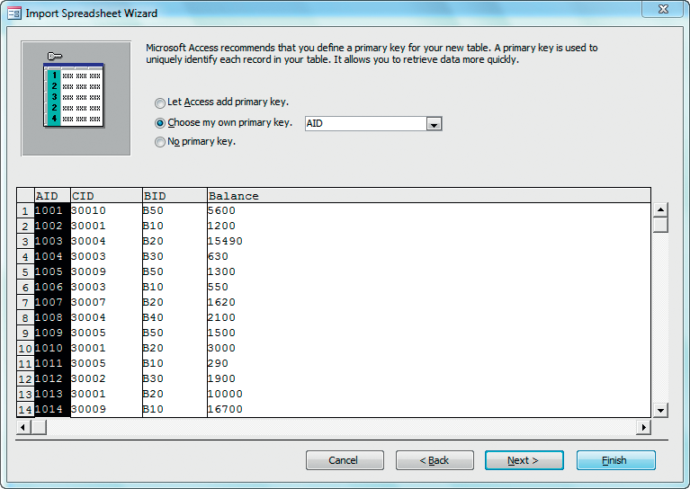
Import Data from Excel (continued)
AID becomes the primary key
Click Next to continue
Notes:
The next window of the Import Spreadsheet Wizard dialog box enables you to choose a primary key before the import takes place. If the option Let Access add primary key is selected, Access will generate an AutoNumber field and designate it as the primary key. Otherwise, you can designate a field to be the primary key.
In the import described in the example, the Excel data has a unique identifier (AID) that will become the table’s primary key.

Slide 32
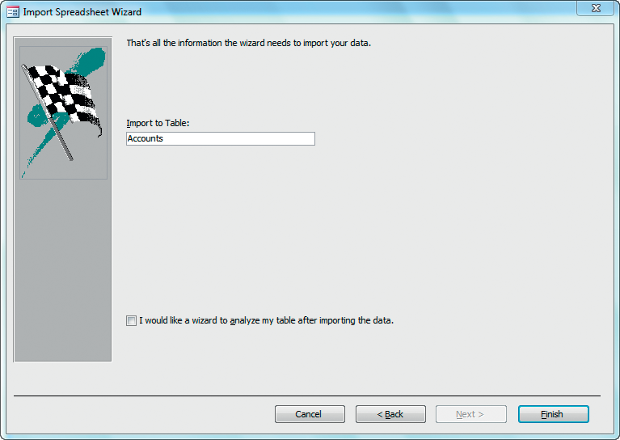
Import Data from Excel (continued)
Accounts becomes the
table name
Click Finish to import the data
Notes:
The final window of the Import Spreadsheet Wizard is used to name the Access table. If the worksheet in the Excel workbook was named, Access uses the worksheet name as the table name. Lastly, Access will ask if you wish to save the import steps. To save the changes, click on Finish.
If the same worksheet is imported from Excel to Access on a recurring basis, you can save the parameters and use them again. To save the import steps, such as the indexing option and any new field names, click Saved Imports in the Import group. Saving the import steps will help you import the data the next time it is needed.

Slide 33
Types of Relationships
One-to-one relationship
One-to-many relationship
Many-to-many relationship
Notes:
You may not be aware of it, but you actually have several one-to-one relationships in your life. You have one driver’s license. You have one birth certificate. You have one Social Security number. So, you have lots of one-to-one relationships in your life, but this relationship is not the most common. Of the three types of relationships, the most common is the one-to-many relationship. Just think about your own experiences, and you can see that this is true. For example, you are a student taking multiple courses from multiple instructors. You may own multiple DVDs, CDs, books, etc.
The one-to many relationship is established when the primary key value in the primary table can match many of the foreign key values in a related table. You may have multiple one-to-many relationships between one table and other tables. For example, you may have a customers table at a bank. This is your one table. This table may be linked to a Loans table, Accounts table, Safety Deposit Box table, etc. These are the many side of the relationship. Each one-to-many relationship is a one-to-many with two tables, but you can have multiple one-to-many relationships from one table.
The many-to-many relationship is an artificially constructed relationship giving many matching records in each direction between tables. It requires the creation of a third table, often called an junction table, to join the two many tables. The junction table creates the join using the foreign keys.

Slide 34
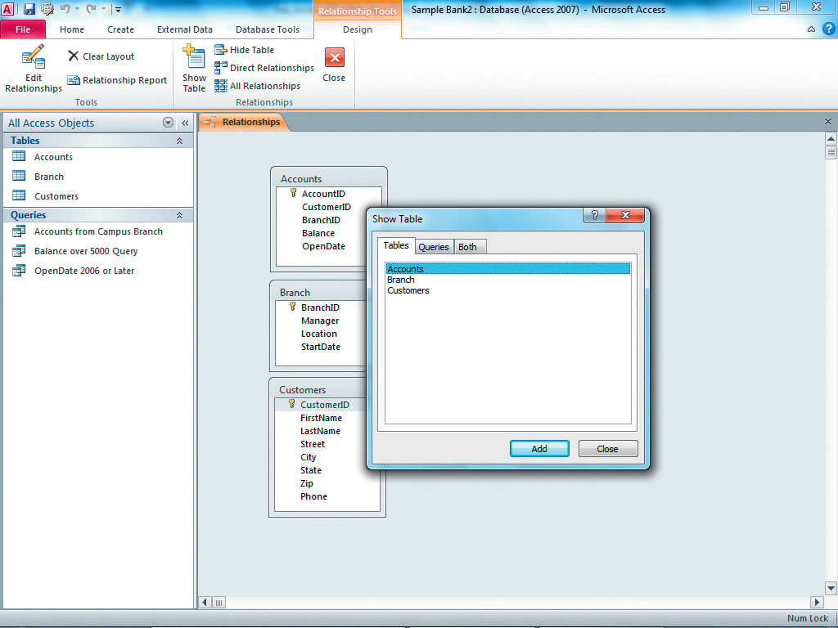
Establishing a One-to-Many Relationship
Open Relationships window
Add tables
Establish relationships
Show Table window
Notes:
To add relationships, open the Relationships window from the Relationships group in the Database Tools tab. You will see the Show Table dialog box where you click on a table name. Then click on Add for each table you want to add.

Slide 35
Relationships Between Tables
One-to-many relationships
Edit Relationships
dialog box
Notes:
Once you’ve added the tables you plan to use, you can right-click on the join lines to edit the relationship using the Edit Relationships dialog box.

Slide 36
Relationships Window
Join lines
Many side: the “∞” (infinity symbol)
1 side
Notes:
Here, you see three tables that are related through join lines. The “1” indicates the one side of the relationship and the “∞” (infinity symbol) represents the many side.
Next, we’ll look at how to use these relationships in queries.

Slide 37
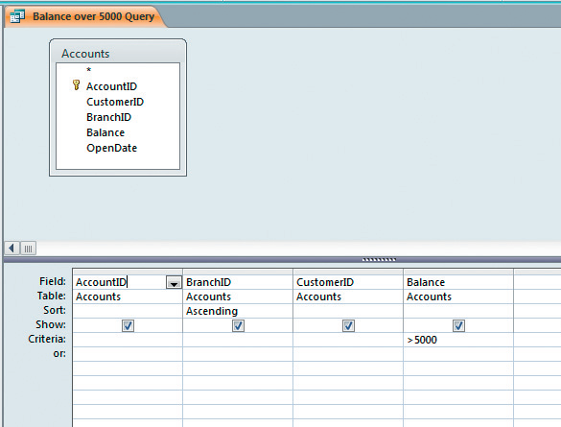
Single-Table Queries
Show Table
Design Grid to add
Field row
Table row
Sort row
Show row
Criteria
Query Design—Tables
Query Design Grid—Fields, Sorting, and Criteria
Notes:
Queries allow us to ask questions about the data stored in a database. Query Design view is used to create queries.
The Query Design view is divided into two sections: the top part displays tables selected, and the bottom part (known as the design grid) displays the selected fields and criteria.
The Query Design view allows you to:
Arrange your fields in the order in which you want them to appear and create calculated fields to display data based upon expressions that use the fields in the underlying table in the Field row.
Display the source table for each field in the Table row.
Select which fields you want to use and which you want to appear in the output in the Show row.
Sort your query based on one or more fields in the Sort row.
Set the rules that determine which records will be selected in the Criteria row.
A select query displays only the fields selected from records that match the criteria entered in Design view. The results of a query are referred to as a recordset. It looks and acts like a table, but it is actually a dynamic subset of a table that selects, sorts, and calculates records as specified in the query. Any changes made to the recordset are reflected in the underlying table, so caution should be exercised when changing data.
You can also use the Simple Query Wizard, which provides dialog boxes to guide you through the query design process.
After you have finished creating your design, you can display the output in the Datasheet view.

Slide 38
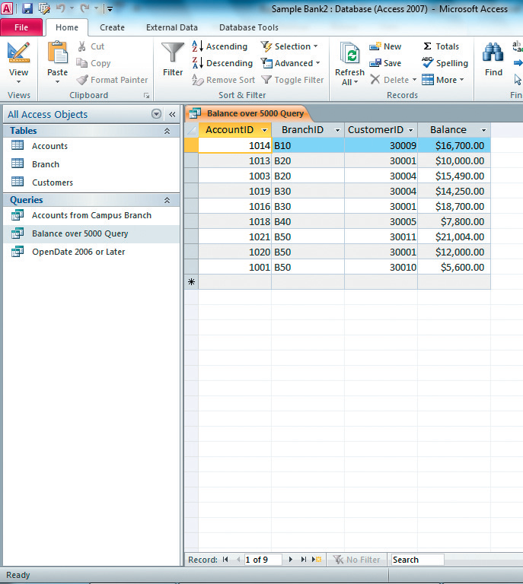
Datasheet View of Results
Query results in
Datasheet view
Only accounts with a
balance over $5,000
Nine records match
the criteria
Notes:
The query results in Datasheet view show 9 records of only accounts with a balance of greater than $5,000.

Slide 39
Specifying Criteria for Different Data Types
Field data type
Delimiters
Criteria
Notes:
The field data type determines which delimiters are required for the criterion of a field. Delimiters are special characters that surround the criterion’s value.
For example, criteria for a:
data type must be enclosed in quotes.
date/time data type must be enclosed in pound (#) signs. (Example: #10/14/2012#)
number data type (numeric, currency or AutoNumber fields) require no delimiters.
Numeric fields can also be entered with or without a decimal point, and with or without a minus sign; however, commas and dollar signs are not allowed. Dates should be in the mm/dd/yyyy format. For the Yes/No field, you can enter Yes or No.

Slide 40
Wildcards
The question mark (?)
Example: H?LL will return Hall, Hill, and Hull
The asterisk (*)
Example: S*nd will return Sand, Stand, and StoryLand
Notes:
Wildcards are special characters that can represent one or more characters in a text value, which are entered in the Criteria row of a query.
Types of Wildcards include:
The question mark (?)—used to stand for a single character in the same position as the question mark (Example: H?LL will return Hall, Hill, and Hull).
The asterisk (*)—used to stand for any number of characters in the same position as the asterisk (Example: S*nd will return Sand, Stand, and StoryLand).

Slide 41
Operators & Operands
Operators
Operands
Notes:
An operator is used to limit the results of a query. Comparison operator examples include equals to (=), greater than (>), less than (<), greater than or equal to (>=), and less than or equal to (<=), and not equals to (<>). Arithmetic operators include addition (+), subtraction (-), multiply (*), and division (/).
An operand is the part of the expression that is being operated on; for example, the value stored in a field.
Use >10 For a Price field, items with a price over $10.00.
Use <10 for a Price field, items with a price under $10.00.
Use >=10 for a Price field, items with a price of at least $10.00.
Use <=10 for a Price field, items with a price of $10.00 or less.
Use =10 for a Price field, items with a price of exactly $10.00.
Use <>10 for a Price field, items with a price not equal to $10.00.
Use #2/2/2012# for a field with a Date/Time data type, such as a ShippedDate field, orders shipped on February 2, 2012.
Use “Harry” for a text field, find the name Harry.
Use Date( ) for an OrderDate field, orders for today’s date.
Use Between #1/1/2012# and #3/31/2012# for a specified interval between a start and end date, including the start and end dates.

Slide 42
Null and Zero-Length Strings
Null
Is Not Null
Notes:
Occasionally, you will want to find what is missing from your data, rather than what is there. To do this, we use the Null and Is Not Null options to test text fields.
You might want to check to see which records have missing names or missing phone numbers. The Is Null expression will find records that are blank. The Is Not Null expression will find records that are not blank—in other words, that have a value in them.

Slide 43
Query Sort
Determines the order of records
Determined from left to right
Notes:
The query sort order determines the order of records in a query’s Datasheet view. You can change the order of records; the order is determined from left to right.
To establish your sort order, you can move columns to place them in the order you want, but it’s usually more efficient to consider the order when first creating the query. For example, a query sorted by Lastname and then by Firstname must have those two fields in the correct order in the design grid.
If you do need to change the order, however, you only need to select the column with the column selector (the thin strip just above the field name), drag the column to where you want it, and then release the mouse.
You can also insert new columns in between two existing columns by clicking on the column to the right of where you want the new column, and then clicking on Insert Columns in the Query Setup group. The new column will be inserted to the left of the selected column.

Slide 44
AND, OR, and NOT Criteria
And operator
Or operator
Not operator
Notes:
There are three additional operators that are very useful to query design. They are the AND, OR, and NOT operators.
The AND operator returns only records that meet all criteria.
For example: When the criteria are in the same row of the query design grid, Access interprets the instructions using the AND operator.
The OR operator returns records meeting any of the specified criteria.
For example: When the criteria are positioned in different rows of the design grid, Access interprets the instructions using the OR operator. The results will return all records that satisfy any of the criteria listed.
The NOT operator returns all records except the specified criteria.
For example: Access will return all records except the specified criteria.

Slide 45
Using the Query Wizard
Launch Query Wizard
Modify Query in Design view
Query Wizard
Notes:
Running a query is accomplished by the Run command (the red exclamation point) in the results group. In simple queries, queries run quickly, but for larger databases, include all necessary fields and tables, but omit unnecessary fields as this will only make the query longer to process.
You can also run a query from the Navigation pane. Locate the query you want to run, and then double-click on the query. Results will appear as a tab in the main window.
To launch the Query Wizard, click on the Create tab, and then click the Query Wizard command in the Macros & Code group. Next, select Simple Query Wizard from the Query Wizard dialog box. Then, specify the tables or queries and fields needed in your query. When a table is selected, the available fields from that table are displayed in the Available Fields list box. At that point, select the necessary fields and add them to the Selected Fields list box using the directional arrows.

Slide 46
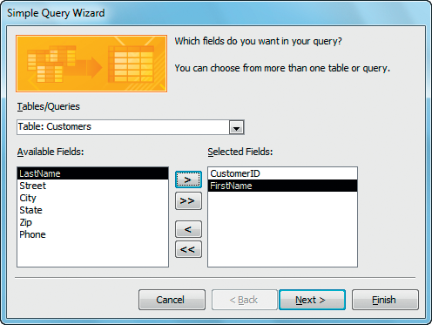
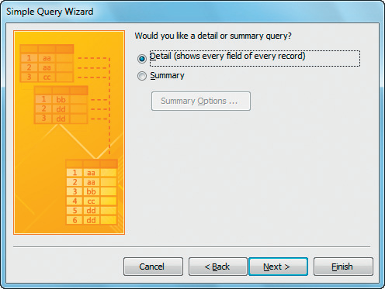
Query Wizard
Fields already moved to the Selected Fields list
Select a Table or Query
Select detail or summary data
Remove all fields from the Selected Fields list
Remove a single field from the Selected Fields list
Move all fields to the Selected Fields list
Move a single field to the Selected Fields list
Notes:
Here, the Query Wizard allows you to select from entering one field at a time, a table’s whole set of fields at one time, or to remove fields one at a time or remove all at one time.
The next dialog box allows you to choose from a query with detail, showing every field of every record or as a summary query. The summary query enables you to group data and view only summary records.
The last dialog box of the Query Wizard allows you to name your query and gives you the option to either open the query to view the results or to modify the query design. When naming queries, you should use a descriptive name.

Slide 47
Multi-Table Queries
Permit multiple tables
Use related tables
Similar to creating a single-table query
Fixing a common problem
Notes:
Multi-table queries contain two or more tables. These queries can take advantage of relationships already established in your database. Actually, printing out your Relationship Report can help you when creating a multi-table query.
As you learned earlier, related tables are tables that are joined in a relationship using a common field. Sometimes, though, the names of common fields are not the same, and so, Access cannot create the automatic join. It is up to the user to manually create the join by dragging one field across to the related field in the related table. If there are no common fields, you might have to add a related table in order to access the related fields you want to use, without creating a join which would multiply the number of records in one table by the number of records in the second unrelated table.
Often one table may contain the core information that you need, but another table may contain the related data that makes the query relevant to the users.
Although similar to a single-table query, choosing the right tables and managing table relationships require additional skills. The process of adding and deleting a table’s fields from a query, though, is the same. Unlike changes to a simple query changing the underlying table, changes to a multi-table query do not affect relationships because they are created and saved externally.

Slide 48
Summary
This chapter introduced the concept of tables and query design.
Tables and forms are used to input data, and to create queries and reports to extract information from the database in an organized and useful way.
The information to be extracted, though, is dependent on the quality of the underlying tables.
Notes:
This chapter introduced the concept of tables and query design. Tables and forms are used to input data, and to create queries and reports to extract information from the database in an organized and useful way. However, the information to be extracted is dependent on the quality of the underlying tables.

Slide 49
Questions
Notes:
Are there any questions?

Slide 50
Copyright
All rights reserved. No part of this publication may be reproduced, stored in a retrieval system, or transmitted, in any form or by any means, electronic, mechanical, photocopying, recording, or otherwise, without the prior written permission of the publisher. Printed in the United States of America.

