Slide 1
Exploring Microsoft
Access 2010
by Robert Grauer, Keith Mast, Mary Anne Poatsy
Chapter 4
Creating and Using Professional Forms and Reports
INSERT
BOOK
COVER
Notes:
In this chapter, you will learn how to create and use professional forms and reports.

Slide 2
Objectives
Create forms using the form tools
Modify a form
Sort records in a form
Identify form sections
Revise forms using form views
Identify control types in forms
Notes:
The objectives of this chapter include to:
create forms using the form tools.
modify a form.
sort records in a form.
identify form sections
revise forms using form views.
identify control types in forms.
The list of objectives are continued on the next slide.

Slide 3
Objectives (continued)
Create reports using report tools
Modify a report
Sort records in a report
Identify report sections
Revise reports using report views
Identify control types in reports
Notes:
The objectives also include to:
create reports using the report tools.
modify a report.
sort records in a report.
identify report sections.
revise reports using report views.
identify control types in reports.

Slide 4
Form Basics
Forms — database objects used to add data into a table
Reasons to use forms rather than tables
Less likely to edit the wrong record by mistake
Can show data from more than one table simultaneously
Can create Access forms to match paper forms
Notes:
A form is a database object that is used to add data into a table. Most Access database applications use forms rather than tables for data entry and for looking up information.
There are 3 main reasons for using forms rather than tables for adding, updating, and deleting data. They are:
You are less likely to edit the wrong record by mistake.
You can create a form that shows data from more than one table simultaneously.
You can create Access forms to match paper forms.
If you’re using a table with many columns, you could easily jump to the wrong record or into the middle of a record accidently. Forms avoid this type of problem because most forms restrict entry to one record at a time.
In addition, many forms require two or more tables as their record source. When paper forms are used to collect information, you can create a form that matches the paper form.
Both of these factors make data entry easier, more efficient, and more reliable, facilitating the simultaneous use of both paper forms and electronic data. Databases do not necessarily eliminate paper forms; they supplement and coexist with them.

Slide 5
Creating Forms Using the Form Tools
16 different tools for creating forms
Forms group
Navigation forms
More Forms
Notes:
Of course, one type of form will not fit every user’s needs, so Access provides 16 different tools for creating forms.
The Forms group, located on the Create tab, contains 4 of the most common form tools (Form, Form Design, Blank Form, and Form Wizard), a list of Navigation forms, and a list of More Forms.
Navigation forms provide a list of 6 templates to create a user interface for a database.
The More Forms command lists 6 additional form tools, including Multiple Items, Datasheet, Split form, and more.
Just select a table or query, click one of the tools, and Access will create an automatic form using the selected table or query. The most common of these tools, the Form tool, is used to create data entry forms for customers, employees, products, and other primary tables. A primary table, as introduced in Chapter 2, has a single field as its primary key and represents the “one” side of a one-to-many relationship. Once the form is created, you can customize the form using the layout or Design views. After the form is created, it should be tested by both the designer and the end user. Ideally, a form should simplify data entry. Creating a form should be a collaborative process between the form designer and the form user. This relationship should extend throughout the life of the form, because the data needs of the organization may change over time.

Slide 6
Identify a Record Source
Record source — the table or query that supplies the records for a form or report
Sketch the form first
Use the Form Tool
Notes:
Before creating a form, a record source must be identified. A record source is the table or query that supplies the records for a form or report. Include a table if you want all of the records from a single table, but use a query if you need to filter the records in a table, or if you need to combine records from two or more related tables.
Before creating a form, it is helpful to develop a sketch of the form to help you determine which fields are required and what the order of the fields should be. Using the Form Tool is the most common tool for creating forms.

Slide 7
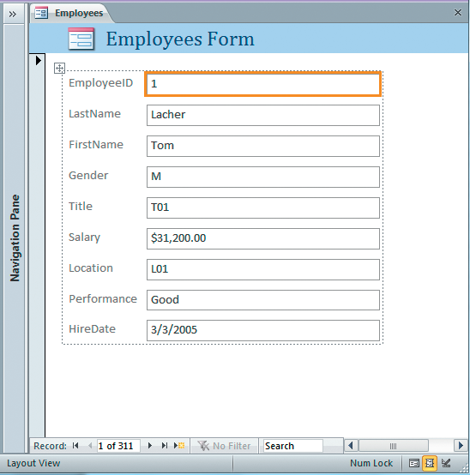
The Form Tool
Stacked Layout
Tabular Layout
Layout view
Layout view
Notes:
As stated before, the Form tool is the most common tool for creating forms. If you select a table or query from the Navigation Pane, and then click Form in the Forms Group on the Create tab, Access will create a new form. You can adapt your form using the following formats.
The Stacked Layout form displays fields in a vertical column, and displays one record at a time.
The Tabular Layout form displays records horizontally, with label controls across the top and the data values in rows under the labels.
The Layout view is used to modify the design of a form.

Slide 8
Work with a Subform
When using the Form tool to create a form:
Access analyzes the table relationships created in the database
Automatically adds a subform to your form
Subforms — display records with foreign key values that match the primary key value in the main form
Notes:
When using the Form tool to create a form, Access analyzes the table relationships created in the database. Then, Access automatically adds a subform to your form. Subforms display records with foreign key values that match the primary key value in the main form.
There will be times when you wish a subform attached to form, but when you wish to remove a subform control from a form, switch to Design view, click on the subform control, and then press Delete.

Slide 9
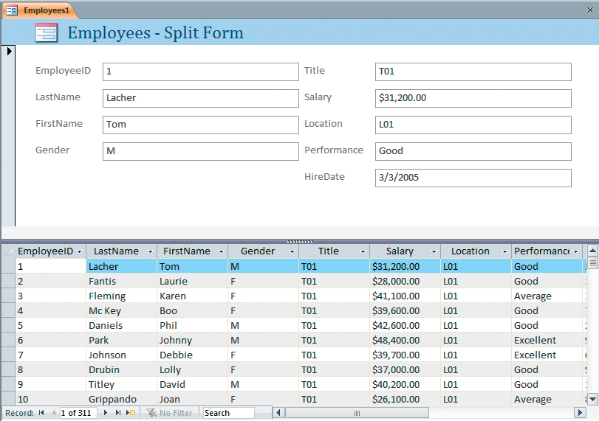
Create a Split form
Split forms — combine two views of the same record source
One section is displayed in a stacked layout
One section is displayed in a tabular layout
Top section shows one
employee in Form view
Use the form splitter bar
to resize each section
Bottom section shows multiple
employees in Datasheet view
Notes:
Split forms combine two views of the same record source—one section displayed in a stacked layout, and the other displayed in a tabular layout. When adding split forms, by default, the form view is positioned on top and the datasheet view is displayed on the bottom. However, the orientation can be changed.
To create a split form, first select a table or query in the Navigation Page. Next, click the Create tab, click More Forms in the Forms group, and then select Split Form from the list of options. A new split form now appears. You can add, edit, or delete records in either section.
The form splitter bar divides the form into two halves. Users may move the form splitter bar up or down, disable the splitter bar from the user’s view, or change the orientation of the splitter to vertical instead of horizontal

Slide 10
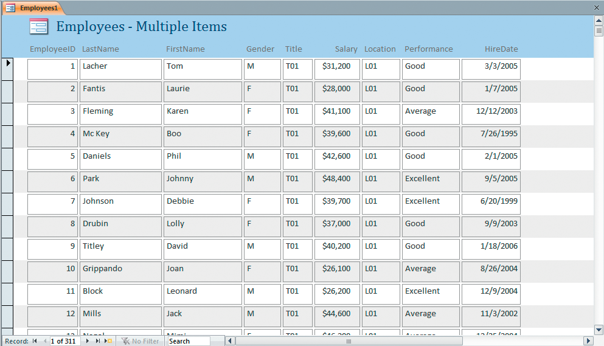
Create a Multiple Items Form
Multiple items form — displays multiple records in a tabular layout similar to a table’s Datasheet view.
Layout resembles a table’s Datasheet view
Employee records are
displayed in tabular format
Notes:
Multiple items form displays multiple records in a tabular layout similar to a table’s Datasheet view. A Multiple Items form provides the user with more customization options than a datasheet—for example, the ability to add graphical elements, buttons, and other controls.

Slide 11
Create a Datasheet Form
Datasheet form
Visual Basic for Applications (VBA)
Notes:
A Datasheet form is a replica of a table or query’s Datasheet view except that it still retains some of the form properties. To create a Datasheet form, first select a table or query from the Navigation Pane. Next, click the Create tab, click More Forms in the Forms group, and then select Datasheet from the list of options.
Visual Basic for Applications (VBA) is Microsoft’s programming language, built into all of the Office products. It allows the Access user to customize forms and reports. Using VBA, you can enforce more complex data entry rules. For example, if a product is entered into the database, the cost of a product should not exceed the sale price. If VBA is used, the data entry form could alert the user.

Slide 12
Create Forms Using the Other Form Tools
Form Design tool
Blank Form tool
Navigation option
PivotTables and PivotCharts converted to Forms
Modal Dialog Form tool
Notes:
In addition to the previously discussed form tools, the Form Design tool and the Blank Form tool can be used to create a form manually.
The Navigation option in the Forms group allows you to create user interface forms that have the look and feel of a Web-based form, and allows users to open and close the objects of a database. These forms are also useful for setting up an Access database on the Internet.
Pivot Tables and PivotCharts can also be converted to Forms by selecting PivotChart or PivotTable in the More Forms option in the Forms Group. After the PivotTable form or PivotChart form have been created, use the Layout view and Design view to customize the form.
The Modal Dialog Form tool can also be used to create a dialog box. This feature is useful when you need to gather information from the user before working with another object.
Dialog boxes are common in all Microsoft Office applications; creating a custom dialog box in Access can be very useful.

Slide 13
Modifying a Form
Add a field
Remove a field
Change the order of fields
Change the width of a field
Modify label text
Changing color themes or style
Notes:
After a form is generated by a Form tool, you will usually need to modify it.
The most common form changes include adding a field, removing a field, changing the order of fields, changing the width of a field, and modifying label text. These changes, as well as adding a color theme or style, can be made in a form’s Layout view. Advanced changes, such as adding a calculated field or adding programming logic, can be made in a form’s Design view.

Slide 14
Add a Field to a Form
Stacked layout
Tabular layout
Notes:
To add a field to a form with a stacked layout, open the form, and then click View in the Views group to switch to the form’s Layout view.
Layout view allows you to alter the form design while still viewing the data. Click Add Existing Fields in the Tools group on the Design tab to reveal the available fields from the form’s record source. Drag the new field to the location on the form, using the orange line as a guide for the position of the new field. The other fields will automatically adjust to make room for the new field.
To add a field to a form with a tabular layout, follow the same steps for adding a field to a stacked layout form. The only difference is the orange line will appear vertically to help determine the insertion point of the new form.

Slide 15
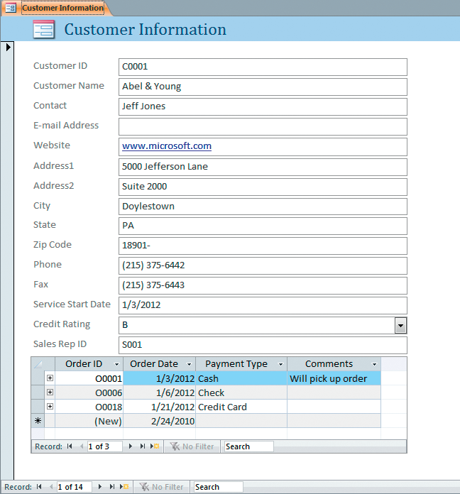
Work with a Form Layout Control
Customer information form
created with the Form tool
Stacked layout
Orders subform automatically
added by Access
Notes:
Access helps you create and modify forms by adding a Layout control to help align the fields. A Layout control provides guides to help keep controls
aligned horizontally and vertically, and to give your form a uniform appearance. If the Layout control is too restrictive, however, you can remove it and position the controls manually on the grid.
To remove a form layout control, switch to Design view, and click anywhere inside the control you want to remove. On the Arrange tab, click Select Layout in the Records group. Click Remove Layout in the Table group and the Layout control will be removed. All of the other controls will remain on the form, but the rectangle binding them together will be gone.

Slide 16
Working with Fields on a Form
Delete a field from a form
Adjust column widths in a form
Notes:
To delete a field from a form, click the text box control of the field to be deleted. There will be an orange border around the control. With the orange border showing, press Delete. The textbox and its associated label will be removed from the form, leaving a space where the field used to be. Press Delete again, and the other fields will automatically adjust to close the gap around the deleted field.
When adjusting column widths in a stacked layout form, all of the columns will increase and decrease together. Therefore it is recommended that you make sure the field columns are wide enough to accommodate the widest value in the table.
To decrease column widths in a stacked layout form, open the form and click View in the Views group to switch to the form’s Layout view. Click on the text box control of the first field to select it. Move the mouse over the right border of the field until the mouse pointer turns into a double arrow. Then drag the right edge to the left until you arrive at the desired width. All the fields change as you change the width of the first field. To increase the width of column widths, drag the same edge to the right.

Slide 17
Sorting Records in a Form
Change the sorting in a form
Remove sorting in a form
Notes:
When creating a form using the Form tool, records appear in the sorted order of the record source, whether it be a record or query. Most tables are sorted on the primary key; whereas queries can be sorted on any field.
To modify the sort order of a form, open the form in Form view. Then select the field you want to use for sorting. Click A-Z (Ascending) in the Sort & Filter group on the Home tab, and the records will immediately be reordered based on the selected field.
To remove the sort order of a form, switch to Form view. Then click the Remove Sort icon in the Sort & Filter group on the Home tab. If the form’s sort order was modified, clicking this command will reset the form to the original order.

Slide 18
Form Sections, Views and Controls
Form Sections
Views
Layout view
Form view
Design view
Controls
Notes:
As you become more familiar the form tools used to create and modify forms, you will often need to switch between the 3 form views in Access: Layout, Form and Design views. Most work will be done in Layout view, but to create a calculated field, or to add a more advanced feature, you will need to switch to Design view. All modifications to forms should be done by the designated form designer, not the end-user, although input from end-users can be very helpful in making the form more user-friendly.
Controls are also covered in this section, so that you can learn the difference between bound and unbound controls as well as how to add a calculated control.

Slide 19
Identify Default Form Sections
Form header section
Detail section
Form footer section
Modifying the Default Form Sections
Notes:
Each type of form will have its own requirements and options, but each form, by default, will have three main sections:
The form header section displays at the top of the form. It usually contains the forms title, a logo or other graphic, and the current date and time.
The detail section displays the records in the form’s record source. Stacked forms will display one label and one textbox for each field placed in the detail section. Navigation controls allow the user to manipulate the next, last, previous, and first record controls. Multiple Item forms will display multiple records (text boxes) in the detail section—as many as can fit onto one screen.
The form footer section displays at the bottom of the form. This section is commonly used to add totals for field values.
Form sections are separated by light grey section bars that mark the top and bottom boundary of each form section. The gridline area shows the allotted space for each section.
In modifying the default form sections, you can collapse a particular section that is not needed by reducing the height between the section bars until they are touching. The section will still be there, but will not show up on the Form view. To expand, or collapse, the space between sections, move your mouse over the lower bar until the mouse pointer turns into a double-headed arrow. Then click and drag to expand or collapse the section.

Slide 20
Revising Forms Using Form Views
Switch between Form Views
Edit data in Form View
Alter a form in Layout View
Perform advanced changes to a form
Notes:
Similar to the views available in tables and queries, Access provides different views for a form (depending on which form you’re using.) Most forms have a Layout view, Form view, and Design view; however, the Datasheet form has a Datasheet view, but not a Form view.
You can switch between the different views for a form by clicking View in the Views group. Then click on the view arrow, right-click a form in the Navigation Pane, right-click the form tab, or click one of the small view icons in the status bar at the bottom right of the form. The quickest method to switch views is by using the View button. This will toggle the form between Layout view and Form view.
Form view is used to add, edit, and delete data in a form; however, the layout and design of the form cannot be changed in this view.
Layout view is used to alter the form design while still viewing the data. You can use the Layout view to add or delete fields in a form, modify field properties, change the column widths, and enhance a form by adding a color scheme or styling. You can view how the data will appear in this view, but you will not be able to edit the data.
Design view is used to perform advanced changes to a form’s design. It provides the most options for editing the Access form. While most changes can be made in Layout view, to make changes to the form sections, you must use Design view. When done making your changes, revert back to Form view to see the results of your changes.

Slide 21
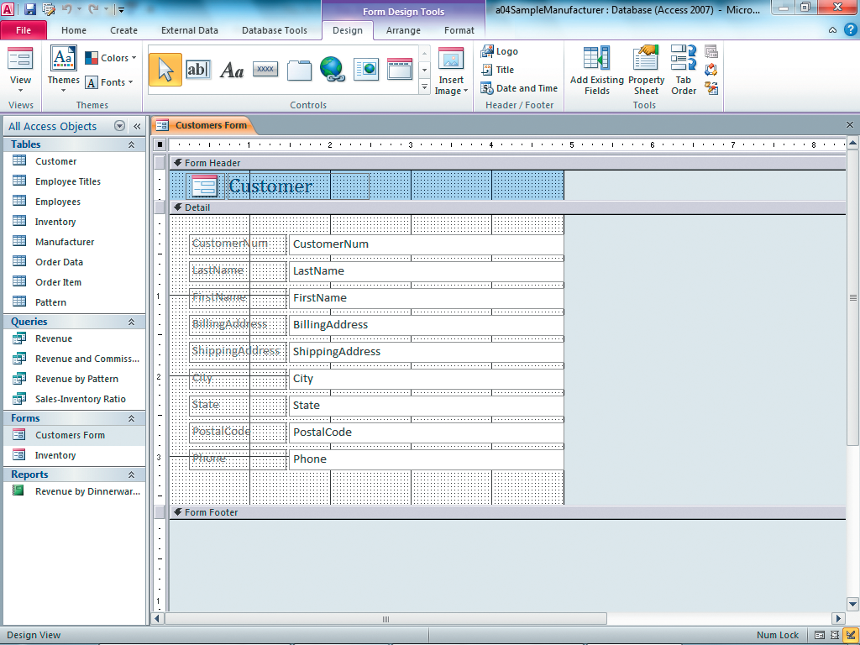
Identifying Control Types in Forms
Work with controls
Text Box control
Label control
Add Styling to a form
Add a Calculated control
Notes:
When looking at fields on a form, note that each field typically has a label on the left and a textbox on the right (although their order can be interchanged.)
A Text Box control displays the data found in a form’s record source.
A Label control is a literal word or phrase to describe the data.
Bound controls are text boxes that are connected to a field in a table or a query. These controls show different data each time you switch to a new record. The most common method for adding a bound control to a form is to drag a field from the Field list and drop it onto the form. Most forms contain one unbound control to describe each bound control (text box) on the form. By default, bound controls are joined to their associated unbound control.
Unbound controls are labels and other decorative design elements, and are not connected to a source of data. These controls usually provide graphics or descriptions and remain the same when switching between records.
Calculated controls contain an expression that generates a calculated result when displayed in Form view. The expression can contain field names from the form’s record source, constants, and functions; however, use a text box, found in the Controls group, to create a calculated control. For example, to add the expression =(Date()-HireDate)/365, first add a text box by opening the form in Design view, and then clicking on Text Box in the Controls group on the Design tab. Place the text box at the desired location, and enter the expression into the control source property of the new text box. Format the control as needed.
You can add style to a form by changing the fonts, color of the font, and adding a background to your form. It is also best to keep like items grouped together on the form. You can also highlight fields to make them more easily visible to the user.

Slide 22
Report Basics
Report — a printed document that displays information from a database in a format that provides meaningful information to its readers
Identifying a record source
Choosing a Report tool
Modifying a report
Notes:
A report is a printed document that displays information from a database in a format that provides meaningful information to its readers. Very often, users will describe what they need in a report; then it’s up to you to create the report from your knowledge of the database.
In this section, you will learn how to create a report using tables and queries as your record source, sketching the report, and using report-writing tools in Access. Reports are used to turn the raw data (the table or query) into a meaningful output that a business can use to make decisions.
You will also learn how to modify a report by adding and deleting fields, resizing columns, and adding a color scheme. You can review report sections, report views, and controls on reports.
After having worked with forms, you’ll find that there are many similarities between forms and reports.

Slide 23
Questions before Creating a Report
What is the purpose of the report?
Who will use the report?
Which tables are needed for the report?
What fields, labels, and calculations are needed?
How will the report be distributed?
Will the results be converted to Word, Excel, HTML, or another format?
Notes:
Before creating a report in Access, ask yourself these questions:
What is the purpose of the report?
Who will use the report?
Which tables are needed for the report?
What fields, labels, and calculations need to be included?
How will the report be distributed? Will users pull the information directly from
Access or will they receive it through e-mail, fax, or the Internet?
Will the results be converted to Word, Excel, HTML, or another format?
These questions will help you determine what type of report to create. Remember, although you can print information from tables, queries, and forms, most of the printed documents generated by Access users come from reports.

Slide 24
Creating Reports using Report Tools
Access Report Tools to create reports
Report Tool
Report Design
Blank Report
Report Wizard
Labels Tool
Modify existing report by using:
Layout View
Design View
Notes:
Access provides 5 different report tools for creating reports. These are found in the Reports group located on the Create tab.
The most common of the tools, the Report tool, is used to instantly create a tabular report based on the table or query currently selected.
To create a new blank report in which you can add your own fields and controls manually, use the Report Design tool or the Blank Report tool.
The Report Wizard will take you through a series of questions and help you create a report based on your answers.
The Labels tool is used to create a page of labels using of the preformatted templates provided by Access.
Once you have created a report, you can modify your report using the Layout View or the Design View.

Slide 25
Identify the Record Source
One or more tables
Queries
Combinations of tables and queries
Can also contain graphics including
Company Logos
Watermarks
Notes:
The first step in planning your report is to identify the record source. You may use one or more table or queries, or a combination of tables and queries.
When using multiple tables or queries, they must be related (as indicated with join lines). Tables with no join lines will indicate an incorrect record source and most likely cause problems in creating an accurate report.
Reports can also include graphics, such as a company’s logo or a watermark, to indicate that information is confidential or in draft form.

Slide 26
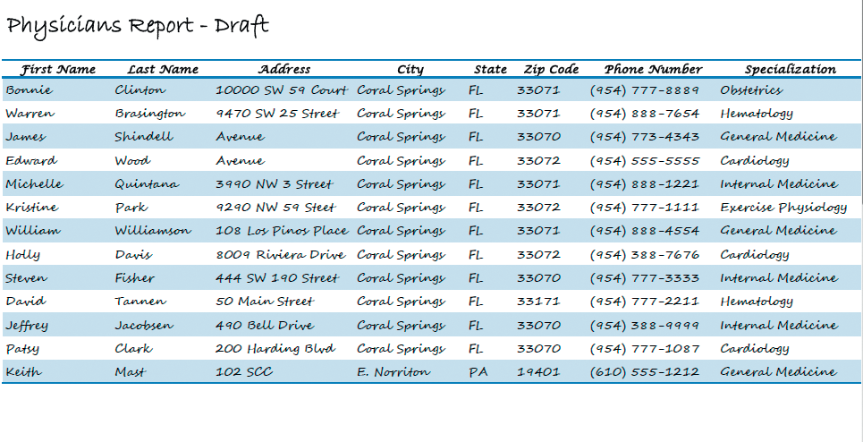
Sketch the Report
Notes:
The next step is to sketch what the report should look like.
Design the report, indicating the record source (table names and query names), the title, the format of the report (stacked or tabular), the fields and the order of the fields. It will also help to indicate any grouping and totals needed for the report.
Just this small step can save you problems and time when it comes to actually creating your report, and you will generally be happier with the results.

Slide 27
Use the Report Tool
Report created with the Report tool
Information is presented
in tabular format
Notes:
As mentioned previously, Access provides several tools to create reports. The one you use depends on the layout of the report, the record source, and the complexity of the report to be created.
The easiest tool and method to use is the Report tool. Select a table or query in the Navigation Page, click Report in the Reports group on the Create tab, and Access will create a tabular layout report for you. A tabular layout report displays data horizontally across the page in a landscape view.

Slide 28
Use the Report Wizard
Report Wizard asks questions
Uses 6 dialog boxes to collect information
Generates report based on answers
Notes:
To help generate a report, the Report Wizard uses 6 dialog boxes to collect information. The report generated is based on your answers.
It is one of the easiest ways to create a good looking report, and you can always go back in and modify it.

Slide 29
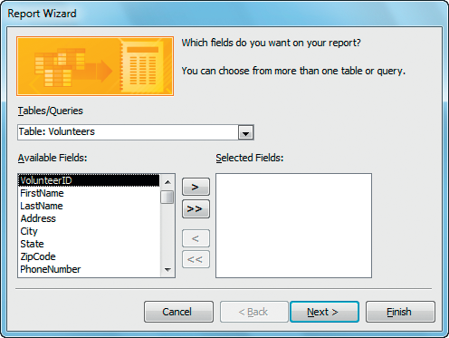
Starting the Report Wizard
Select a table or query
Select fields
Notes:
The first dialog box in the Report Wizard will ask for the record source(s) you want to use. Once you’ve selected a record source, select the specific fields you want to use.
If you’re going to use more than one record source, select the next record source and repeat the select fields process until you have all of the fields you want to use.
The fields can be ordered based on the order in which you select them, or by using the left and right arrows to move the fields to the left and right until you have them in the order you want.

Slide 30
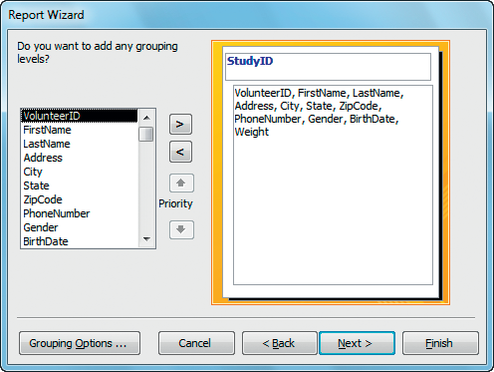
Add Grouping to the Report Wizard
Access adds StudyID
automatically
Add a group
Select a field to group by
Remove a group
Notes:
The next dialog box will ask you if you want to add any grouping levels. Grouping levels let you organize and summarize your data. You can also add totals (such as sum, count, average) at the end of a group.
In this example, Access selected StudyID as the grouping option, but you could change the group by clicking on the remove a group button and selecting another option by clicking on the add group button.

Slide 31
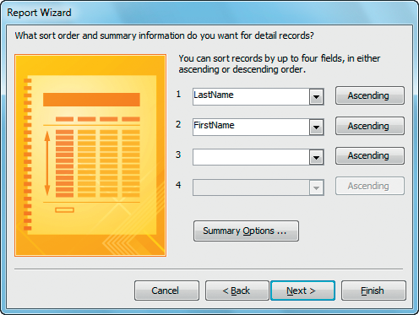
Add Sorting and Summary Options
Choose the sort fields
Choose Ascending or
Descending order
Click Summary Options to
add aggregate functions
Notes:
The next dialog box will ask you to select the order and summary information you want for your detail records. For the sorting options, specify which field you want to sort—first, second, third, and then fourth. You can only sort up to 4 fields.
For each field, select either ascending or descending order. The summary information will only appear if there is a numeric field in the selected fields.
To select any of the aggregate functions (Sum, Avg, Min, or Max), click on Summary Options and specify whether you want to see detail records on the report or only aggregate results. You can also select to calculate percent of total for sums. Then click on OK or Cancel to return to the Report Wizard.

Slide 32
Choose the Layout of the Report
Choose the Orientation
Choose the Layout
Adjust field widths so fields fit on one page wide.
Notes:
The next dialog box will help you determine the appearance of your report. First, select the layout from the three options—Stepped, Block, or Outline. Clicking on an option will give you a general preview in the preview area.
You can also select the orientation of your report—either Portrait or Landscape.
Finally, you can adjust the field widths so that all fields fit on a page, but be aware that this is not the same as in Excel’s Fit one page wide by one page tall Page Layout option. This will squeeze the fields to appear within the width of one page, but will not do anything about fitting one page tall. The report will roll to the next page, as needed. As such, you may have to adjust the field widths of some of your fields if they are too small to display all of the contents.

Slide 33
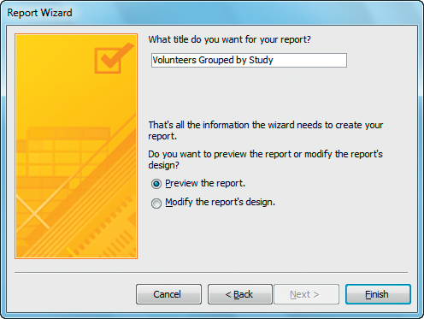
Save and Name the Report
Type a report name
Click Preview the report to see what the report will look like
Click Finish to see a
preview of the report
Notes:
The last step is to select an appropriate name for your report. It should be something descriptive of the report’s contents or summary information. Preview the report is automatically selected, so when you click on Finish, the Report Wizard will close and take you to a preview of what your report will look like.

Slide 34
Previewing the Report
Notes:
The last step is to preview the report.
Now, we will move on to using the Label Wizard.

Slide 35
Use the Label Wizard
Notes:
The Label Wizard allows you to easily create mailing labels, name tags, and other specialized tags. Mailing labels are specialized reports that come preformatted to coordinate with name-brand labels, such as Avery.
To create labels, click Labels in the Reports group on the Create tab, and then select the manufacturer, the product number, and the label type. Then, choose the font type and size you want to use. Finally, add the fields to the label template. When you click on Finish, you will see a preview of the labels report.
Next, we will look at how to modify existing reports.

Slide 36
Modifying a Report
Add a Field to a Report
Tabular layout
Stacked layout
Delete a Field from a Report
Tabular layout
Stacked layout
Notes:
Once you’ve created a report, you may need to modify it. Similar to forms, the most common changes to a report are adding a field, removing a field, changing the order of fields, changing the widths of fields, and modifying the title. You can also add a grouping level. These changes are made in the Layout view. Advanced changes, such as adding a calculated field or adding VBA code, can only be made in Design view.
Adding a field to a report with a tabular layout is similar to adding a field to a form with a tabular layout. Right-click on a report in the Navigation pane, and then click Layout view. Next, click Add Existing Fields in the Tools group on the Design tab to reveal the available fields in the report’s record source. Drag the new field to the precise location on the report, using the vertical orange line as a guide for the position of the new field, and then release the mouse. The other fields will automatically adjust to make room for the new field.
To add a field to a stacked layout is similar to the process for a tabular layout except the orange line will appear horizontally instead of vertically.
To delete a field from the detail section of a tabular report, first switch to Layout view or Design view of the report. Next, click on the text box of the field to be deleted and note the orange border around the field. When the orange border becomes visible, press Delete. Repeat the process to delete the associated label from the report header. After the controls have been deleted, click in the blank space and press Delete again. After the text box and label have been removed from the report, the other fields will automatically adjust to close the gap around the deleted field.

Slide 37
Modifying a Report (continued)
Work with Report Layout Control
Adjust Column Widths in a report
Add a Theme to a report
Notes:
To help you in modifying a report, Access provides a layout control to help align the fields. Layout controls in reports work in the same way as in forms. The layout control provides guides to help keep controls aligned horizontally and vertically, which gives your report a uniform appearance.
If you want to remove the Layout control from a report, switch to Design view, and click anywhere inside that control. On the Arrange tab, click Select Layout in the Records group. Click Remove Layout in the Table group, and the layout control will be removed.
To adjust column widths in a tabular report, first switch to Layout view or Design view. Then, click on the text box of the field you want to adjust. The orange border indicates that the field has been selected. Move the mouse to the right border of the selected field and when the mouse pointer turns to a double arrow, drag the edge to the right (to increase) or to the left (to decrease) until you reach the desired width of the field.
To add a theme to your report, switch to Layout view and click on Themes in the Themes group on the Design tab. Scroll through the themes using the up and down arrows. You can hover over one of the options to see a quick preview of the current report using that theme. When you have selected the theme, click to apply it to the report.

Slide 38
Sorting Records in a Report
Select FirstName for
the second sort
LastName is the first sort
Notes:
Similar to the way in which records are sorted in a form, when a report is created using the Report tool, the sort order of the records in the report is dependent, initially, on the sort order of the record source.
The primary key of the record source is usually what dictates the order of the sort; however, a report has an additional feature for sorting. While in Layout View or Design View, click Group & Sort in the Grouping & Totals group on the Design tab. The Group, Sort, and Total pane now appears at the bottom of the report. This section allows you to set the sort order for the report and overrides the original sorting of the report’s record source.
To change the sorting in a report, select Layout view, click Group & Sort to display the Group, Sort, and Total section. To sort records in a report by a different field name, click on Add and Sort and select the field name from the list. The report records will instantly sort by the new field name in ascending order. You can add additional sorts by repeating this process.

Slide 39
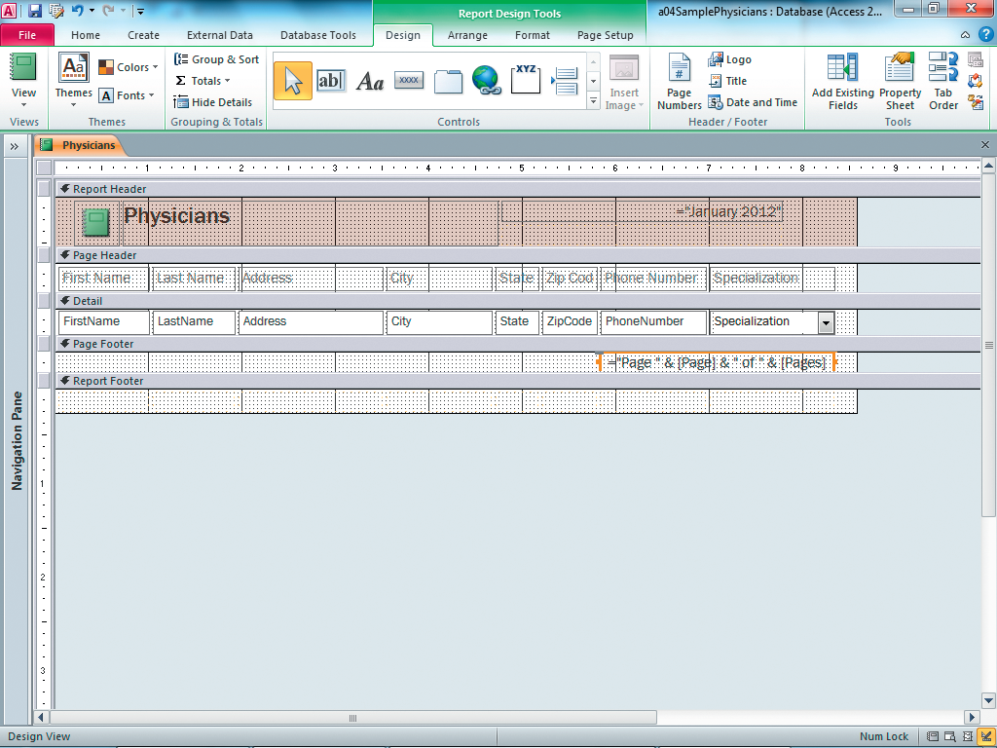
Identifying Report Sections
Report header
Page header
Detail
Page footer
Report footer
Notes:
Access divides a report into 5 main sections: report header, page header, detail, page footer, and report footer.
The report header section prints at the beginning of each report. This section usually contains the report title, a logo or other graphic, and the date and time when the report was printed.
The page header section appears at the top of each page. Use this section to add or edit column headings at the top of each page. The page header will usually contain a horizontal line to separate the column headings from the data values.
The detail section prints one line for each record in the report’s record source. Fields that are connected to the report’s record source are known as bound controls. The detail section can be hidden, if necessary, by clicking Hide Details in the Grouping & Totals group on the Design tab. For reports that only require summarized data, you will want to hide the details. Click Hide Details again to redisplay hidden details.
The page footer section appears at the bottom of each page. Use this section to show page numbers at the bottom of each page. It is best to not add Totals to this section, since the results will produce an error.
The report footer section prints one time at the bottom of the report. The report footer is a commonly used to display the grand total of certain columns or to display the count of all records in the report footer section.

Slide 40
Adding a Group Header/Footer
Click Group & Sort
to add grouping
Specialization group
header section
Specialization group
footer section
Modify the grouping & sorting
Notes:
In addition to the 5 main sections, you can add a custom group header/footer section to a report.
A group header section, when activated, will appear just above the detail section in Design view, with the name of the field you are grouping.
The group footer section, when activated, will appear just below the detail section in Design view, but only when you select this option in the Group, Sort, and Total pane.

Slide 41
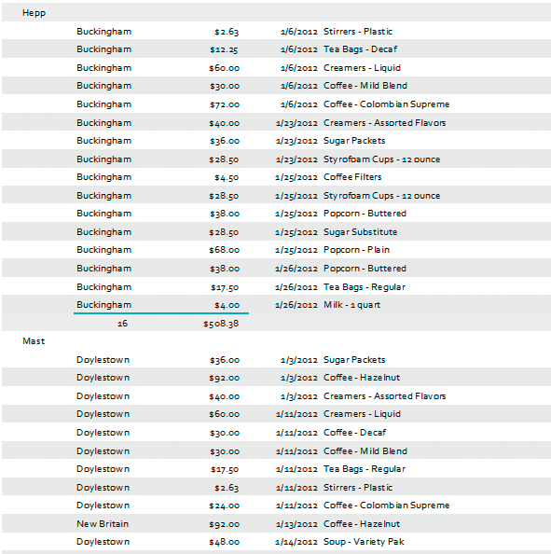
Add Totals to a Group Footer/ Report Footer
Total revenue is shown at the
bottom of each sales rep
Count is shown at the bottom of each sales rep
Notes:
Most reports will require totals at the group level and/or at the grand total level. To add totals to a report, first create the group section required for the totals.
Next, in Layout view, click on the field that contains the data you want to total, click Totals in the Grouping & Totals group on the Design tab, and then select the appropriate option. Access will add a total after each group and again at the end of the report.
You remove a total from a report in the same way you add a total. Select the field that contains the total, click Totals in the Grouping & Totals group, and uncheck the option you want to remove.

Slide 42
Revising Reports Using Report Views
Layout View
Print Preview
Design View
Report View
Notes:
Access provides different views to give you plenty of options in modifying your report, so that it will represent your data to its best advantage.
Layout View is used to alter the report design while still viewing the data. Use Layout view to add or delete fields in the report, modify field properties, change the column widths, add grouping and sorting levels to a report, and to filter data by excluding certain records.
Print Preview allows you to see exactly what the report will look like when it is printed. Users should always preview their reports before printing to catch errors.
Design View displays the report’s design without displaying data. You can perform many of the same tasks here that you can perform in Layout view; however, when the report is very long, Design view is useful because you can alter the design without having to scroll through pages of data.
Report view allows you to see what the printed report will look like in a continuous page layout.

Slide 43
Identifying Control Types in Reports
Work with controls
Bounded controls
Unbounded controls
Calculated Controls
Add a Calculated control to a report
Notes:
You can find many types of controls in the Controls group on the Design tab when you are in Design view of a report. Controls can be categorized as bound, unbound, or calculated.
Bound controls are text boxes that are connected to a field in a table or a query. These controls display different data for each new record that is printed. To add a bound control to a report, switch to Layout view and then drag a field from the Field list and dropt it onto the report.
Unbound controls are labels and other decorative design elements. These controls usually describe and decorate, rather than display, the data. These controls remain the same each time a new record is printed. Unbound controls include labels, lines, borders, and images. Add an unbound control to a report using the Controls group on the Design tab in Design view of a report.
Calculated controls contain an expression that generates a calculated result when displayed in Print Preview. The expression can contain field names from the report’s record source, constants, or functions. Use a text box, found in the Controls group on the Design tab, while in Design view, to create a calculated control.
To add a calculated control to a report, switch to Design view. Then, click Text Box in the Controls group on the Design tab. Place a text box at your desired location and then enter the expression to create the calculation. Format the control as needed.

Slide 44
Summary
In this chapter, you learned how to create forms using form tools, modify a form, sort records in a form, identify form sections, revise forms using form views, and identify control types in forms.
You also learned how to create reports using report tools, modify reports, sort records in a report, identify report sections, revise reports using report view, and identify control types in reports.
Notes:
In this chapter, you learned how to create, modify, sort and revise forms and reports.

Slide 45
Questions
Notes:
Are there any questions?

Slide 46
Copyright
All rights reserved. No part of this publication may be reproduced, stored in a retrieval system, or transmitted, in any form or by any means, electronic, mechanical, photocopying, recording, or otherwise, without the prior written permission of the publisher. Printed in the United States of America.

