Slide 1
Chapter 8
Representing Information Digitally

Slide 2
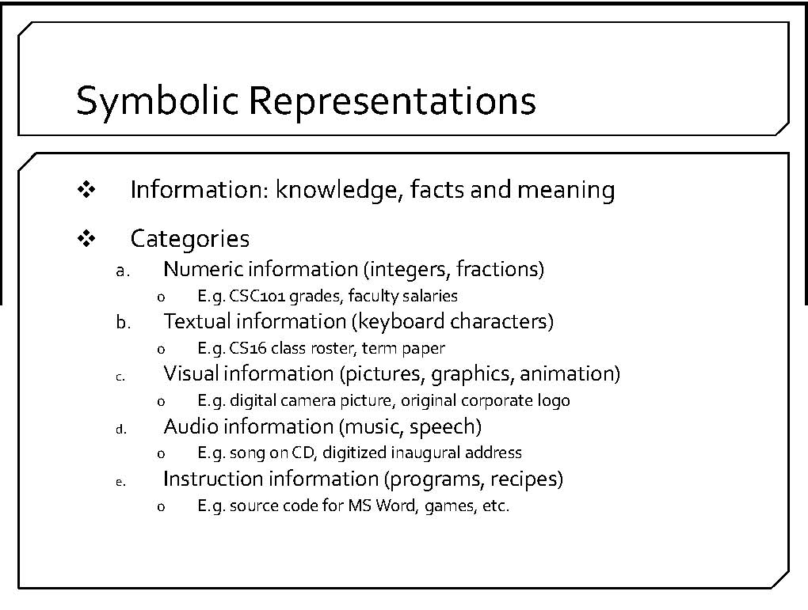

Slide 3
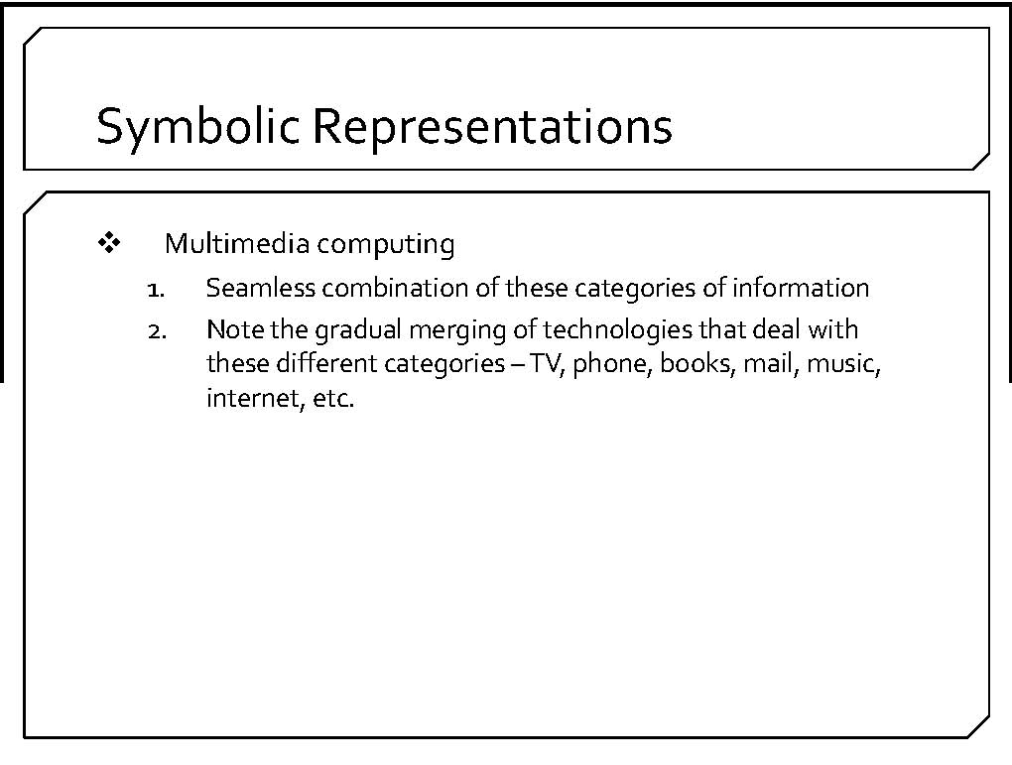

Slide 4
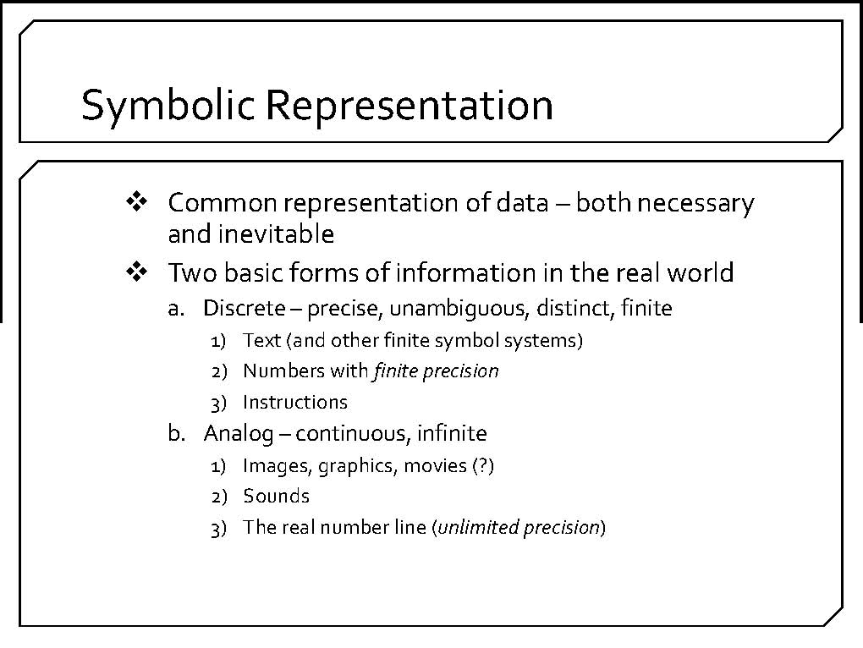
analog information is continuous, e.g., wave

Slide 5
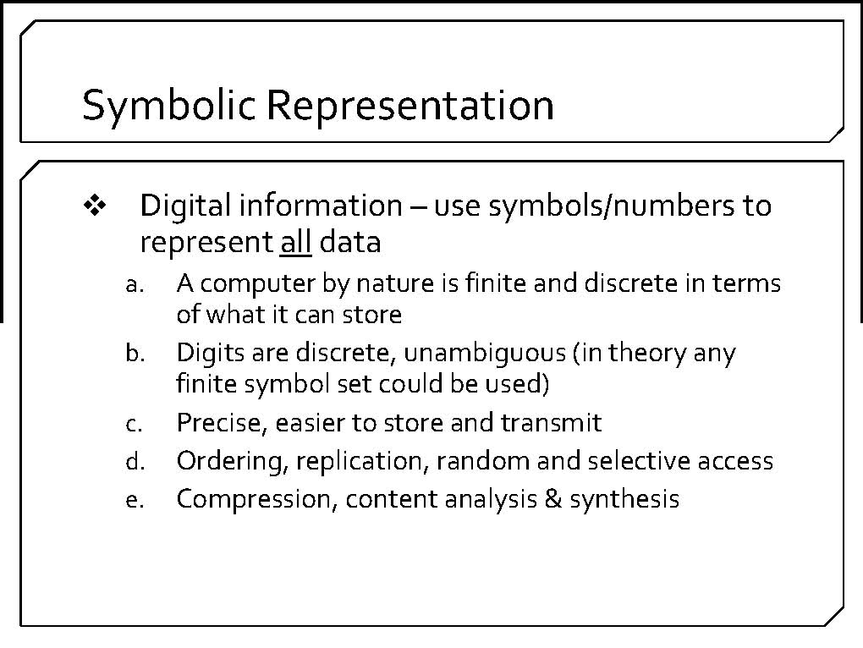
computers process discrete or digital data

Slide 6
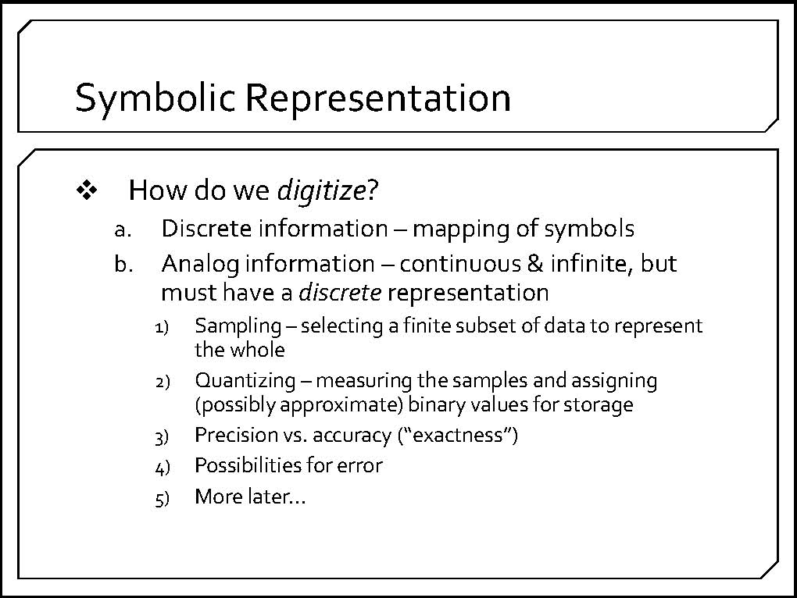
the process of converting information to a binary form is called digitization
both discrete and analog forms of information may be digitized

Slide 7
Example: Digitizing Images
The two step process for digitizing images:
  sampling the continuous tone image for pixels
  quantizing pixels
image is sampled by pixel resolution
pixels samples are averaged

Slide 8
Example: Digitizing Images
pixels are converted to numeric form
The two step process for digitizing images:
  sampling the continuous tone image for pixels
  quantizing pixels

Slide 9
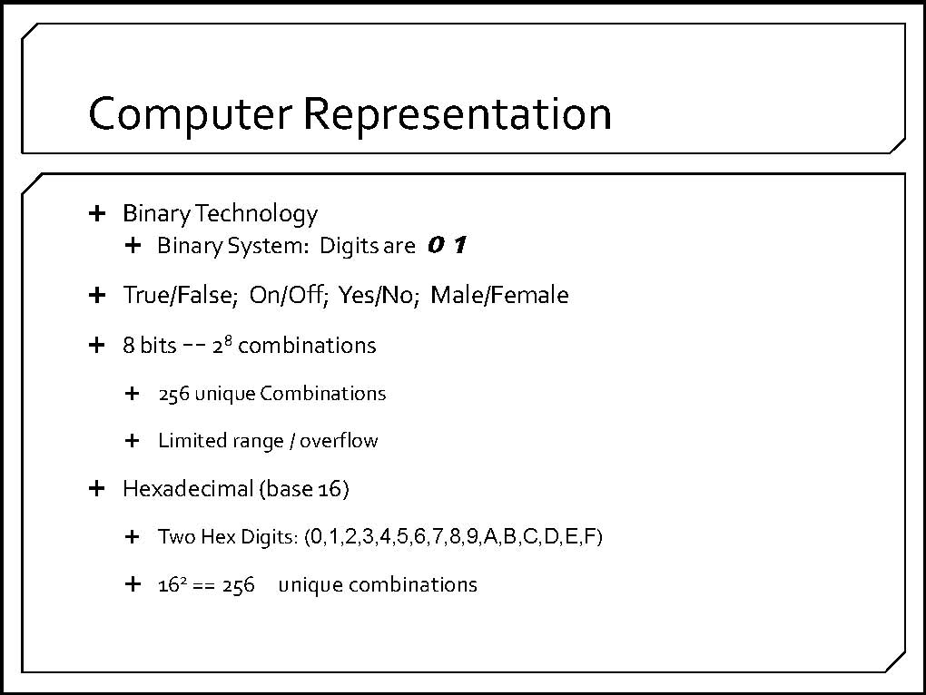
binary numbering system is a base-2 positional numbering system
binary digits are called “bits”
bits are organized into groups, e.g., 8 = “byte”

Slide 10
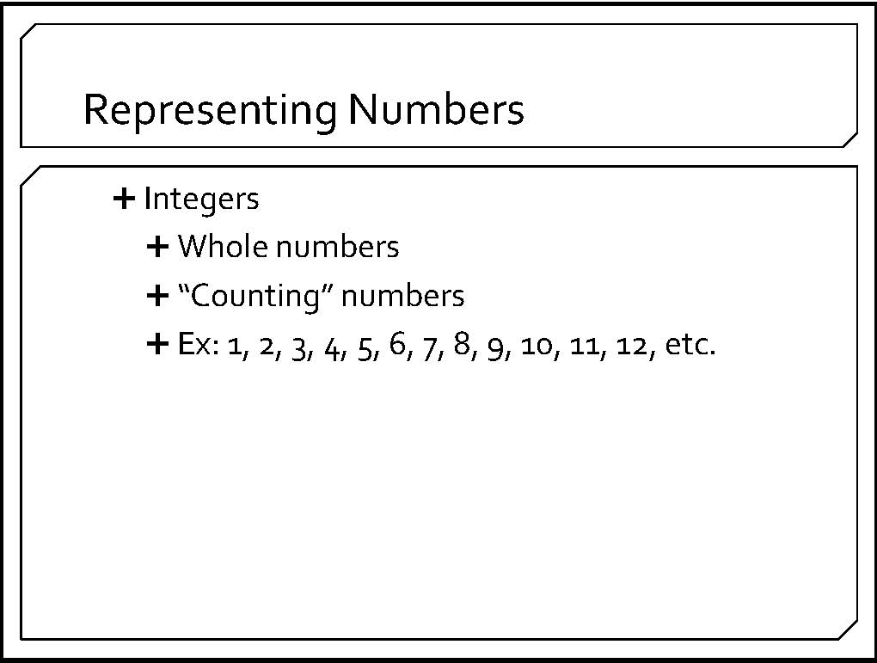

Slide 11
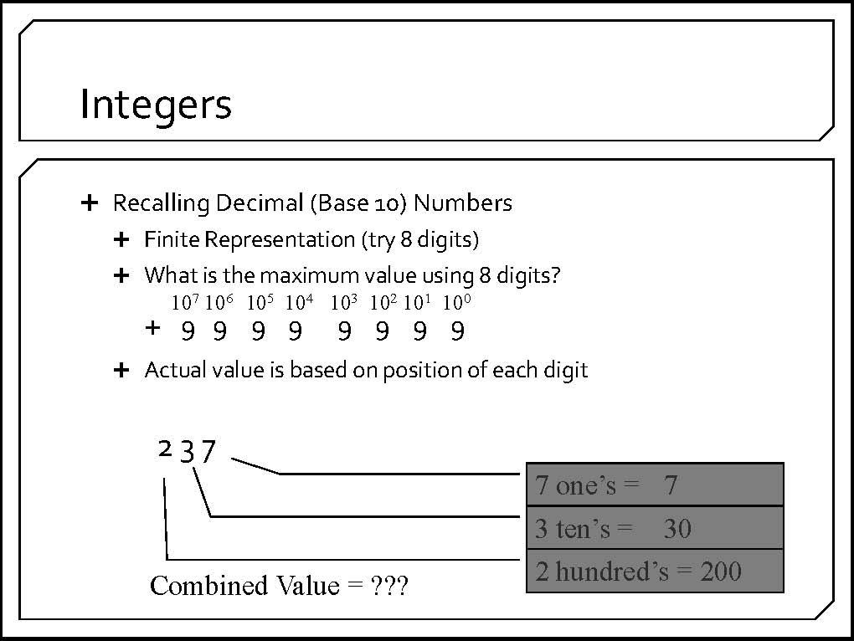

Slide 12
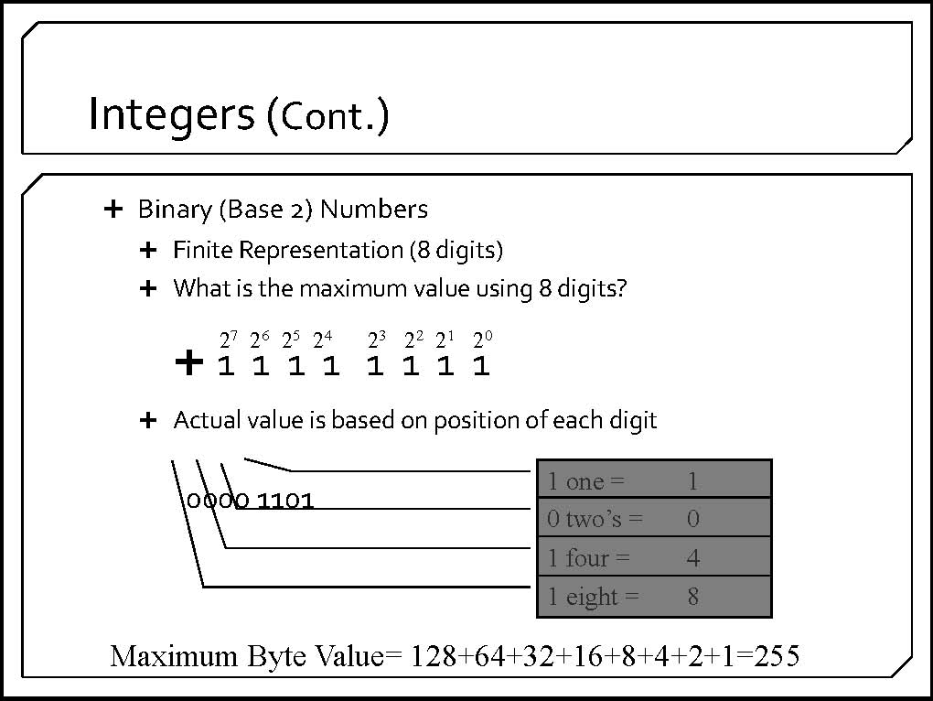

Slide 13
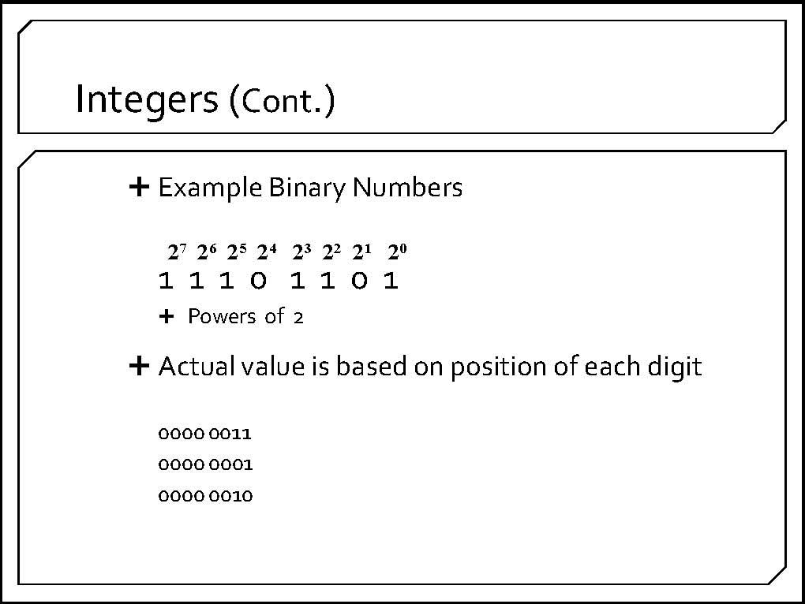

Slide 14
Decimal 14 Converted to Binary
2⁸ | 2⁷ | 2⁶ | 2⁵ | 2⁴ | 2³ | 2² | 2¹ | 2⁰
256 | 128 | 64 | 32 | 16 | 8 | 4 | 2 | 1
0 | 0 | 0 | 0 | 0 | 1 | 1 | 1 | 0
Decimal 176 Converted to Binary
176
-128
48
-32
16
-16
2⁸ | 2⁷ | 2⁶ | 2⁵ | 2⁴ | 2³ | 2² | 2¹ | 2⁰
256 | 128 | 64 | 32 | 16 | 8 | 4 | 2 | 1
0 | 1 | 0 | 1 | 1 | 0 | 0 | 0 | 0

Slide 15
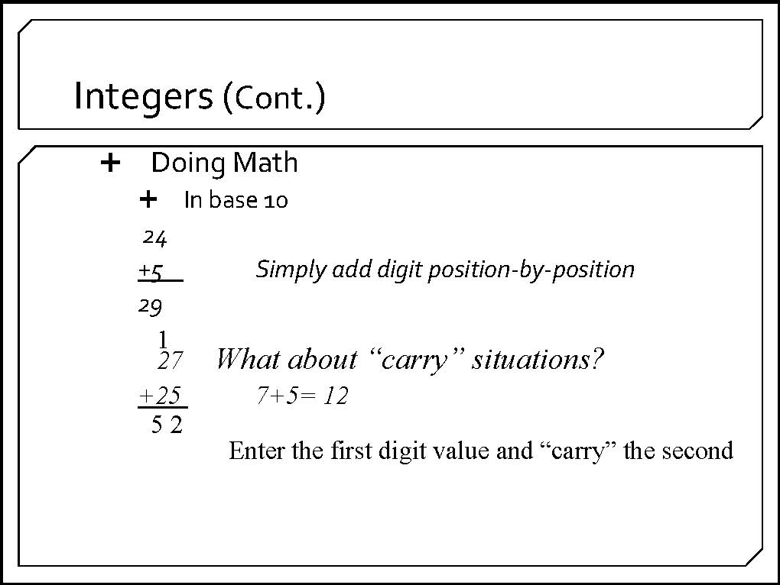

Slide 16
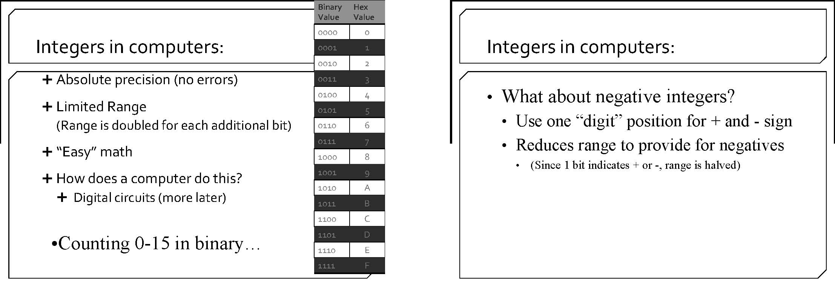

Slide 17
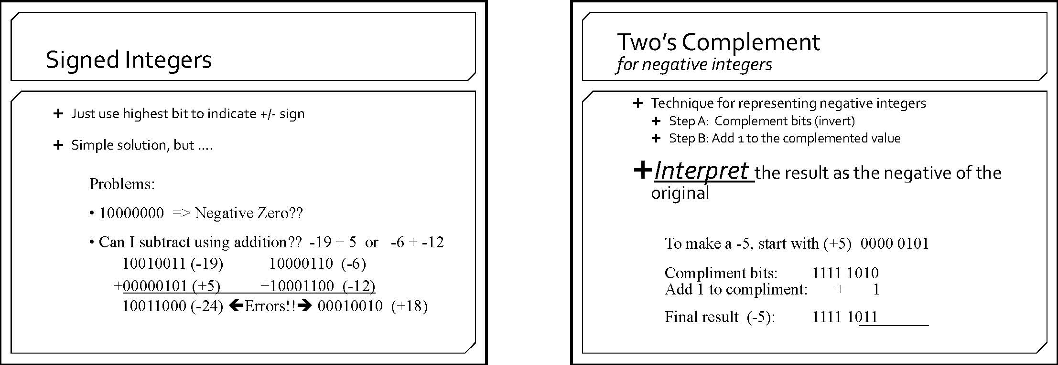

Slide 19
Real Numbers – Decimal Component
Decimal – Negative Powers of 10
  10⁻¹ = 1/10
  10⁻² = 1/100
  10⁻³ = 1/100
.75 = 7 X 10⁻¹ +5 X 10⁻² = 7/10 +5/10
Binary 14.75 14= 1100
2⁻¹ = ½ 2⁻² = ¼ 2⁻³ = 1/8
1 X 1/2 + 1 X 1/4 = ¾ = .11 (binary)
Binary 14.75 = 11100.11

Slide 20
Easier Way 14.75 = 1110.11
.75
x 2
1.50
x 2
1.00 Stop when we get to zero
.11
.625
x 2
1.250
x 2
0.500
x 2
1.00 .101

Slide 21
Floating Point
Problem:
  .1 = 0.00011001100110011……..
  Run out of memory for storage
Same problem with 1/3 = 0.3333333……
Real numbers represented in Floating Point
Decimal number 234.563 in floating point:
  .234563 we normalize the decimal point
Same principal in binary

Slide 22
Real (Decimal) Number Storage
Real numbers are stored in floating point representation
  a sign
  an exponent (indicate how many positions you moved the decimal point)
  a mantissa (normalized decimal fraction)
    no digits to the left of the decimal
    first digit to the right of the decimal is nonzero
Limited precision because most real numbers have an infinite decimal expansion (this holds no matter what number base is used in the representation)
Real Value | Floating Point
12001.00 | 12001*10⁰
-120.01 | -12001*10⁻²
0.12000 | 12000*10⁻⁵
155555000.00 | 15555*10³

Slide 23
Real Number Storage
Limited Range and Precision
There are three categories of numbers left out when floating point representation is used
  numbers out of range because their absolute value is too large
  numbers out of range because their absolute value is too small (numbers too near zero to be stored given the precision available)
  numbers whose binary representations require either an infinite number of binary digits or more binary digits than the bits available

Slide 24
Limited Range and Precision
Some Consequences
Limited range will invalidate certain calculations
Limited precision for real numbers is very pervasive
  Assume that most decimal calculations could, in fact, be in error!
  Evaluate and use computer calculations with this in mind

Slide 25
Risks in Numerical Computing
Almost all computer calculations involve roundoff error (limited precision error)
If not monitored and planned for carefully, such errors can lead to unexpected and catastrophic results
  Ariane 5 Rocket Failure
  Patriot Missile Failure during Gulf War

Slide 26
The Explosion of the Ariane 5
On June 4, 1996 an unmanned Ariane 5 rocket launched by the European Space Agency exploded just forty seconds after its lift-off.
The rocket was on its first voyage, after a decade of development costing $7 billion. The destroyed rocket and its cargo were valued at $500 million.
It turned out that the cause of the failure was a software error in the inertial reference system. Specifically a 64 bit floating point number relating to the horizontal velocity of the rocket with respect to the platform was converted to a 16 bit signed integer. The number was larger than 32,767, the largest integer storeable in a 16 bit signed integer, and thus the conversion failed.
Back

Slide 27
  Patriot Missile Failure during Gulf War
During the Gulf War, an American Patriot Missile battery in Saudi Arabia, failed to track and intercept an incoming Iraqi Scud missile. The Scud struck an American Army barracks, killing 28 soldiers and injuring around 100 other people.
The General Accounting office reported on the cause of the failure. It turns out that the cause was an inaccurate calculation due to computer arithmetic errors.
The time in tenths of second as measured by the system's internal clock was multiplied by 1/10 to produce the time in seconds.
The value 1/10, which has a non-terminating binary expansion, was chopped at 24 bits. The small chopping error, when multiplied by the large number giving the time in tenths of a second, led to a significant error. Indeed, the Patriot battery had been up around 100 hours, and an easy calculation shows that the resulting time error due to the magnified chopping error was about 0.34 seconds. (The number 1/10 equals 1/2⁴+1/2⁵+1/2⁸+1/2⁹+1/2¹²+1/2¹³+....
A Scud travels at about 1,676 meters per second, and so travels more than half a kilometer in this time. This was far enough that the incoming Scud was outside the "range gate" that the Patriot tracked.
Back

Slide 28
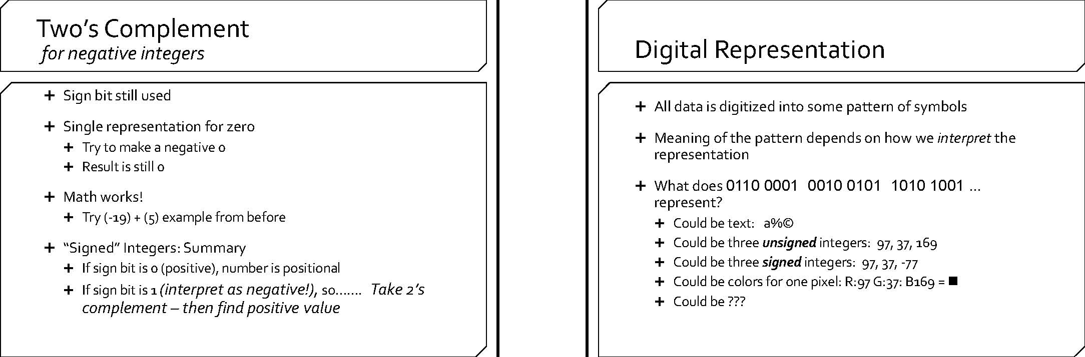

Slide 29
Digital Representation - Text
Text (letters punctuation, invisible formatting characters)
HTML (already discussed need for visual deign)

Slide 30
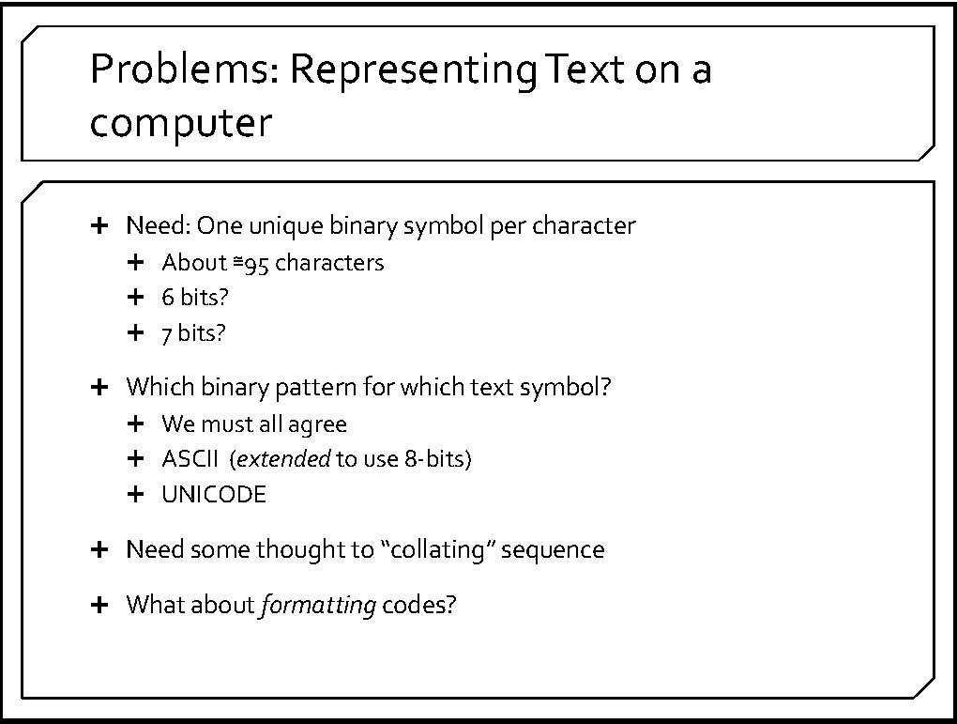

Slide 31
Text - One Byte per Character Suffices
Notes:
4

Slide 32
ASCII and the English Character Set
ASCII = American Standard Code for Information Interchange . Allows for 256 unique characters
All uppercase and lowercase letters
Punctuation symbols like ! . , ? : ; “ ‘ etc.
Digits 0, …, 9
Arithmetic symbols + = - / < >
Assorted special symbols like # @ $ % ^ & * ( ) { } [ ] etc.
Invisible formatting characters
Notes:
5

Slide 33
Unicode
ASCII not enough characters for international use
Unicode – represent every character in every language including Asian ideograms
Uses 16 bits per character
Can represent 2¹⁶ or more than 65,000 characters compared to 256 for ASCII
Gaining in popularity

Slide 34
Using ASCII
Notes:
6

