Slide 2
Technology in Action
Chapter 3
Using the Internet:
Making the Most of the Web’s Resources
Notes:
The Internet has changed our world. Communications and commerce move instantaneously across borders and around the world. Anyone can publish their wares, ideas, or desires. Chapter 3 will present a brief introduction to the history of the Internet, its structure, and how it is used.

Slide 3
Chapter Topics
History of the Internet
Forms of Internet communication
Web entertainment
E-commerce
Web browsers
URLs
Hyperlinks
Notes:
Topics in this chapter include:
History of the Internet
Internet basics and forms of Internet communications
Web entertainment
E-commerce
Web browsers
URLs
Hyperlinks

Slide 4
Chapter Topics (cont.)
Search engines
Improving search results
Evaluating Web sites
Connecting to the Internet
Future of the Internet
Notes:
Search engines
Improving search results
Web site evaluation
Connecting to the Internet
The future of the Internet

Slide 5
History of the Internet
Developed for secure military communications
Evolved from Advanced Research Projects Agency Network (ARPANET)
Funded by the U.S. government in the 1960s
Enabled computers at leading universities and research organizations to communicate with each other
Notes:
Scientists were asked to come up with a solution to secure communications between large computer centers in case of a nuclear attack. They responded by inventing packet switching and routers. By taking data messages and breaking them into small packets, each packet could be addressed and sent individually to a destination through a series of routers. The routers would send each packet along the optimum path to the next router, depending on traffic and availability.
The Internet is a network of networks that utilizes a common communication protocol so that computers from different manufacturers can communicate.
Today we can’t imagine life without the Internet. It is the way we communicate, shop, research, entertain, and express ourselves.

Slide 6
The Web vs. the Internet
The Web is part of the Internet, distinguished by
Common communication protocols
Hyperlinks
1989: Web invented by Tim Berners-Lee
1993: Mosaic browser released
1994: Netscape Navigator marked beginning of the Web’s major growth
Notes:
What distinguishes the Web from the rest of the Internet is its use of:
Common communication protocols enabling different computers to talk to teach other and display information.
Special links (called hyperlinks) enabling users to jump from one place to another on the Web.
The Web was invented long after the Internet, in 1989 by Tim Berners-Lee at CERN in Switzerland.
In 1993, the National Center for Supercomputing Applications (NCSA) released the Mosaic browser.
Netscape Navigator heralded the beginning of the Web’s monumental growth.

Slide 7
Internet Communications
E-mail
Instant messaging
Voice over Internet Protocol (VoIP)
Group communication
Notes:
Forms of Internet-based communication include:
E-mail
Instant messaging
Voice over Internet Protocol (VoIP)
Group communication such as chat rooms, newsgroups, listservs, and social networks

Slide 8
E-Mail
Electronic mail
Asynchronous communication
Types of e-mail accounts
Client-based
Web-based
Not private
Can be printed or forwarded
Employer can monitor
Notes:
E-mail is short for electronic mail and has quickly caught on as the primary method of electronic communication because it’s fast and convenient and it reduces postage and long-distance phone call expenses.
With e-mail, the sender and receiver don’t have to be available at the same time to communicate.
Some e-mail accounts are client-based and use programs such as Microsoft Outlook. Client-based systems are normally tied to a local Internet service provider (ISP) and use that domain for an address. If a user changes ISPs, his or her e-mail address changes.
Web-based e-mail, on the other hand, finds the messages at a host site received by and stored on a mail server and can be accessed from anywhere. A Web-based e-mail address will stay the same no matter what ISP is used. Free e-mail accounts such as Yahoo! or Hotmail use Web-based e-mail clients.
Be careful what you say in an e-mail message because it might come back to haunt you.

Slide 9
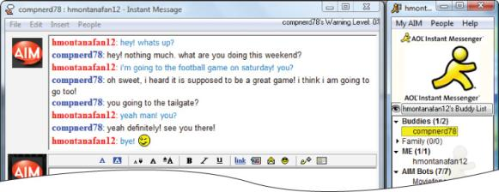
Instant Messaging
Real-time, text-based conversations
Personal and business uses
List of contacts: buddy list
IM software detects members’ presence
Example: AOL Instant Messenger
Notes:
Instant messaging (IM) uses real-time text-based conversations, similar to chat rooms.
IM isn’t just for casual conversations between friends and family, as more and more businesses are using it for communications between co-workers.
Users set up a list of contacts, often called a buddy list.
IM software detects the presence of members who are online.
Examples include:
AOL Instant Messenger
Yahoo! Messenger
Windows Live Messenger
Many of the popular IM services are proprietary, but universal chat services are now available to allow users to communicate no matter which service they use.

Slide 10
Voice over Internet Protocol
VoIP: Using the Internet to place phone calls
Uses technology similar to e-mail to send voice data digitally
Requires speakers, a microphone, an Internet connection, and a VoIP provider
Notes:
VoIP turns the Internet into a means for placing phone calls.
VoIP uses a protocol similar to e-mail to send voice data. Voice is digitized as an alternative to analog phone lines.
VoIP minimally requires
Speakers
A microphone
An Internet connection
A VoIP provider

Slide 11
Voice over Internet Protocol
VoIP services differ:
Free services require an account on both ends
Paid services connect phone to computer
Cable/DSL providers offer phone through broadband
Wi-Fi IP phones call through Internet hotspots and wireless networks
Notes:
VoIP services differ.
Free services like Skype require an account on both ends.
Paid services like Vonage connect your regular phone to your computer through a special adapter.
Cable and DSL providers offer telephone service through their existing broadband account.
Wi-Fi IP phones allow calls through Internet hotspots and wireless networks.

Slide 12
Voice over Internet Protocol
Advantages
Disadvantages
Free or low cost
Portability
Convenience
Lower sound quality
Less reliability
Loss of service when power is interrupted
Security issues
Notes:
VoIP has become very popular due to its affordability, portability, and convenience. However, it does have some disadvantages compared to traditional phone lines:
Sound quality varies based on available bandwidth.
The very nature of Internet transmission can cause reliability problems during a call.
When the power (electricity) is out, service is lost and calls cannot be placed.
If proper security and encryption are not used in the transmission process, calls can easily be monitored.

Slide 13
Group Communication
Chat rooms
Newsgroups
Listservs
Blogs and vlogs
Wikis
Podcasts and webcasts
Social networks
Notes:
There are many ways you can interact with a wide variety of people online:
Chat rooms
Newsgroups
Listservs
Blogs and vlogs
Wikis
Podcasts and webcasts
Social networks

Slide 14
Chat Rooms
Real-time, text-based conversations
Rooms can focus on specific topics or interests or be general interest
Identity protection
Username can allow anonymous interaction
Netiquette: rules of polite interaction
Notes:
A chat room is an area on the Web where many people come together to communicate online. The conversations are in real time and are visible to everyone in the chat room.
Chat rooms are sometimes theme oriented and sometimes not.
There is no chance for editing out outlandish or offensive opinions or language.
People in chat rooms choose an identity and therefore are anonymous.
General rules of etiquette (netiquette) include introducing yourself when you enter the room; specifically addressing the person you are talking to; and refraining from swearing, name calling, and using explicit or prejudiced language. Users cannot repeatedly post the same text and should not type in all capital letters.

Slide 15
Newsgroups and Listservs
Newsgroups
Online discussion forums
Members post and reply to messages
Create or respond to “threads”
Listservs
Electronic mailing lists of people interested in a topic
Threads are sent as e-mails
Less public than newsgroups
Notes:
Newsgroups are sometimes called threaded discussions or discussion groups. Built around topics or interests, participants read entries from other participants and respond, with each respondent adding something new to the discussion, creating a thread. A participant can also start a new thread. Unlike chat rooms, threaded discussions don’t rely on instant responses, but on a more thought-out written response. In distance education classes, threaded discussions are often required and serve as the class participation component of a course.
Listservs are similar to newsgroups except that the threads are sent out as e-mails, with each participant in the thread receiving each new posting. They are less public than newsgroups.

Slide 16
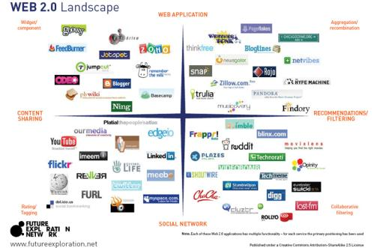
Web 2.0
Web interactions between people, software, and data
Social web where the user is also a participant
New applications that combine the functions of multiple applications
Notes:
Use of the Web has evolved to emphasize online sharing and collaboration.
Web 2.0 is a new wave of Web interactions between people, software, and data. It is classified as the social Web in which the user is also a participant. Additionally, Web 2.0 describes a trend of new applications that combine the functionality of multiple applications.
Examples include blogs, wikis, podcasts, and social networking sites.

Slide 17
Blogs and Vlogs
Personal journals posted on the Web
Weblogs: blogs
Primarily text-based
Simple to create, read, and manage
Entries listed on a single page, with most recent entry at the top
Searchable
Video logs: vlogs
Digital video clips playable on media player software
Notes:
Weblogs, or blogs, are a way for anyone to post their thoughts for public viewing. They are personal logs, or journal entries, posted on the Web.
The beauty of blogs is that they are simple to create, manage, and read. Traditionally blogs are text-based and are written by one author, arranged as a listing of entries on a single page, with the most recent entry located at the top of the list.
Blogging is easy and free. Many blogs are personal logs but some focus on specific topics. Blogs are public and their content is searchable.
Video logs, or vlogs, are personal journals that use video as the main form of expression. You can play vlogs on your personal computer and mobile devices.

Slide 18
Wikis
Wikis: Web sites that allow anyone to change their content
Provide a source for collaborative writing
Eliminate exchanging e-mails
Track revisions
Notes:
A wiki is a type of Web site that allows anyone visiting the site to change its content by adding, removing, or editing the content.
Wikis provide an excellent source for collaborative writing by eliminating the need to send e-mails back and forth.
A history of all changes is kept so a previous version can be easily accessed if desired.

Slide 19
Podcasts
Podcasts: Compressed audio or video files distributed on the Internet
Really Simple Syndication (RSS) technology allows constant updates for subscribers
Podcasts are all over the Web
Need “aggregator” software to gather podcasts
Need media player software to play them
Simple to create
Notes:
Podcasts use compressed audio and video files to distribute content on the Internet using RSS technology.
Really Simple Syndication (RSS) technology allows for constant, automatic updates of Web pages.
Podcasts are found all over the Web.
They require aggregator software to gather the podcasts and media player software to listen to them.
Podcast creation is an easy process.

Slide 20
Webcasts
Webcasts: Broadcasts of audio or video content over the Internet
Often live
Delivered to your computer
Use streaming media
Notes:
Webcasts are broadcasts of mostly live audio or video files on the Internet.
Webcasts use streaming media technology to deliver content to many simultaneous viewers.

Slide 21
Social Networks
Online personal and business networks
Examples include Facebook , MySpace, and LinkedIn
Members share common interests
Members communicate by voice, chat, IM, videoconference, and blogs
Growth has been explosive
Notes:
Social networking sites like Facebook, MySpace, and LinkedIn have become immensely popular.
These sites are easy places for members to hang out, meet new people, and share common interests.
They provide a way for members to communicate with their friends and business associates by voice, chat, IM, videoconference, and blogs.
Growth of participation in these sites has been explosive.

Slide 22
Online Storage and Backup
Anytime, anywhere access via Internet
Preserves and protects valuable files
Examples:
Carbonite Online PCBackup
Idrive
MozyHome Online Backup
Notes:
Online storage is an alternative to portable storage devices such as flash drives and external hard drives. Your data can be accessed anywhere that Internet access is available.
You can back up sensitive or essential files as well. Your information is stored online in a secure, remote location so it is less vulnerable to potential disasters.
Some services offer free, limited online storage. Others offer unlimited space for a fee.

Slide 23
Web Entertainment
Multimedia
Involves forms of media and text
Graphics
Audio
Video
Streaming audio and video
Games
Multiplayer online games
Interact with other players
Notes:
Multimedia is anything that involves one or more forms of media in addition to text.
All kinds of multimedia are available on the Web. You can download music files, video files, and even movies.
Streaming audio and video can deliver on-demand pictures and sounds. Sites like CNN.com offer clips from their broadcasts.
Some files require a plug-in program like RealPlayer. In recent versions of Windows, Microsoft’s MediaPlayer is built in and automatically loads when a music file is selected.
There are many multiplayer online games in which play occurs among hundreds or thousands of other players over the Internet.
You can interact with other players around the world in a meaningful context by trading, chatting, or playing cooperative or combative mini-games.

Slide 24
E-Commerce
E-Commerce: conducting business online
Business-to-consumer (B2C)
Business-to-business (B2B)
Consumer-to-consumer (C2C)
Notes:
E-commerce grows in importance every day, with billions of dollars worth of transactions.
In business-to-consumer or B2C transactions, such as Amazon.com, the end buyer purchases goods or services over the Internet.
In business-to-business or B2B transactions, businesses sell to one another.
In consumer-to-consumer or C2C transactions, like ebay.com, consumers sell to one another.

Slide 25
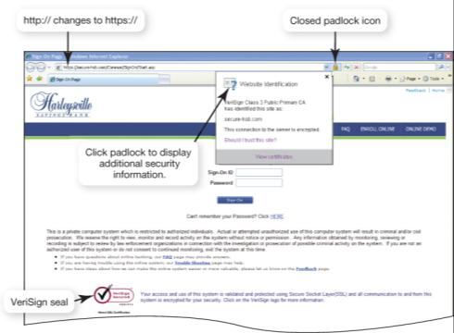
Secure Web Sites
Display:
VeriSign seal
Closed padlock or key icon
URL changes from http:// to https://
Notes:
Businesses hire security companies such as VeriSign to certify that their online transactions are secure. Thus, if a Web site displays the VeriSign seal, you can usually trust that the information you submit to the site is protected.
Another indication that a Web site is secure is the appearance in your browser of a small icon of a closed padlock (Internet Explorer) or key (Netscape).
Additionally, the beginning of the URL of the site changes from http:// to https://, the s standing for “secure.”

Slide 26
Online Shopping Guidelines
Shop at well-known, reputable sites
Pay by credit card, not debit card
Check the return policy
Notes:
To shop safely online, follow these guidelines:
Shopping at well-known, reputable sites helps ensure a safe shopping experience. If you are not familiar with a site, check it out with the Better Business Bureau, and also make sure that the company has a phone number and street address before ordering.
Debit cards do not have the same level of protection as credit cards under U.S. federal consumer credit card protection laws. Use a card with a small limit, or consider using a prepaid credit card.
Check and print out the return policy. You might need it when filing a complaint to prove what the policy showed at the time of your order. Web sites can be changed easily and rapidly and can also be shut down overnight.

Slide 27
Web Browsers
Computer software
Graphical
Enables Web navigation
Popular browsers:
Microsoft Internet Explorer
Mozilla Firefox
Apple Safari
Google Chrome
Notes:
A Web browser is software installed on your computer system that allows you to locate, view, and navigate the Web.
Web browsers are graphical, meaning they can display pictures (graphics) in addition to text, as well as other forms of multimedia, such as sound and video.
Although Microsoft Internet Explorer is the most used Web browser, there are other browsers available, such as Mozilla Firefox and Google Chrome. Because Microsoft products are the main targets for virus writers, an alternative browser might be less vulnerable.

Slide 28
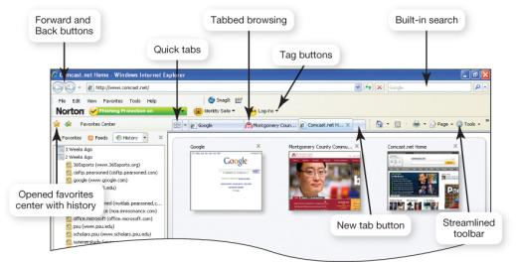
Browser Features
Quick tabs: Show thumbnail images of all open Web pages in open tabs
Tabbed browsing: Multiple pages available in the same browser window
Built-in search engine(s)
Notes:
Internet Explorer 7 has a much more streamlined approach than its predecessors. The browser’s toolbars provide convenient navigation and Web page management tools.
Quick tabs show thumbnail images of all open Web pages in open tabs.
With tabbed browsing, Web pages are loaded in “tabs” within the same browser window. Rather than having to switch between Web pages on several open windows, you can flip between the tabs in one window.
The browser also includes a built-in search box in which you can designate your preferred default search engine.

Slide 29
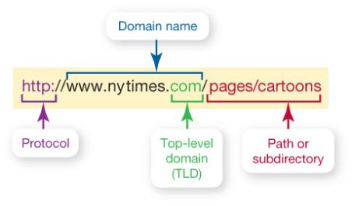
URLs
URL:
Uniform Resource Locator
Unique Web site address
URL
Notes:
A URL is a Web site’s address. It is composed of several parts that help identify the Web document it stands for.
The first part of the URL indicates the set of rules (or the protocol) used to retrieve the specified document. HTTP is most common. Another popular protocol is FTP.
The protocol is generally followed by a colon, two forward slashes, www (indicating World Wide Web), and then the domain name. The domain name is also referred to as the host name.
At times, a forward slash and additional text follow the domain name. The information after the slash indicates a particular file or path (or subdirectory) within the Web site.

Slide 30
Top-Level Domains
Domain Name | Who Can Use the Domain Name
.biz | Businesses
.com | Originally for commercial sites but can be used by anyone now
.edu | Degree-granting institutions
.gov | United States government
.info | Information service providers
.int | Limited to organizations, offices, and programs that are sanctioned by a treaty between two or more nations
.mil | United States military
.name | Individuals
.net | Originally for networking organizations but no longer restricted
.org | Organizations (often nonprofits)
Notes:
The three-letter suffix in the domain name (such as .com or .edu) is called the top-level domain. This suffix indicates the kind of organization the host is.
The most used is the .com or commercial domain, which can be used by anyone.
There are also domains for countries outside the United States. For instance, a Web site in Germany has the extension .de, and in Italy it is .it.

Slide 31
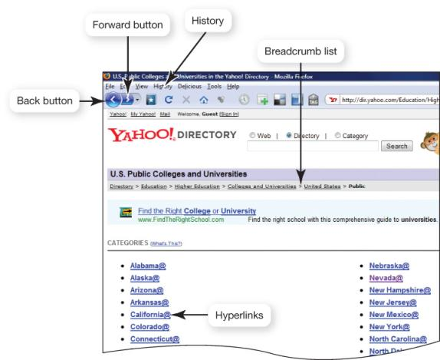
Hyperlinks
Notes:
Once you’ve reached a Web site, you can jump from one Web page to another within the Web site or to another Web site altogether by clicking on specially coded text called hyperlinks.
Generally, text that operates as a hyperlink appears in a different color (often blue) or is underlined. Sometimes images also act as hyperlinks.
When you pass your cursor over a hyperlink, the pointer turns from an arrow into a hand with the index finger pointing.
To retrace your steps, some sites also provide a breadcrumb list—a list of pages within a Web site you’ve visited that usually appears at the top of a page. Additionally, the history list in your browser keeps track of where you’ve visited, organized by date.

Slide 32
Favorites and Bookmarks
Allow you to return to Web pages
Favorites (Internet Explorer and Safari)
Bookmarks (Firefox and Google Chrome)
Stay up to date
Live bookmarks (Firefox)
Organize and share
Social bookmarking sites
Copyright © 2011 Pearson Education, Inc. Publishing as Prentice Hall
32
Notes:
While browsing the Web, you might want to remember a site for future reference. Using the Favorites or Bookmark feature, you can store the site’s URL in a special folder on the hard drive of your computer.
Firefox offers live bookmarks, which adds the technology of RSS feeds to bookmarking, allowing updates to be delivered to you as soon as they are available.
Social bookmarking sites such as delicious.com and digg.com allow you to tag and organize Web sites and news content using your own keywords and share them with others.

Slide 33
Popular Search Sites
AltaVista | www.altavista.com | Keyword search engine
Yippy | www.yippy.com | Keyword search engine that groups similar results into clusters
ChaCha | www.chacha.com | Don’t like your search results? This site lets you chat with a real live professional guide who helps you search, and it’s free of charge.
Complete-Planet | www.completeplanet.com | Deep Web directory that searches databases not normally searched by typical search engines
Dogpile | www.dogpile.com | Metasearch engine that searches Google, Yahoo!, MSN Search, and Ask
Excite | www.excite.com | Portal with keyword search capabilities
InfoMine | www.infomine.com | Subject directory of academic resources with keyword search engine capabilities
Rollyo | www.rollyo.com | Short for Roll Your Own Search Engine. Basically, this site lets you create your own search engine (searchroll) that searches just the sites you want it to search.
Open Directory Project | www.dmoz.org | Subject directory with keyword search capabilities
Stumbleupon | www.stumbleupon.com | Lets you rate pages thumbs up or thumbs down. As it learns your preferences, your search results improve.
Technorati | www.technorati.com | A great search engine for blog content
Wolfram Alpha | www.wolframalpha.com/ | Computational knowledge engine
Some great Web sites for finding information
Notes:
You can search the Web using a search engine or a subject directory.
A search engine is a set of programs that searches the Web for specific keywords you wish to query and then returns a list of the Web sites on which those keywords are found.
A subject directory is a guide to the Internet organized by topics and subtopics.
The list on this slide gives alternatives to sites such as Google, Yahoo!, and Ask.com.

Slide 34
Search Engines
User keys word or phrase into search box
Spider or Web crawler program scans Web pages
Results are indexed and sent to the client
Different engines produce different hit lists
Multimedia search functionality is also available
Notes:
Search engines have three parts. The first part is a program called a spider, which collects data on the Web.
The second part is an indexer program that organizes the data into a large database.
The third part is the search engine software, which searches the indexed data, pulling out relevant information according to your search.
You won’t get the same results from each search engine as proprietary algorithms are used and the sites they search differ.
You can search for digital images and audio and video files, too.

Slide 35
Improve Search Results
Place quotation marks around keywords
Search within a specific Web site
Enter wildcard symbols
Use the advanced search form
Notes:
To narrow search results to a list of relevant sites you can search for exact phrases by putting quotation marks around keywords so the search engine returns sites where the words are contained in that exact order.
You can search just a specific Web site by typing in your keyword followed by “site:” and then the site’s URL.
Wildcards are symbols used to replace a series of letters. The asterisk (*) is helpful when you’re searching for a keyword but are unsure of its spelling, or if a word can be spelled in different ways or contain different endings. Some search engines let you use a question mark (?) or percent sign (%) to replace a single letter in a word.

Slide 36
What Can You Borrow from the Web?
Avoid:
Plagiarism: Representing someone else’s ideas or words as your own.
Copyright violation: Using another person’s material for your own economic gain
Properly credit information you quote or paraphrase
Obtain written permission from copyright holder
Notes:
You cannot borrow information you obtain from the Internet including words, ideas, graphics, data, and audio and video clips. This could be construed as plagiarism. Use quotation marks around all words you borrow directly and credit your sources for any ideas you paraphrase or borrow.
Copyright law assumes all original work (including online work) is copyrighted even if it does not display the copyright symbol. Copyright violation is punishable by law. You need to seek and receive permission from the copyright holder if you are using the other person’s material for your own personal economic benefit, or if you are taking away from the economic benefit of the originator. Work in the public domain is an exception to this rule.

Slide 37
Evaluating Web Sites
Who is the author of the article or Web site sponsor?
Is the site biased?
Is the information current?
Toward what audience is the site geared?
Are links available?
Notes:
Evaluating the content of a Web site is important. Before you believe what the site says or take action based on the information presented, several questions need to be answered.
Who exactly owns and operates the Web site?
Are the opinions expressed on the site objective, or are they slanted toward one position or another? If it is slanted, why is it slanted?
Is the information up to date? How often is the site updated?
Who is the site trying to reach with its message?
Do the hyperlinks all work, or are some dead ends? Are the links appropriate?
Like anything else, how well maintained a site is helps determine its believability.

Slide 38
Internet Clients and Servers
The Internet is a client/server network
Client computer:
Users connected to the Internet
Requests data and Web pages
Server computer:
Stores Web pages and data
Returns the requested data to the client
Internet backbone
IP addresses whatismyip.com
Notes:
The Internet is a huge client/server network. Thus, a computer connected to the Internet acts in one of two ways: It is either a client, a computer that asks for data, or a server, a computer that receives the request and returns the data to the client.
Data travels between clients and servers along pathways, the largest of which is called the Internet backbone.
Internet Protocol (IP) addresses are the means by which all computers connected to the Internet identify each other.

Slide 39
Connecting to the Internet
Dial-up connections
Broadband connections
DSL
Cable
FiOS
Satellite
Notes:
To take advantage of the resources the Internet offers, you need a means to connect your computer to it. Home users have several connection options.
Originally, the only means to connect to the Internet was with a dial-up connection where you connect to the Internet using a standard telephone line.
However, other connection options, collectively called broadband connections, offer faster means to connect to the Internet. Broadband connections include DSL, cable, and satellite. A recent broadband service available for home use is fiber-optic service (FiOS).

Slide 40
Broadband Connections
Cable
Uses coaxial cable and a cable modem
Fast connection speed
Speed depends on number of users
Not available in all areas
Notes:
One type of broadband connection is cable Internet.
Cable Internet uses coaxial cable and a cable modem.
This always-on connection can be slowed by the number of users connected at any one time, and it is not available in all areas.

Slide 41
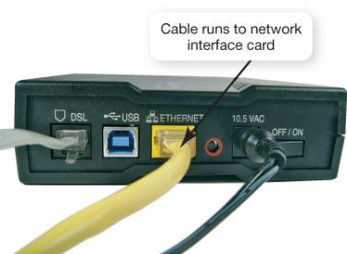
Broadband Connections
Digital subscriber line (DSL)
Uses telephone lines
Faster than dial-up
Doesn’t tie up phone line
Requires special DSL modem
Not available in all areas
Notes:
DSL uses a standard phone line to connect to the Internet. However, the line is split between digital and voice, meaning that the digital signal does not have to be converted into sounds, and greater speeds can be realized.
Although the monthly fee is higher than that for dial-up, there is no need for a second phone line.
DSL requires a special DSL modem.
Not all areas of the United States have DSL. Also, to use DSL, your telephone connection must be within fairly close proximity of a switching station.

Slide 42
Broadband Connections
Fiber-optic service (FiOS)
Sends light through fiber optic lines
Faster than cable or DSL
Expensive
Available only in certain areas
Notes:
Fiber-optic Internet transmits data by sending light through optical fibers. Because light travels so quickly, this technology can bring an enormous amount of data to your home at superfast speeds. When the data reaches your house, it’s converted to electrical pulses that transmit digital signals your computer can read.
The biggest advantage to fiber-optic Internet is its speed.
Cost might be the main disadvantage.
Also, because fiber-optic lines must be laid before service is available, the service is available only in select areas.

Slide 43
Broadband Connections
Satellite
Uses satellite dish and coaxial cable
Slower than cable or DSL
Expensive
Notes:
When other high-speed options are not available, satellite Internet is an option.
A two-way satellite Internet connection is always on and is faster than dial-up; however, there is a difference between the upstream and downstream speeds.

Slide 44
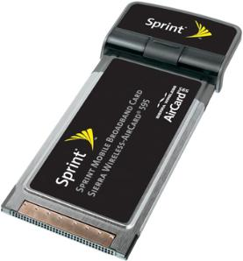
Wireless Access
Increases mobility and productivity
Requires a Wi-Fi hotspot
Requires either internal or external wireless access card for device
Aircards provide wireless access through mobile devices when a Wi-Fi hotspot is not available
Notes:
Connecting wirelessly increases mobility and productivity, as the user can access networks and resources from more locations without having to have a wired connection.
To connect wirelessly, a Wi-Fi (wireless fidelity) hotspot must be within range and the device (i.e., notebook, PDA, or cell phone) must have either an internal or an external Wi-Fi access card.
Another expensive option available that’s usually used when a Wi-Fi hotspot is not in range is an aircard. Aircards provide access through cell phone towers and generally require a separate service plan.

Slide 45
Dial-Up Connections
Use standard telephone line
Tie up phone line
Require a modem to convert analog and digital signals
Slowest connection speed (56 Kbps)
Lowest cost
Notes:
A dial-up connection needs only a standard phone line and a modem. A dial-up modem is a device that converts (modulates) the digital signals the computer understands to the analog signals that can travel over phone lines. In turn, the computer on the other end must also have a modem to translate (demodulate) the received analog signal back to a digital signal for the receiving computer to understand.
Modern desktop computers generally come with internal modems. Notebooks use either internal modems or PC cards that are inserted into a special slot on the notebook.
Current modems have a maximum data transfer rate that is generally five times slower than a broadband connection.

Slide 46
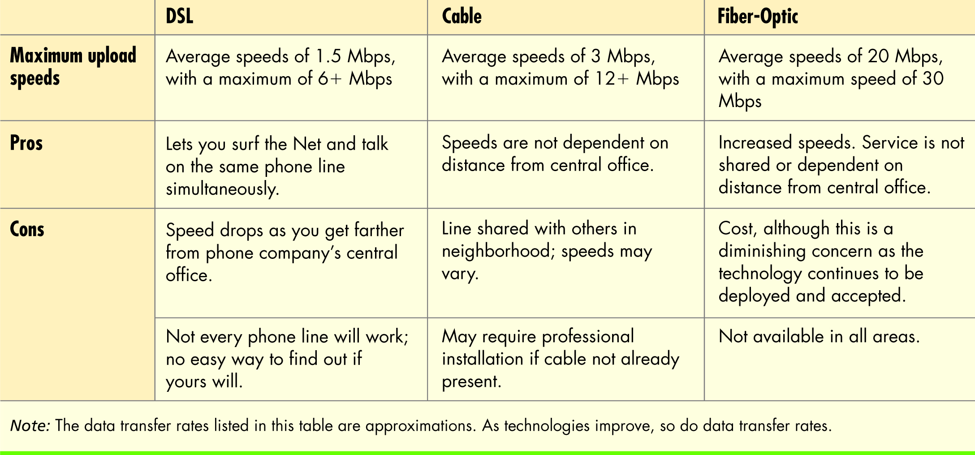
Comparing Internet Connection Options
Copyright © 2011 Pearson Education, Inc. Publishing as Prentice Hall
46
Notes:
Internet connection costs vary widely, as does performance. One factor to consider in choosing the right Internet connection is speed. The data transfer rate, also informally referred to as the connection speed, is the measurement of how fast data travels between computers.

Slide 47
Future of the Internet
Large scale networking (LSN)
Research and development of cutting-edge networking and wireless technologies
Internet2
Project sponsored by universities, government, and industry to develop new Internet technologies
Internet2 backbone supports transmission speeds of 9.6 Gbps
Notes:
The Internet will continue to have great influence in the future. Greater bandwidth; wireless access; and the amalgamation of telephone, TV, and Internet technologies will bring change and spur new, unforeseen developments.
The U.S. government sponsors research called the large scale networking (LSN) program, which funds cutting-edge research in wireless and networking technologies.
Another major effort is Internet2, a cooperative research project of over 200 universities with government and industry partners. A major thrust of their research is increased bandwidth for the whole Internet.

Slide 48
Future of the Internet
Internet entrenched in daily life
Web-based services for personal and professional interactions
Internet-enabled appliances and systems
Notes:
The future Internet will assist us with day-to-day activities and tasks. The Internet is already integral to the way we communicate, shop, research, entertain, and express ourselves. With increasing wireless accessibility, we will become even more dependent on the Internet.
More Web-based applications will continue to evolve.
Internet-enabled appliances and household systems will become more affordable and will allow your home to run itself. For example, your refrigerator will monitor its contents and restock by placing online orders.

Slide 49
Chapter 3 Summary Questions
What is the origin of the Internet?
Notes:
What is the origin of the Internet?

Slide 50
Chapter 3 Summary Questions
How can I communicate through the Internet?
Notes:
How can I communicate through the Internet?

Slide 51
Chapter 3 Summary Questions
How do I communicate and collaborate using Web 2.0 technologies?
Notes:
How do I communicate and collaborate using Web 2.0 technologies?

Slide 52
Chapter 3 Summary Questions
What are the various kinds of multimedia files found on the Web, and what software do I need to use them?
Notes:
What are the various kinds of multimedia files found on the Web, and what software do I need to use them?

Slide 53
Chapter 3 Summary Questions
What is e-commerce, and what e-commerce safeguards protect me when I’m online?
Notes:
What is e-commerce, and what e-commerce safeguards protect me when I’m online?

Slide 54
Chapter 3 Summary Questions
What is a Web browser?
Notes:
What is a Web browser?

Slide 55
Chapter 3 Summary Questions
What is a URL, and what are its parts?
Notes:
What is a URL, and what are its parts?

Slide 56
Chapter 3 Summary Questions
How can I use hyperlinks and other tools to get around the Web?
Notes:
How can I use hyperlinks and other tools to get around the Web?

Slide 57
Chapter 3 Summary Questions
How do I search the Internet effectively?
Notes:
How do I search the Internet effectively?

Slide 58
Chapter 3 Summary Questions
How do I evaluate a Web site?
Notes:
How do I evaluate a Web site?

Slide 59
Chapter 3 Summary Questions
How does data travel on the Internet?
Notes:
How does data travel on the Internet?

Slide 60
Chapter 3 Summary Questions
What are my options for connecting to the Internet?
Notes:
What are my options for connecting to the Internet?

Slide 61
Chapter 3 Summary Questions
What will the Internet of the future look like?
Notes:
What will the Internet of the future look like?

Slide 62
All rights reserved. No part of this publication may be reproduced, stored in a retrieval system, or transmitted, in any form or by any means, electronic, mechanical, photocopying, recording, or otherwise, without the prior written permission of the publisher. Printed in the United States of America.
Copyright © 2011 Pearson Education, Inc.
Publishing as Prentice Hall
62

