Slide 2
Technology in Action
Chapter 5
Using System Software: The Operating System, Utility Programs, and File Management
Notes:
This chapter discusses system software and how vital it is to your computer. We examine the operating system (OS), by looking at the different operating systems on the market as well as the tasks the OS manages. We’ll also discuss how you can use the OS to keep your files and folders organized so that you can use your computer more efficiently. Finally, we’ll look at the many utility programs included as system software on your computer.

Slide 3
Chapter Topics
System software
Categories of operating systems
OS role in:
Providing user interaction
Managing the processor
Managing memory
Managing hardware
Interacting with application software
Starting the computer
Notes:
Chapter topics include:
System software
Categories of OSs
OS role in:
Providing user interaction
Managing the processor
Managing memory
Managing hardware
Interacting with application software
Starting the computer

Slide 4
Chapter Topics (cont.)
Desktop and Windows features
OS role in keeping the desktop organized
Utility programs
Notes:
Desktop and Windows features
OS role in keeping desktop organized
Utility programs

Slide 5
System Software: The OS
Controls computer functions (hardware, processor, memory, peripheral devices)
Provides means for software to work with CPU
Responsible for management, scheduling, and interaction of tasks
Provides user interface
Notes:
System software consists of two primary types of programs: the operating system and utility programs.
The operating system (OS) is the main program that controls how your computer system functions. The OS manages the computer’s hardware, including the processor, memory, and storage devices, as well as peripheral devices. The operating system also provides a consistent means for software applications to work with the CPU. Additionally, it is responsible for the management, scheduling, and interaction of tasks. Your first interaction with the OS is the user interface.

Slide 6
System Software: Utilities
Utilities: Programs that perform computer housekeeping tasks
Backup
Security
Diagnostic
Recovery
Notes:
System software also includes utility programs. These are small programs that perform many of the general housekeeping tasks for the computer, such as those listed on the slide.

Slide 7
Operating System Categories
Traditionally included four categories:
Single-user, single-task
Example: MS-DOS
Single-user, multitask
Example: Apple’s Mac OS
Multiuser
Example: Microsoft Windows
Real-time (RTOS)
Example: found in measurement instruments
Notes:
Today the lines are beginning to blur between the traditional categories as operating systems continue to become more powerful.
Single-user, single-task operating systems are proprietary systems developed specifically for the devices they manage.
Single-user, multitask operating systems are available commercially for personal and business use.
Multiuser operating systems coordinate resources for many users on a network.
Real-time operating systems don’t require the intervention of any users at all.

Slide 8
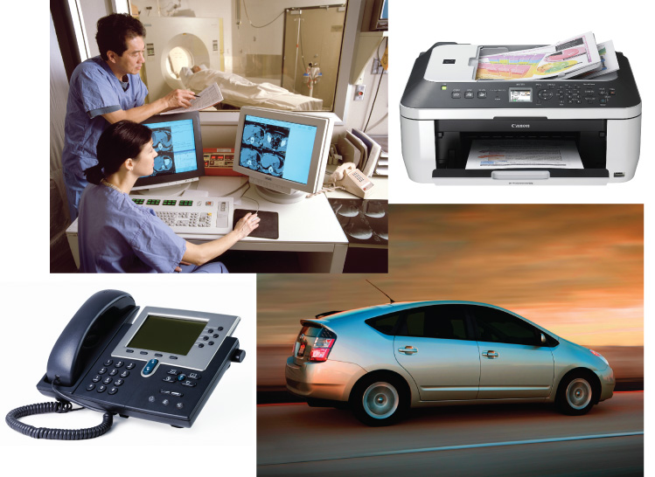
Real-Time Operating Systems
Systems with a specific purpose and a certain result
Uses include:
Automobiles
Printers
VoIP phones
Medical devices
Robotic equipment
Notes:
Machinery that performs a repetitive series of specific tasks in an exact amount of time requires a real-time operating system.
This type of operating system is a program with a specific purpose.
For example, instruments such as those found in the scientific, defense, and aerospace industries that must perform regimented tasks or record precise results require real-time operating systems.
Real-time operating systems are also found in fuel-injection systems in car engines, inkjet printers, VoIP phones, medical devices, and robotic cameras.
Real-time operating systems require minimal user interaction. The programs are written specifically to the needs of the devices and their functions. Therefore, there are no commercially available standard RTOS software programs.

Slide 9
Multiuser Operating Systems
Known as network operating systems
Allow access to the computer system by more than one user
Manage user requests
Systems include:
Linux
UNIX
Windows Vista and Windows 7
Mac OS X
i5/OS
z/OS
Notes:
A multiuser operating system (also known as a network operating system) enables more than one user to access the computer system at one time by efficiently juggling all the requests from multiple users.
Networks require a multiuser operating system because many users access the server computer at the same time and share resources.
Examples include Linux, UNIX, and IBM’s i5/OS and z/OS.
The latest versions of Microsoft Windows and Mac OS X can also be considered multiuser operating systems because they allow the creation of home networks without any requiring additional operating systems.

Slide 10
UNIX
Multiuser, multitask operating system
Used primarily with mainframes
Also found on PCs
Vendors can modify the code:
Hewlett-Packard’s HP/UX
Sun’s Solaris
IBM’s AIX
Notes:
UNIX is a multiuser, multitask operating system used primarily with mainframes as a network operating system, although it is also often found on PCs.
The UNIX code was initially not proprietary. Rather, any programmer was allowed to use the code and modify it to meet his or her needs.
UNIX is now a brand that belongs to the company The Open Group, but any vendor that meets testing requirements and pays a fee can use the UNIX name.
Individual vendors can modify the UNIX code to run specifically on their hardware. HP/UX from Hewlett-Packard, Solaris from Sun, and AIX from IBM are some of the UNIX systems currently available in the marketplace.

Slide 11
Mainframes and Supercomputers
Other computers utilizing multiuser operating systems:
Mainframes
Handle requests from hundreds or thousands of users simultaneously
Supercomputers
Used by scientists and engineers
Notes:
Multiuser operating systems are also used by mainframes and supercomputers.
Mainframe computers store, manage, and process data from hundreds or thousands of users simultaneously.
Scientists and engineers use supercomputers to solve complex problems or perform massive computations.

Slide 12
Single-User Operating Systems
Single-Task Systems
Perform one task at a time
PDAs
Palm OS
Windows Mobile
Cell phone
Proprietary OS
Multitask Systems
Perform simultaneous tasks
Smartphones
Symbian OS
iPhone OS
Google Android
Palm webOS
Notes:
When cell phones and PDAs were separate and single-function devices, they required an OS that could perform one task at a time.
A convergence between the cell phone and PDA created the smartphone, which requires an OS with multitasking capabilities.

Slide 13
Desktop and Notebook Operating Systems
An operating system combined with a processor is known as a platform
Microsoft Windows OS/Intel and AMD processors
Apple Macintosh OS/Motorola, IBM, and Intel processors
OS not interchangeable between platforms
Application software is platform specific
Notes:
The combination of an operating system and a processor is referred to as a computer’s platform.
For example, Microsoft Windows operating systems are designed to coordinate with a series of processors from Intel Corporation and AMD (Advanced Micro Devices) that share the same or similar sets of instructions. Until recently, Apple Macintosh operating systems worked primarily with processors from Motorola and IBM designed specifically for Apple computers. Apple has recently adapted the Intel processor.
You cannot load a Windows OS on a Mac computer or vice versa because the processor would not understand and would not function properly.
Application software comes in PC or Mac versions.
PC and Mac computers can be networked to share files and peripheral devices.

Slide 14
Microsoft Windows
Multiuser, multitasking OS
Windows 7 is the newest version
Features
Increased functionality
User-friendliness
Improved Internet capabilities
Enhanced privacy and security
Notes:
Windows 7 is the most recent version of the Microsoft Windows operating system. Improvements focus on increasing user functionality and friendliness, improving Internet capabilities, and enhancing file privacy and security. Many computers still run earlier versions, such as Windows Vista, Windows XP, and Windows 95.
Windows 7 comes in a number of versions, including Windows 7 Starter, Windows 7 Home Premium, Windows 7 Professional, Windows 7 Enterprise, and Windows 7 Ultimate.

Slide 15
Mac OS
First commercially available OS with point-and-click technology (GUI)
Excellent in:
Graphics display
Processing
System reliability
File backup
Fewer applications available than for Windows
More expensive
Notes:
In 1984, the Mac OS became the first commercially available operating system to incorporate the user-friendly point-and-click technology known as a graphical user interface (GUI) [pronounced gooey] in a commercially affordable computer.
Macs have long been recognized for their superior graphics display and processing capabilities. Users also attest to Mac’s greater system reliability and superior file backup utilities.
However, there are fewer software applications available for the Mac platform than for the Windows platform, and Macs tend to be more expensive than Windows-based PCs.
The most recent version of the Mac operating system, Mac OS X Leopard, is based on the UNIX operating system.

Slide 16
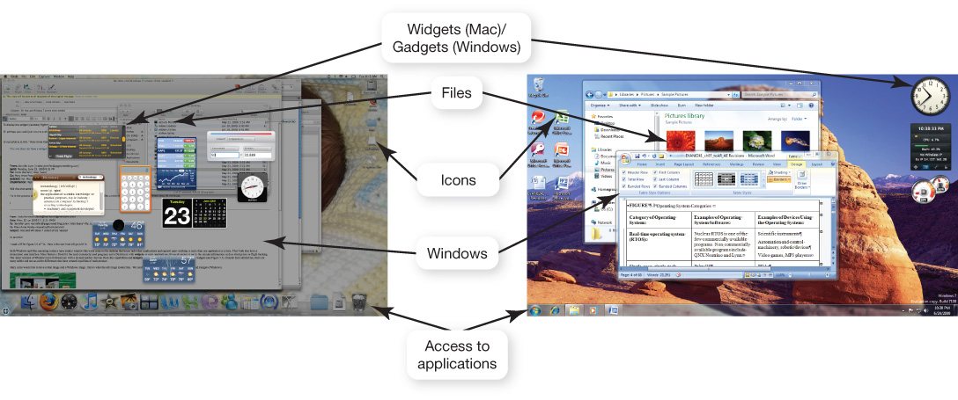
Mac vs. Windows
Similar functionality
Streamlined user interface
Window-like work areas on the desktop
Mac
Windows
Notes:
Although the Mac OS and the Windows operating systems are not compatible, they are similar in terms of functionality. Both have a streamlined user interface and window work areas on the desktop that house individual applications and support users working in more than one application at a time.
Macs feature a Dock for the most commonly used programs and a Dashboard with widgets for quick access to up-to-the-minute information such as stock prices.
The latest versions of Windows have followed suit with a revised taskbar that has Dock-like capabilities and Gadgets that are similar to Mac widgets.
Despite their similarities, there are still differences that cause users to prefer one product over the other.

Slide 17
Linux
Open source operating system
Based on UNIX
Stable system
May be downloaded for free from the Internet
Runs on PCs, netbooks, iPods, and gaming systems
Allows you to choose desktop appearance
Notes:
In 1991, a Finnish graduate student named Linus Torvalds decided he would create a UNIX-like operating system that could run on an Intel processor. His product, called Linux, was offered for free to developers around the world and has been upgraded and improved continually since then.
Linux is open source software, meaning that anyone can obtain the code for free and alter it. The agreement is that improvements and methods must also be shared.
Today, Linux is gaining a reputation as a stable operating system that is not subject to crashes and failures.
You can download the open source versions of Linux for free from the Internet. Versions have been designed for use on PCs, netbooks, iPods, and gaming systems. However, there are several versions of Linux that are more proprietary in nature. These versions come with support and other products not generally associated with open source Linux. Red Hat has been packaging and selling versions of Linux since 1994 and is probably the most well-known Linux distributor.
Linux does not have a single default graphical user interface. One free interface allows you to select a Windows or Mac desktop appearance.

Slide 18
What the OS Does
Provides a user interface
Manages the CPU
Manages memory and storage
Manages hardware and peripheral devices
Coordinates application software with the CPU
Notes:
The operating system provides a way for the user to interact with the computer, manages the processor (CPU), manages the memory and storage, manages the computer system’s hardware and peripheral devices, and provides a consistent means for software applications to work with the CPU.

Slide 19
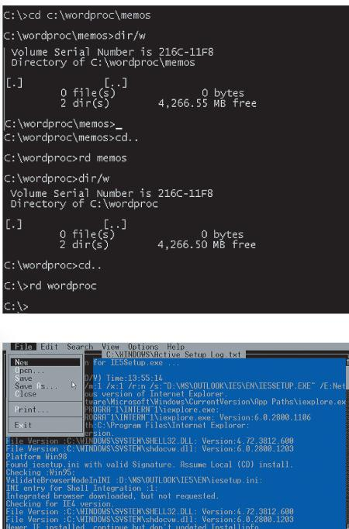
The User Interface
Enables you to interact with the computer
Types of interfaces
Command-driven interface
Menu-driven interface
Graphical user interface (GUI)
Command-driven
Notes:
The OS provides a user interface that enables you to interact with the computer.
In early PCs, interaction with the OS was through a command-driven interface, meaning that the user had to type very specific commands to get the computer to load a program. The commands were not always easy to understand; therefore the interface proved to be too complicated for the average user.
The command-driven interface was later improved by incorporating a menu-driven interface in which the user chooses a command from menus displayed on the screen. Menu-driven interfaces eliminated the need to know every command because you could select most of the commonly used commands from a menu. However, they were still not easy enough for most people to use.
Most operating systems today use a graphical user interface (GUI). Unlike the command- and menu-driven interfaces used earlier, GUIs display graphics and use the point-and-click technology of the mouse and cursor, making operating systems much more user friendly.

Slide 20
Processor Management
Controls the timing of events the processor works on
Multitasking
Interrupts
Interrupt handler
Interrupt table
Stack
Notes:
Although the CPU is the brains of the computer, it needs the OS to arrange for the execution of all its activities in a systematic way.
To do so, the OS assigns a slice of its time to each activity requiring the CPU’s attention. The OS then switches between processes thousands of times a second so it appears that everything is happening seamlessly.
When the OS allows you to perform more than one task at a time, it is said to be multitasking.
The OS processes a task assigned a higher priority before processing a task that has been assigned a lower priority. This is called preemptive multitasking.
For example, assume you’re typing and you want to print a file. When you tell your computer to print the file, the printer generates a signal called an interrupt that tells the OS it is in need of attention.
Every device has its own type of interrupt, which is associated with an interrupt handler, a special numerical code that prioritizes the requests. These requests are placed in the interrupt table in RAM.
In our example, the OS pauses the CPU from its typing activity when it receives the interrupt from the printer and puts a “memo” in a special location in RAM called a stack. The memo is a reminder of where the CPU was before it left off so that it can work on the printer request.
The CPU then retrieves the printer request from the interrupt table and begins to process it. Upon completion of the printer request, the CPU goes back to the stack, retrieves the memo it placed about the typing activity, and returns to that task until it is interrupted again.

Slide 21
OS Architecture
More than 4 GB of RAM
64-bit system
Windows Vista
Windows 7
Make sure applications and devices are compatible
Notes:
Computers with more than 4GB of RAM feature 64-bit versions of Windows.
Previous Windows versions used the traditional 32-bit operating system architecture.
The newer 64-bit systems provide added responsiveness to users running several applications at the same time and switching between them frequently.
If you purchase a 64-bit operating system, make sure your hardware and software are compatible.

Slide 22
Virtual Memory
Instructions and data are stored on the hard drive when RAM is full
Swap file
Paging
Thrashing
Notes:
RAM has limited capacity. When there isn’t enough room in RAM for the OS to store the required data and instructions, it borrows room from the hard drive.
This process of optimizing RAM storage by borrowing hard drive space is called virtual memory.
When more RAM space is needed, the OS swaps out from RAM the data or instructions that have not been recently used and moves them to a temporary storage area on the hard drive called the swap file.
If the data and/or instructions in the swap file are needed later, the OS swaps them back into active RAM and replaces them in the hard drive’s swap file with less active data or instructions. This process of swapping is known as paging.
Eventually your computer will become sluggish as it is forced to page more and more often. This condition of excessive paging is called thrashing.
The solution to this problem is to increase the amount of RAM in your system so that it can avoid having to send data and instructions to virtual memory.

Slide 23
Hardware and Peripheral Device Management
Device drivers
Programs that enable the operating system to communicate with peripheral devices
Provided by the manufacturer of the device
Plug and Play
Hardware and software standard
Facilitates the installation of new hardware
Notes:
Each device attached to your computer comes with a special program, called a device driver, that facilitates communication between the device and the OS.
The device driver translates the specialized commands of the device to commands that the OS can understand, and vice versa. Thus, devices will not function without the proper device driver because the OS would not know how to communicate with them.
Today, most devices come with the driver preinstalled in Windows. Devices that have drivers included in Windows are called Plug and Play (PnP).
Plug and Play is not a driver. Instead, it is a software and hardware standard designed to facilitate the installation of a new piece of hardware in computers by including in the OS the driver the device needs to run.
Plug and Play enables users to plug their new device into a port on the system, turn on the system, and immediately use the device. The OS automatically recognizes the device and its driver.

Slide 24
Software Application Coordination
Application programming interfaces (APIs)
Blocks of code contained in the operating system
Coordinate the operating system with software applications
Similar toolbars and menus
Microsoft DirectX
Notes:
For software programs to work with a CPU, they must contain code that the CPU recognizes. Rather than having the same blocks of code for similar procedures in each software application, the OS includes the blocks of code that software applications need.
These blocks of code are called application programming interfaces (APIs).
To create programs that can communicate with the operating system, software programmers need only refer to the API code blocks in their individual application programs rather than including the entire code in the application itself. Not only do APIs avoid redundancies in software code, but they also make it easier for software developers to respond to changes in the OS.
Microsoft DirectX, for example, is a group of multimedia APIs built into the Windows operating system that improves graphics and sounds when you’re playing games or watching video on your PC.

Slide 25
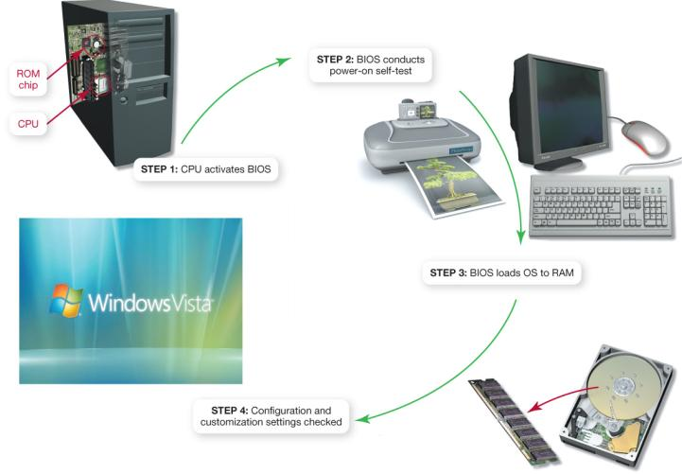
Starting the Computer
The boot process
BIOS is activated.
A POST checks attached hardware.
The OS loads into RAM.
Configuration and customization settings are checked.
Notes:
For a computer to go from a dead stop to ready for use, a start-up process is required. This is often referred to as booting up the computer, or the boot process. The boot process consists of four basic steps:
1. The basic input/output system (BIOS) is activated by powering on the CPU.
2. The BIOS checks that all attached devices are in place (called a power-on self-test, or POST).
3. The operating system is loaded into RAM.
4. Configuration and customization settings are checked.
Once the boot process has completed these steps, the computer is ready to accept commands and data.

Slide 26
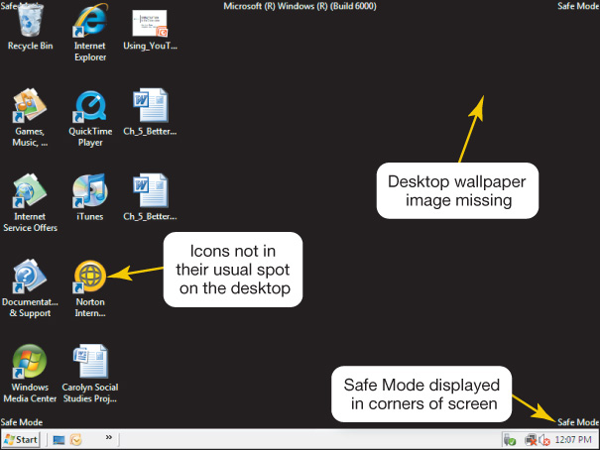
Handling Errors in the Boot Process
Safe mode
Windows does not boot properly
Try rebooting
Uninstall any new devices or software
Notes:
Errors during the boot process are often very simple to correct. It is helpful to be aware of the most common problems.
Sometimes Windows does not boot properly and you end up with a screen with the words Safe Mode in the corners. Safe mode is a special diagnostic mode designed for troubleshooting errors. When in Safe mode, only the essential devices of the system (such as the mouse, keyboard, and monitor) function. If, after you boot, you end up in Safe mode, try rebooting the machine before doing anything else. If you still end up in Safe mode and if you have recently installed new software or a new hardware device, try uninstalling it.

Slide 27
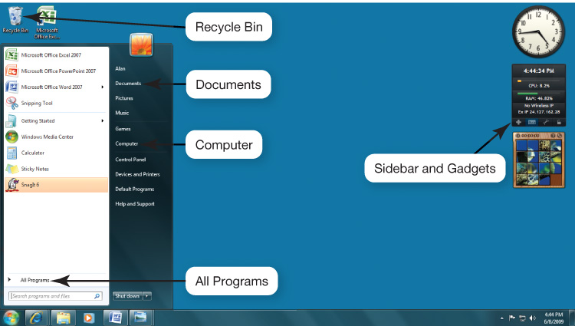
The Desktop
Notes:
The desktop is the first interaction you have with the OS and the first image you see on your monitor. As its name implies, your computer’s desktop puts at your fingertips all of the elements necessary for a productive work session that typically are found on or near the top of a traditional desk, such as files and folders.

Slide 28
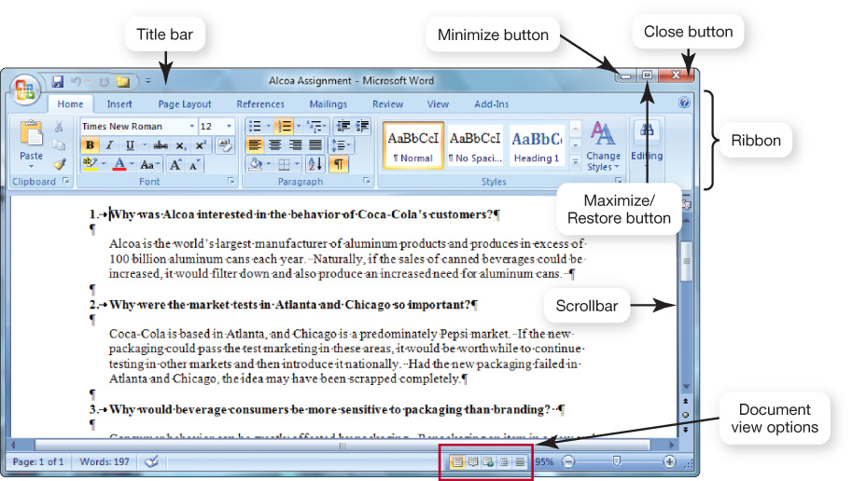
Windows
Notes:
The standard window in Windows has consistent features. Once a user is familiar with the setup of these features, he or she will be immediately familiar with the windows in any Windows-based software.

Slide 29
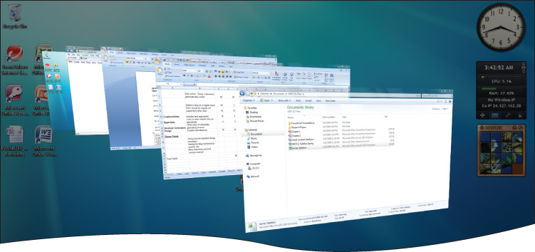
Viewing Windows
Side-by-side
Stacked
Cascading
Flip 3D
Notes:
Tiling windows is a great way to see two windows at the same time. Windows Vista and Windows 7 give you the ability to “flip” through live 3D images of open windows. You can also arrange windows in more traditional cascade, stacked, or side-by-side arrangements by right-clicking an empty space on the taskbar.

Slide 30
File Management
The operating system provides an organizational structure for the computer’s contents.
Hierarchical structure of directories:
Drives
Folders
Subfolders
Files
Windows 7: libraries
Notes:
An additional function of the OS is to enable file management, which entails providing an organizational structure for the computer’s contents. The OS allows you to organize the contents of your computer in a hierarchical structure of directories that includes drives, folders, subfolders, and files.
Windows 7 introduces the concept of libraries, which are folders that gather files from different locations and display them as if they were all saved in a single folder, regardless of where they are physically stored.

Slide 31
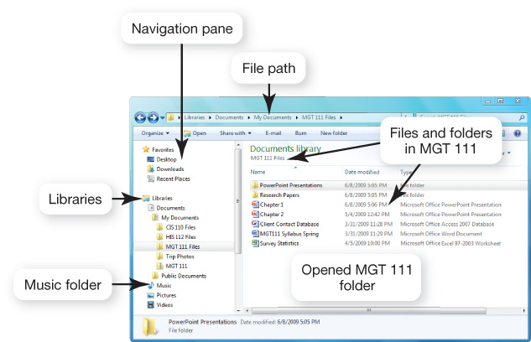
File Management
Notes:
If you use a Windows PC, Windows Explorer is the main tool for finding, viewing, and managing the contents of your computer by showing the location and contents of every drive, folder, and file.
Details view, shown here, is the most interactive view. Files and folders are displayed in list form, and the additional file information is displayed in columns alongside the file name. You can sort and display the contents of the folder by any of the column headings; you therefore can sort the contents alphabetically by file name or type, or hierarchically by date last modified or file size.

Slide 32
Viewing and Sorting Files and Folders
Many views available
Large Icon view
Extra Large Icon view
Tiles view
List view
Small and Medium Icon views
Notes:
In Windows Vista and 7, Large Icon view replaces Thumbnails view from Windows XP. Large Icon view shows the contents of folders as small images.
There is also Extra Large Icon view, which shows folder contents and other icons as even larger images.
Large and Extra Large Icon views are best to use if your folder contains picture files. For those folders that contain PowerPoint presentations, the Title slide of the presentation will display so you can easily distinguish between presentations.
Tiles view displays files and folders as icons in list form. Each icon includes the file name, the application associated with the file, and the file size. The display information is customizable. Tiles view also displays picture dimensions, a handy feature for Web page developers.
List view is a display of even smaller icons and file names. This is a good view if you have a lot of content in a folder and need to see most or all of it at once.
Small and Medium Icon views also display files and folders as icons in list form, but the icons are either small or medium sized and include no other file information than the file name. Additional file information is displayed in a ScreenTip, however.

Slide 33
File Name Extensions
Extension | Type of Document | Application
.doc | Word processing document | Microsoft Word 2003
.docx | Word processing document | Microsoft Word 2007
.wpd | Word processing document | Corel WordPerfect
.xlsx | Spreadsheet | Microsoft Excel 2007
.accdb | Database | Microsoft Access 2007
.pptx | PowerPoint presentation | Microsoft PowerPoint 2007
.pdf | Portable Document Format | Adobe Acrobat or Adobe Reader
.rtf | Text (Rich Text Format) | Any program that can read text documents
.txt | Text | Any program that can read text documents
Notes:
Following the file name and after the dot (.) comes an extension, or file type. This extension identifies what family of files the file belongs to or which application should be used to read the file.
For example, if a file is a Word 2003 document, it has a .doc extension and is named something like report.doc. If the file is created in Word 2007, the file extension is .docx and is named report.docx.
When you save a file created in most applications running under the Windows OS, the extension is automatically added for you.

Slide 34
File Name Extensions
Extension | Type of Document | Application
.htm or .html | Hyper Text Markup Language for a Web page | Any program that can read HTML
.jpg | Joint Photographic Experts Group (JPEG) image | Most programs capable of displaying images
.gif | Graphic Interchange Format (GIF) image | Most programs capable of displaying images
.bmp | Bitmap image | Windows
.zip | Compressed file | WinZip

Slide 35
Naming Files
File name: Name assigned plus file name extension
Up to 255 characters
Characters not legal in Windows file names: “ / \ * ? < > | :
Character not legal in Mac file names: :
Mac file names are case sensitive
Notes:
The first part of a file, or the file name, is the name you assign to the file when you save it.
Each operating system has its own naming conventions. Several are listed on the slide.

Slide 36
File Path
File path: Location of the file
Notes:
You can tell the location of a file by its file path. The file path starts with the drive on which the file is located and includes all folders, subfolders (if any), the file name, and the extension. For example, if you were saving a picture of Emily Brontë for a term paper for an English composition course, the file path might be C:\Users\Username\Documents\Spring 2010\English Comp\Term Paper\Illustrations\EBronte.jpg.

Slide 37
Working with Files
File management actions
Open
Copy
Move
Rename
Delete
Recycle Bin (Windows)
Trash (Mac)
Notes:
Once you’ve located your file with Windows Explorer, you can perform many other file management actions, such as opening, copying, moving, renaming, and deleting files.
You open a file by double-clicking the file in its storage location. The operating system then determines which application needs to be loaded to open the requested file and opens the file within the correct application automatically.
You can copy a file to another location using the Copy command. When you copy a file, a duplicate file is created and the original file remains in its original location.
To move a file from one location to another, you use the Move command. When you move a file, the original file is deleted from its original location.
The Recycle Bin is a folder on the desktop in Windows where files deleted from the hard drive reside until you permanently purge them from your system. Files in the Recycle Bin can be easily restored to their original location.
Mac systems have something similar to the Recycle Bin, called Trash.
Files deleted from other drives, such as a floppy drive, CD, flash drive, or network drive, do not go to the Recycle Bin, but are deleted from the system immediately.

Slide 38
Utility Programs
Small programs that perform special functions
Manage system resources
Create a pleasant environment
Improve efficiency
Notes:
Utility programs are small applications that perform special functions.
Some utility programs (such as disk defragmenter utilities) manage system resources; others (such as screen savers) help make your time and work on the computer more pleasant; still others (such as file compression utilities) improve efficiency.

Slide 39
Display Utilities
Change the appearance of:
Desktop
Background
Screen savers
Window colors
Notes:
In Windows 7, the Personalization icon allows you to change background themes, screen savers, and window colors.
You can right-click the desktop and choose Personalize or use the Control Panel.

Slide 40
Add or Remove Programs
Installation wizard
Uninstall wizard
Programs cannot simply be deleted
Notes:
When you install a new program, the program runs a wizard that walks you through the installation process. If a wizard does not initialize automatically, however, you should go to the Programs and Features utility in the Control Panel. This prompts the OS to look for the setup program of the new software and starts the installation wizard.
Some people think that deleting a program from the Program Files folder on the C drive is the best way to remove a program from the system. However, most programs include support files that are not located in the main program folder. By selecting the Windows uninstaller utility, Programs and Features, you delete the main program file and all supporting files as well.

Slide 41
File Compression Utilities
Reduce the size of a file
Take out redundancies
Make it easier and faster to send files over the Internet, upload, and save
Generally, repeated patterns are replaced with a shorter placeholder
The rain in Spain falls mainly on the plain.
Notes:
A file compression utility is a program that takes out redundancies in a file to reduce the file size.
File compression is helpful because it makes a large file more compact, making it easier and faster to send over the Internet, upload to a Web page, or save onto a disk.
Windows has built-in compression (or zip) file support.
There are also several stand-alone freeware and shareware programs, such as WinZip (for Windows) and StuffIt (for Windows or Mac), that you can obtain to compress your files.
Most compression programs look for repeated patterns of letters and replace them with a shorter placeholder.

Slide 42
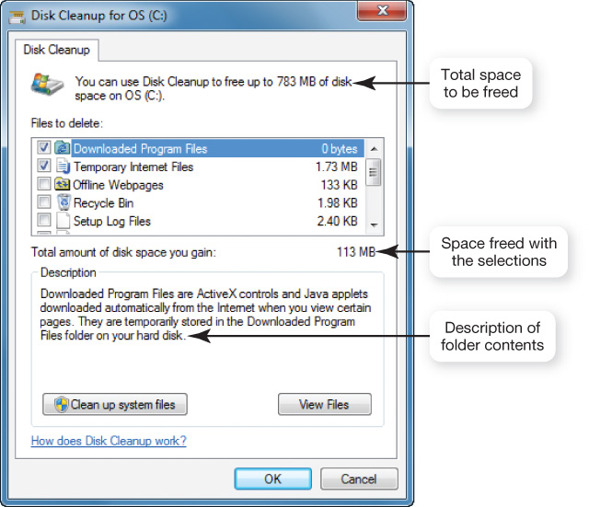
System Maintenance Utilities
Disk Cleanup: Removes unnecessary files
Choose the files to be deleted
Downloaded program files
Temporary Internet files
Offline Web pages
Recycle Bin
Notes:
A set of maintenance utilities is built into Windows primarily for system efficiency.
Disk Cleanup cleans unnecessary files from your hard drive. These include files that have accumulated in the Recycle Bin as well as temporary files. If not deleted periodically, these unnecessary files can affect a computer’s performance.

Slide 43
System Maintenance Utilities
Disk defragmenter: Regroups related pieces of files
Error checker: Checks for lost files and fragments
Task Manager: Checks on nonresponsive programs
Notes:
Disk defragmenter utilities regroup related pieces of files together on the hard disk, allowing the OS to work more efficiently. Using the Windows Disk Defragmenter Analyzer feature, users should check their hard drive several times a year.
Error checking, once known as ScanDisk, checks for lost files and fragments as well as physical errors on your hard drive. Sometimes error checking can recover the lost data, but more often, it deletes files that are taking up space unnecessarily.
If a program on your system stops working, you can use the Windows Task Manager utility to check on the program or to exit the nonresponding program.

Slide 44
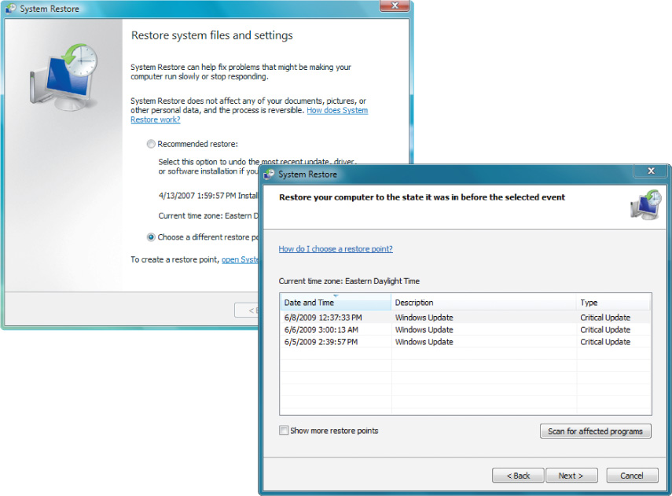
System Restore
Restores system settings to a specific date
Notes:
Recent versions of Windows have a utility called System Restore that lets you restore your system settings back to a specific date when everything was working properly.

Slide 45
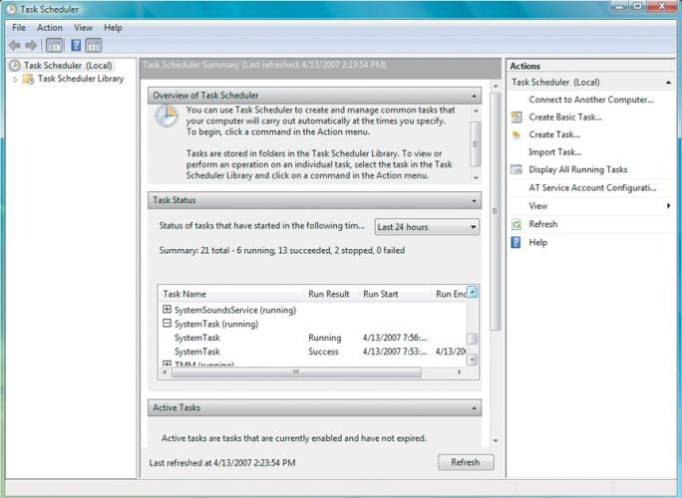
System Backup
Backup
Creates a copy of the hard drive to another storage device
Task Scheduler
Runs selected utilities automatically
Task Scheduler
Notes:
When you use the Windows Backup and Restore utility, you create a duplicate copy of all the data on your hard disk and copy it to another storage device, such as a CD or an external hard drive.
The Windows Task Scheduler utility allows you to schedule tasks to run automatically at predetermined times, with no interaction necessary on your part.

Slide 46
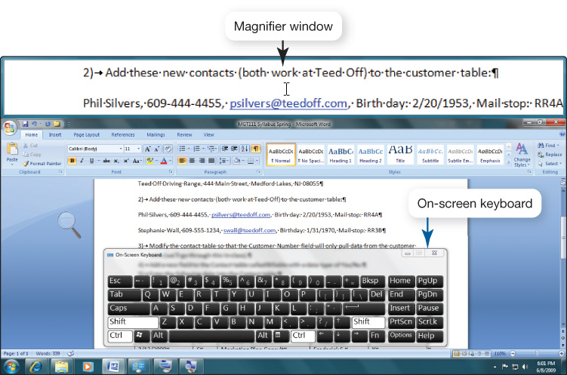
Accessibility Utilities
Ease of Access Center
Centralized location for assistive technology
High contrast
Magnifier
On-screen keyboard
Windows speech recognition
Notes:
Windows Vista and Windows 7 have an Ease of Access Center, a centralized location for assistive technology and tools that adjust accessibility settings. In the Ease of Access Center, you can find tools to help you adjust the contrast of or magnify the screen image, read screen contents to you, or display an on-screen keyboard.

Slide 47
Chapter 5 Summary Questions
What software is included in system software?
Notes:
What software is included in system software?

Slide 48
Chapter 5 Summary Questions
What are the different kinds of operating systems?
Notes:
What are the different kinds of operating systems?

Slide 49
Chapter 5 Summary Questions
What are the most common desktop operating systems?
Notes:
What are the most common desktop operating systems?

Slide 50
Chapter 5 Summary Questions
How does the operating system provide a means for users to interact with the computer?
Notes:
How does the operating system provide a means for users to interact with the computer?

Slide 51
Chapter 5 Summary Questions
How does the operating system help manage resources such as the processor, memory, storage, hardware, and peripheral devices?
Notes:
How does the operating system help manage resources such as the processor, memory, storage, hardware, and peripheral devices?

Slide 52
Chapter 5 Summary Questions
How does the operating system interact with application software?
Notes:
How does the operating system interact with application software?

Slide 53
Chapter 5 Summary Questions
How does the operating system help the computer start up?
Notes:
How does the operating system help the computer start up?

Slide 54
Chapter 5 Summary Questions
What are the main desktop and windows features?
Notes:
What are the main desktop and windows features?

Slide 55
Chapter 5 Summary Questions
How does the operating system help me keep my computer organized?
Notes:
How does the operating system help me keep my computer organized?

Slide 56
Chapter 5 Summary Questions
What utility programs are included in system software, and what do they do?
Notes:
What utility programs are included in system software, and what do they do?

Slide 57
All rights reserved. No part of this publication may be reproduced, stored in a retrieval system, or transmitted, in any form or by any means, electronic, mechanical, photocopying, recording, or otherwise, without the prior written permission of the publisher. Printed in the United States of America.
Copyright © 2011 Pearson Education, Inc.
Publishing as Prentice Hall
57

