Slide 2
Technology in Action
Chapter 7
Networking:
Connecting Computing Devices
Notes:
Networks can increase the usefulness of computers. In this chapter, we’ll discuss networks, including home networks that share an Internet connection. Because networks are vulnerable to intrusion, we’ll also discuss computer threats—both what they are and how to prevent them.

Slide 3
Chapter Topics
Networking fundamentals
Network architecture
Network components
Peer-to-peer networks
Ethernet networks
Power-line networks
Configuring software
Wireless security
Notes:
Topics in Chapter 7 include:
Networking fundamentals
Network architecture
Network components
Peer-to-peer networks
Ethernet networks
Power-line networks
Configuring software
Wireless security

Slide 4
Networking Fundamentals
Computer network
Two or more computers connected together
Devices connected to networks: nodes
Benefits of a network
Sharing resources and peripherals
Transferring files
Sharing of broadband connection with use of a router
Notes:
A computer network is simply two or more computers connected together via software and hardware so they can communicate.
Devices connected to a network are referred to as nodes. A node can be a computer, a peripheral (such as a printer), a game console (such as an Xbox 360), a digital video recorder (such as a TiVo), or a communications device (such as a modem).
The main function for most networks is to facilitate information sharing, but networks provide other benefits as well.
They allow users to share peripherals.
Files can be transferred from one computer to another without using external storage media.
Shared folders can allow access to stored files on one computer to other networked computers.
If you install a device called a router on your network, you can share broadband Internet connections.

Slide 5
Network Architecture
Network designs
Locally administered
Peer-to-peer (P2P)
Centrally administered
Client/server
Notes:
There are two main ways a network can be administered (or run): locally or centrally. A peer-to-peer network is the most common example of a locally administered network. The most common type of centrally administered network is a client/server network.

Slide 6
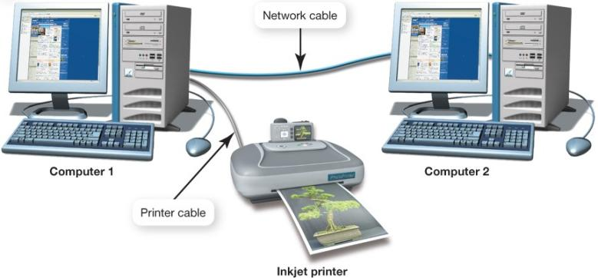
Peer-to-Peer Networks
Nodes communicate with each other
Peers
Share peripheral devices
Common in home networks
Notes:
In peer-to-peer (P2P) networks, each node connected to the network can communicate directly with every other node on the network, rather than having a separate device control the network centrally.
Thus, all nodes on this type of network are in a sense peers (or equals).
When printing, for example, a computer on a P2P network doesn’t have to go through the computer that’s connected to the printer. Instead, it can communicate directly with the printer.
Because they are simple to set up, P2P networks are the most common type of home network.

Slide 7
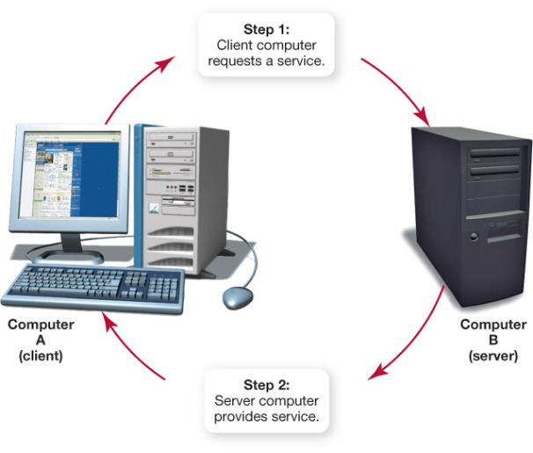
Client/Server Networks
Client computers
Users who make requests
Server computers
Provide resources to clients
Central network control
Internet
A large, multiserver,
multiclient network
Notes:
Most networks that have 10 or more nodes are client/server networks.
A client/server network contains two types of computers: clients and servers.
The client is the computer on which users accomplish specific tasks and make specific requests.
The server is the computer that provides information or resources to the client computers on the network.
The server on a client/server network also provides central control for functions on the network (such as printing).
The Internet is a client/server network. When your computer is connected to the Internet, it is functioning as a client computer. When connecting to the Internet through an ISP, your computer connects to a server computer maintained by the ISP. The server “serves up” resources to your computer so that you can interact with the Internet.
Home server options, such as Windows Home Server or Hewlett Packard’s MediaSmart servers, are now being marketed as the use of media files on home computers expands rapidly.

Slide 8
HANs and LANs
Home area network (HAN)
Connects digital devices within a home
Local area network (LAN)
Nodes are within a small geographic region
Schools
Small businesses
Notes:
The distance between nodes on a network is another way to describe a network.
Home area networks (HANs) are networks located in a home that are used to connect digital devices such as computers, peripherals, phones, cameras, digital video recorders (DVRs), and televisions.
Local area networks (LANs) are networks in which the nodes are located within a small geographic area. A network in a computer lab at school is an example of a LAN.

Slide 9
WANs and MANs
Wide area network (WAN)
LANs connected over long distances
A few miles to thousands of miles
Uses telecommunications lines
Metropolitan area network (MAN)
Provides access within a specific geographic region, such as a city
Notes:
Wide area networks (WANs) are made up of LANs connected over long distances. Say a school has two campuses located in different towns. Connecting the LAN at one campus to the LAN at the other campus (by telecommunications lines) allows users on the two LANs to communicate with each other. The two LANs would be described as a single WAN.
Metropolitan area networks (MANs) are designed to provide access to an entire city.

Slide 10
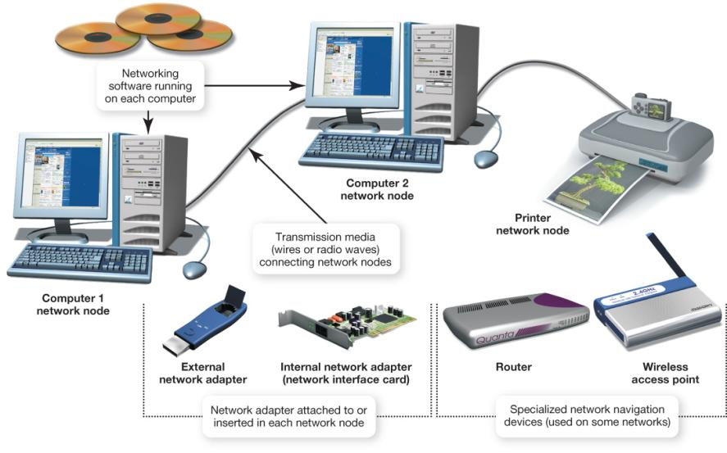
Network Components
Transmission media
Network communication devices
Software
Notes:
To function, all networks must include:
a means of connecting the nodes to the network (by cables or wireless technology)
special devices that allow the nodes to communicate with each other and to send data
software that allows the network to run.

Slide 11
Transmission Media
Provide communications channel between nodes
Forms of media
Twisted pair cable
Coaxial cable
Fiber-optic cable
Radio waves (wireless)
Bandwidth
Data transfer rate
Throughput
Notes:
All network nodes are connected to each other and to the network by transmission media. A transmission medium establishes a communications channel between the nodes on a network and can take several forms.
Networks can use existing wiring (such as phone lines or power lines) to connect nodes.
They can use additional cable (such as twisted pair cable, coaxial cable, or fiber-optic cable) to connect nodes.
Wireless networks use radio waves instead of wires or cable to connect nodes.
The data transfer rate (also called bandwidth) is the maximum speed at which data can be transmitted between two nodes on a network.
Throughput is the actual speed of data transfer that is achieved; this is usually less than the data transfer rate.

Slide 12
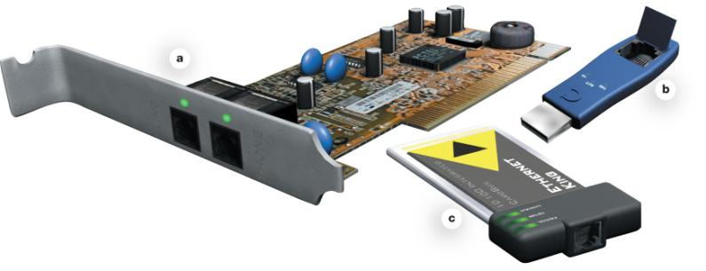
Network Adapters
Devices connected to or installed in nodes
Network interface cards (NICs)
External or internal network adapters
Enable communication between nodes
Notes:
Network adapters are devices connected to or installed in network nodes that enable the nodes to communicate with each other and to access the network.
Other network adapters are installed inside computers and peripherals as expansion cards. These adapters are referred to as network interface cards (NICs).
Some network adapters take the form of external devices that plug into an available USB port.

Slide 13
Network Navigation Devices
Devices that help make data flow possible
Routers
Route data between networks
Switches
Receive data and retransmit it to nodes on the same network
Notes:
Data is sent over transmission media in bundles called packets. For computers to communicate, these packets of data must be able to flow between computers. Network navigation devices help make this data flow possible.
In simple networks, navigation devices are built right into network adapters. More sophisticated networks need specialized navigation devices.
The two most common specialized navigation devices are routers and switches.
-Routers transfer packets of data between two or more networks. For example, if a home network is connected to the Internet, a router is required to send data between the two networks.
-Switches receive data packets and send them to the node for which they are intended on the same network (not between different networks).

Slide 14
Networking Software
Peer-to-peer software
Built into operating systems that support networking
Windows
Mac OS
Linux
Notes:
Home networks need OS software that supports peer-to-peer networking. The most common versions of Windows used in the home support P2P networking. You can connect computers running any of these OSs to the same network. The last several versions of the Mac OS and the various versions of Linux also support P2P networking.

Slide 15
Networking Software
Client/server software
Network operating system (NOS) software
Windows Server 2008
SUSE Linux Enterprise
Notes:
Client/server networks are controlled by a central server that has specialized network operating system (NOS) software installed on it. This software handles requests for information, Internet access, and the use of peripherals for the rest of the network nodes. Examples of NOS software are Windows Server 2008 and SUSE Linux Enterprise.

Slide 16
Types of Peer-to-Peer Networks
Wired Ethernet networks
Wireless Ethernet networks
Power-line networks
Notes:
There are three main types of P2P networks:
Wired Ethernet networks
Wireless Ethernet networks
Power-line networks
The major difference among these networks is the transmission media by which the nodes are connected and the bandwidth each achieves.

Slide 17
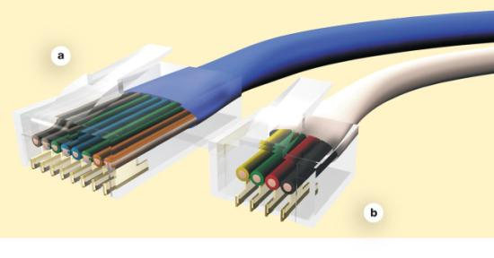
Wired Ethernet Networks
Ethernet network adapters are used to connect nodes
NIC card
ExpressCard
USB adapter
Computers are connected to each other using unshielded twisted pair cable
Ethernet
Phone
Notes:
Ethernet networks use the Ethernet protocol as the means by which the nodes on the network communicate.
An Ethernet network requires that you install or attach network adapters to each computer or peripheral you want to connect to the network. Most computers come with Ethernet adapters preinstalled as network interface cards (NICs).
If your computer doesn’t have a NIC, you can buy one and install it, or you can use a USB adapter, which you plug into any open USB port on the system unit.
Although you can use USB versions in laptops, ExpressCard versions of Ethernet NICs are made especially for laptops.
The most popular transmission medium for wired Ethernet networks is unshielded twisted pair (UTP) cable. Used in telephone lines, it is composed of four pairs of wires that are twisted around each other to reduce electrical interference.
UTP cable for Ethernet comes as Cat 5E, Cat 6, and Cat 7. Cat 5E has a bandwidth of up to 1,000 Mbps, and Cat 6 over 1 Gbps. Cat 7 cable is designed for Ultra Fast Ethernet networks, which run at speeds of up to 10 Gbps. It is generally not used in home networks. However, if the cost of installing Cat 7 cable is not significantly more than installing Cat 6 cable, you might want to consider using it as a hedge against needing higher bandwidth for future networking applications.

Slide 18
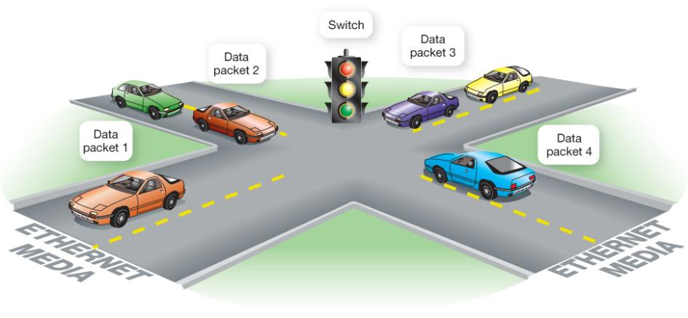
Ethernet Switches
Keep track of data packets
Amplify and retransmit signals
Keep the network running efficiently
Notes:
Data is transmitted through the wires of an Ethernet network in packets. Data packets can suffer collisions. If data packets collide, the data in them is damaged or lost. In either case, the network doesn’t function efficiently.
A switch in an Ethernet network acts like a traffic signal by enforcing the rules of the data road on the transmission media. The switch keeps track of the data packets and, in conjunction with NICs, helps the data packets find their destinations without running into each other.
Home networks often use four or eight port switches that can accommodate four or eight devices, respectively. Switches can be chained together if more ports are needed for the home network.

Slide 19
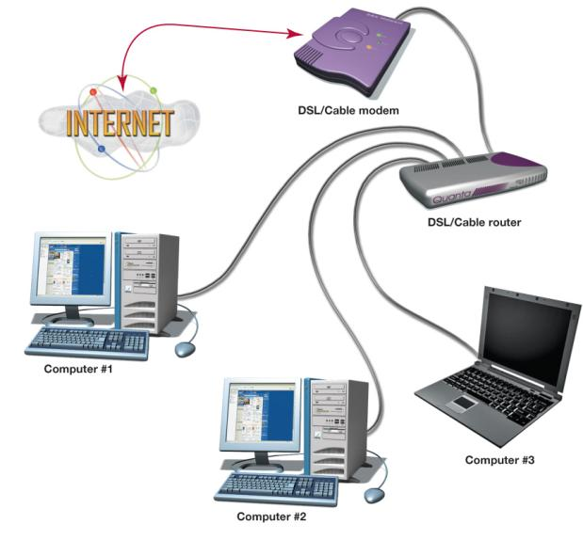
Ethernet Routers
Transfer packets from one network to another
Home Internet routers transfer data from the Internet to the home network
Allows for network-ready devices such as network printers or network attached storage (NAS)
Notes:
Routers are devices that transfer packets of data between two or more networks. If a home network is connected to the Internet, you need a router to send data between the home network and the Internet.
Because so many people are sharing Internet access in home networks, manufacturers are making devices that combine switches and routers and are specifically designed to connect to DSL or cable modems. These are often referred to as DSL/cable routers.
Other network-ready devices, such as network printers or network attached storage (NAS), can be attached directly to a router, allowing access by all computers on the network. This allows these devices to be accessed directly instead of going through another computer, such as happens with shared devices on a P2P network.

Slide 20
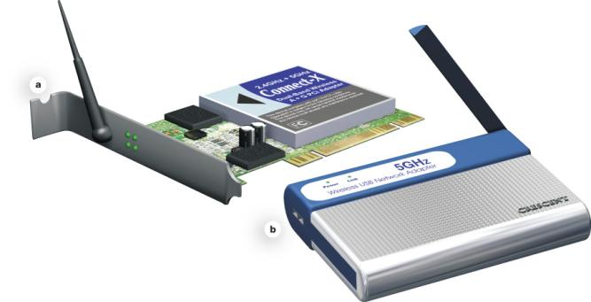
Wireless Ethernet Networks
Ethernet networks that use radio waves instead of wires to connect nodes
Based on the IEEE 802.11 standard, also known as Wi-Fi
Each node requires a wireless network adapter
Transceivers
Notes:
A wireless network uses radio waves instead of wires or cables as its transmission media.
Current wireless Ethernet networks in the United States are based on the 802.11 standard, which is also known as Wi-Fi.
Just as with other networks, each node on a wireless network requires a network adapter. Wireless network adapters are available as NICs that are inserted into expansion slots on the computer or as USB devices that plug into an open USB port.
Wireless network adapters differ from other network adapters in that they contain transceivers. A transceiver is a device that translates the electronic data that needs to be sent along the network into radio waves and then broadcasts these radio waves to other network nodes. Transceivers also receive signals from other network nodes.

Slide 21
Wireless Access Point (WAP)
Device added to a wireless network to extend the range of the network
Must connect to either a switch, a router, or a node on the network
Notes:
A wireless access point (WAP) is a device added to a network to extend the range of the wireless network by providing a second point at which nodes can connect to the network. It must connect directly to either a switch, a router, or a node on the network.

Slide 22
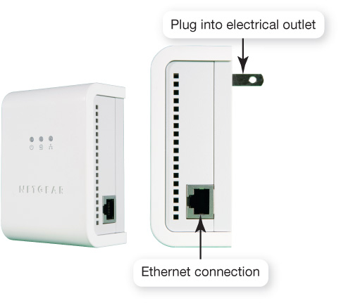
Power-Line Networks
Computers are connected to a house’s electrical wiring to create a network
A power-line network adapter connects nodes to electrical outlets
Notes:
Power-line networks use the existing electrical wiring in your home to connect the nodes in the network.
In a power-line network, any electrical outlet provides the network connection. The original power-line networks had a maximum data transfer rate of 14 Mbps. New standards provide for data transfer rates approaching 200 Mbps.
To create a power-line network, you connect a power-line network adapter to each computer or peripheral attached to the network. You plug the adapters into an electrical outlet. Most power-line network adapters are automatically recognized by the Windows operating system.
The original power-line networks were not popular. However, the higher data throughput of today’s power-line networks is bringing the idea back into focus. Also, power-line networks can sometimes exceed speeds of wireless Ethernet networks, and can be especially useful where there is a lot of interference on the wireless network.

Slide 23
Choosing a Peer-to-Peer Network
Things to consider - Whether existing wiring is available
- Whether you want wireless communications
- How fast you want your network connection to be
- How much money you can spend on your network
Comparing the Major Types of Home Networks
 | Wired Ethernet | Power-Line | Wireless 802.11g | Wireless 802.11n
Maximum data transfer rate (bandwidth) | 100 Mbps to 1 Gbps | 200 Mbps | 54 Mbps | 540 Mbps
Relative installation and equipment costs for networking two computers | $ | $$ | $ | $$
Notes:
If you’re setting up a home network, the type of network you should choose depends on your particular needs. In general, consider the following factors in determining your network type:
Whether existing wiring is available
Whether you want wireless communications
How fast you want your network connection to be
How much money you can spend on your network

Slide 24
Configuring Software for Your Home Network
Windows Vista and later versions
Use wizards launched from Network and Sharing Center in Control Panel
Before running wizards:
Install network adapters on each node.
For a wired network, plug all the cables into the router, network adapters, and so on.
Notes:
Once you install the hardware for your network, you need to configure your operating system software for networking on your computers.
Windows Vista (and later versions) makes configuring software relatively simple by providing the Network Setup Wizard for setting up wired networks. For wireless networks, Windows provides the Wireless Network Setup Wizard. You can launch both of these wizards from the Network Sharing Center in the Control Panel. Before running these wizards, you should do the following:
1. Install network adapters on each node.
2. For a wired network, plug all the cables into the router, network adapters, and so on.

Slide 25
Configuring Software for Your Home Network
Make sure your cable/DSL modem is connected to your router and the Internet.
Turn on your equipment in the following order:
Cable/DSL modem
Router
All computers and peripherals (printers, scanners, and so on)
Notes:
3. Make sure your cable/DSL modem is connected to your router and the Internet.
Turn on all equipment in this order, allowing time for each to power up and configure before starting the next device:
Your cable/DSL modem
Your router
All computers and peripherals (printers, scanners, and so on)
Completing these steps enables the wizards to make decisions about how best to configure your network.

Slide 26
Networking Multiple Versions of Windows
Set up Windows 7 and Vista machines first
Automatically detect other computers running Windows on network
Windows XP will need adjustment to see other versions of Windows
Give each Windows computer a unique name
Place all computers in the same workgroup
Notes:
Windows 7, Windows Vista , and Windows XP are the most common OSs for home use that support P2P networking. Fortunately, you can network computers using any of these versions of Windows.
If you have one computer with Windows 7 but your other computers run on other versions of Windows, then you should set up your Windows 7 computer first. Windows 7 and Windows Vista can automatically detect computers running other versions of Windows on your network; however, you might have to make adjustments to the Windows XP computers on your network to enable them to see the networked Windows 7 and Vista computers.
When you set up your Windows computer, you gave it a name. Each computer on a network needs a unique name (different from the names of all other computers on the network) so that the network can identify it.
Also, computers on a network can be located in various workgroups. For simplicity on a home network, you should assign all your computers to the same workgroup.

Slide 27
Configuring a Router to Connect to the Internet
Contact ISP for special settings
Access router from Web browser
Enter username and password
Use router’s wizard to set up connection using settings and info provided by ISP
Test Internet connection speed
Speedtest.net
Notes:
To set up your router so you can use it to connect to the Internet, you must first contact your ISP to help you with any special settings that you might need to configure your router to work with your ISP.
Next, you can access your router from a Web browser by entering the router’s IP address or default URL. You can usually find this information in the documentation that came with the router. You’ll also need a username and password to log on to the router, both of which you’ll also find in the documentation that came with the router.
Many routers feature their own wizard that takes you through unique configuration screens. If you’re unsure of any information that needs to be entered to configure the router (such as whether IP addresses are assigned dynamically—meaning you are assigned a new IP address by your ISP each time you connect to the Internet), call your ISP and ask for guidance.
There are numerous sites on the Internet, such as Speedtest.net, where you can test the speed of downloading files to your computer and uploading files to other computers. You can then see how your results compare to other users in your state and across the United States. Many factors can influence your Internet speeds, so be sure to run the test at several different times during the day over the course of a week before complaining to your ISP if you think you aren’t getting your promised speed.

Slide 28
Securing Wireless Networks
Wireless network range doesn’t stop at the property line
Default device and network ID settings allow intruders to enter the network
Internet bandwidth can be stolen
Computers can be vulnerable to hacker intrusion and takeover
Notes:
If you’re keeping a wired network secure with a firewall, you’re fairly safe from most hacker attacks. However, wireless networks have wide ranges, including areas outside of your house. This makes it possible for a hacker to access your network without your knowing it.
Most wireless network adapters are set up to access the strongest wireless network signal detected. Piggybacking is connecting to a wireless network (that is not your own) without the permission of the owner. This practice is illegal in many jurisdictions but often happens inadvertently between neighbors.
Because your packets of information are being broadcast through the airwaves, a hacker can intercept and decode information from your transmissions that might allow him or her to bypass your firewall.
Others might steal your bandwidth, and crimes can be committed through your network.

Slide 29
Securing Wireless Networks
To secure a wireless network, do the following:
Change your network name (SSID)
Disable SSID broadcast
Change the default password on your router
Turn on security protocols
Implement media access control
Limit your signal range
Apply firmware upgrades
Notes:
To secure a wireless network, you should take the following additional precautions:
Change your network name (SSID).
Disable SSID broadcast.
3. Change the default password on your router (use at least 8 characters with a combination of letters, symbols, and numbers).
Turn on security protocols such as Wired Equivalent Privacy (WEP) or Wi-Fi Protected Access (WPA). Both use encryption (a method of translating your data into code) to protect data in your wireless transmissions.
Implement media access control, which restricts access to the network to only certain media access control (MAC) addresses.
Limit your signal range.
Apply firmware upgrades.

Slide 30
Chapter 7 Summary Questions
What is a network, and what are the advantages of setting one up?
Notes:
What is a network, and what are the advantages of setting one up?

Slide 31
Chapter 7 Summary Questions
What is the difference between a client/server network and a peer-to-peer network?
Notes:
What is the difference between a client/server network and a peer-to-peer network?

Slide 32
Chapter 7 Summary Questions
What are the main hardware components of every network?
Notes:
What are the main hardware components of every network?

Slide 33
Chapter 7 Summary Questions
What are the most common home networks?
Notes:
What are the most common home networks?

Slide 34
Chapter 7 Summary Questions
What are wired Ethernet networks, and how are they created?
Notes:
What are wired Ethernet networks, and how are they created?

Slide 35
Chapter 7 Summary Questions
What are wireless Ethernet networks, and how are they created?
Notes:
What are wireless Ethernet networks, and how are they created?

Slide 36
Chapter 7 Summary Questions
How are power-line networks created, and are they a viable alternative to Ethernet networks?
Notes:
How are power-line networks created, and are they a viable alternative to Ethernet networks?

Slide 37
Chapter 7 Summary Questions
How do I configure my computer’s software to set up a network?
Notes:
How do I configure my computer’s software to set up a network?

Slide 38
Chapter 7 Summary Questions
Why are wireless networks more vulnerable than wired networks, and what special precautions are required to ensure my wireless network is secure?
Notes:
Why are wireless networks more vulnerable than wired networks, and what special precautions are required to ensure my wireless network is secure?

Slide 39
All rights reserved. No part of this publication may be reproduced, stored in a retrieval system, or transmitted, in any form or by any means, electronic, mechanical, photocopying, recording, or otherwise, without the prior written permission of the publisher. Printed in the United States of America.
Copyright © 2011 Pearson Education, Inc.
Publishing as Prentice Hall
39

