Slide 1
Business Analytics

Slide 2
Business Intelligence
Business intelligence (BI) is a broad category of applications, technologies, and processes for:
gathering,
storing,
accessing, and
analyzing data
to help business users make better decisions.
Notes:
This definition is broad. BI encompasses not only applications, but also technologies and processes. It includes not only “getting data out” (through tools and applications), but also getting “data in” (to a data mart or warehouse).
It should be pointed out that some authors use the BI term to refer to “getting data out” and data warehousing as “getting data in.” And there are some authors who use the data warehousing term to refer to both “getting data in” and “getting data out,” much like we are using the BI term. The good news is that the differing terminology does not normally cause confusion because of the context in which the terms are used.

Slide 3
Things Are Getting More Complex
Organizations are finding business value in capturing, storing, and analyzing new kinds of data, such as social media, machine sensing, and clickstream.
Many companies are performing new kinds of analytics (sentiment analysis), to better and more quickly understand and respond to what customers are saying about them and their products.
The cloud, and appliances are being used as data stores
Advanced analytics are growing in popularity and importance
Notes:
Organizations are finding business value in capturing, storing, and analyzing new kinds of data, such as social media, machine sensing, and clickstream. Because of its three Vs -- volume, variety, and velocity – this kind of data is often called Big Data. Many companies are performing new kinds of analytics, such as sentiment analysis to better and more quickly understand and respond to what customers are saying about them and their products.
There are changes in how this data is stored and analyzed. For example, some companies store and analyze data in the cloud. The open source software Hadoop and MapReduce from Apache Software is being used to store and analyze massive amounts of multistructured data (as opposed to the more structured data maintained in RDMS).

Slide 4
What is Big Data?
Information from multiple internal and external sources:
Transactions
Social media
Enterprise content
Sensors
Mobile devices
Companies leverage data to adapt products and services to:
Meet customer needs
Optimize operations
Optimize infrastructure
Find new sources of revenue
Can reveal more patterns and anomalies
IBM estimates that by 2015 4.4 million jobs will be created globally to support big data
1.9 million of these jobs will be in the United States

Slide 5
Types of Data

Slide 6
When collecting or gathering data we collect data from individuals cases on particular variables.
A variable is a unit of data collection whose value can vary.
Variables can be defined into types according to the level of mathematical scaling that can be carried out on the data.
There are four types of data or levels of measurement:
1. Nominal | 2. Ordinal
3. Interval | 4. Ratio
Notes:
When thinking about research we are looking at gathering knowledge through some form of observation.
Research in the scientific sense, as talked about in the first lecture, involves the systematic measurement of these observations.
When we observe something we understand that observation in terms of its attributes for example, colour or texture, and we look at how that attribute varies across our observations.
So, when we collect or gather data we collect information from individual cases (people, organisations, businesses and so on) about particular variables.
Level of mathematical scaling? The level of mathematical precision with which the values of a variable can be expressed.

Slide 7
Nominal data
Nominal or categorical data is data that comprises of categories that cannot be rank ordered – each category is just different.
The categories available cannot be placed in any order and no judgement can be made about the relative size or distance from one category to another.
What does this mean? No mathematical operations can be performed on the data relative to each other.
Therefore, nominal data reflect qualitative differences rather than quantitative ones.

Slide 8
Nominal data
Examples:
What is your gender? (please tick)
Male
Female
Did you enjoy the film? (please tick)
Yes
No

Slide 9
Nominal data
Systems for measuring nominal data must ensure that each category is mutually exclusive and the system of measurement needs to be exhaustive.
Variables that have only two responses i.e. Yes or No, are known as dichotomies.
Notes:
Mutually exclusive: each observation (person, case, score) cannot fall into more than one category.
Exhaustive: the system of categories system should have enough categories for all the observations.

Slide 10
Ordinal data
Ordinal data is data that comprises of categories that can be rank ordered.
Similarly with nominal data the distance between each category cannot be calculated but the categories can be ranked above or below each other.
What does this mean? Can make statistical judgements and perform limited maths.
Notes:
Ordinal data works with the same assumptions as nominal data but is more complex in that here, whilst still comprising of categories, now the categories
themselves can be rank-ordered i.e. one category has more or less of some underlying quality than being in another category.
What does this mean? We can make statistical judgements about the relative position of one value to another and can perform limited mathematical calculations.

Slide 11
Ordinal data
Example:
How satisfied are you with the level of service you have received? (please tick)
Very satisfied
Somewhat satisfied
Neutral
Somewhat dissatisfied
Very dissatisfied

Slide 12
Interval and ratio data
Both interval and ratio data are examples of scale data.
Scale data:
data is in numeric format ($50, $100, $150)
data that can be measured on a continuous scale
the distance between each can be observed and as a result measured
the data can be placed in rank order.
Notes:
Ordinal data can be ranked – similarly interval and ratio data also operate on a mechanism of scale. The key difference is that with interval and ratio data the data is numerical and has numerically equal distances between each category. For example, a 5cm difference in height between 150cm and 155cm is the same as a 5cm difference between 15cm and 20cm.
Imagine a 30cm ruler – it shows equal distance between each mark i.e. 10 1mm markers between each cm.

Slide 13
Interval data
Interval data measured on a continuous scale and has no true zero point.
Examples:
Time – moves along a continuous measure or seconds, minutes and so on and is without a zero point of time.
Temperature – moves along a continuous measure of degrees and is without a true zero.
Notes:
Temperature and true zero – whilst there is a zero degrees this is a measure of temperature!

Slide 14
Ratio data
Ratio data measured on a continuous scale and does have a true zero point.
Examples:
Age
Weight
Height

Slide 15
Types of Analytics

Slide 16
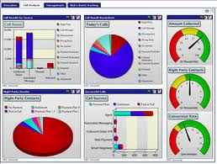
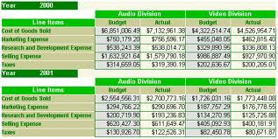
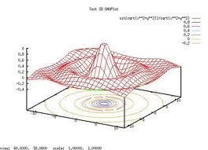
Descriptive Analytics
Descriptive analytics, such as reporting/OLAP, dashboards, and data visualization, have been widely used for some time.
They are the core of traditional BI.
What has occurred?
Descriptive analytics, such as data visualization, is important in helping users interpret the output from predictive and predictive analytics.
Notes:
Descriptive analytics, such as reporting/OLAP, dashboards, and data visualization, have been widely used for some time. They are the core of traditional BI.

Slide 17
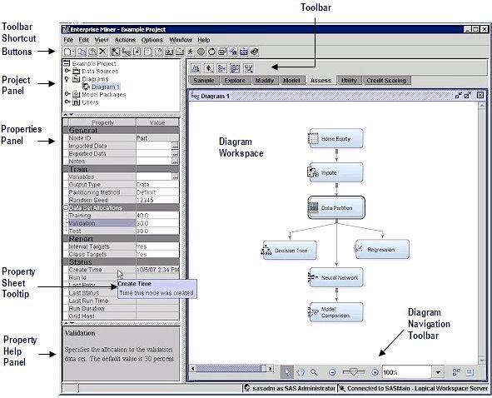
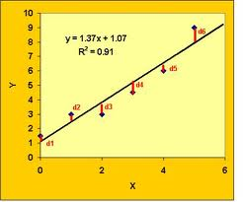
Predictive Analytics
Algorithms for predictive analytics, such as regression analysis, machine learning, and neural networks, have also been around for some time.
Prescriptive analytics are often referred to as advanced analytics.
What will occur?
Marketing is the target for many predictive analytics applications.
Descriptive analytics, such as data visualization, is important in helping users interpret the output from predictive and prescriptive analytics.
Notes:
Algorithms for predictive analytics, such as regression analysis, machine learning, and neural networks, have also been around for some time. Recently, however, software products have made them much easier to understand and use. They have also been integrated into specific applications, such as for campaign management. Marketing is the target for many predictive analytics applications. Descriptive analytics, such as data visualization, is important in helping users interpret the output from predictive and predictive analytics. Prescriptive analytics are often referred to as advanced analytics.

Slide 18
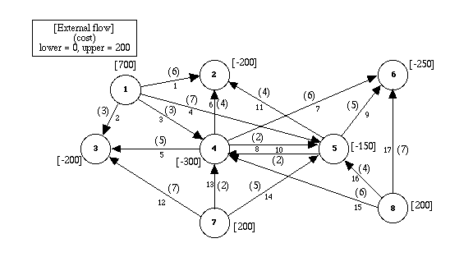
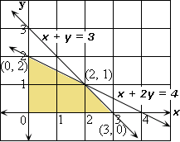
Prescriptive Analytics
Prescriptive analytics are often referred to as advanced analytics.
Regression analysis, machine learning, and neural networks
Often for the allocation of scarce resources
What should occur?
For example, the use of mathematical programming for revenue management is common for organizations that have “perishable” goods (e.g., rental cars, hotel rooms, airline seats).
Harrah’s has been using revenue management for hotel room pricing for some time.
Notes:
Prescriptive analytics provide an optimal solution, often for the allocation of scarce resources. They, too, have been in academia for a long time but are now finding wider use in practice. For example, the use of mathematical programming for revenue management is common for organizations that have “perishable” goods (e.g., rental cars, hotel rooms, airline seats). Harrah’s has been using revenue management for hotel room pricing for some time.

Slide 19
Organizational Transformation
Brought about by opportunity or necessity
The firm adopts a new business model enabled by analytics
Analytics are a competitive requirement
Notes:
This is the most interesting target. It occurs when a company either sees an opportunity or faces a problem that requires a new business model that can only be executed using analytics. To an extent, analytics is the business. Without analytics, the business model cannot be execute and the company cannot compete.

Slide 20
For BI-based organizations, the use of BI/analytics is a requirement for successfully competing in the marketplace.
Notes:
In some industries, the use of advanced analytics has moved beyond a “nice to have” to being a requirement.

Slide 21
2013 Academic Research
A 2011 TDWI report on Big Data Analytics found that 85% of respondents indicated that their firms would be using advanced analytics within three years
A 2011 IBM/MIT Sloan Management Review research study found that top performing companies in their industry are much more likely to use analytics rather than intuition across the widest range of possible decisions.
Notes:
The relationship between the use of data and analytics in decision making and a variety of organizational performance measures is described in a 2011 study by Brynjolfsson, Hitt, and Kim in the Social Science Research Network (SSRN).
Also, A 2010 IBM/MIT Sloan Management Review research study found that top performing companies in their industry are much more likely to use analytics rather than intuition across the widest range of possible decisions.
A 2011 TDWI report on Big Data Analytics found that 85% of respondents indicated that their firms would be using advanced analytics within three years.
A 2011 IDC study found that analytics is one of the top two IT priorities for this year.

Slide 22
Conditions that Lead to Analytics-based Organizations
The nature of the industry
Seizing an opportunity
Responding to a problem

Slide 23
Complex Systems
Tackle complex problems and provide individualized solutions
Products and services are organized around the needs of individual customers
Dollar value of interactions with each customer is high
There is considerable interaction with each customer
Examples: IBM, World Bank, Halliburton

Slide 24
Volume Operations
Serves high-volume markets through standardized products and services
Each customer interaction has a low dollar value
Customer interactions are generally conducted through technology rather than person-to-person
Are likely to be analytics-based
Examples: Amazon.com, eBay, Hertz
Notes:
Analytics are critical to high volume companies competing in the marketplace.

Slide 25
The Nature of the Industry: Online Retailers
BI Applications
Analysis of clickstream data
Customer profitability analysis
Customer segmentation analysis
Product recommendations
Campaign management
Pricing
Forecasting
Dashboards
Notes:
Online retailers like Amazon.com and Overstock.com are great examples of high volume operations who rely on analytics to compete. As soon as you enter, their sites a cookie is placed on your PC and all clicks are recorded. Based on your clicks and any search terms, recommendation engines decide what products to display. After you purchase an item, they have additional information that is used in marketing campaigns. Customer segmentation analysis is used in deciding what promotions to send you. How profitable you are influences how the customer care center treats you. A pricing team helps set prices and decides what prices are needed to clear out merchandise. Forecasting models are used to decide how many items to order for inventory. Dashboards monitor all aspects of organizational performance.

Slide 26
The Nature of the Industry
Online retailers like Amazon.com and Overstock.com are high volume operations who rely on analytics to compete.
When you enter their sites a cookie is placed on your PC and all clicks are recorded.
Based on your clicks and any search terms, recommendation engines decide what products to display.
After you purchase an item, they have additional information that is used in marketing campaigns.
Customer segmentation analysis is used in deciding what promotions to send you.
How profitable you are influences how the customer care center treats you.
A pricing team helps set prices and decides what prices are needed to clear out merchandise.
Forecasting models are used to decide how many items to order for inventory.
Dashboards monitor all aspects of organizational performance
Notes:
Online retailers like Amazon.com and Overstock.com are great examples of high volume operations who rely on analytics to compete. As soon as you enter, their sites a cookie is placed on your PC and all clicks are recorded. Based on your clicks and any search terms, recommendation engines decide what products to display. After you purchase an item, they have additional information that is used in marketing campaigns. Customer segmentation analysis is used in deciding what promotions to send you. How profitable you are influences how the customer care center treats you. A pricing team helps set prices and decides what prices are needed to clear out merchandise. Forecasting models are used to decide how many items to order for inventory. Dashboards monitor all aspects of organizational performance.

Slide 27
Knowledge Requirements for Advanced Analytics
Business Domain
Video
Data
Modeling
Choosing the right data to include in models is important.
Predictive analytics should not be searching for a diamond in a coal mine.
You will get too many spurious findings.
Important to have some thoughts as to what variables might be related.
Domain knowledge is necessary to understand how they can be used.
Consider the story of the relationship between beer and diapers in the market basket of young males in convenience stores.
You still have to decide (or experiment to discover) whether it is better to put them together or spread them across the store (in the hope that other things will be bought while walking the isles).
Notes:
Analytics requires an understanding of what data is available, how to access it, and how to manipulate it. Data is necessary for first building models and later testing them. Choosing the right data to include in models is important. Predictive analytics should not be searching for a diamond in a coal mine. You will get too many spurious findings. Rather, it is important have some thoughts as to what variables might be related. And once you have findings, domain knowledge is necessary to understand how they can be used. Consider the hoary story of the relationship between beer and diapers in the market basket of young males in convenience stores. You still have to decide (or experiment to discover) whether it is better to put them together or spread them across the store (in the hope that other things will be bought while walking the isles). Domain knowledge is important here. And finally, it is necessary to understand the models being used. At a minimum, this requires training in multivariate statistics.

Slide 28
Visualization

Slide 29
Visualization: A Definition
Visualize: to form a mental model or mental image of something
Visualization is a human cognitive activity, not something that a computer does

Slide 30
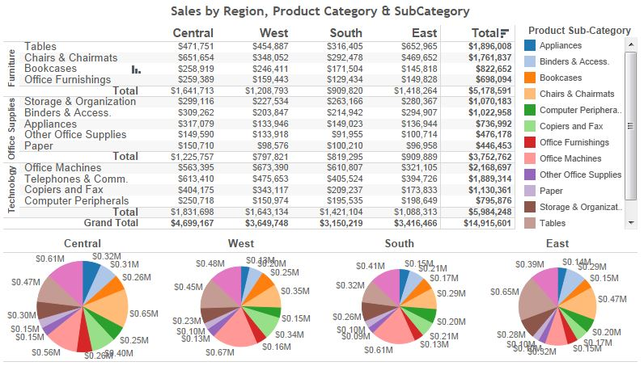
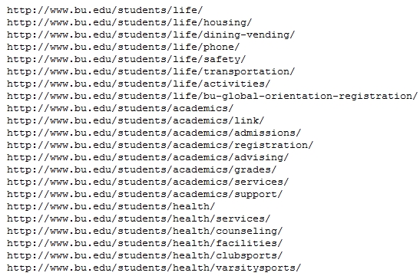
Visualization
Refers to the innovative use of images and interactive technology to explore large, high- density datasets
Help users see patterns and relationships that would be difficult to see in text lists
Rich graphs, charts
Dashboards
Maps
Increasingly is being used to identify insights into both structured and unstructured data for such areas as
operational efficiencies
profitability
strategic planning
Video Tableau

Slide 31
Acquisition of Insight
Many people and institutions possess data that may ‘hide’ fundamental relations
Realtors
Bankers
Air Traffic Controller
Fraud investigators
Engineers
They want to be able to view some graphical representation of that data, maybe interact with it, and then be able to say…….ahha!

Slide 32
Example: Fraud Detection
The Serious Fraud Office (SFO) suspected mortgage fraud
The SFO provided 12 filing cabinets of data
After 12 person years a suspect was identified
The suspect was arrested, tried and convicted

Slide 33
Example: Fraud Detection continued
The data was supplied in electronic form
A visualization tool (Netmap) was used to examine the data
After 4 person weeks the same suspect was identified
A master criminal behind the fraud was also identified

Slide 34
Is Information Visualization Useful?
Drugs and Chips
Texas Instruments
Manufactures microprocessors on silicon wafers that are routed through 400 steps in many weeks. This process is monitored, gathering 140,000 pieces of information about each wafer. Somewhere in that heap of data can be warnings about things going wrong. Detect a bug early before bad chips are made. TI uses visualization tools to aid in this detection
Eli Lilly
Has 1500 scientists using an advanced information visualization tool (Spotfire) for decision making. “With its ability to represent multiple sources of information and interactively change your view, it’s helpful for homing in on specific molecules and deciding whether we should be doing further testing on them”
Sheldon Ort of Eli Lilly, speaking to Fortune

Slide 35
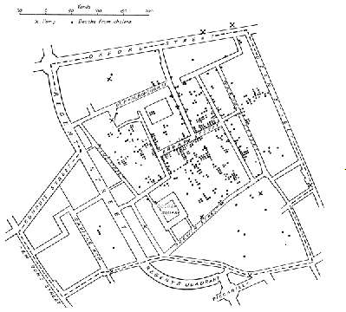
The cholera epidemic, London 1845
Dr. John Snow, medical officer for London, investigated the cholera epidemic of 1845 in Soho. He noted that the deaths, indicated by points, tended to occur near the Broad Street pump. Closure of the pump coincided with a reduction in cholera.

Slide 36
Challenger Disaster
On 28th January 1986 the space shuttle Challenger exploded, and seven astronauts died, because two rubber O-Rings leaked.
The previous day, engineers who designed the rocket opposed the launch, concerned that the O-Rings would not seal at the forecast temperature (25 to 29oF).
After much discussion, the decision was taken to go ahead.
Cause of the accident:
An inability to assess the link between cool temperature and O-Ring damage on earlier flights.
Many charts poorly presented

Slide 37
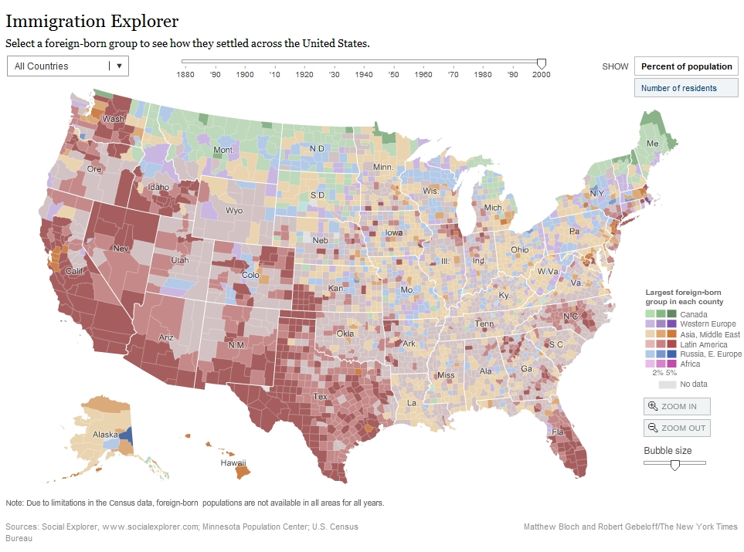
Examples
Geo data
mapping
Demo
Introduction to Information Visualization - Fall 2012
Notes:
37

Slide 38
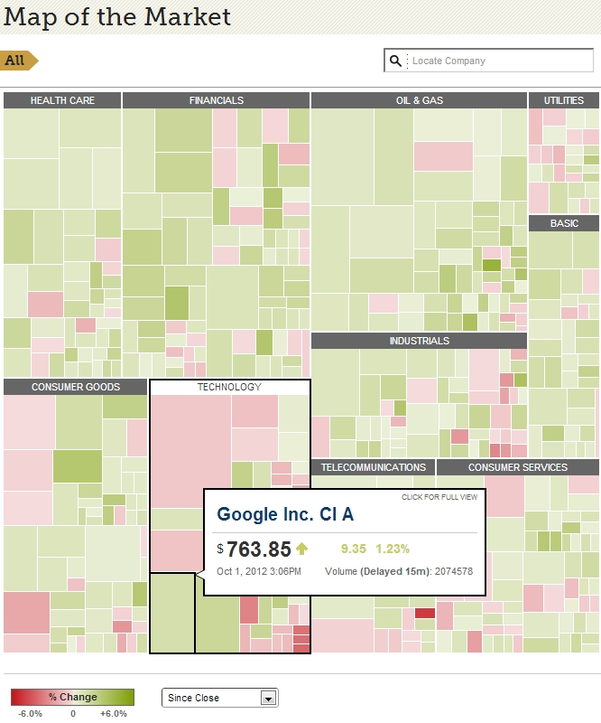
Examples
Treemap
Demo
Introduction to Information Visualization - Fall 2012
Notes:
38

Slide 39
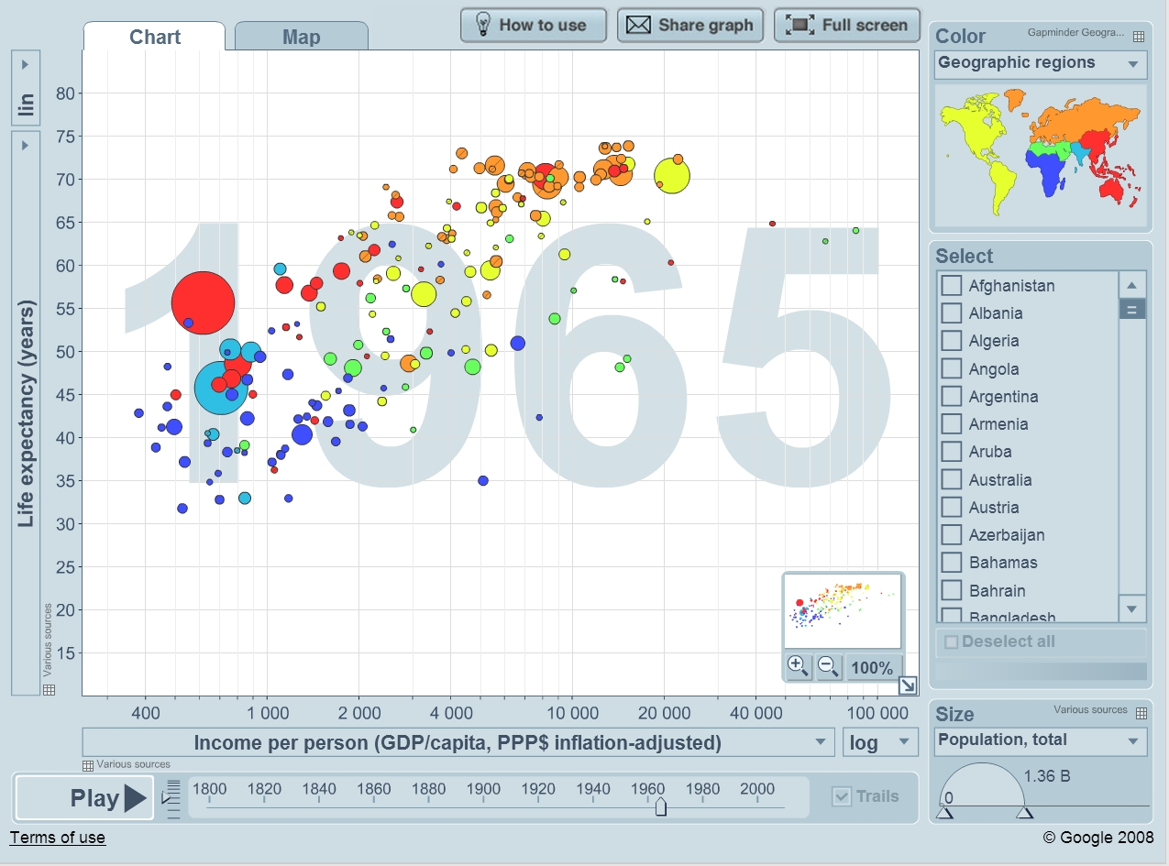
Examples
Population
“Trendalyzer”
Demo
Introduction to Information Visualization - Fall 2012
Notes:
39

Slide 40
Video on the use of visualization to extract knowledge from data.

Slide 41
Analytics Help the Cincinnati Zoo Know Its Customers
What management, organization, and technology factors were behind the Cincinnati Zoo losing opportunities to increase revenue?
Why was replacing legacy point-of-sale systems and implementing a data warehouse essential to an information system solution?
How did the Cincinnati Zoo benefit from business intelligence? How did it enhance operational performance and decision making? What role was played by predictive analytics?
Visit the IBM Cognos Web site and describe the business intelligence tools that would be the most useful for the Cincinnati Zoo.

