Slide 1
Business Intelligence Overview
Notes:
Parts of this presentation were first given on February 13, 2012 at the TDWI BI Executive Summit in Las Vegas. The complete presentation was given as a keynote talk at the Southern Association for Information Systems conference on March 28, 2012 in Atlanta. Feel free to use any of these slides in teaching your classes.

Slide 2
What Is Business Intelligence?
Its roots go back to the late 1960s
In the 1970s, there were decision support systems (DSS)
In the 1980s, there were EIS, OLAP, GIS, and more
Data warehousing and dashboards/scorecards became popular in the 1990s
Notes:
An excellent history of DSS is available at DSS resources. See Power, D.J., “A Brief History of Decision Support Systems,” DSSResources.com, World Wide Web, URL DSSResources.com/history/dsshistory2.8.html, version 2.8, May 31, 2003.
In the 1960s, the first computer applications were for scientific purposes and transaction processing. Reports that summarized the processed transaction data provided some, but very limited, information for decision support.
It was not long, however, before maturing technology, business need, and the vision of the early pioneers led to the first decision support applications. Much of the early development work was conducted at MIT and Harvard. Particularly important was Michael S. Scott Morton’s 1967 doctoral dissertation research. He built, implemented, and tested a system to support planning for laundry equipment. Later, he published an influential Sloan Management Review article and book that helped spread decision support concepts and provided a name for these analytical applications -- management decision systems – though this name was soon to be replaced with decision support systems.
Throughout the late 1960s and early-to-mid 1970s, a variety of decision support applications were developed and reported. Many academicians with backgrounds in management science/operations research were attracted to the field because of the practical potential for these new kinds of applications. Decision support systems (DSS) began to be used to describe these applications and the name of the emerging field. During this time, Ralph Sprague published his initial DSS frameworks articles that were followed by his seminal MIS Quarterly article and book.
Over the next decade, other kinds of decision support applications emerged – executive information systems, online analytical processing, and geographic information systems to mention a few.
A major stumbling block to supporting decision making was the lack of a decision support data infrastructure. This was addressed with the creation of data marts and warehouses in the 1990s. Also in the 1990s, dashboards and scorecards appeared, and in some ways (e.g., the providing of performance metrics), replaced EIS.

Slide 3
Business intelligence (BI) is a broad category of applications, technologies, and processes for gathering, storing, accessing, and analyzing data to help business users make better decisions.
Notes:
This definition is broad. BI encompasses not only applications, but also technologies and processes. It includes not only “getting data out” (through tools and applications), but also getting “data in” (to a data mart or warehouse).
It should be pointed out that some authors use the BI term to refer to “getting data out” and data warehousing as “getting data in.” And there are some authors who use the data warehousing term to refer to both “getting data in” and “getting data out,” much like we are using the BI term. The good news is that the differing terminology does not normally cause confusion because of the context in which the terms are used.

Slide 4
Things Are Getting More Complex
Organizations are finding business value in capturing, storing, and analyzing new kinds of data, such as social media, machine sensing, and clickstream.
Because of its three Vs -- volume, variety, and velocity – this kind of data is often called Big Data.
Many companies are performing new kinds of analytics, such as sentiment analysis to better and more quickly understand and respond to what customers are saying about them and their products.
The cloud, and appliances are being used as data stores
Advanced analytics are growing in popularity and importance
Notes:
Current BI architectures are not your “mother’s architecture” as of recent as five years ago. In many organizations they are much more varied and complex.
Organizations are finding business value in capturing, storing, and analyzing new kinds of data, such as social media, machine sensing, and clickstream. Because of its three Vs -- volume, variety, and velocity – this kind of data is often called Big Data. Many companies are performing new kinds of analytics, such as sentiment analysis to better and more quickly understand and respond to what customers are saying about them and their products.
There are changes in how this data is stored and analyzed. For example, some companies store and analyze data in the cloud. The open source software Hadoop and MapReduce from Apache Software is being used to store and analyze massive amounts of multistructured data (as opposed to the more structured data maintained in RDMS).

Slide 5
What Is Meant by Analytics?
A new term for BI
Just the data analysis part of BI
“Rocket science” algorithms
Three kinds of analytics
(descriptive, predictive and prescriptive analytics, which are discussed later).
Notes:
The analytics or business analytics term can be interpreted in different ways. The distinctions become most important when discussing what is required for being successful with advanced analytics (predictive and prescriptive analytics, which are discussed later).

Slide 6
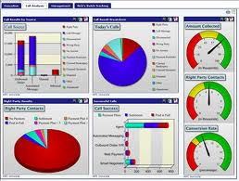
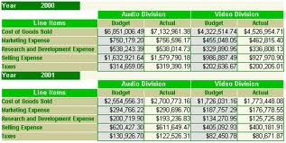
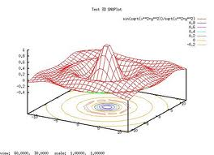
Descriptive Analytics
Descriptive analytics, such as reporting/OLAP, dashboards, and data visualization, have been widely used for some time. They are the core of traditional BI.
What has occurred?
Descriptive analytics, such as data visualization, is important in helping users interpret the output from predictive and predictive analytics.
Notes:
Descriptive analytics, such as reporting/OLAP, dashboards, and data visualization, have been widely used for some time. They are the core of traditional BI.

Slide 7
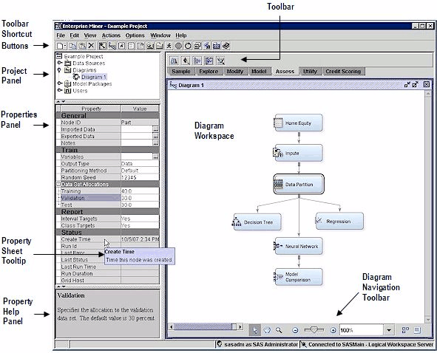
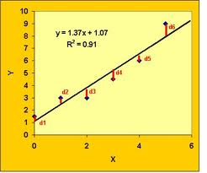
Predictive Analytics
Algorithms for predictive analytics, such as regression analysis, machine learning, and neural networks, have also been around for some time. Prescriptive analytics are often referred to as advanced analytics.
What will occur?
Marketing is the target for many predictive analytics applications. Descriptive analytics, such as data visualization, is important in helping users interpret the output from predictive and predictive analytics. Prescriptive analytics are often referred to as advanced analytics=egression analysis, machine learning, and neural networks
Notes:
Algorithms for predictive analytics, such as regression analysis, machine learning, and neural networks, have also been around for some time. Recently, however, software products have made them much easier to understand and use. They have also been integrated into specific applications, such as for campaign management. Marketing is the target for many predictive analytics applications. Descriptive analytics, such as data visualization, is important in helping users interpret the output from predictive and predictive analytics. Prescriptive analytics are often referred to as advanced analytics.

Slide 8
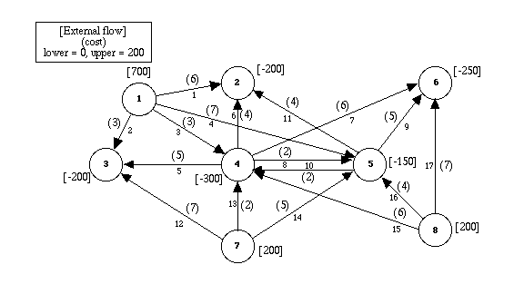
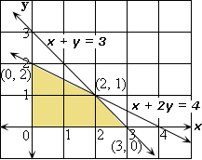
Prescriptive Analytics
Prescriptive analytics are often referred to as advanced analytics.
What should occur?
For example, the use of mathematical programming for revenue management is common for organizations that have “perishable” goods (e.g., rental cars, hotel rooms, airline seats). Harrah’s has been using revenue management for hotel room pricing for some time.
Notes:
Prescriptive analytics provide an optimal solution, often for the allocation of scarce resources. They, too, have been in academia for a long time but are now finding wider use in practice. For example, the use of mathematical programming for revenue management is common for organizations that have “perishable” goods (e.g., rental cars, hotel rooms, airline seats). Harrah’s has been using revenue management for hotel room pricing for some time.

Slide 9
Organizational transformation
Brought about by opportunity or necessity
The firm adopts a new business model enabled by analytics
Analytics are a competitive requirement
Notes:
This is the most interesting target. It occurs when a company either sees an opportunity or faces a problem that requires a new business model that can only be executed using analytics. To an extent, analytics is the business. Without analytics, the business model cannot be execute and the company cannot compete.

Slide 10
For BI-based organizations, the use of BI/analytics is a requirement for successfully competing in the marketplace.
Notes:
In some industries, the use of advanced analytics has moved beyond a “nice to have” to being a requirement.

Slide 11
2011 Academic Research
Firms that
emphasize
data and
analytics
5-6%
Productivity
Return on equity
Market value
Also, A 2010 IBM/MIT Sloan Management Review research study found that top performing companies in their industry are much more likely to use analytics rather than intuition across the widest range of possible decisions.
Notes:
The relationship between the use of data and analytics in decision making and a variety of organizational performance measures is described in a 2011 study by Brynjolfsson, Hitt, and Kim in the Social Science Research Network (SSRN).
Also, A 2010 IBM/MIT Sloan Management Review research study found that top performing companies in their industry are much more likely to use analytics rather than intuition across the widest range of possible decisions.
A 2011 TDWI report on Big Data Analytics found that 85% of respondents indicated that their firms would be using advanced analytics within three years.
A 2011 IDC study found that analytics is one of the top two IT priorities for this year.

Slide 12
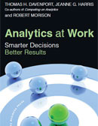
Conditions that Lead to Analytics-based Organizations
The nature of the industry
Seizing an opportunity
Responding to a problem
Notes:
There are several reasons that some companies are heavily committed to analytics – the nature of the industry in which they compete, an opportunity, or a critical business problem.
Tom Davenport in his books, Competing on Analytics (with Jeanne G. Harris) and Analytics at Work (with Jeanne G. Harris and Robert Morison), has shown how a variety of companies are benefiting from analytics.

Slide 13
Complex Systems
Tackle complex problems and provide individualized solutions
Products and services are organized around the needs of individual customers
Dollar value of interactions with each customer is high
There is considerable interaction with each customer
Examples: IBM, World Bank, Halliburton
Notes:
Companies that operate complex systems use analytics, but they are less reliant of analytics to achieve competitive advantage.

Slide 14
Volume Operations
Serves high-volume markets through standardized products and services
Each customer interaction has a low dollar value
Customer interactions are generally conducted through technology rather than person-to-person
Are likely to be analytics-based
Examples: Amazon.com, eBay, Hertz
Notes:
Analytics are critical to high volume companies competing in the marketplace.

Slide 15
The nature of the industry: Online Retailers
BI Applications
Analysis of clickstream data
Customer profitability analysis
Customer segmentation analysis
Product recommendations
Campaign management
Pricing
Forecasting
Dashboards
Online retailers like Amazon.com and Overstock.com are great examples of high volume operations who rely on analytics to compete. As soon as you enter, their sites a cookie is placed on your PC and all clicks are recorded. Based on your clicks and any search terms, recommendation engines decide what products to display. After you purchase an item, they have additional information that is used in marketing campaigns. Customer segmentation analysis is used in deciding what promotions to send you. How profitable you are influences how the customer care center treats you. A pricing team helps set prices and decides what prices are needed to clear out merchandise. Forecasting models are used to decide how many items to order for inventory. Dashboards monitor all aspects of organizational performance
Notes:
Online retailers like Amazon.com and Overstock.com are great examples of high volume operations who rely on analytics to compete. As soon as you enter, their sites a cookie is placed on your PC and all clicks are recorded. Based on your clicks and any search terms, recommendation engines decide what products to display. After you purchase an item, they have additional information that is used in marketing campaigns. Customer segmentation analysis is used in deciding what promotions to send you. How profitable you are influences how the customer care center treats you. A pricing team helps set prices and decides what prices are needed to clear out merchandise. Forecasting models are used to decide how many items to order for inventory. Dashboards monitor all aspects of organizational performance.

Slide 16
“We are a business intelligence company”
Patrick Byrne,
CEO, Overstock.com
Notes:
When I interviewed Patrick Byrne and asked him to describe Overstock.com, I expected him to say it was an “online retailer” or perhaps an “information-based company”. Instead, he said that it is a “business intelligence company”. That is how Overstock.com competes in the marketplace, as does other large online retailers.

Slide 17
Seizing an Opportunity: Harrah’s
In 1993, the gaming laws changed
Harrah’s decided to compete and expand using a brand and customer loyalty strategy
Offered the industry’s first customer loyalty program, Total Rewards
Key to this new model was analytics using an operational store and a data warehouse.
It allowed Harrah’s to perform analytics in order to know who its customers are, where they gamble, what games they play, their profitability, and what offers to make to get them to return.
Notes:
Harrah’s was originally the “blue collar” casino where everyone knew your name. When the gaming laws changed, Harrah’s adopted a new business model that included expansion, creating a brand identity, and the industry’s first loyalty program, Total Rewards. Gary Loveman, a Harvard marketing professor, was brought in to drive this new business strategy. Key to this new model was analytics using an operational store and a data warehouse. It allowed Harrah’s to perform analytics in order to know who its customers are, where they gamble, what games they play, their profitability, and what offers to make to get them to return.

Slide 18
Seizing an Opportunity: Harrah’s
The managers of the Harrah’s properties used to run their casinos as private fiefdoms and decisions were made based on “Harrahisms” – things that were just assumed to be true.
With the new business model, decision making became much more centralized and was based on constant experimentation of what worked best (i.e., fact based decision making).
The success of this approach is seen in Harrah’s now being the largest gaming company in the world. The “blue collar” casino bought the more upscale Caesars in 2004 and changed its corporate name to Caesars in 2010.
Many of the people who were successful with Harrah’s original uses of analytics were hired by other casinos and spread the use of analytics throughout the gaming industry.
Notes:
The managers of the Harrah’s properties used to run their casinos as private fiefdoms and decisions were made based on “Harrahisms” – things that were just assumed to be true. With the new business model, decision making became much more centralized and was based on constant experimentation of what worked best (i.e., fact based decision making). The success of this approach is seen in Harrah’s now being the largest gaming company in the world. The “blue collar” casino bought the more upscale Caesars in 2004 and changed its corporate name to Caesars in 2010. Quite a success story. Many of the people who were successful with Harrah’s original uses of analytics were hired by other casinos and spread the use of analytics throughout the gaming industry.

Slide 19
The right analytical tools
Notes:
Most organizations’ BI environments are designed to support descriptive BI. As organizations go into predictive analytics and expand the types of data they analyze, it is necessary to add analysis tools and technologies to their analytics’ architecture. Traditional BI tools and predictive analytics are very synergistic, however. BI tools are very useful in understanding the data and thinking about relationships before using predictive analytics. Data visualization tools are very useful in helping interpret the output for predictive analytics models.
While you may want to standardize on a single of a few advanced analytics tools, modelers often have preferences for specific tools they are familiar with and are well suited for a specific task. They also like to experiment with new ones, often from the open-source community. It is a balancing act between the benefits of standardization and getting the best tool for the task at hand.

Slide 20
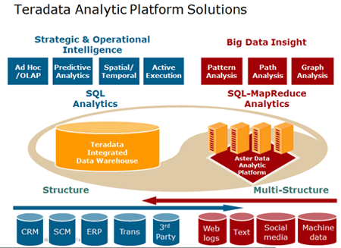
New tools and architectures may be needed
Notes:
While traditional BI vendors claim their tools support data mining/predictive analytics, this is often not true. Slicing and dicing and data visualization are not data mining. Data mining requires tools that incorporate algorithms and processes that are designed specifically to find hidden relationships in data. SAS and SPSS are two of the traditional leaders in this space. R is a programming language and software environment for statistical computing and graphics and is now the most popular tool used by data miners. It is also at the core of many open source products. As organizations expand their analytics to include multi-structured data for applications such as sentiment analysis, organizations are adding to their architectures with new advances such as Hadoop/MapReduce. They also are turning to analytical sandboxes, in-memory analytics, and analytical appliances to provide an analytics environment and power that data scientists need. It should also be remembered that exploring, preparing, and combining data is often required prior to running a predictive analytics algorithm and the tools should support this requirement. The ability to score based on the results of predictive modeling is important for many applications, such as customer credit.

Slide 21
Strong analytical personnel in an appropriate organizational structure
A 2011 Bloomberg BusinessWeek study found that many organizations lack the proper analytical talent. With proper training some of the existing personnel will be able to accept the challenge, at least for more structured analytics supported by appropriate software. Most of the large vendors, such as IBM and SAS, offer training on their products. For the “rocket science” work, new personnel will often have to be brought in, either through hires or professional services. This was the case at both Harrah’s and First American.
Notes:
The use of advanced analytics will require new skills. A 2011 Bloomberg BusinessWeek study found that many organizations lack the proper analytical talent. With proper training some of the existing personnel will be able to accept the challenge, at least for more structured analytics supported by appropriate software. Most of the large vendors, such as IBM and SAS, offer training on their products. For the “rocket science” work, new personnel will often have to be brought in, either through hires or professional services. This was the case at both Harrah’s and First American.
Another option is to outsource your analytics to providers such as Mu Sigma and Apollo Data Technologies. Companies that take this approach don’t have to invest time and money in hiring, training, and organizing their own analytic teams. On the other hand, companies may not feel comfortable turning their data to a third party and it can get expensive if there is a lot of analytics work to be done.

Slide 22
Knowledge Requirements for Advanced Analytics
Business Domain
Modeling
Data
Choosing the right data to include in models is important. Predictive analytics should not be searching for a diamond in a coal mine. You will get too many spurious findings. Rather, it is important have some thoughts as to what variables might be related. And once you have findings, domain knowledge is necessary to understand how they can be used. Consider the story of the relationship between beer and diapers in the market basket of young males in convenience stores. You still have to decide (or experiment to discover) whether it is better to put them together or spread them across the store (in the hope that other things will be bought while walking the isles).
Notes:
Analytics requires an understanding of what data is available, how to access it, and how to manipulate it. Data is necessary for first building models and later testing them. Choosing the right data to include in models is important. Predictive analytics should not be searching for a diamond in a coal mine. You will get too many spurious findings. Rather, it is important have some thoughts as to what variables might be related. And once you have findings, domain knowledge is necessary to understand how they can be used. Consider the hoary story of the relationship between beer and diapers in the market basket of young males in convenience stores. You still have to decide (or experiment to discover) whether it is better to put them together or spread them across the store (in the hope that other things will be bought while walking the isles). Domain knowledge is important here. And finally, it is necessary to understand the models being used. At a minimum, this requires training in multivariate statistics.

Slide 23
Business Analyst
Uses BI tools and applications to understand business conditions and drive business processes
Notes:
Because of the need for predictive analytics, companies want their business analysts to move more into this application area. Vendors have responded to this demand in various ways. They are providing more user-friendly graphical interfaces and automating the process of building models. Some products build multiple models using different algorithms and suggest which one is best based on the data. Training is critical to upgrade the skills of the business analysts. Other vendors are offering predictive analytics using the software as a service model. While these advances help, for the work that requires a deep understanding of statistics, a data scientist is needed.
Big Data and Hadoop/MapReduce will also create a demand for people with specialized skills.

Slide 24
Data Scientist
Uses advanced algorithms and interactive exploration tools to uncover non-obvious patterns in data
Data scientists have advanced training in multivariate statistics, artificial intelligence, machine learning, mathematical programming, and simulation to perform predictive and prescriptive analytics. They often hold advanced degrees, including PhDs in econometrics, statistics, mathematics, and management science. You don’t need a lot of them, but for some of the really advanced work, they come in very handy. Be prepared to pay top dollar for them, though. A number of universities are ramping up to meet the demand, such as the new Master of Science in Analytics at North Carolina State University.
Notes:
The data scientist title is taking hold, even though it sounds elitist . Data scientists have advanced training in multivariate statistics, artificial intelligence, machine learning, mathematical programming, and simulation to perform predictive and prescriptive analytics. They often hold advanced degrees, including PhDs in econometrics, statistics, mathematics, and management science. You don’t need a lot of them, but for some of the really advanced work, they come in very handy. Be prepared to pay top dollar for them, though. A number of universities are ramping up to meet the demand, such as the new Master of Science in Analytics at North Carolina State University.

