Slide 1
Database Fundamentals
CSC105
Furman University
Peggy Batchelor

Slide 2
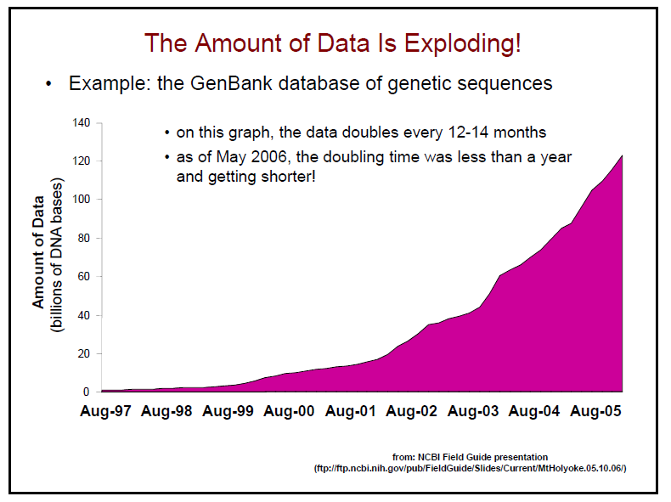

Slide 3
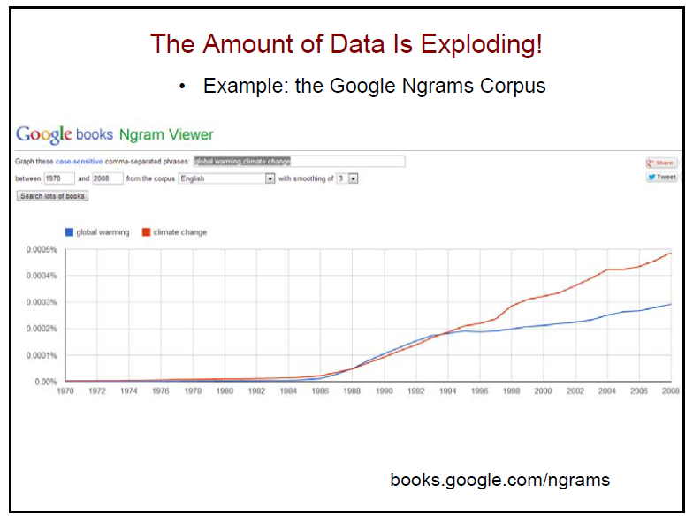

Slide 4
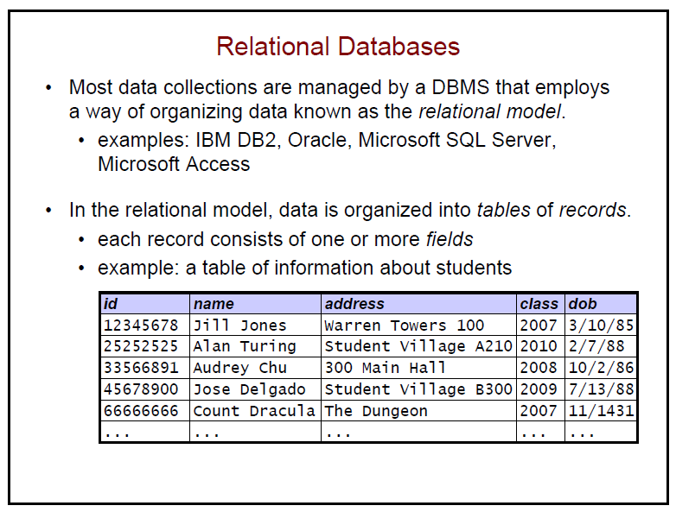

Slide 5
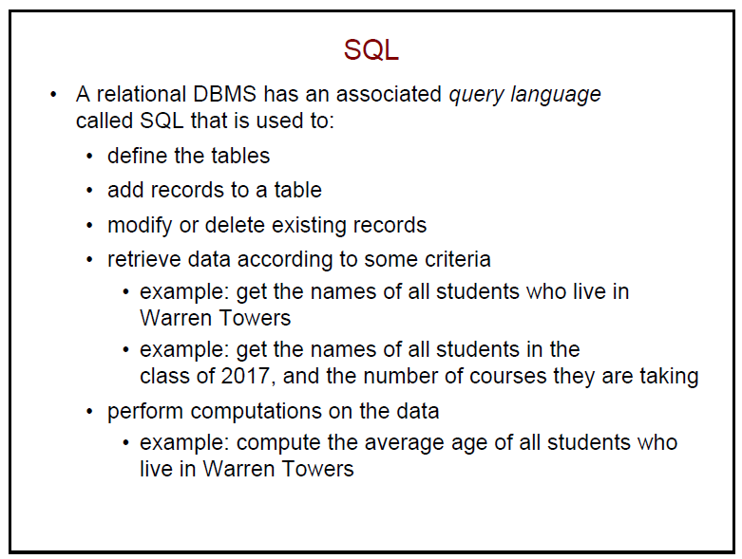

Slide 6
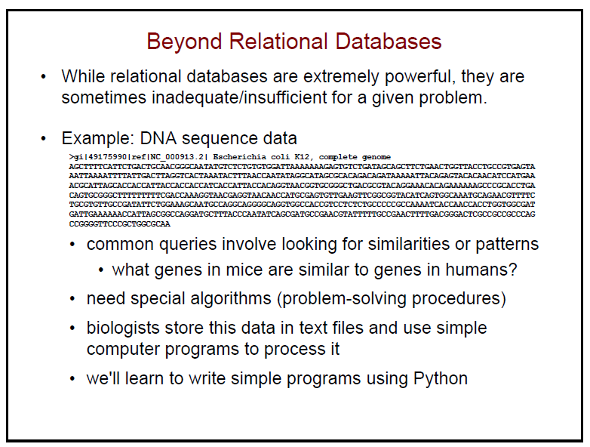

Slide 7
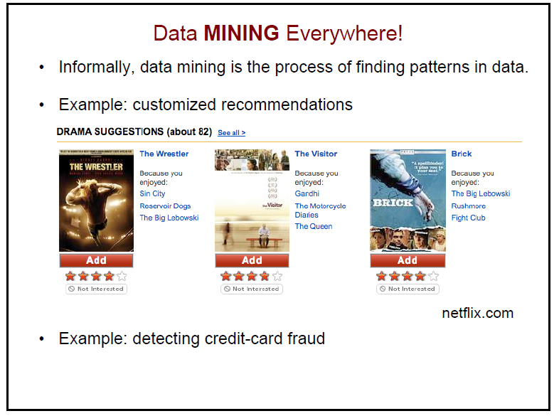

Slide 8
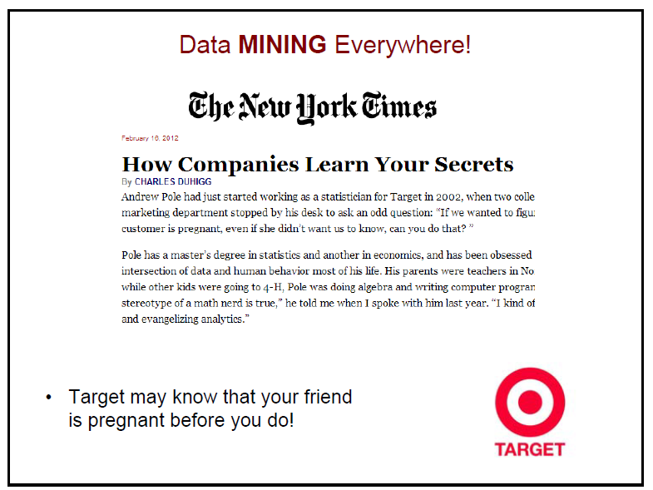

Slide 9
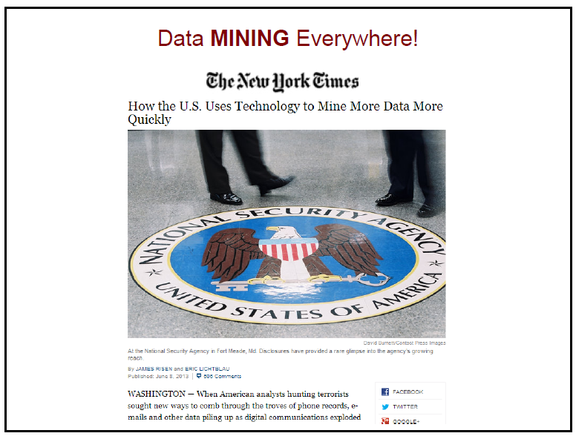

Slide 10
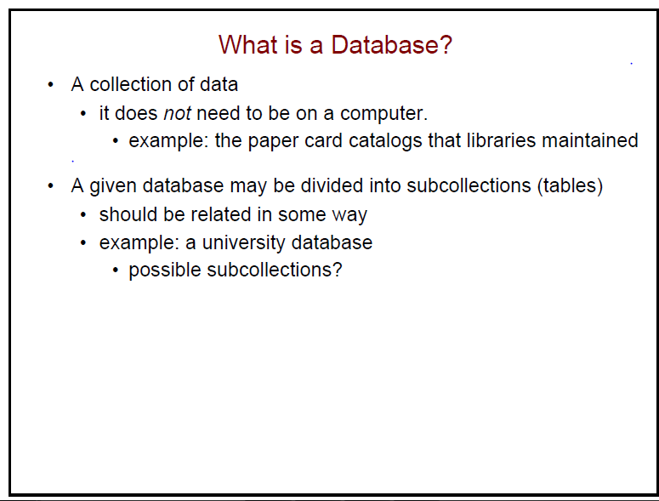

Slide 11
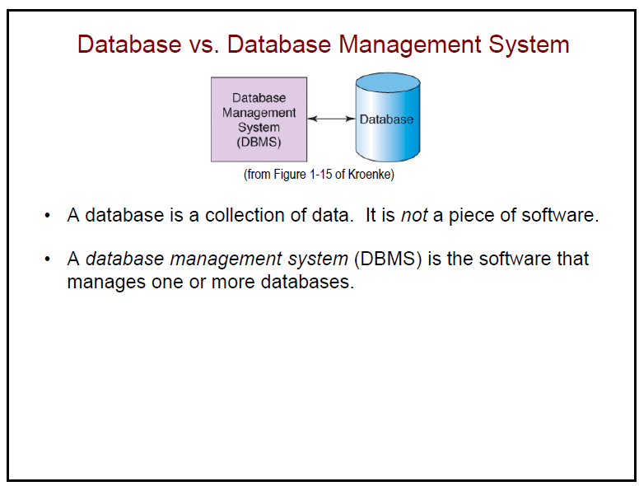

Slide 12
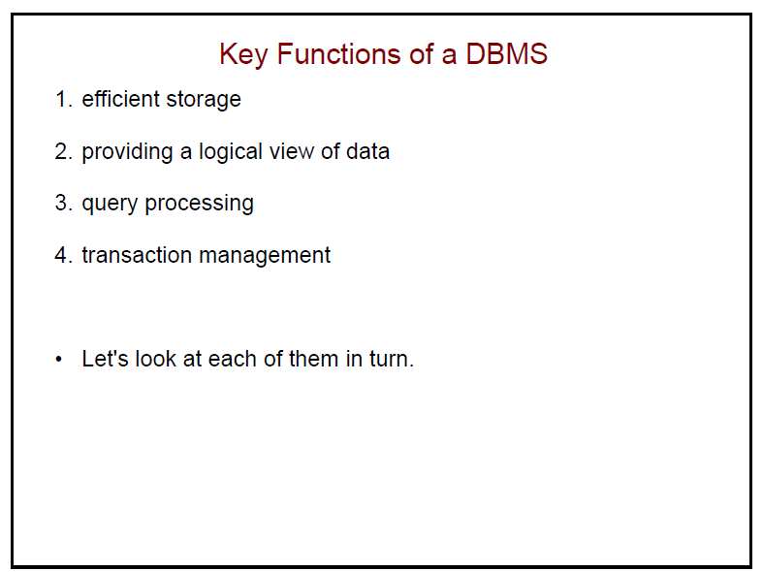

Slide 13
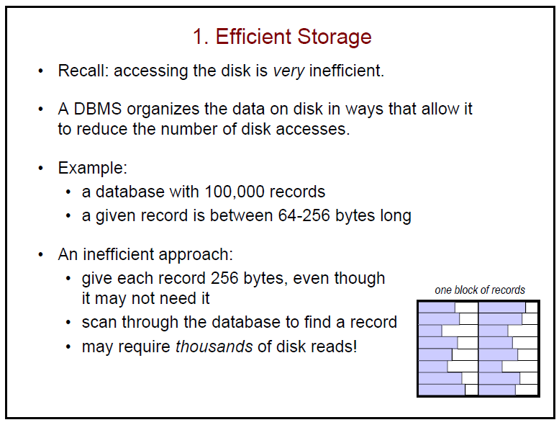

Slide 14
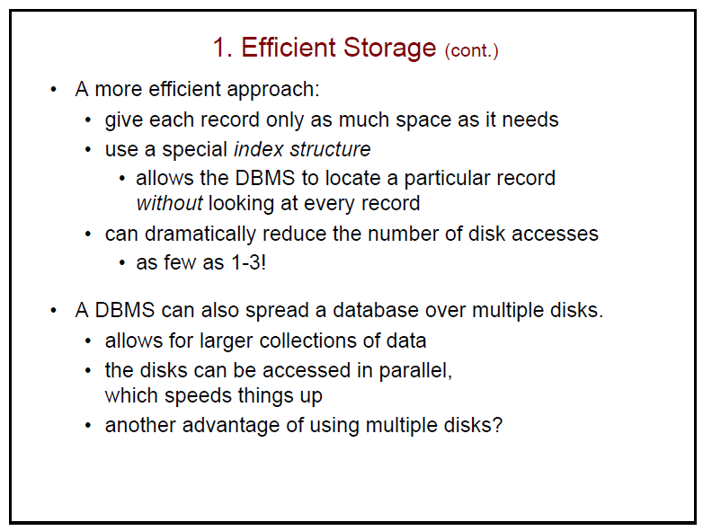

Slide 15
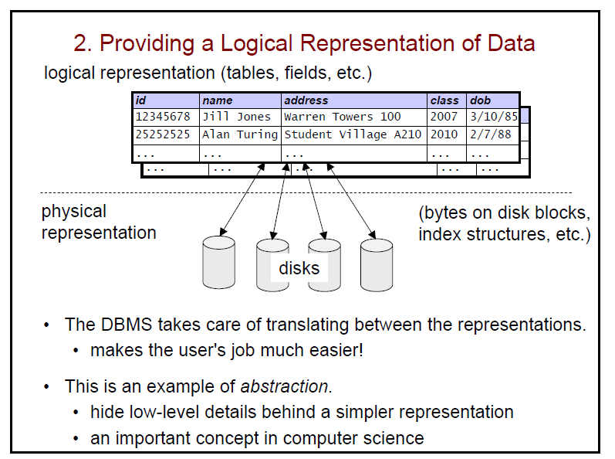

Slide 16
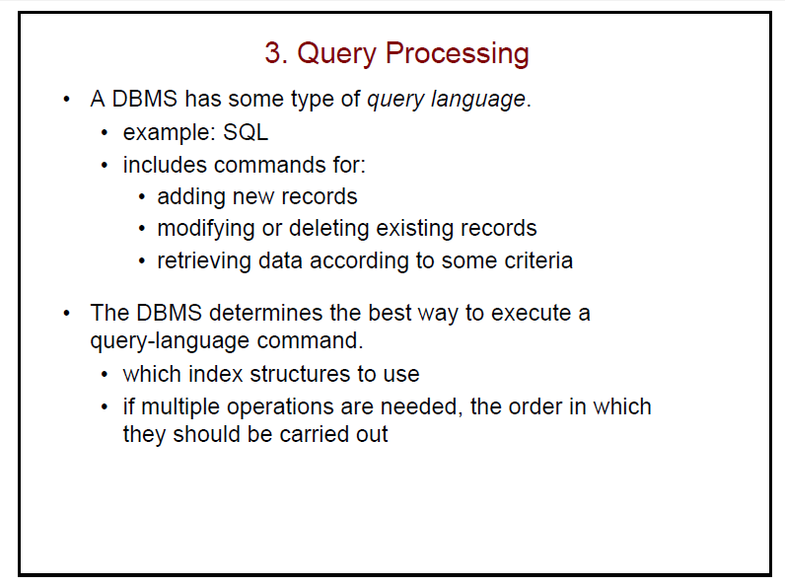

Slide 17
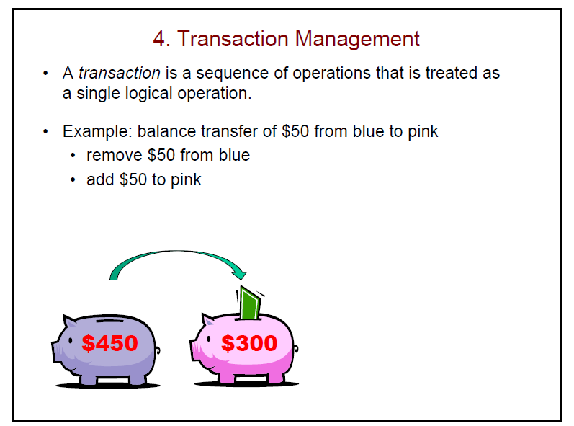


Slide 18
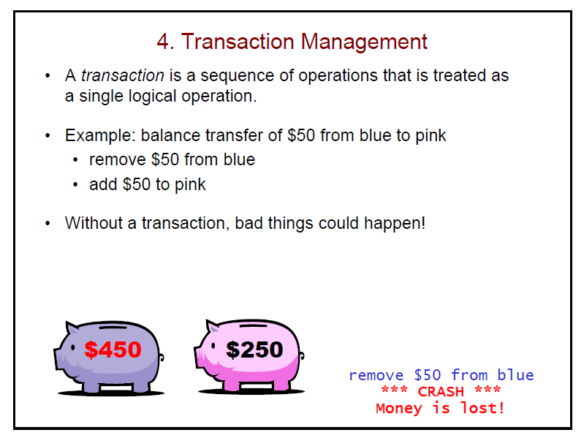

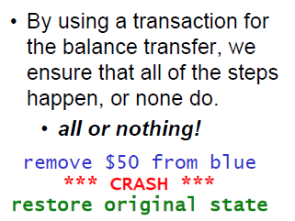

Slide 19
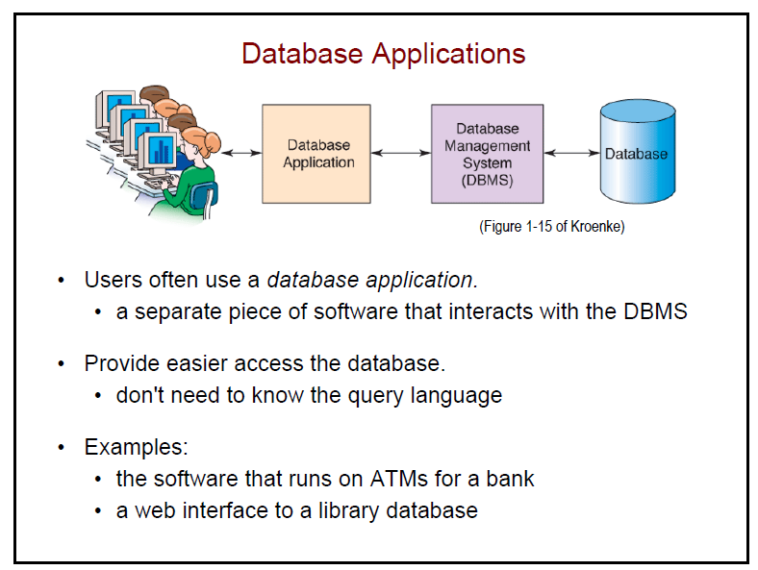

Slide 20
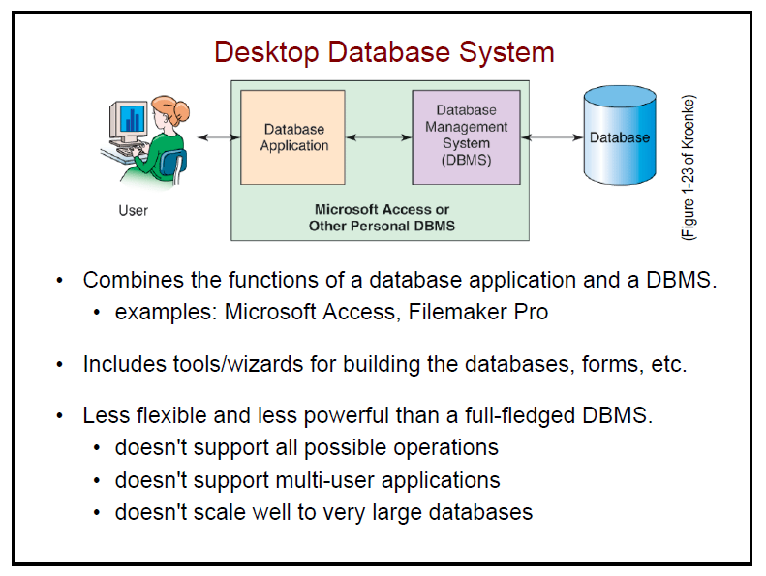

Slide 21
The Relational Model

Slide 22
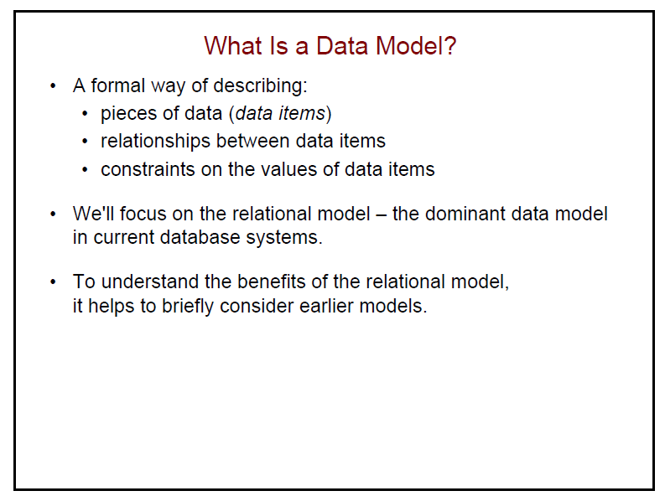

Slide 23
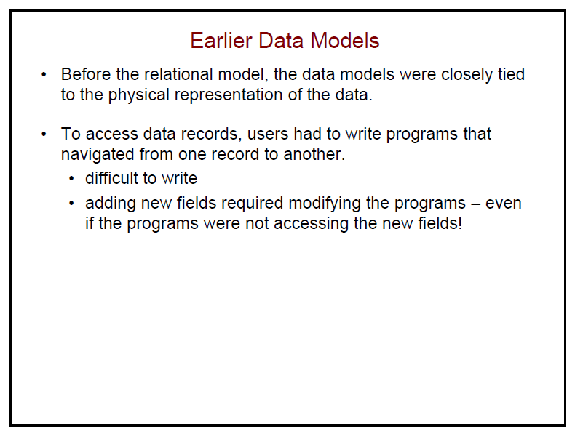
  Data redundancy:
    Presence of duplicate data in multiple files
  Data inconsistency:
    Same attribute has different values
  Program-data dependence:
    When changes in program requires changes to data accessed by program
  Lack of data sharing and availability

Slide 24
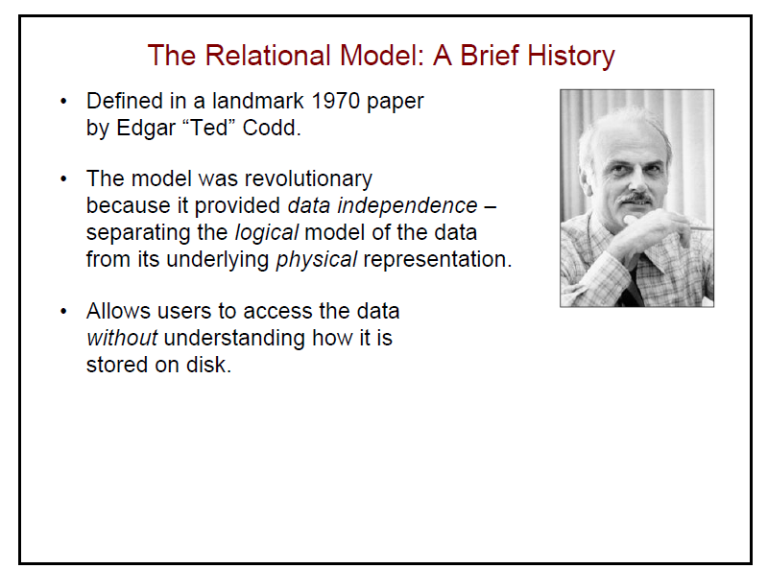

Slide 25
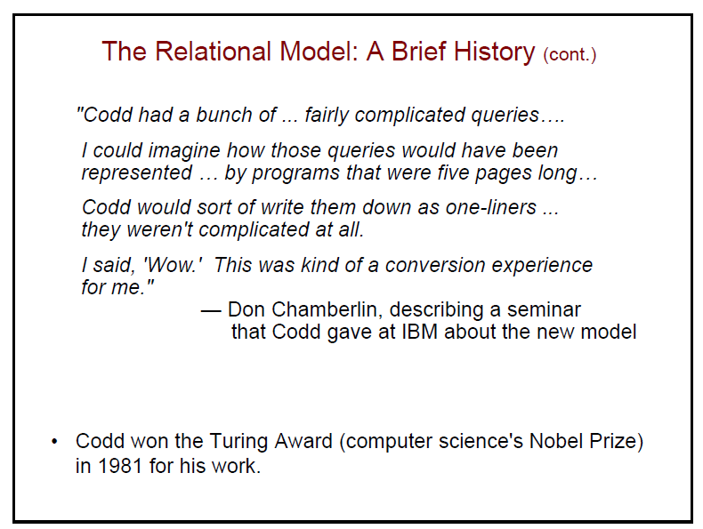

Slide 26
Organizing Data in a Traditional File Environment
File organization concepts
  Database: Group of related files
  File: Group of records of same type
  Record: Group of related fields
  Field: Group of characters as word(s) or number
    Describes an entity (person, place, thing on which we store information)
    Attribute: Each characteristic, or quality, describing entity
      Example: Attributes DATE or GRADE belong to entity COURSE
Notes:
This slide describes a hierarchy of data that is used to store information in a database, progressing from the database as the top-level holder of information down through the field, which stores information about an entity’s attribute. This hierarchy is illustrated by the graphic on the next slide. Ask students to come up with some other entities that might be found in a university database (Student, Professor, etc.). What attributes (characteristics) would be important to store in the database?

Slide 27
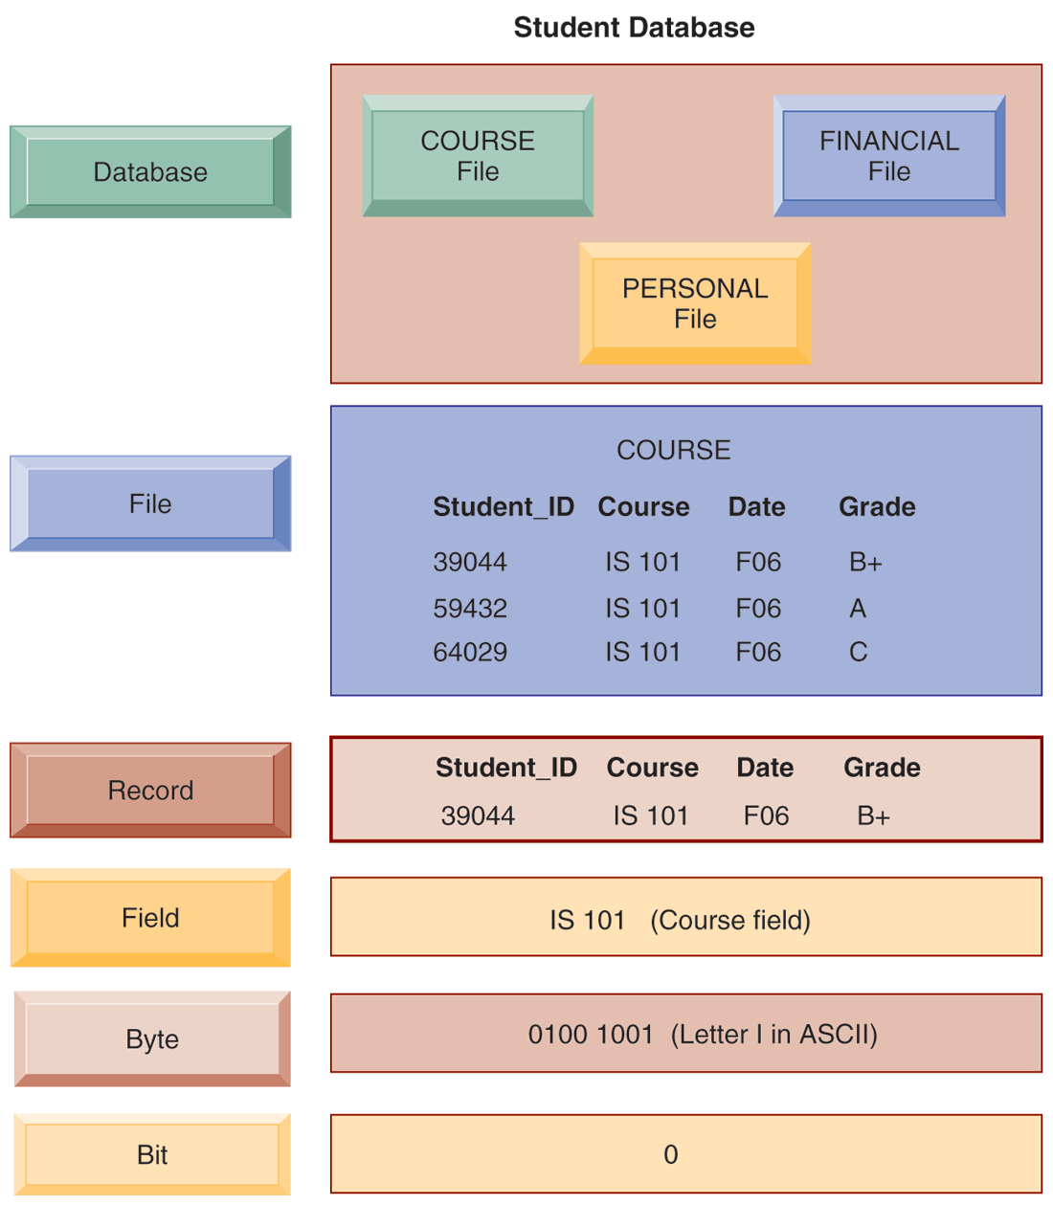
THE DATA HIERARCHY
A computer system organizes data in a hierarchy that starts with the bit, which represents either a 0 or a 1. Bits can be grouped to form a byte to represent one character, number, or symbol. Bytes can be grouped to form a field, and related fields can be grouped to form a record. Related records can be collected to form a file, and related files can be organized into a database.
FIGURE 6-1
Notes:
This graphic illustrates the hierarchy of data found in a database. It shows the student course file grouped with files on students’ personal histories and financial backgrounds that form the student database. It illustrates what data is found at each hierarchical level, from the database level down. Making up the smallest information unit, the field, are smaller units of data, common to all applications: bits and bytes. A bit stores a single binary digit, 0 or 1, and a byte stores a group of digits to represent a single character, number, or other symbol.

Slide 28
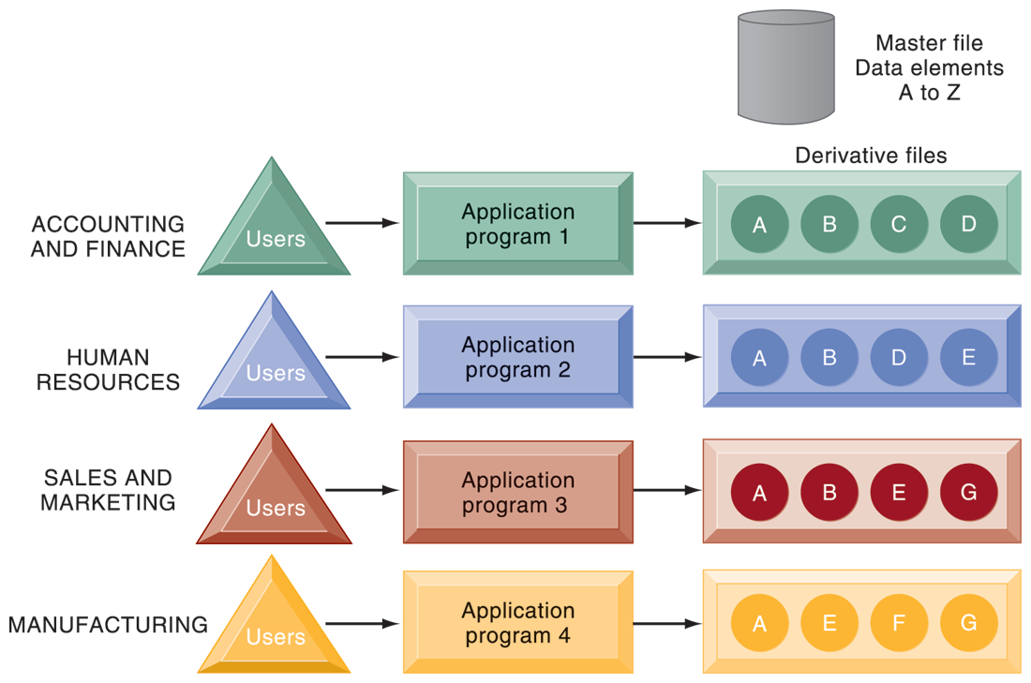
TRADITIONAL FILE PROCESSING
The use of a traditional approach to file processing encourages each functional area in a corporation to develop specialized applications. Each application requires a unique data file that is likely to be a subset of the master file. These subsets of the master file lead to data redundancy and inconsistency, processing inflexibility, and wasted storage resources.
FIGURE 6-2
Notes:
This graphic illustrates a traditional environment, in which different business functions maintain separate data and applications to store and access that data. Ask students what kinds of data might be shared between accounting/finance and HR. What about between sales and marketing and manufacturing?

Slide 29
The Database Approach to Data Management
Database
  Serves many applications by centralizing data and controlling redundant data
Database management system (DBMS)
  Interfaces between applications and physical data files
  Separates logical and physical views of data
  Solves problems of traditional file environment
    Controls redundancy
    Eliminates inconsistency
    Uncouples programs and data
    Enables organization to central manage data and data security
Notes:
This slide defines and describes databases and DBMS. Ask students to explain what the difference is between a database and a DBMS. What is the physical view of data? What is the logical view of data?

Slide 30
The Database Approach to Data Management
Relational DBMS
  Represent data as two-dimensional tables
  Each table contains data on entity and attributes
Table: grid of columns and rows
  Rows (tuples): Records for different entities
  Fields (columns): Represents attribute for entity
  Key field: Field used to uniquely identify each record
  Primary key: Field in table used for key fields
  Foreign key: Primary key used in second table as look-up field to identify records from original table
Notes:
This slide introduces the most common type of DBMS in use with PCs, servers, and mainframes today, the relational database. Ask students why these DBMS are called relational. Ask students for examples of RDBMS software popular today and if they have every used any of this software. You can walk students through an example database that you have prepared in Access or use one of the exercise data tables found at the end of the chapter. Identify rows, fields, and primary key.

Slide 31
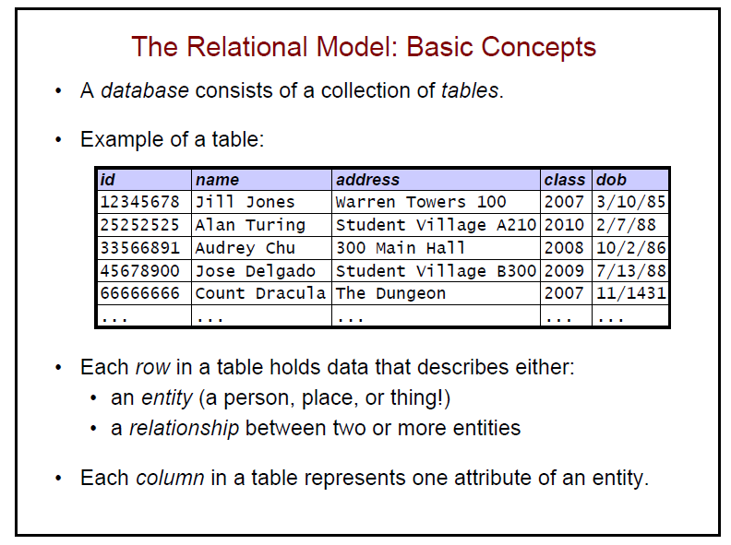

Slide 32
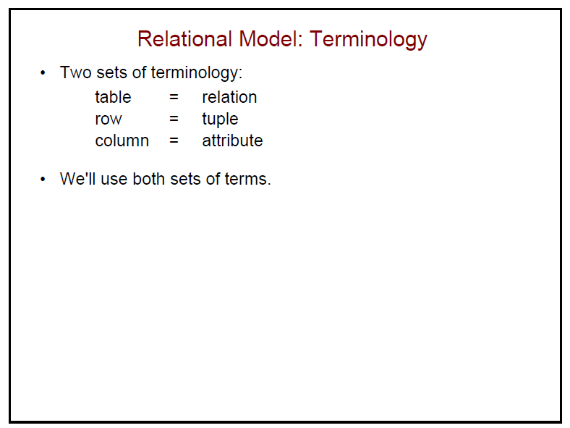

Slide 33
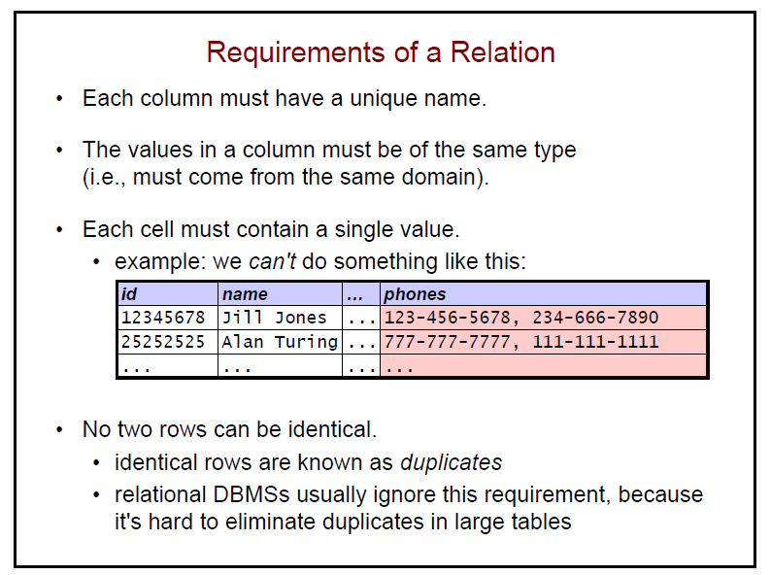

Slide 34
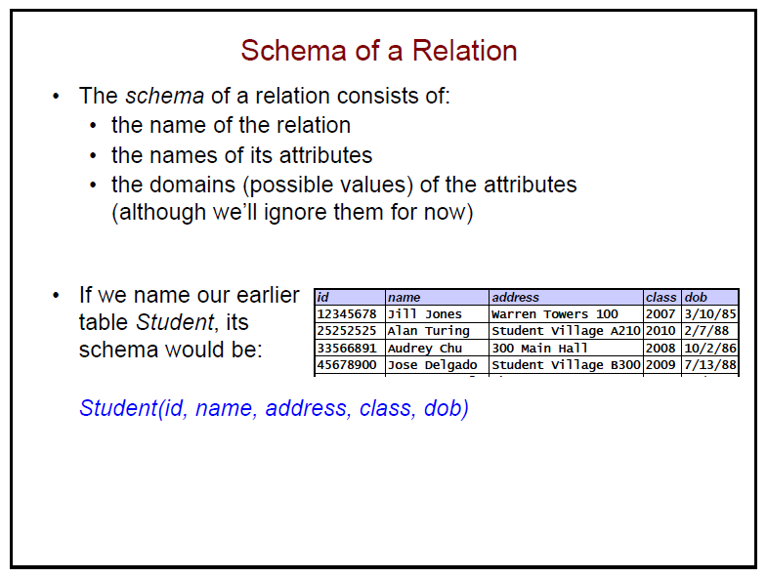

Slide 35
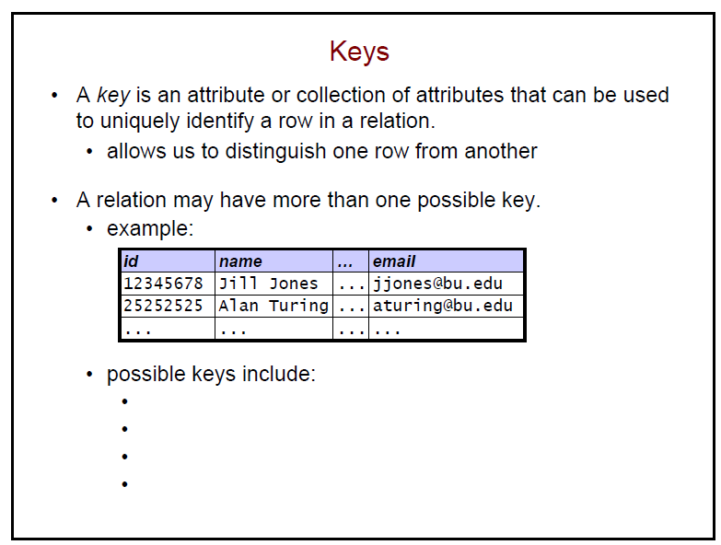

Slide 36
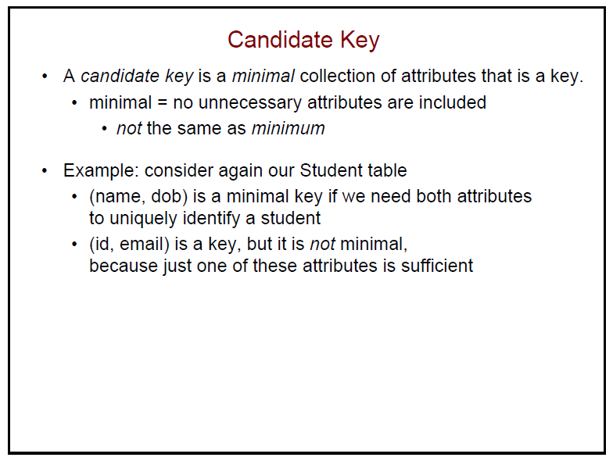

Slide 37
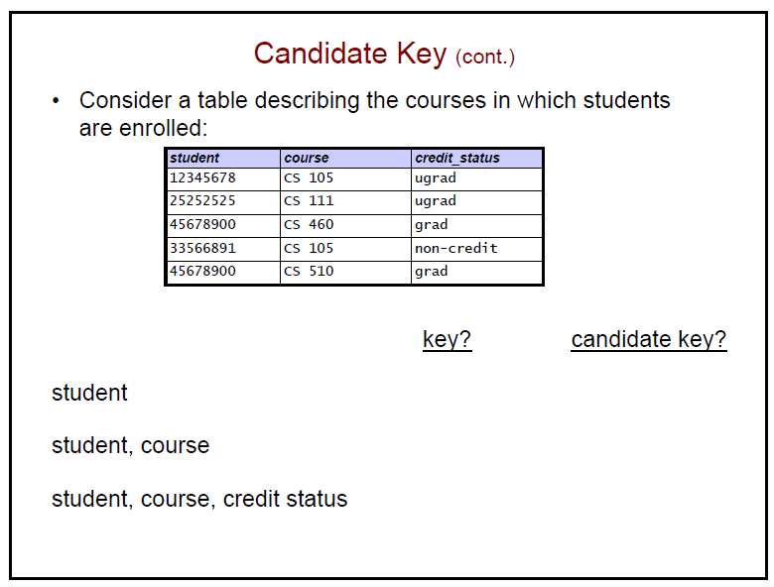

Slide 38
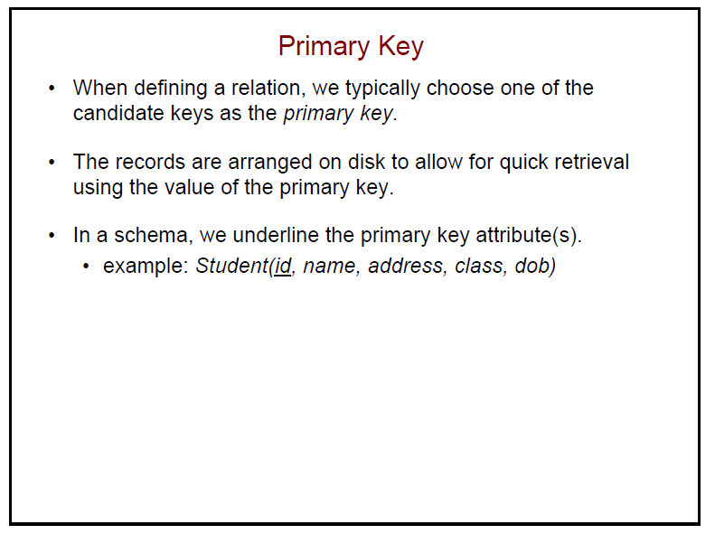

Slide 39
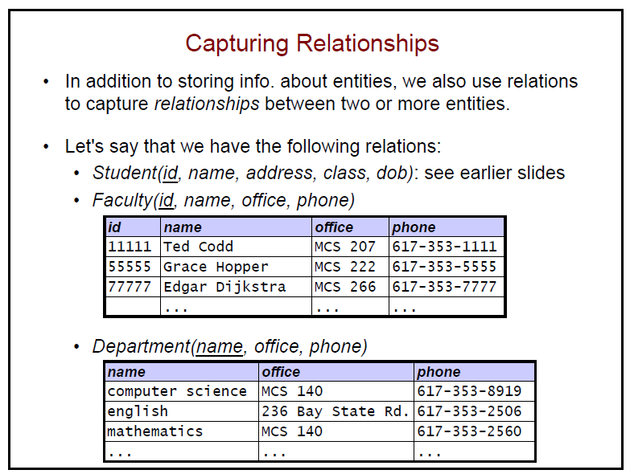

Slide 40
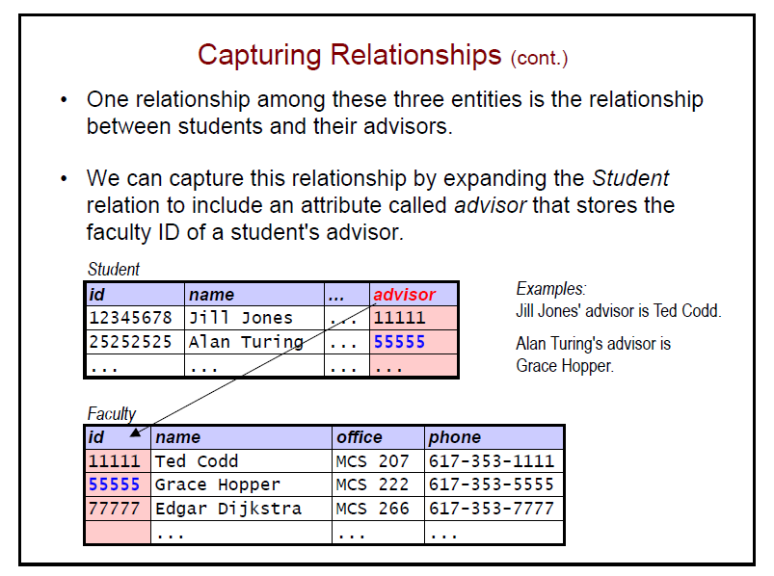

Slide 41
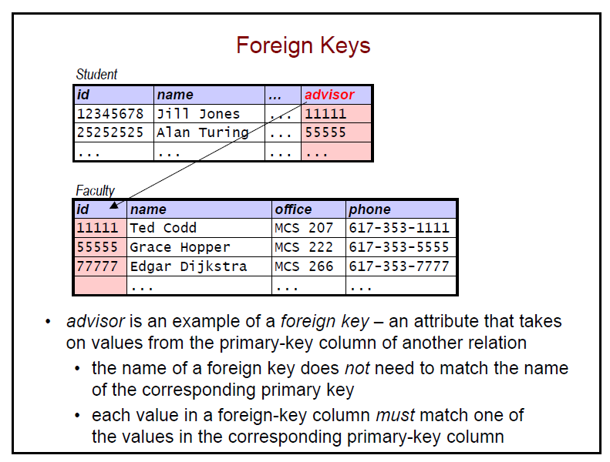

Slide 42
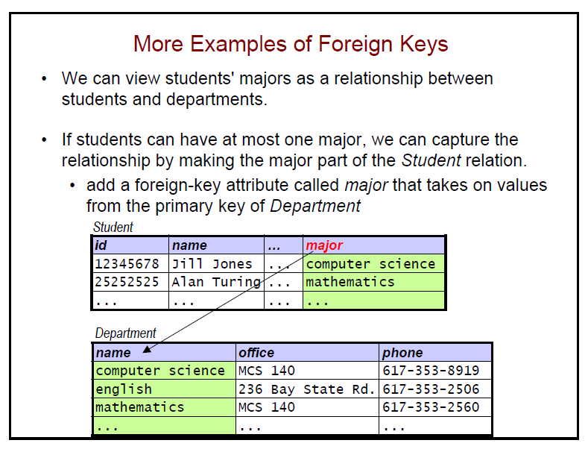

Slide 43
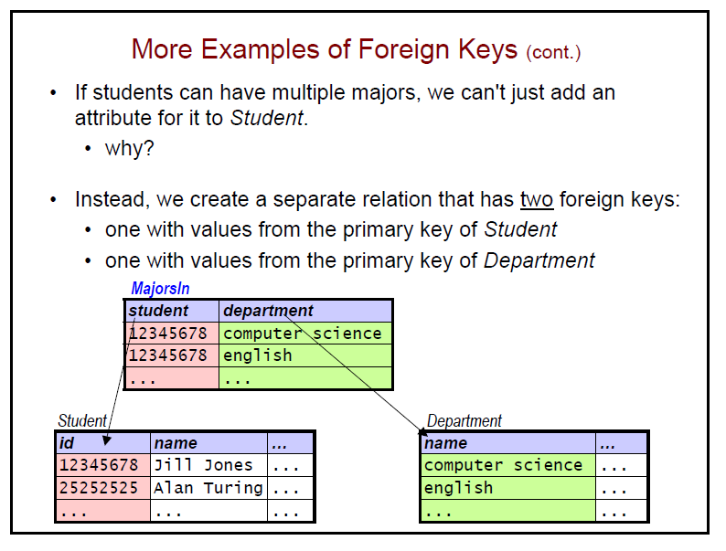

Slide 44
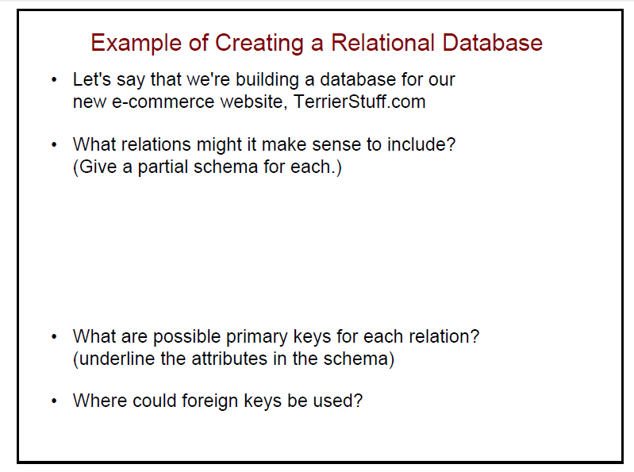

Slide 45
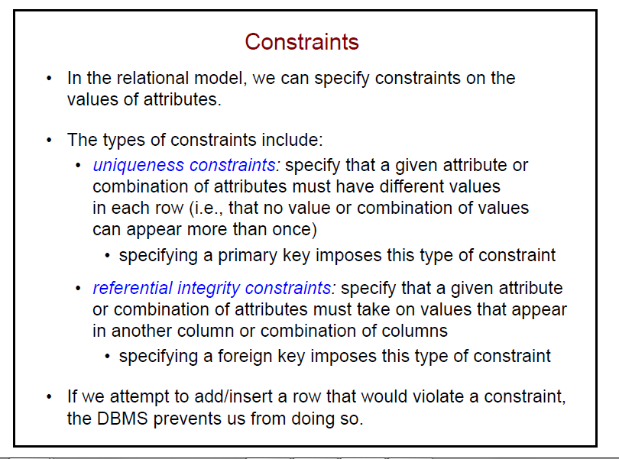

Slide 46
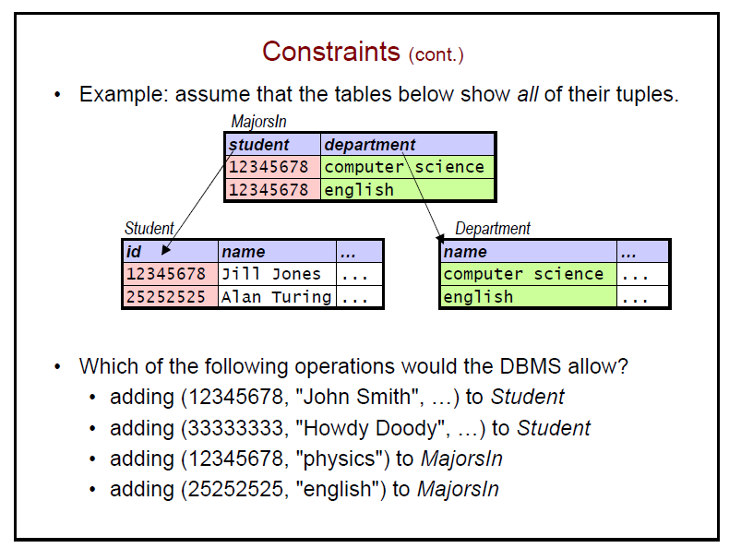

Slide 47
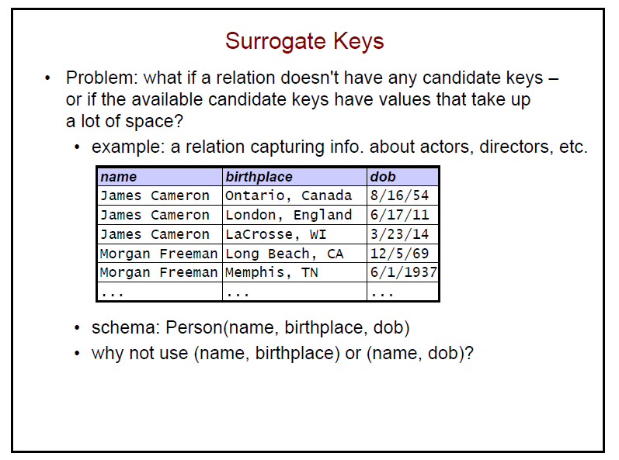

Slide 48
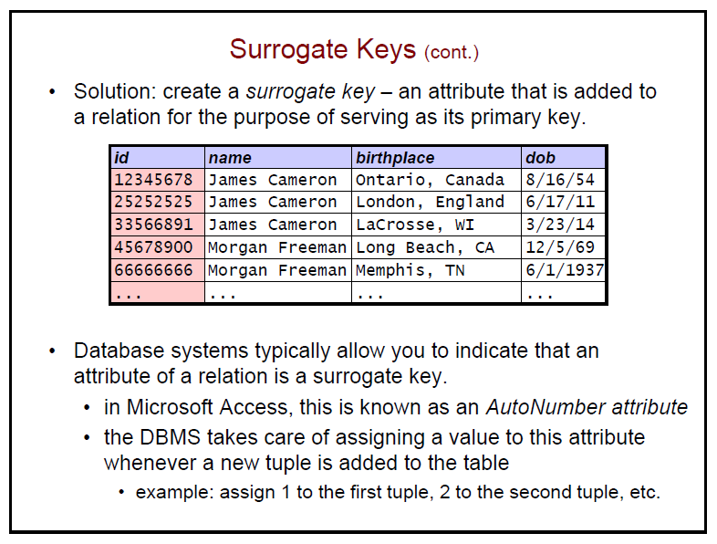

Slide 49
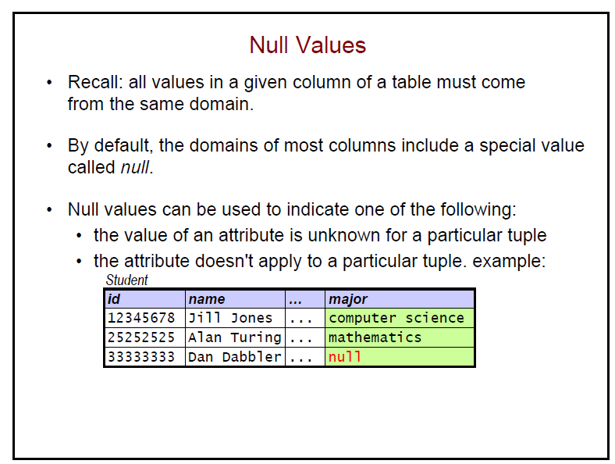

Slide 50
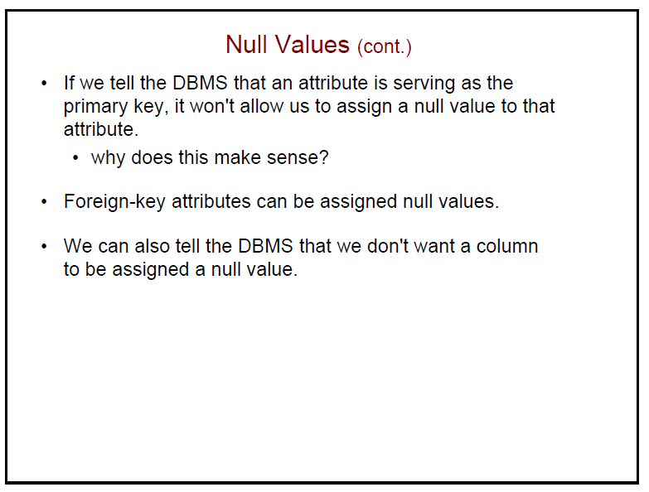

Slide 51
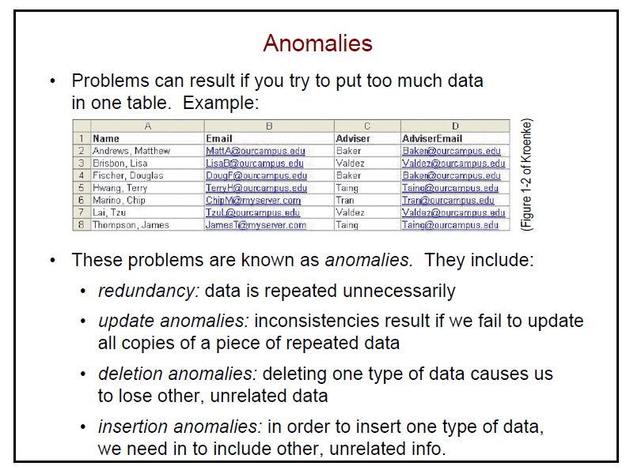

Slide 52
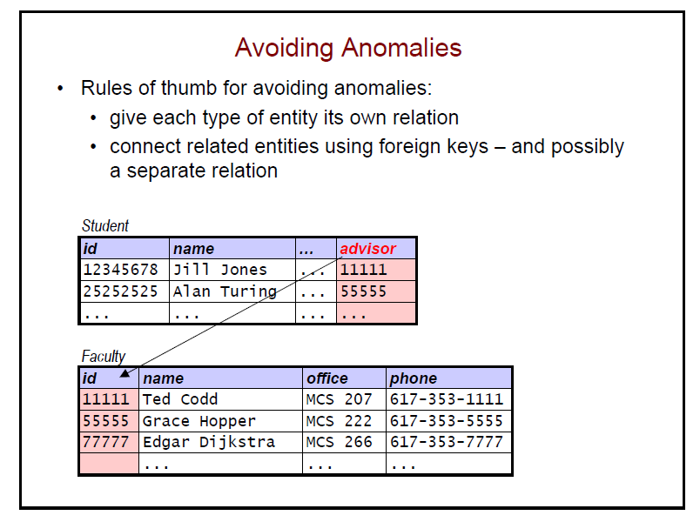

Slide 53
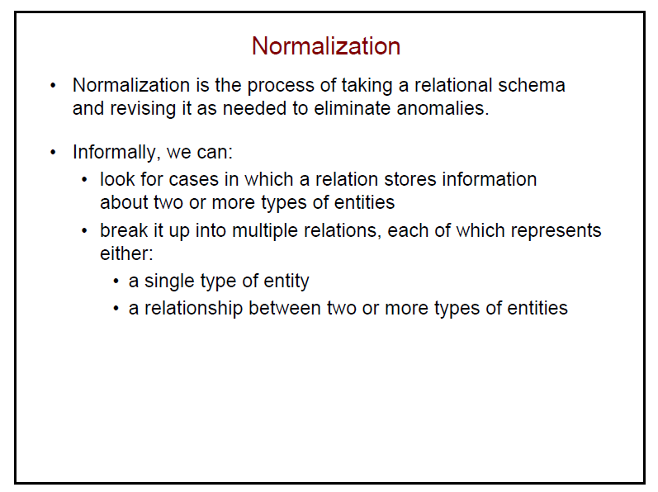

Slide 54
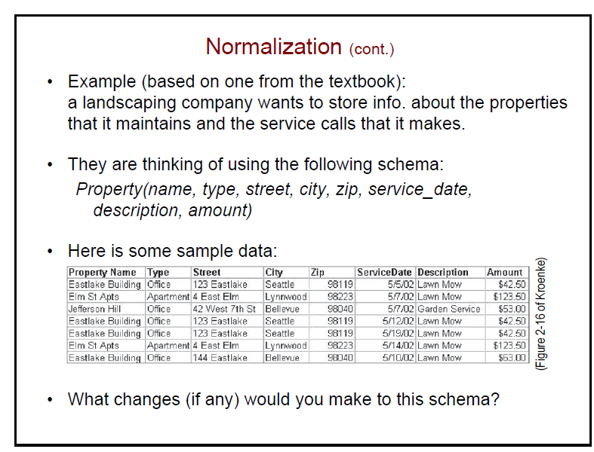

Slide 55


Slide 56


Slide 57


Slide 58


Slide 59


