Slide 1
Chapter 1: Introduction to Business Analytics
Business Analytics: Methods, Models,
and Decisions, 1st edition
James R. Evans

Slide 2
“Big Data”
A zettabyte (symbol ZB, derived from the SI prefix zetta-) is a unit of information or computer storage equal to one sextillion bytes
As of April 2012, no storage system has achieved one zettabyte of information. The combined space of all computer hard drives in the world was estimated at approximately 160 exabytes in 2006.^{[6]} This has increased rapidly however, as Seagate reported selling 330 exabytes worth of hard drives during the 2011 Fiscal Year.^{[7]} As of 2009, the entire World Wide Web was estimated to contain close to 500 exabytes.^{[8]} This is a half zettabyte.
1,000,000,000,000,000,000,000 bytes = 1000⁷ bytes = 10²¹ bytes
The term "zebibyte" (ZiB), using a binary prefix, is used for the corresponding power of 1024
Multiples of bytes
SI decimal prefixes |  | Binary usage
Name (Symbol) | Value
kilobyte (kB) | 10³ | 2¹⁰
megabyte (MB) | 10⁶ | 2²⁰
gigabyte (GB) | 10⁹ | 2³⁰
terabyte (TB) | 10¹² | 2⁴⁰
petabyte (PB) | 10¹⁵ | 2⁵⁰
exabyte (EB) | 10¹⁸ | 2⁶⁰
zettabyte (ZB) | 10²¹ | 2⁷⁰
yottabyte (YB) | 10²⁴ | 2⁸⁰

Slide 3
What is Business Analytics?
Analytics is the use of:
data,
information technology,
statistical analysis,
quantitative methods, and
mathematical or computer-based models
to help managers gain improved insight about their business operations and
make better, fact-based decisions.

Slide 4
What is Business Analytics?
Business Analytics Applications
Management of customer relationships
Financial and marketing activities
Supply chain management
Human resource planning
Pricing decisions
Sport team game strategies

Slide 5
What is Business Analytics?
Importance of Business Analytics
There is a strong relationship of BA with:
- profitability of businesses
- revenue of businesses
- shareholder return
BA enhances understanding of data
BA is vital for businesses to remain competitive
BA enables creation of informative reports

Slide 6
Scope of Business Analytics
Descriptive analytics
- uses data to understand past and present
Predictive analytics
- analyzes past performance
Prescriptive analytics
- uses optimization techniques

Slide 7
Scope of Business Analytics
Example 1.1 Retail Markdown Decisions
Most department stores clear seasonal inventory by reducing prices.
The question is:
When to reduce the price and by how much?
Descriptive analytics: examine historical data for similar products (prices, units sold, advertising, …)
Predictive analytics: predict sales based on price
Prescriptive analytics: find the best sets of pricing and advertising to maximize sales revenue

Slide 8
Data for Business Analytics
DATA
- collected facts and figures
DATABASE
- collection of computer files containing data
INFORMATION
- comes from analyzing data

Slide 9
Data for Business Analytics
Metrics are used to quantify performance.
Measures are numerical values of metrics.
Discrete metrics involve counting
- on time or not on time
- number or proportion of on time deliveries
Continuous metrics are measured on a continuum
- delivery time
- package weight
- purchase price

Slide 10
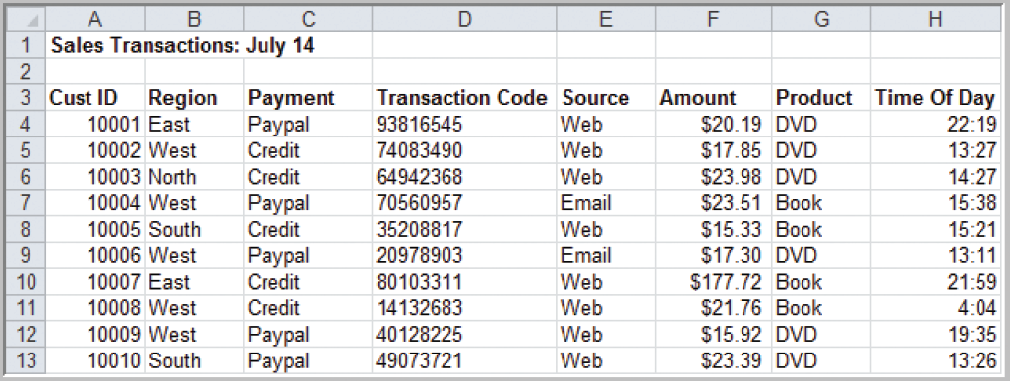
Data for Business Analytics
Example 1.2 A Sales Transaction Database File
Records
Figure 1.1
Entities
Fields or Attributes

Slide 11
Data for Business Analytics
Four Types Data Based on Measurement Scale:
Categorical (nominal) data
Ordinal data
Interval data
Ratio data

Slide 12
Data for Business Analytics
Example 1.3
Classifying Data Elements in a Purchasing Database
Figure 1.2

Slide 13
Data for Business Analytics
Example 1.3 (continued)
Classifying Data Elements in a Purchasing Database
Figure 1.2
Ratio
Ratio
Ratio
Ratio
Categorical
Categorical
Categorical
Interval
Interval
Categorical

Slide 14
Data for Business Analytics
Categorical (nominal) Data
Data placed in categories according to a specified characteristic
Categories bear no quantitative relationship to one another
Examples:
- customer’s location (America, Europe, Asia)
- employee classification (manager, supervisor,
associate)

Slide 15
Data for Business Analytics
Ordinal Data
Data that is ranked or ordered according to some relationship with one another
No fixed units of measurement
Examples:
- college football rankings
- survey responses
(poor, average, good, very good, excellent)

Slide 16
Data for Business Analytics
Interval Data
Ordinal data but with constant differences between observations
Ratios are not meaningful
Examples:
- temperature readings
- SAT scores

Slide 17
Data for Business Analytics
Ratio Data
Continuous values and have a natural zero point
Ratios are meaningful
Examples:
- monthly sales
- delivery times

Slide 18
Decision Models
Model:
An abstraction or representation of a real system, idea, or object
Captures the most important features
Can be a written or verbal description, a visual display, a mathematical formula, or a spreadsheet representation

Slide 19
Decision Models
Example 1.4 Three Forms of a Model
The sales of a new produce, such as a first-
generation iPad or 3D television, often follow a
common pattern.
Sales might grow at an increasing rate over time
as positive customer feedback spreads.
(See the S-shaped curve on the following slide.)
A mathematical model of the S-curve can be
identified; for example, S = ae^{bect}, where S is
sales, t is time, e is the base of natural logarithms,
and a, b and c are constants.
Copyright © 2013 Pearson Education, Inc.
publishing as Prentice Hall
1-23

Slide 20
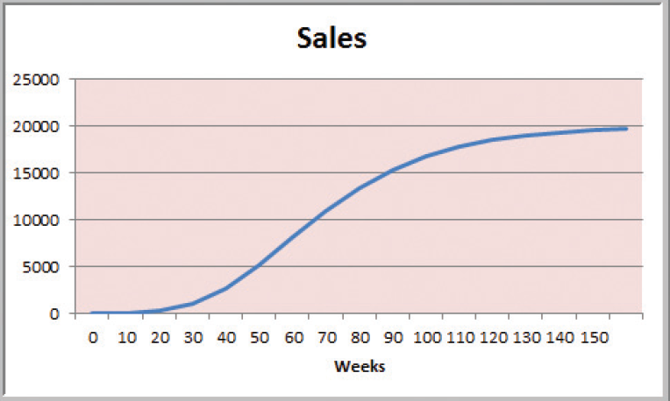
Decision Models
Figure 1.3

Slide 21
Decision Models
A decision model is a model used to understand, analyze, or facilitate decision making.
Types of model input
- data
- uncontrollable variables
- decision variables (controllable)
Types of model output
- performance measures
- behavioral measures

Slide 22
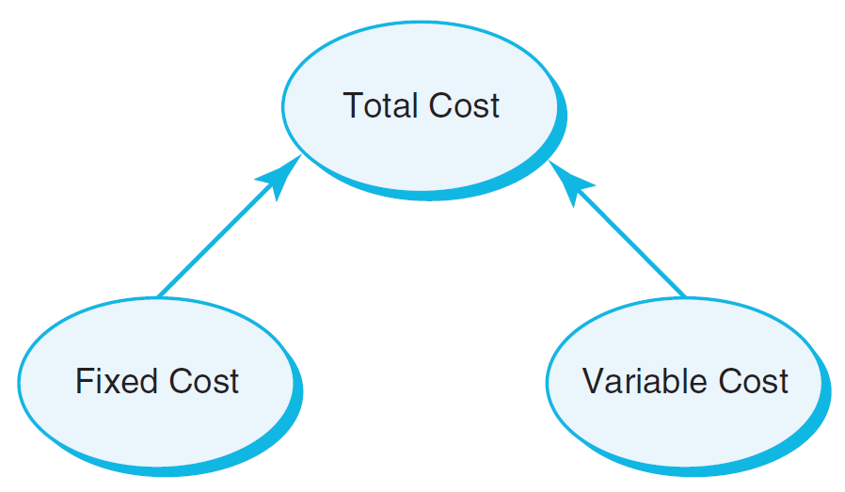
Decision Models
Descriptive Decision Models
Simply tell “what is” and describe relationships
Do not tell managers what to do
Example 1.6 An Influence Diagram for Total Cost
Influence Diagrams visually show how various model elements relate to one another.
Figure 1.5

Slide 23
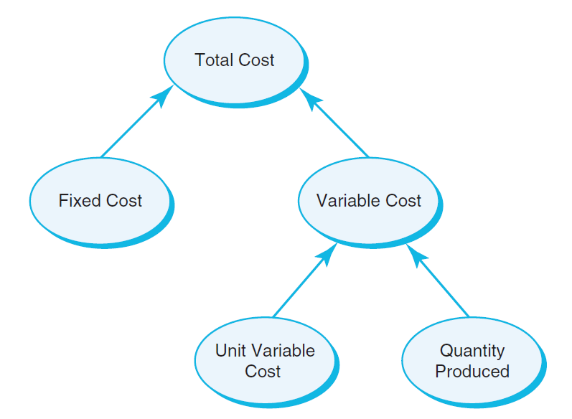
Decision Models
Example 1.7 A Mathematical Model for Total Cost
TC = F +VQ
TC is Total Cost
F is Fixed cost
V is Variable unit cost
Q is Quantity produced
Figure 1.6

Slide 24
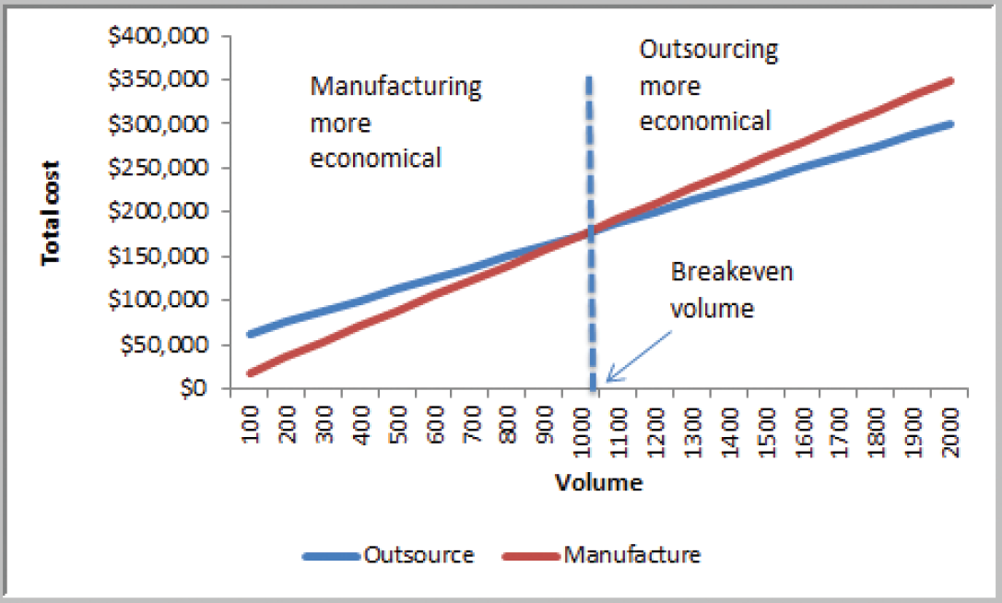
Decision Models
Example 1.8 A Break-even Decision Model
TC(manufacturing) = $50,000 + $125*Q
TC(outsourcing) = $175*Q
Breakeven Point:
Set TC(manufacturing)
= TC(outsourcing)
Solve for Q = 1000 units
Figure 1.7

Slide 25
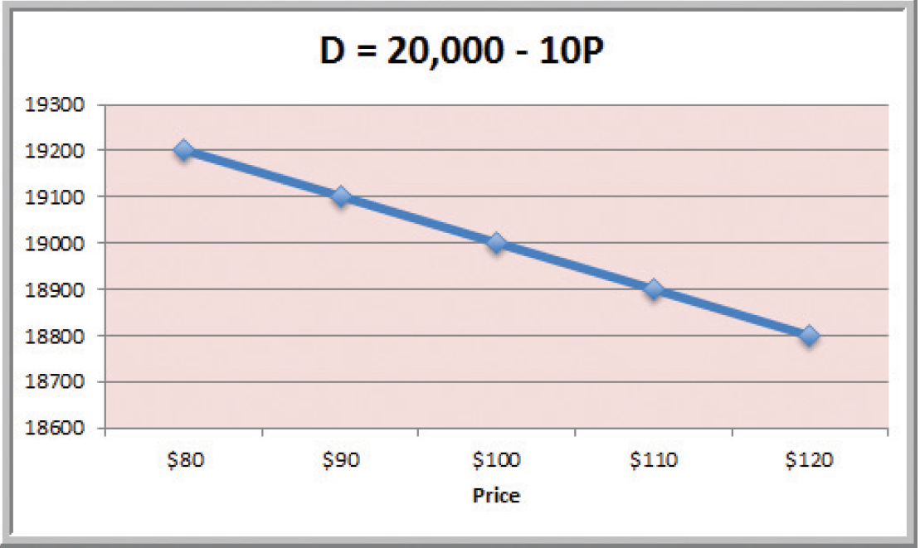
Decision Models
Example 1.9 A Linear Demand Prediction Model
As price increases, demand falls.
Figure 1.8

Slide 26
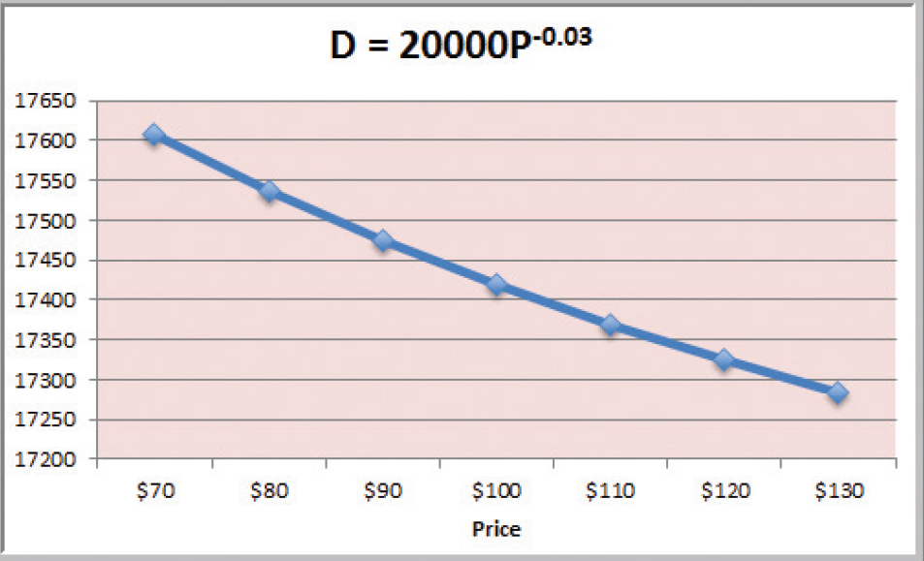
Decision Models
Example 1.10 A Nonlinear Demand Prediction Model
Assumes price elasticity (constant ratio of % change in demand to % change in price)
Figure 1.9

Slide 27
Decision Models
Predictive Decision Models often incorporate uncertainty to help managers analyze risk.
Aim to predict what will happen in the future.
Uncertainty is imperfect knowledge of what will happen in the future.
Risk is associated with the consequences of what actually happens.

Slide 28
Decision Models
Prescriptive Decision Models help decision makers identify the best solution.
Optimization - finding values of decision variables that minimize (or maximize) something such as cost (or profit).
Objective function - the equation that minimizes (or maximizes) the quantity of interest.
Constraints - limitations or restrictions.
Optimal solution - values of the decision variables at the minimum (or maximum) point.

