Slide 1
Chapter 8:
Predictive Modeling and Analysis
Business Analytics, 1st edition
James R. Evans

Slide 2
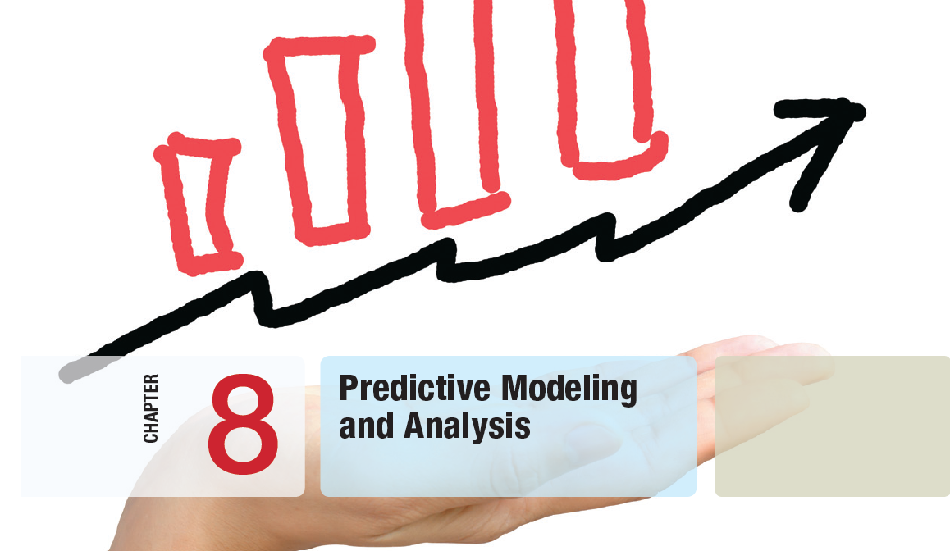

Slide 3
Chapter 8 Topics
Logic-Driven Modeling
Data-Driven Modeling
Analyzing Uncertainty and Model Assumptions
Model Analysis Using Risk Solver Platform

Slide 4
Logic-Driven Modeling
Predictive modeling is the heart and soul of business decisions.
Building decision models is more of an art than a science.
Creating good decision models requires:
- solid understanding of business functional areas
- knowledge of business practice and research
- logical skills
It is best to start simple and enrich models as necessary.

Slide 5
Logic-Driven Modeling
Example 8.1 The Economic Value of a Customer
A restaurant customer dines 6 times a year and spends an average of $50 per visit.
The restaurant realizes a 40% margin on the average bill for food and drinks.
Annual gross profit on a customer = $50(6)(0.40)
= $120
30% of customers do not return each year.
Average lifetime of a customer = 1/.3 = 3.33 years
Average gross profit for a customer = $120(3.33)
= $400

Slide 6

Logic-Driven Modeling
Example 8.1 (continued)
The Economic Value of a Customer
V = value of a loyal customer
R = revenue per purchase
F = purchase frequency (number visits per year)
M = gross profit margin
D = defection rate (proportion customers not
returning each year)

Slide 7
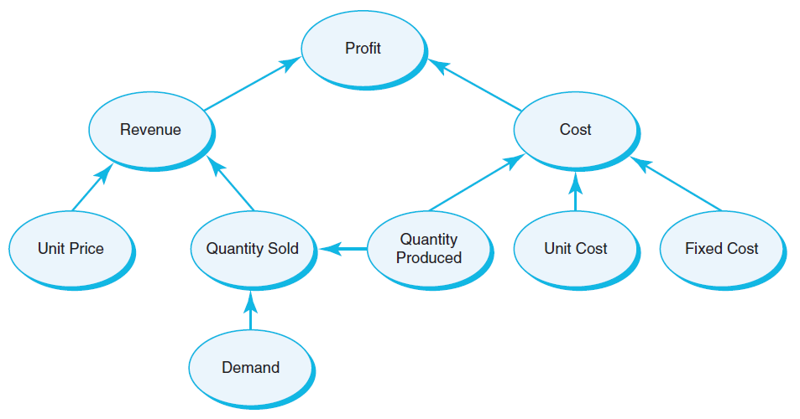
Logic-Driven Modeling
Example 8.2 A Profit Model
Develop a decision model for predicting profit in face of uncertain demand.
P = profit
R = revenue
C = cost
p = unit price
c = unit cost
F = fixed cost
S = quantity sold
D = demand
Q = quantity
produced
Figure 8.1

Slide 8
Logic-Driven Modeling
Example 8.2 (continued) A Profit Model
Cost = fixed cost + variable cost
C = F + cQ
Revenue = price times quantity sold
R = pS
Quantity sold = Minimum{demand, quantity sold}
S = min{D, Q}
Profit = Revenue − Cost
P = p*min{D, Q} − (F + cQ)

Slide 9
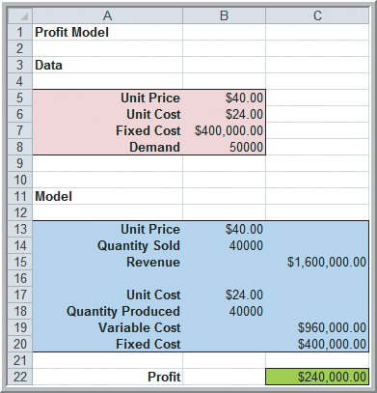
Logic-Driven Modeling
Example 8.2 (continued) A Profit Model
p = $40
c = $24
F = $400,000
D = 50,000
Q = 40,000
Compute:
R = p*min{D,Q}
= 40(40,000) = 1,600,000
C = F + cQ = 1,360,000
= 400,000 + 24(40,000)
P = R − C = 1,600,000 – 1,360,000 = $240,000
Figure 8.2a

Slide 10
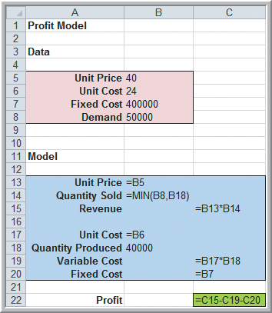
Logic-Driven Modeling
Example 8.2 (continued) A Profit Model
Figure 8.2a
Figure 8.2b

Slide 11
Logic-Driven Modeling
Example 8.3 New-Product Development
Moore Pharmaceuticals needs to decide whether to conduct clinical trials and seek FDA approval for a newly developed drug.
Estimated figures:
R&D cost = $700 million
Clinical trials cost = $150 million
Market size = 2 million people
Market size growth = 3% per year

Slide 12
Logic-Driven Modeling
Example 8.3 (continued) New-Product Development
Additional estimated figures
Market share = 8%
Market share growth = 20% per year (for 5 years)
Revenue from a monthly prescription = $130
Variable cost for a monthly prescription = $40
Discount rate for net present value = 9%
Moore Pharmaceuticals wants to determine net present value for the next 5 years and to determine how long it will take to recover fixed costs.

Slide 13
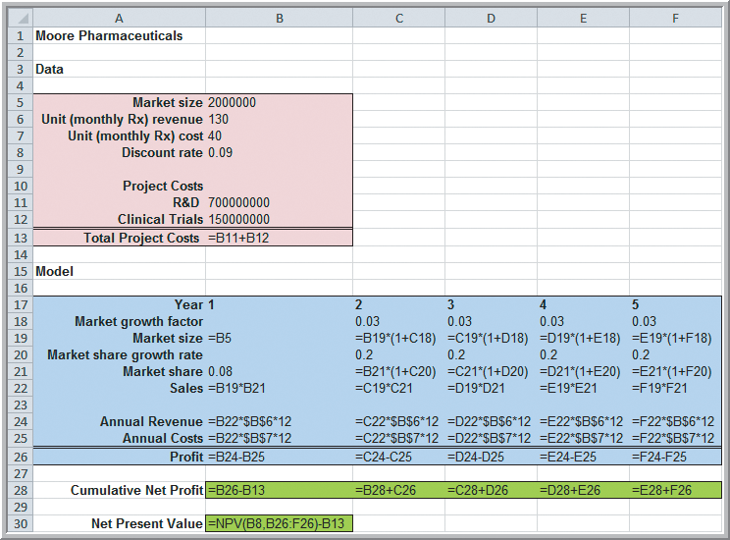
Logic-Driven Modeling
Example 8.3 (continued) New-Product Development
Figure 8.3b

Slide 14
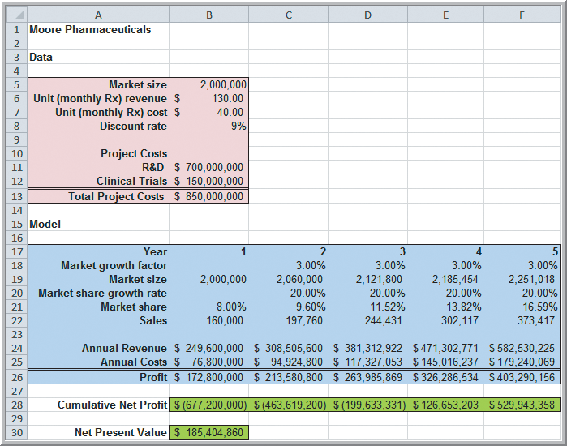
Logic-Driven Modeling
Example 8.3 (continued) New-Product Development
NPV =
$185 million
Profitable in 4th year
Figure 8.3a

Slide 15
Logic-Driven Modeling
Single-Period Purchase Decisions
One-time purchase decisions often must be made in the face of uncertain demand.
Newsvendor Problem:
How many newspapers to purchase each day?
C = cost to purchase a newspaper
Q = number of newspapers the vendor purchases
D = number of newspapers demanded
R = revenue from selling a newspaper
S = salvage value of unsold newspapers
Net profit = R(min{Q,D}) + S(max{0,Q−D}) − CQ

Slide 16
Logic-Driven Modeling
Example 8.4
A Single-Period Purchase Decision Model
A small candy store makes Valentine’s Day gift boxes that cost $12 and sell for $18.
In the past, at least 40 boxes have sold by Valentine’s Day but the actual amount is unknown.
After the holiday, boxes are discounted 50%.
Determine net profit on the gift boxes.
C = 12, R = 18, S = 9
Net profit = R(min{Q,D}) + S(max{0,Q−D}) − CQ
=18(min{Q,D}) + 9(max{0,Q−D}) − 12Q

Slide 17
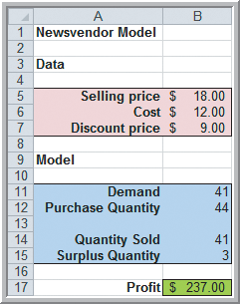
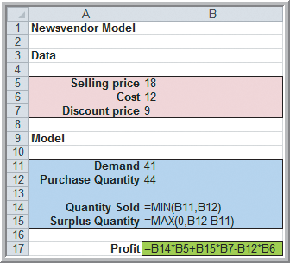
Logic-Driven Modeling
Example 8.4
A Single-Period Purchase Decision Model
Net profit =18(min{Q,D}) + 9(max{0,Q−D}) − 12Q
Figure 8.4

Slide 18
Logic-Driven Modeling
Example 8.5 A Hotel Overbooking Model
A popular resort hotel has 300 rooms.
The room rate is $120 per night.
Reservations can be cancelled by 6:00 p.m.
Cost of overbooking is $100 per occurrence.
Determine net revenue on the rooms.
Q = 300, P = 120, C = 100
D = Reservations − Cancellations
Net revenue = P(min{300,D}) − C(max{0,D−Q})
= 120(min{300,D})−100(max{0,D−300})

Slide 19
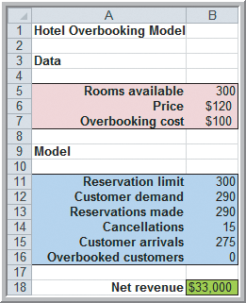
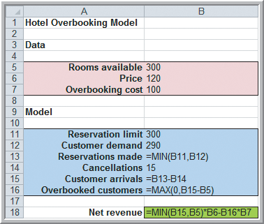
Logic-Driven Modeling
Example 8.5 (continued)
A Hotel Overbooking Model
Net revenue = 120(min{300,D})−100(max{0,D−300})
Figure 8.5

Slide 20

Logic-Driven Modeling
Analytics in Practice:
Using an Overbooking Model
at a Student Health Clinic
East Carolina University’s health clinic experiences a large number of no-shows.
A quality improvement team analyzed an overbooking option.
Analytic models developed suggested that an overbooking rate of 7.3% would result in savings of $95,000 per semester.

Slide 21
Logic-Driven Modeling
Example 8.6 A Retirement-Planning Model
Start work at age 22, earning $50,000 per year.
Expect a salary increase of 3% per year.
Required to contribute 8% to retirement.
Employer contributes 35% of that amount.
Expect an annual return of 8% on the portfolio.
Determine the value of the retirement account when the employee is 50 years old.

Slide 22
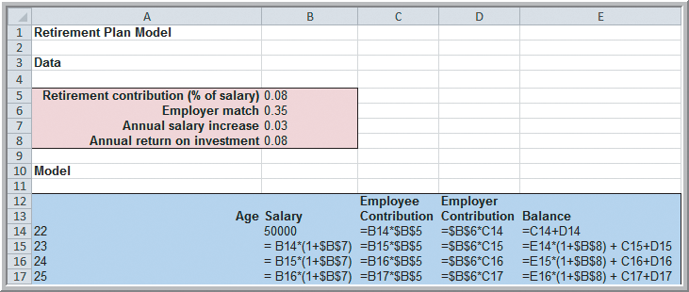
Logic-Driven Modeling
Example 8.6 (continued) Retirement-Planning Model
Salary = 1.03(previous year’s salary)
Employee contribution = 0.08(salary)
Employer contribution = 0.35(employee contrib.)
Value of account = 1.08(previous value) + employee contribution + employer contribution
Figure 8.6a

Slide 23
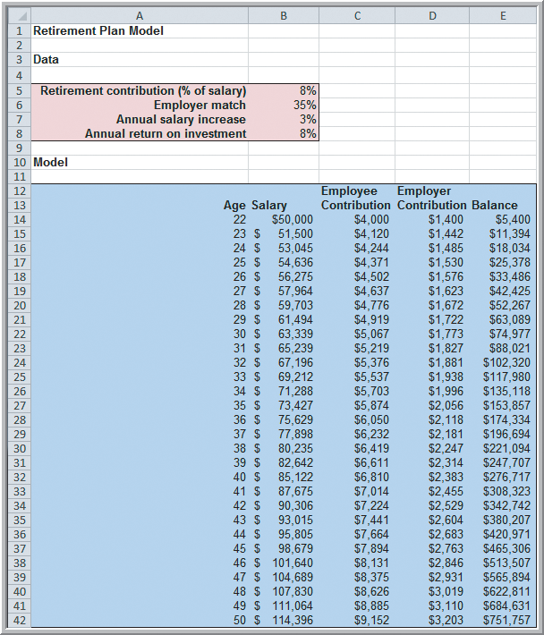
Logic-Driven Modeling
Example 8.6 (continued)
Retirement Planning
Model
Value at 22 years old = $5,400
Value at 50 years old = $751,757
Figure 8.6b

Slide 24
Data-Driven Modeling
Example 8.7
Modeling Retail Markdown Pricing Decisions
In the spring, a department store introduces a new line of bathing suits that sells for $70.
The store purchases 1000 of these bathing suits.
During the prime selling season, the store sells an average of 7 units per day at full price (40 days).
On 10 sale days, the price is discounted 30% and sales increase to 32.2 units per day.
Around July 4th, the price is marked down 70% to sell off remaining inventory.
Determine total revenue from the bathing suits.

Slide 25
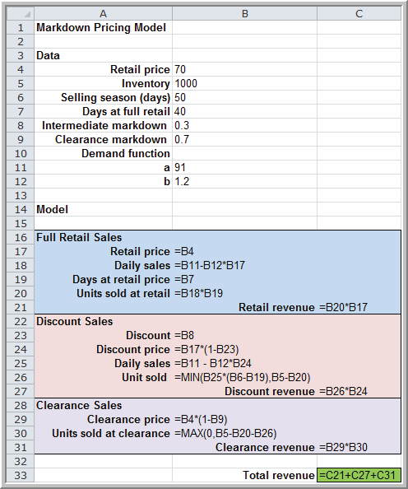
Data-Driven Modeling
Example 8.7 (continued)
Modeling Retail Markdown
Pricing Decisions
Assume a linear trend model between sales and price:
daily sales = a – b(price)
7 = a – b(70)
32.2 = a – b(49)
Daily sales = 91 – 1.2(price)
Figure 8.7

Slide 26
Data-Driven Modeling
Example 8.7 (continued)
Revenue from full retail sales
= units sold * days * price
= (7)*(40)*(70)
= $19,600
Revenue from sale weekends
= (32.2)*(10)*(49)
= $15,778
Revenue from clearance sales
= leftovers * price
= (1000−7(40) − 32.2(10))*(21)
= (398)(21)
= $8,358
Figure 8.7

Slide 27
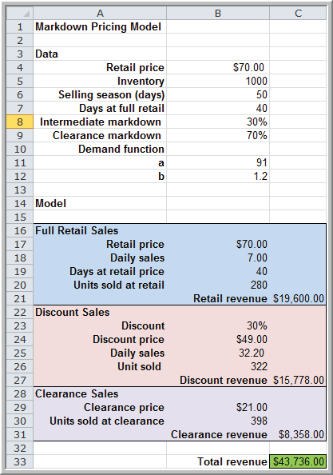
Data-Driven Modeling
Example 8.7 (continued)
Modeling Retail Markdown Pricing Decisions
Total revenue
= $43,736
Figure 8.7

Slide 28
Data-Driven Modeling
Modeling Relationships and Trends in Data
Create charts to better understand data sets.
For cross-sectional data, use a scatter chart.
For time series data, use a line chart.
Consider using mathematical functions to model relationships.

Slide 29
Data-Driven Modeling
Common mathematical functions used to model relationships in data:
Linear y = a + bx
Logarithmic y = ln(x)
Polynomial (2nd order) y = ax² + bx + c
Polynomial (3rd order) y = ax³ + bx² + dx + e
Power y = ax^{b}
Exponential y = ab^{x}

Slide 30
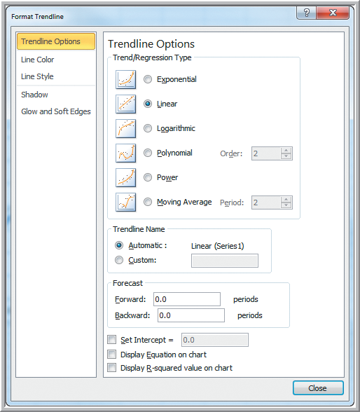
Data-Driven Modeling
Excel Trendline tool
Click on a chart
Chart tools
Layout
Trendline
Choose a Trendline. Choose whether to display equation and R-squared.
R-squared values closer to 1 indicate better fit of the Trendline to the data.
Figure 8.8

Slide 31
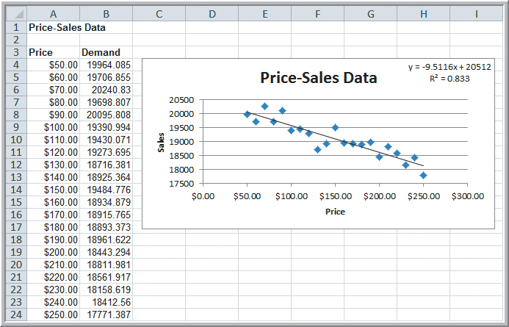
Data-Driven Modeling
Example 8.8 Modeling a Price-Demand Function
Linear demand function:
Sales = -9.5116(price) + 20512
Figure 8.9

Slide 32
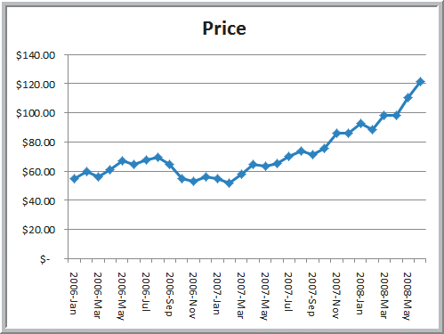
Data-Driven Modeling
Example 8.9 Predicting Crude Oil Prices
Line chart of historical crude oil prices
Figure 8.10

Slide 33
Data-Driven Modeling
Example 8.9 (continued) Predicting Crude Oil Prices
Excel’s Trendline tool is used to fit various functions to the data.
Logarithmic y = 13 ln(x) + 39 R² = 0.382
Power y = 45.96x^{0.0169} R² = 0.397
Exponential y = 50.5e^{0.021x} R² = 0.664 Polynomial 2° y = 0.13x² − 2.4x + 68 R² = 0.905
Polynomial 3° y = 0.005x³ − 0.111x²
+ 0.648x + 59.5 R² = 0.928 *

Slide 34
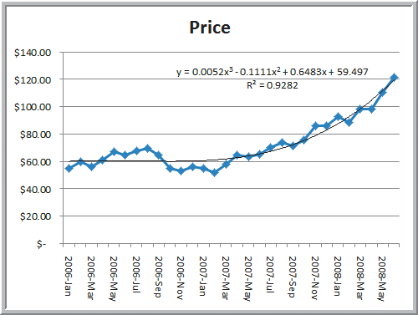
Data-Driven Modeling
Example 8.9 (continued) Predicting Crude Oil Prices
Third Order Polynomial Trendline fit to the data
Figure 8.11

Slide 35
Analyzing Uncertainty and Model Assumptions
What-If Analysis
Spreadsheet models allow you to easily evaluate what-if questions.
How do changes in model inputs (that reflect key assumptions) affect model outputs?
Systematic approaches to what-if analysis make the process easier and more useful.

Slide 36
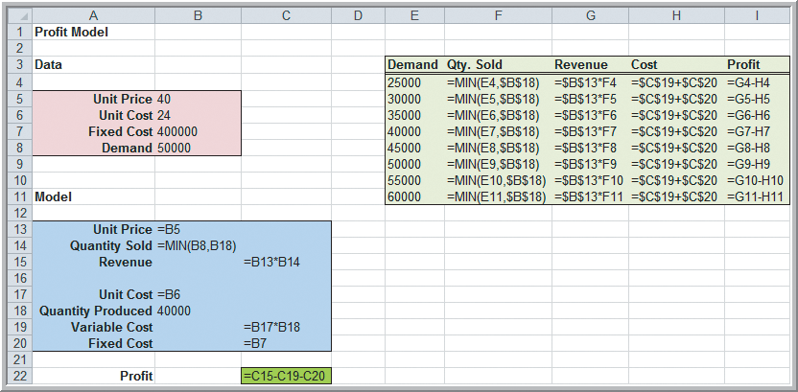
Analyzing Uncertainty and Model Assumptions
Example 8.10 Using Excel for What-If Analysis
Uncertain demand in the Profit Model.
Figure 8.12a

Slide 37
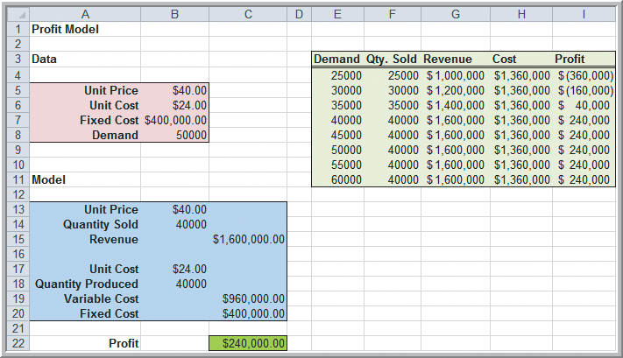
Analyzing Uncertainty and Model Assumptions
Example 8.10 (continued)
Using Excel for What-If Analysis
Profit increases until demand equals the quantity produced.
Figure 8.12b

Slide 38
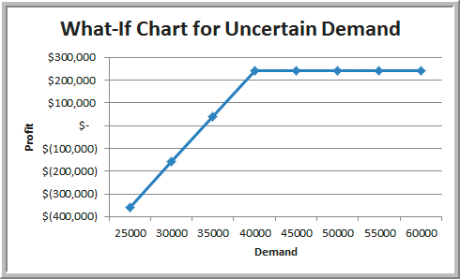
Analyzing Uncertainty and Model Assumptions
Example 8.10 (continued)
Using Excel for What-If Analysis
Figure 8.13

Slide 39
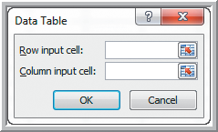
Analyzing Uncertainty and Model Assumptions
Data Tables
Data Tables summarize the impact of one or two inputs on a specified output.
Excel data table types:
One-way data tables – for one input variable
Two-way data table – for two input variables
To construct a data table:
Data
What-If Analysis
Data Table
Figure 8.14

Slide 40
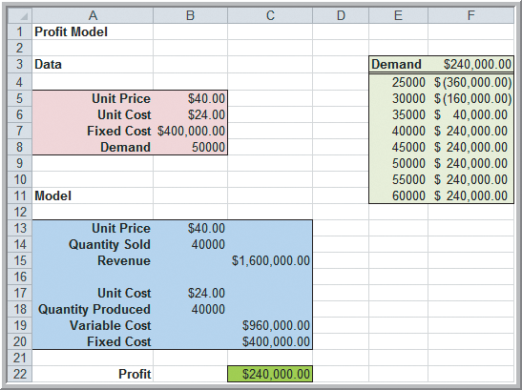
Analyzing Uncertainty and Model Assumptions
Example 8.11
A One-Way Data Table for Uncertain Demand
Create a column of demand
values (column E).
Enter =C22 in cell F3
(to reference the output cell).
Highlight the range E3:F11.
Choose Data Table.
Enter B8 for Column input cell.
(tells Excel that column E is
demand values)
Data
Table tool
computes these
values
Figure 8.15a
Figure 8.14

Slide 41
Analyzing Uncertainty and Model Assumptions
Example 8.11 (continued)
A One-Way Data Table for Uncertain Demand
The Data Table tool computes the profit values in column F (below $240,000).
Figure 8.15b

Slide 42
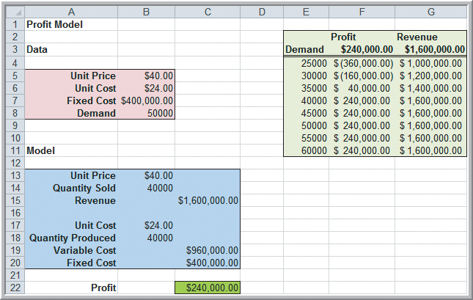
Analyzing Uncertainty and Model Assumptions
Example 8.12
One-Way Data Tables with Multiple Outputs
Create a second output, revenue.
Enter =C15 in
cell G3.
Highlight E3:G11.
Choose Data Table
Proceed as in the
previous example.
Excel computes the
revenues values.
Figure 8.15

Slide 43
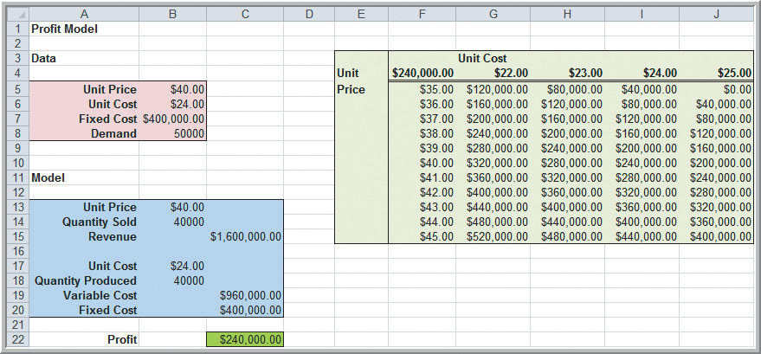
Analyzing Uncertainty and Model Assumptions
Example 8.13
A Two-Way Data Table for the Profit Model
Evaluate the impact of both unit price and unit cost
Create a column of
unit prices (F5:F15).
Create a row of unit
costs (G4:J4).
Enter =C22 in cell F4.
Select F4:J15.
Choose Data Table.
Data Table tool computes these cell values.
Figure 8.17a
Enter B6 for Row input cell.
Enter B5 for Column input cell.

Slide 44
Analyzing Uncertainty and Model Assumptions
Example 8.13 (continued)
A Two-Way Data Table for the Profit Model
Figure 8.17b

Slide 45
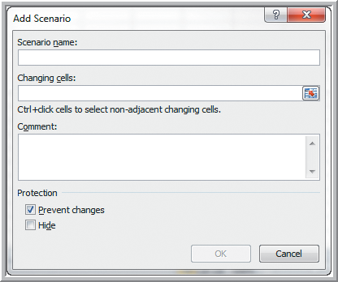
Analyzing Uncertainty and Model Assumptions
Excel’s Scenario Manager
Allows creation of scenarios – sets of values that are saved and can be substituted in worksheets.
Data
What-If Analysis
Scenario Manager
Add
Enter a Scenario Name
Changing Cells:
Enter cell references
to include in scenario.
Figure 8.18

Slide 46
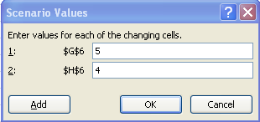
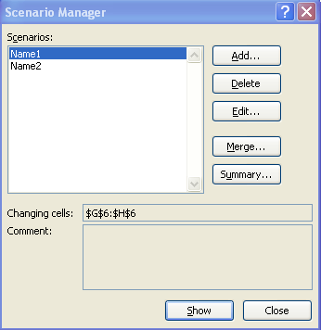
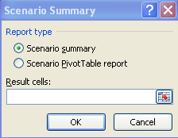
Analyzing Uncertainty and Model Assumptions
Scenario Manager (continued)
After entering Changing Cells,
a Scenario Values dialog box
appears.
Enter values for each of the
changing cells.
From the Scenario Manager,
choose Summary.
Choose a PivotTable or Summary.
Enter Results cells for the output
computations.

Slide 47
Analyzing Uncertainty and Model Assumptions
Example 8.14 Using the Scenario Manager for the Markdown Pricing Model
Evaluate 4 strategies for pricing and discounts on the bathing suits in the Markdown Pricing Model.
Days at full price Price discount on sale days
10 10%
20 20%
30 30%
40 40%

Slide 48
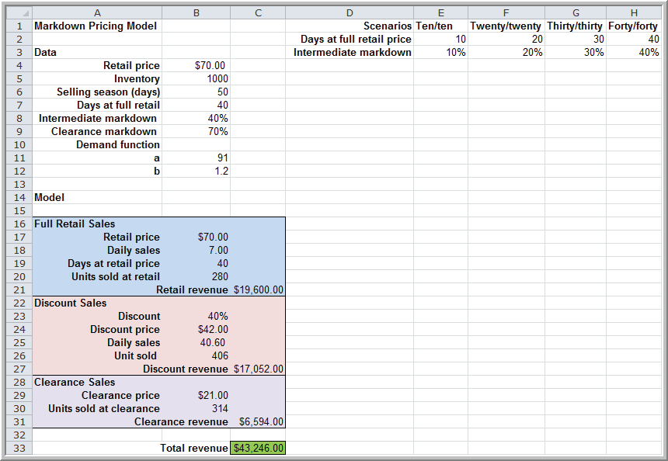
Analyzing Uncertainty and Model Assumptions
Example 8.14 (continued)
In the Add Scenario dialog box
Scenario Name:
Ten/ten
In the Scenario Values dialog;
=E2 for changing cell B7
=E3 for changing cell B8
Repeat for the other scenarios.
Choose Summary.
Enter C33 (total revenue) for
the Result cell.
A Summary table is generated.
Figure 8.19

Slide 49
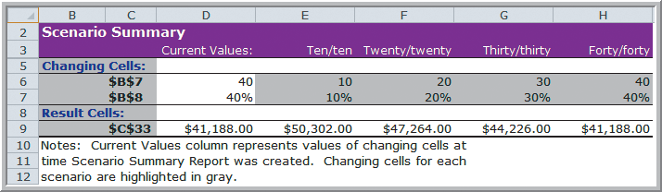
Analyzing Uncertainty and Model Assumptions
Example 8.14 (continued) Using the Scenario Manager for the Markdown Pricing Model
Figure 8.20
The largest profit results from using the Ten/ten strategy.

Slide 50
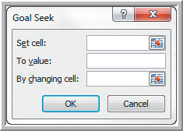
Analyzing Uncertainty and Model Assumptions
Goal Seek
Goal Seek allows you to alter the data used in a formula in order to find out what the results will be.
Set cell contains the formula that will return the result you're seeking.
To value is the target value you
want the formula to return.
By changing cell is the location
of the input value that Excel
can change to reach the target.
Figure 8.21

Slide 51
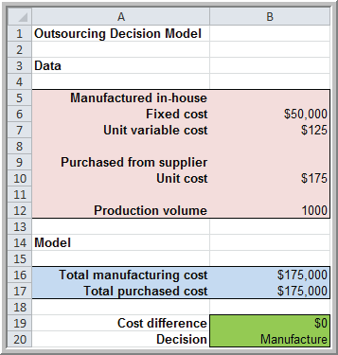
Analyzing Uncertainty and Model Assumptions
Example 8.15 Finding the Breakeven Point in the Outsourcing Model (using Goal Seek)
Find the value of demand
at which manufacturing
cost equals purchased cost
Set cell: B19
To value: 0
By changing
cell: B12.
Figure 8.21
The breakeven volume is 1000 units.
Figure 8.22

Slide 52
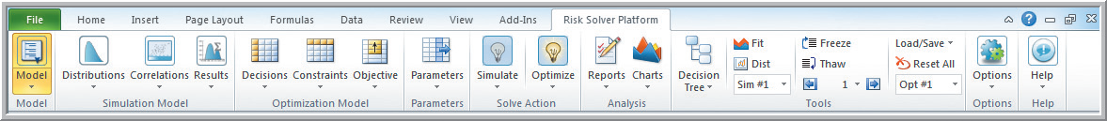
Model Analysis Using Risk Solver Platform
Example 8.16 Creating Data Tables with Risk Solver Platform (for Profit Model)
Create a one-way data table to evaluate profit as the unit price is varied between $35 and $45.
Risk Solver
Select cell B5.
Click Parameters in the ribbon.
Select Sensitivity.
Figure 8.2
Figure 8.23

Slide 53
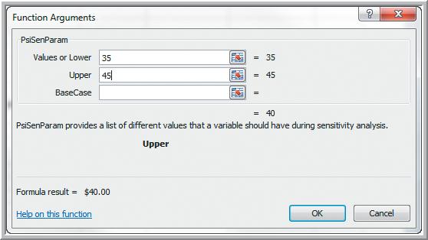
Model Analysis Using Risk Solver Platform
Example 8.16 (continued) Creating Data Tables
Enter the lower (35) and upper (45) price values.
Figure 8.24

Slide 54
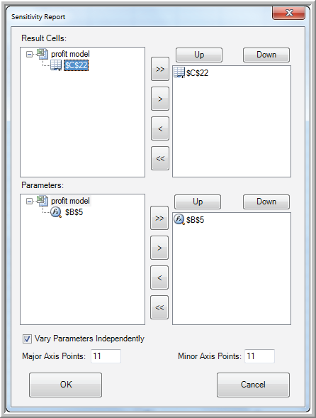
Model Analysis Using Risk Solver Platform
Example 8.16 (continued) Creating Data Tables
Select cell C22.
Reports
Sensitivity
Parameter Analysis
Figure 8.2
Figure 8.25

Slide 55
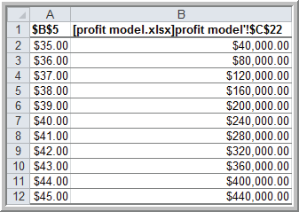
Model Analysis Using Risk Solver Platform
Example 8.16 (continued) Creating Data
Data Table created by Risk Solver
Figure 8.26
Unit price versus profit
when unit cost = $24

Slide 56
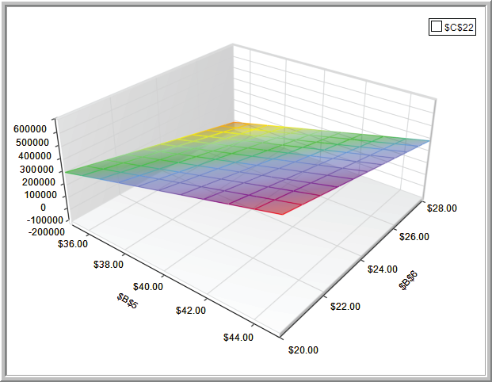
Model Analysis Using Risk Solver Platform
Example 8.16 (continued) Creating Data Tables
3D Chart for a two-
way data table when
both unit price and
unit cost are varied.
Charts
Sensitivity Analysis
Parameter Analysis
Vary parameters
independently
Figure 8.27

Slide 57
Model Analysis Using Risk Solver Platform
Tornado Chart
Shows the impact that variation in a model input has on some output while holding all other inputs constant.
Shows which inputs are the least and most influential on the output.
Helps you select the inputs that you would want to further analyze.

Slide 58
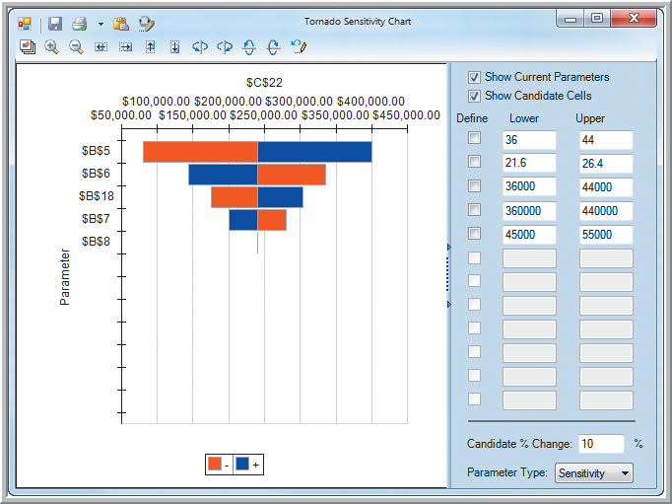
Model Analysis Using Risk Solver Platform
Example 8.17
Creating a Tornado Chart in Risk Solver Platform
Profit Model
Select cell C22.
Parameters
Identify
A 10% change in unit price (B5)
affects profit the most. Next is unit cost (B6).
Figure 8.28

Slide 59
Chapter 8 – Key Terms
Data table
Exponential function
Linear function
Logarithmic function
Newsvendor problem
One-way data table
Overbook
Parametric sensitivity analysis
Polynomial function
Power function
R² (R-squared)
Scenarios
Tornado chart
Two-way data table
Validity
What-if analysis

Slide 60


Case Study
Performance Lawn Equipment (8)
Recall that PLE produces lawnmowers and a medium size diesel power lawn tractor.
Predict net income for the next 3 years.
Determine which variables are uncertain and might change in the future. Discuss any assumptions that you make.
Perform what-if, scenario, and parametric sensitivity analysis on the 3 years of net income.
Construct a tornado chart and write a formal report summarizing your results.

Slide 61


