Slide 1
Simulation and Risk Analysis

Slide 2
Chapter Topics
Simulation and Risk Analysis
Spreadsheet Models with Random Variables
Monte Carlo Simulation Using Risk Solver
New-Product Development Model
Newsvendor Model
Overbooking Model
Cash Budget Model

Slide 3
Simulation and Risk Analysis
Models that include randomness are called stochastic or probabilistic.
These models help us evaluate risks associated with undesirable consequences.
Risk is simply the probability of occurrence of an undesirable outcome.
Risk analysis seeks to examine the impact of uncertain inputs on various outputs.
Simulation involves generating values for the uncertain model inputs.

Slide 4
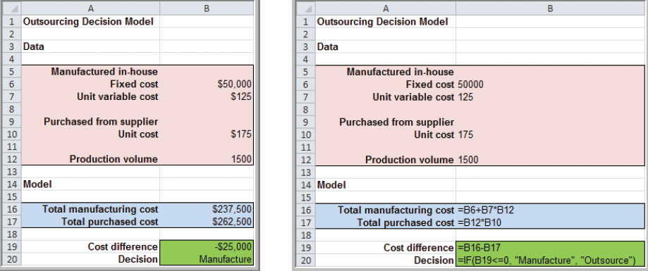
Spreadsheet Models with Random Variables
Example 11.1 Incorporating Uncertainty in the Outsourcing Decision Model
Suppose production volume is uncertain.
Replace cell B12 with
=ROUND(NORM.INV(RAND(), 1000, 100, true), 0)
Press F9
to recalculate
=ROUND(NORM.INV(RAND(),1000,100,true),0)
Figure 11.1
Figure 2.13

Slide 5
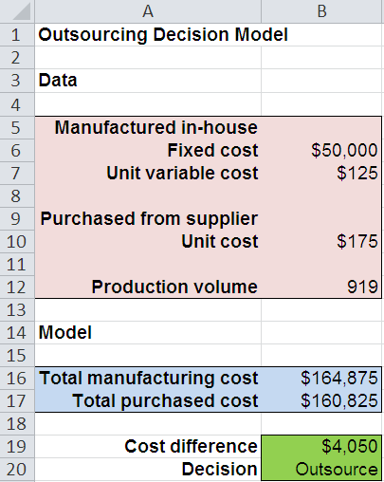
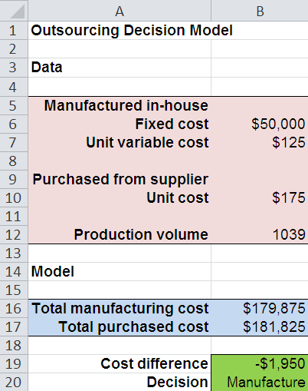
Spreadsheet Models with Random Variables
Example 11.1 (continued) Incorporating Uncertainty in the Outsourcing Decision Model
The results of two more simulations
From Figure 11.1
From Figure 11.1

Slide 6
Spreadsheet Models with Random Variables
Example 11.2 Using Data Tables for Monte Carlo Spreadsheet Simulation
Prepare a data table for simulating uncertain demand in the Outsourcing Decision Model.
Enter the trial number (1 to 20) in column D.
Reference the cells associated with demand in row 3 (E3, F3, G3) → (=B12, =B19, =B20)
Select the range for the data table (D3:G23)
Chose Data Table from What-If Analysis menu.
Row Input Cell: (none)
Column Input Cell: enter any blank cell

Slide 7
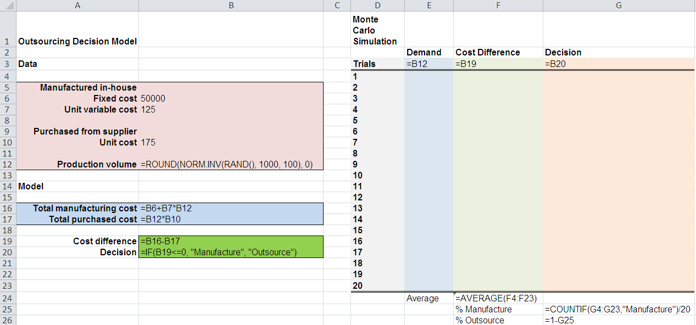
Spreadsheet Models with Random Variables
Example 11.2 (continued) Using Data Tables for Monte Carlo Spreadsheet Simulation
Data Table Cells
D3:G23
From Figure 11.2

Slide 8
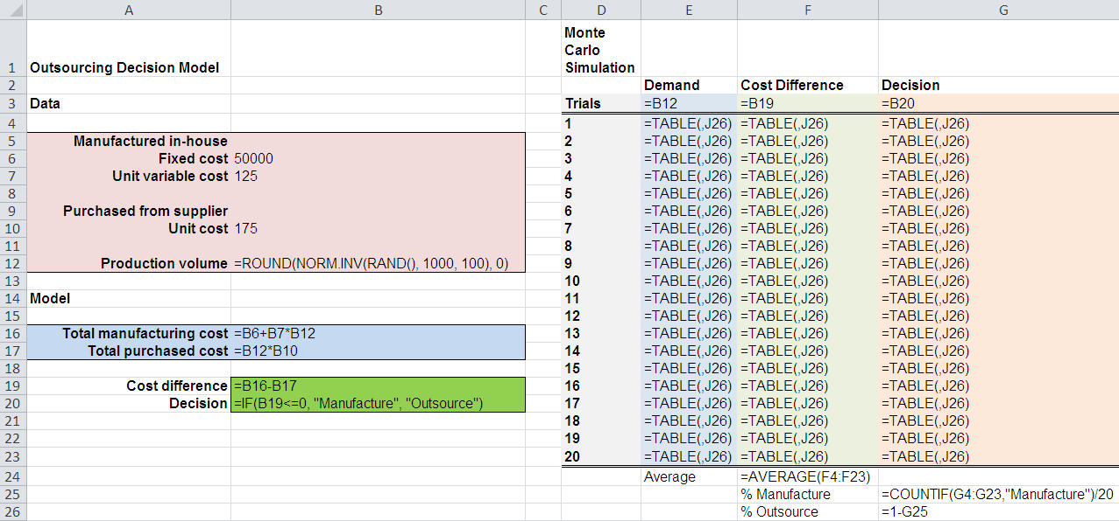
Spreadsheet Models with Random Variables
Example 11.2 (continued) Using Data Tables for Monte Carlo Spreadsheet Simulation
Formulas that appear after running the Data Table
From Figure 11.2

Slide 9
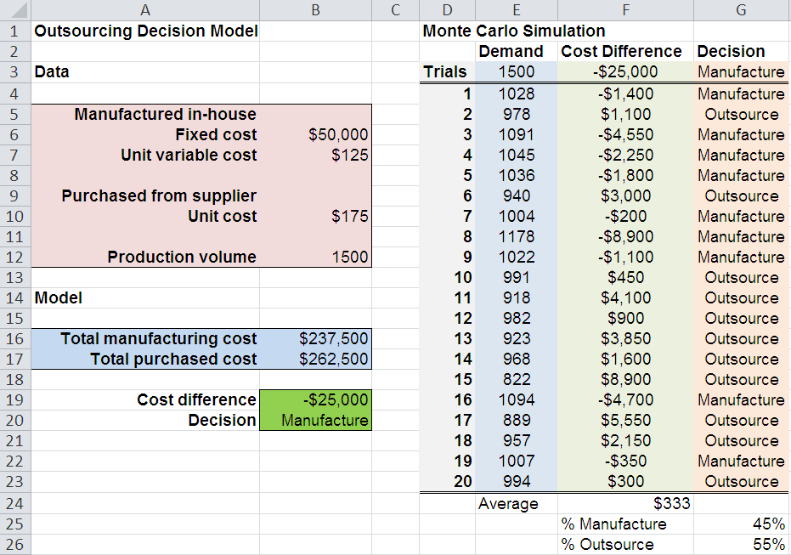
Spreadsheet Models with Random Variables
Example 11.2 (continued) Using Data Tables for Monte Carlo Spreadsheet Simulation
Outsourcing chosen in 55% of the 20 trials.
Press F9 to simulate another 20 trials.
From Figure 11.2

Slide 10
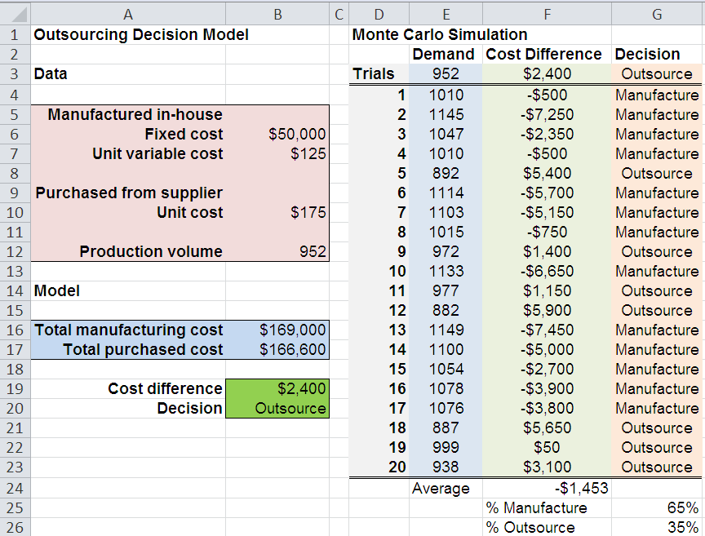
Spreadsheet Models with Random Variables
Example 11.2 (continued) Using Data Tables for Monte Carlo Spreadsheet Simulation
Now outsourcing is chosen in only 35% of the trials.
From Figure 11.2

Slide 11
Monte Carlo Simulation Using Risk Solver
Steps for Simulating with the Risk Solver Platform
1. Develop a spreadsheet model.
2. Determine probability distributions for uncertain
input variables.
3. Identify output variables you want to predict.
4. Choose the number of trials and replications.
5. Run the simulation.
6. Interpret the results.

Slide 12
Monte Carlo Simulation Using Risk Solver
Example 11.3 Using Risk Solver Platform Probability Distribution Functions
For the Outsourcing Decision Model, assume that two inputs are uncertain – demand and unit cost.
Demand (production volume) is normally distributed with a mean of 1000 and standard deviation of 100 units.
Unit cost has a triangular distribution with a minimum of $160, most likely value of $175, and a maximum of $200.

Slide 13
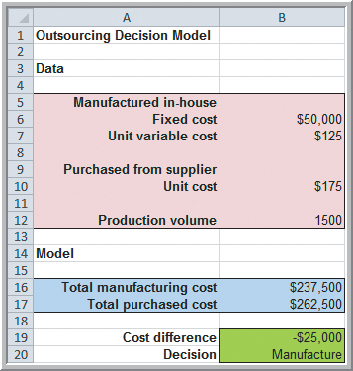
Monte Carlo Simulation Using Risk Solver
Example 11.3 (continued) Using Risk Solver Platform Probability Distribution Functions
X
=ROUND(PsiTriangular(160,175, 200)
X
=ROUND(PsiNormal(1000,100)
Figure 11.3

Slide 14
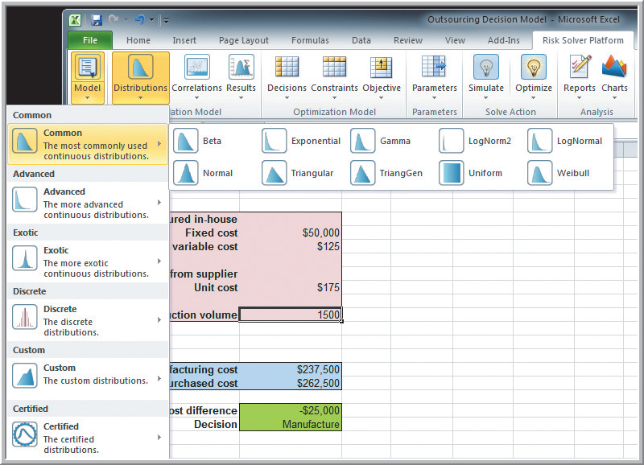
Monte Carlo Simulation Using Risk Solver
Example 11.4 Using the Distributions Button in Risk Solver Platform
Select cell B12.
Risk Solver
Distributions
Common
Normal
Mean=1000
Stdev=100
Select cell B10
and enter unit
cost distribution.
Figure 11.3

Slide 15
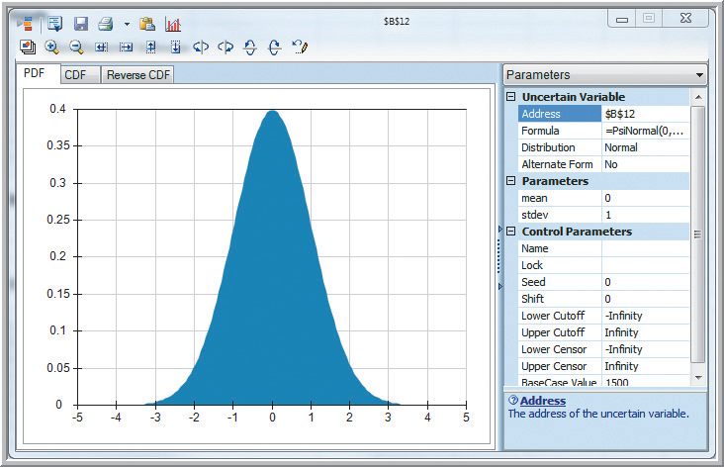
Monte Carlo Simulation Using Risk Solver
Example 11.4 (continued) Using the Distributions Button in Risk Solver Platform
Normal Distribution dialog for Demand in cell B12
Figure 11.4

Slide 16
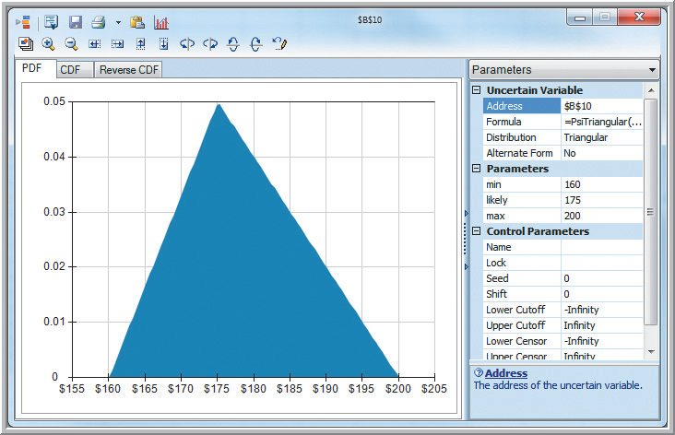
Monte Carlo Simulation Using Risk Solver
Example 11.4 (continued) Using the Distributions Button in Risk Solver Platform
Triangular Distribution dialog for Unit Cost in cell B10.
Figure 11.5

Slide 17
Monte Carlo Simulation Using Risk Solver
Defining Uncertain Cells in Risk Solver
Define worksheet cells for the output variables you want to predict using the Results button in the Simulation Model group.
Risk Solver calls these uncertain cells.
Uncertain cells must be numeric.
The values of these cells will be computed using the randomly generated input values.
There will be one value of each uncertain cell generated on each trial of the simulation.

Slide 18
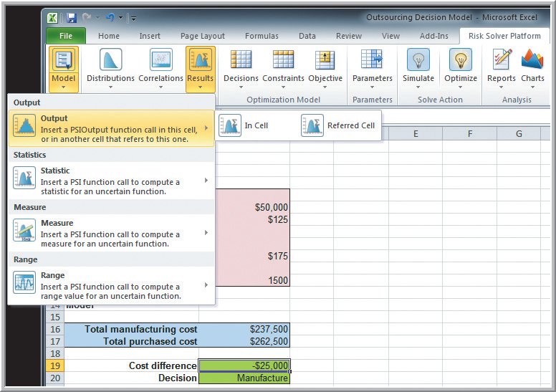
Monte Carlo Simulation Using Risk Solver
Example 11.5 (continued) Using the Results Button in Risk Solver Platform
Select cell B19.
Risk Solver
Results
Output
In Cell
Risk Solver then modifies cell B19 (you can do this manually as well).
xx
=B16-B17+PsiOutput()
Figure 11.6

Slide 19
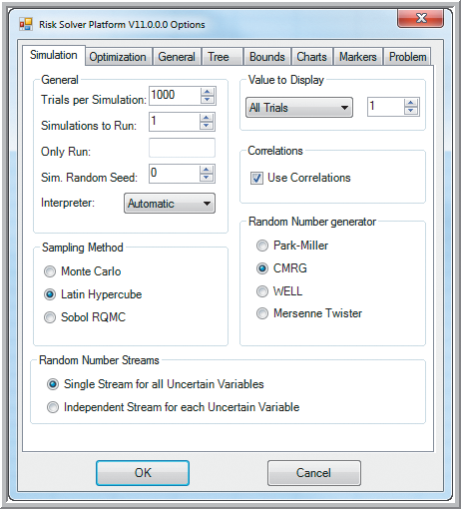
Monte Carlo Simulation Using Risk Solver
Running a Simulation
Options, All Options
Simulation Tab
Trials per Simulation
Use at least 5000 trials.
Simulations to Run
Use more than 1 run if
you want to examine
variation between runs.
Simulation Random Seed
Choose a nonzero number
if you want to reproduce the
exact same results.
Sampling Method
Use Monte Carlo for more
randomized sampling.
Figure 11.7

Slide 20
Monte Carlo Simulation Using Risk Solver
Run and View Simulation Results in Risk Solver
Choose Simulate, Run Once
Frequency tab displays a histogram and summary statistics for the output variable.
Chart Statistics support risk analysis via changes to upper/lower cutoffs.
Click the down arrow next to Statistics to change the results displayed.
Double click on any uncertain output cell to view its results.
Figure 8.23

Slide 21
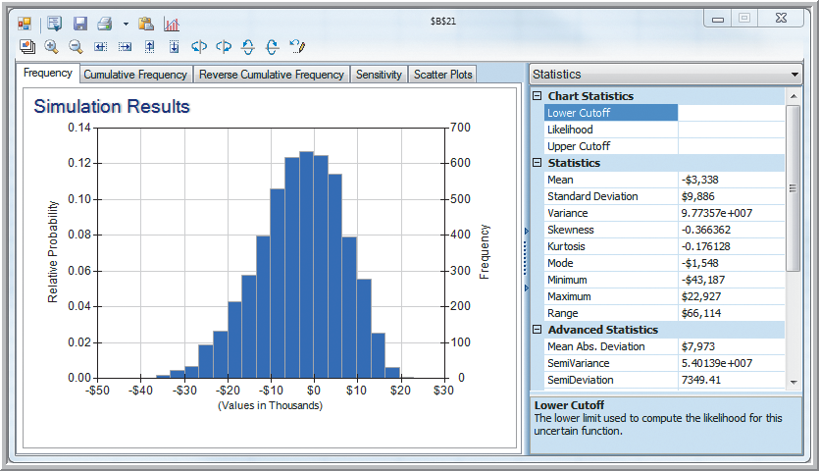
Monte Carlo Simulation Using Risk Solver
Example 11.6 Analyzing Simulation Results for the Outsourcing Decision Model
Figure 11.8

Slide 22
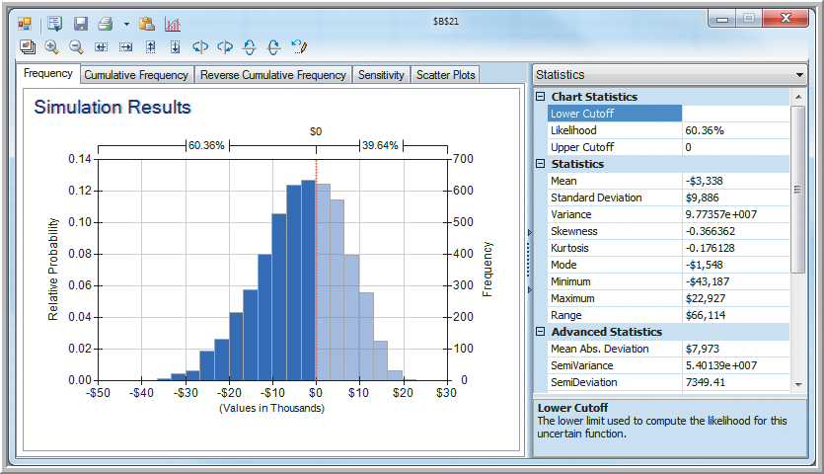
Monte Carlo Simulation Using Risk Solver
Example 11.6 (continued) Analyzing Simulation Results for the Outsourcing Decision Model
Figure 11.9

Slide 23
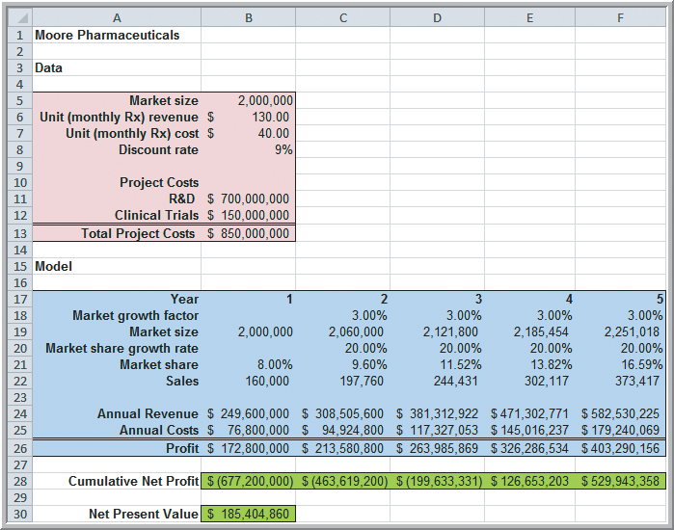
New-Product Development Model
Moore Pharmaceuticals Model for New Product Development
Uncertain Inputs:
Market size
R&D costs
Clinical trial costs
Market growth factor
Market share
growth rate
Original model from Chapter 8 with constant (certain) model inputs.
Figure 11.10

Slide 24
New-Product Development Model
Example 11.7 Setting Up the Simulation Model for Moore Pharmaceuticals
Define the input distributions for the
5 uncertain inputs
(13 blue-boxed cells).
Define the 6 green cells as the output cells (profit and NPV).
Figure 11.10

Slide 25
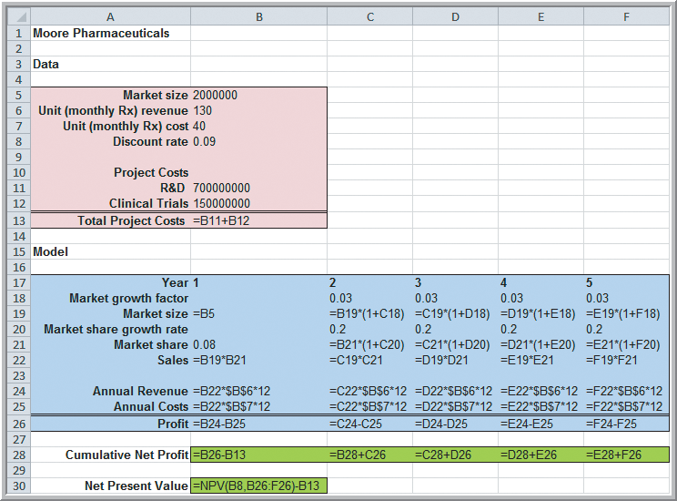
New-Product Development Model
Example 11.7 (continued) Setting up the Simulation
Examples of defining 2 input distribution cells and
2 uncertain output cells.
=PsiNormal(2000000, 400000)
=PsiUniform(600000000, 800000000)
=B28+B26+PsiOutput()
=NPV(B8,B26:F6)-B13+PsiOutput()
Figure 8.3

Slide 26
New-Product Development Model
Example 11.8
Risk Analysis for Moore Pharmaceuticals
Run the simulation using 10,000 trials.
Use the results to answer 3 risk analysis questions:
1. What is the risk that the NPV over the 5 years will not be positive?
2. What are the chances the product will show a cumulative net profit in the third year?
3. What cumulative profit in the 5th year are we likely to realize with a probability of at least 0.90 (that is, the 10th percentile)?

Slide 27
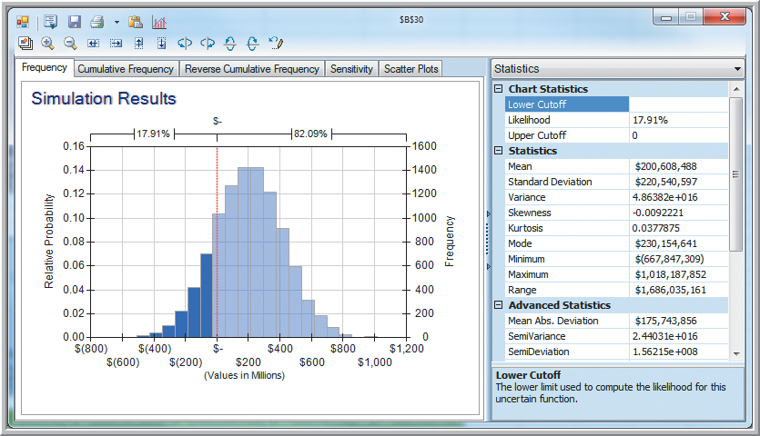
New-Product Development Model
Example 11.8 (continued) Risk Analysis
#1. Probability of a non-positive NPV = 17.91%
Double click on the NPV cell B30 to open the results shown here.
Figure 11.11

Slide 28
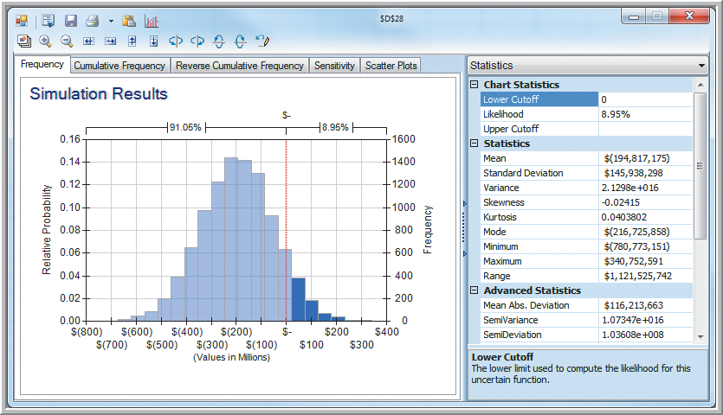
New-Product Development Model
Example 11.8 (continued) Risk Analysis
#2. Probability of a cumulative net profit in 3rd year = 8.95%
Double click on cell D28 to open the results shown here.
Figure 11.12

Slide 29
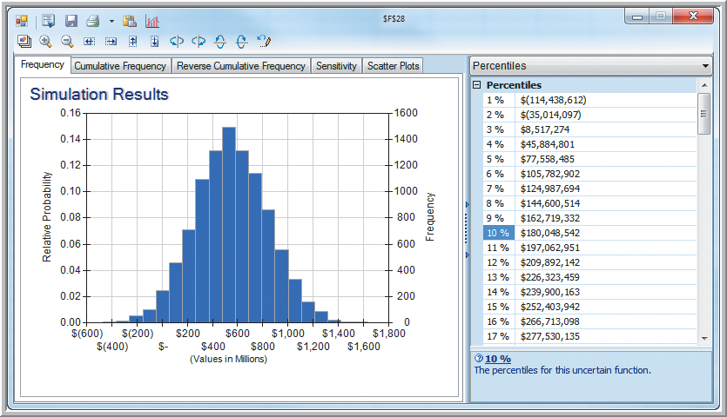
New-Product Development Model
Example 11.8 (continued) Risk Analysis
#3. 10th percentile for 5th year net profit = $180,048,542
Double click on cell F28 to open the results shown here.
Figure 11.13

Slide 30
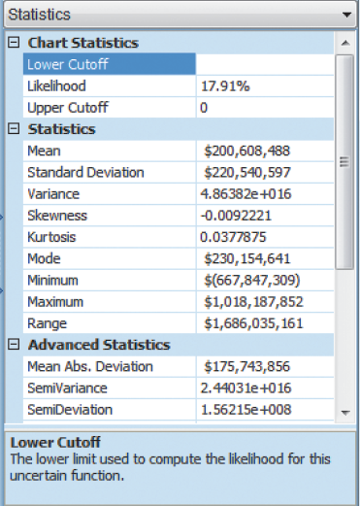
New-Product Development Model
Example 11.9 A Confidence Interval for the Mean Net Present Value
(Moore Pharmaceuticals data)
Compute a 95% confidence interval for the mean NPV.
95% CI for mean NPV:
$196 billion to $205 billion
From Figure 11.11

Slide 31
New-Product Development Model
Sensitivity Charts in Risk Solver
Display rankings of uncertain variables according to their impact on an output cell.
Sensitivity charts provide 3 benefits:
1. Provide an understanding of the relative sensitivity of the model outputs to the inputs.
2. Used to determine which uncertain input variables influence output variables the most and would benefit the most from better estimates.
3. Identify which input variables influence output variables the least and could possibly be ignored or set as constants.

Slide 32
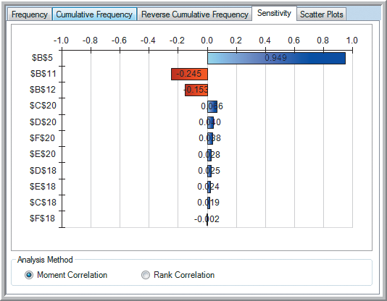
New-Product Development Model
Example 11.10
Interpreting the Sensitivity Chart for NPV (at Moore
Pharmaceuticals)
Correlation Input Var.
0.949 Market size
-0.245 R&D costs
-0.153 Clinical trials
Better information on these inputs would reduce variation in forecasted NPV.
Figure 11.14

Slide 33
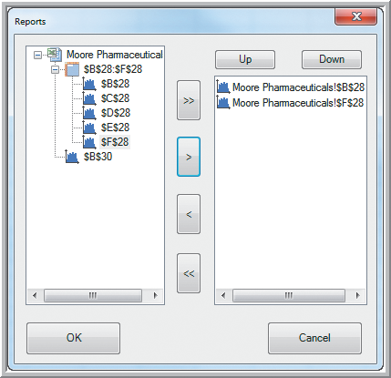
New-Product Development Model
Example 11.11 Creating an Overlay Chart
Compare cumulative net profit in years 1 and 5 for
new product development
at Moore Pharmaceuticals
Risk Solver
Charts
Multiple Simulations
Overlay
B28, F28
Figure 11.15

Slide 34
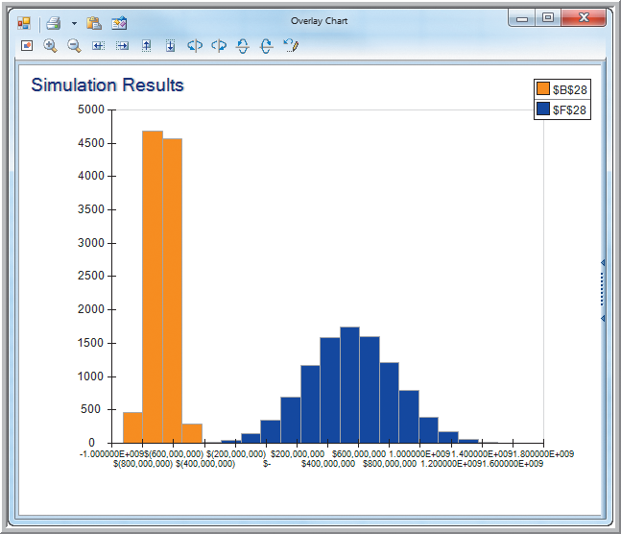
New-Product Development Model
Example 11.11 (continued) Creating an Overlay Chart (net profit at Moore Pharmaceuticals)
The mean and variance of forecasted cumulative net profit are much smaller for year 1 than for year 5.
Figure 11.16

Slide 35
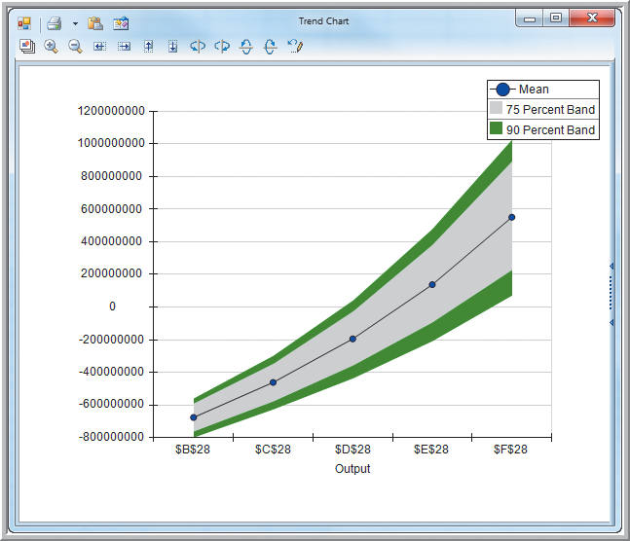
New-Product Development Model
Example 11.12 Creating a Trend Chart
Trend chart for Moore
Pharmaceuticals
cumulative net
profit over 5 years
Risk Solver
Charts
Multiple Simulations
Trend
B28:F28
Uncertainty in the forecasts is increasing.
Figure 11.17

Slide 36
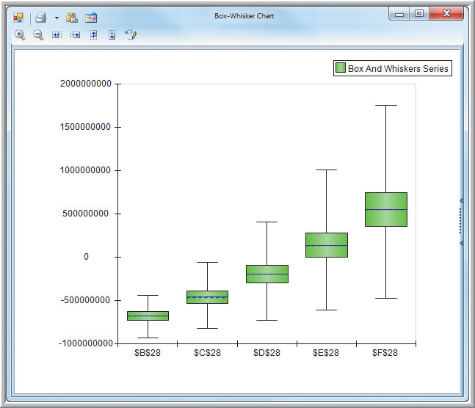
New-Product Development Model
Box-Whisker Chart (Moore Pharmaceuticals
cumulative net profit over 5 years)
Risk Solver
Charts
Multiple Simulation
Results
Box-Whisker
Add: B28:F28
Again, uncertainty in forecasted net profit is increasing as we go further into the future.
Figure 11.18

Slide 37
Newsvendor Model
Recall from Chapter 8, Example 8.4
A small candy store sells Valentine’s Day gift boxes that cost $12 and sell for $18.
In the past, at least 40 boxes have sold by Valentine’s Day but the actual amount is unknown.
After the holiday, boxes are discounted 50%.
Determine net profit on the gift boxes.
C = 12, R = 18, S = 9
Net profit = R(min{Q,D}) + S(max{0,Q−D}) − CQ
=18(min{Q,D}) + 9(max{0,Q−D}) − 12Q

Slide 38
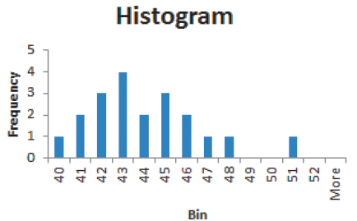
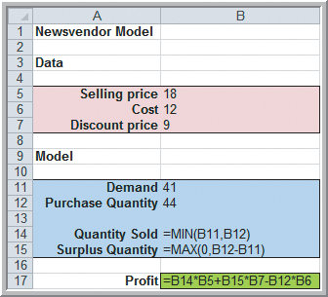
Newsvendor Model
Suppose the store owner kept records for the past 20 years on number of boxes sold.
Historical data on boxes sold
Original Newsvendor Model
From Figure 11.19
Figure 8.4

Slide 39
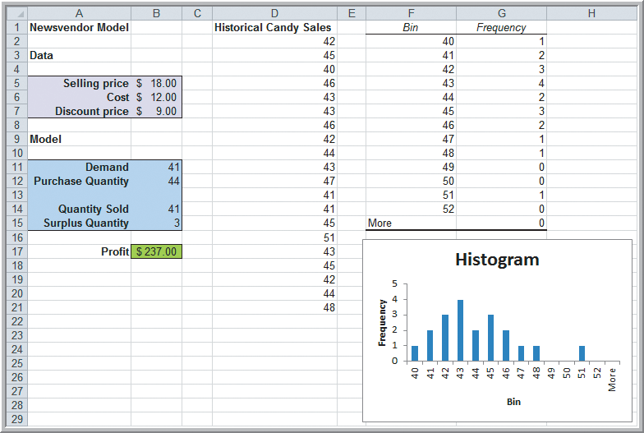
Newsvendor Model
Figure 11.19

Slide 40
Newsvendor Model
Flaw of Averages
Different average output values often result when there are uncertain model inputs depending upon how the model is evaluated:
1. Using average values for uncertain inputs
2. Using random values (with the same averages
used in #1 above) for uncertain inputs
Using averages (as in #1) can conceal risk.
This is why Monte Carlo simulation is so valuable.

Slide 41
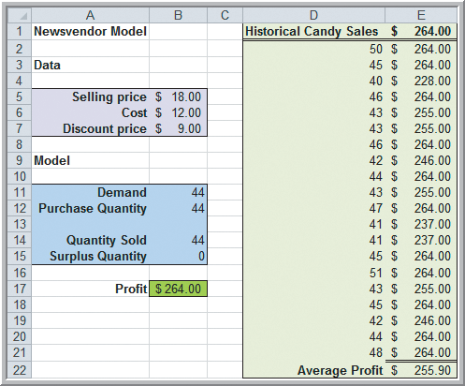
Newsvendor Model
Example 11.13 Using Average Values in the Newsvendor Model
Using Historical Candy Sales
Average Sales = 44 boxes
Average Profit = $255.90
Using Demand Model
Set demand = 44 boxes
Compute Profit = $264.00
Figure 11.20

Slide 42
Newsvendor Model
Example 11.14 Simulating the Newsvendor Model Using Resampling
Generate candy sales by resampling from the 20 historical values.
Set demand in B11 as a random variable.
Set profit in B17 as the uncertain output.
=PsiDisUniform(D2:D21)
=B14*B5+B15*B7-B12*B6+PsiOutput()
Figure 11.20

Slide 43
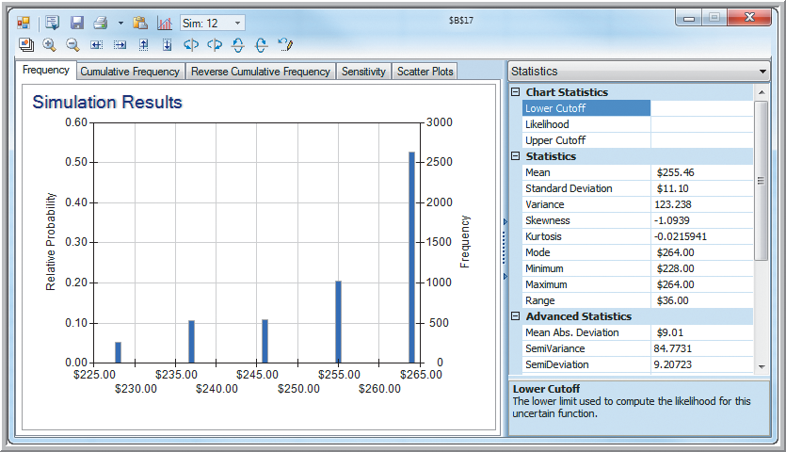
Newsvendor Model
Example 11.14 (continued) Simulating the Newsvendor Model Using Resampling
Figure 11.21

Slide 44
Newsvendor Model
Example 11.15 Using a Fitted Distribution for Monte Carlo Simulation
Generate candy sales by fitting a probability distribution to the 20 historical sales values.
Highlight D2:D21
Risk Solver
Fit, Discrete, Fit Options
Negative Binomial
Accept
=D2 in Demand cell B11
=D2
=B14*B5+B15*B7-B12*B6+PsiOutput()
Figure 11.20

Slide 45
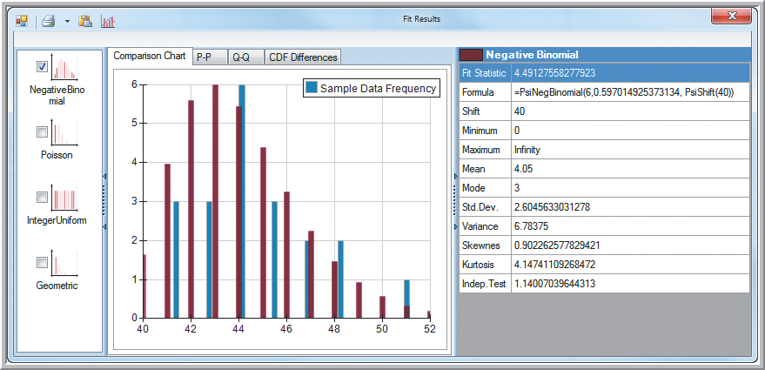
Newsvendor Model
Example 11.15 (continued) Using a Fitted Distribution for Monte Carlo Simulation
← D2
Figure 11.22

Slide 46
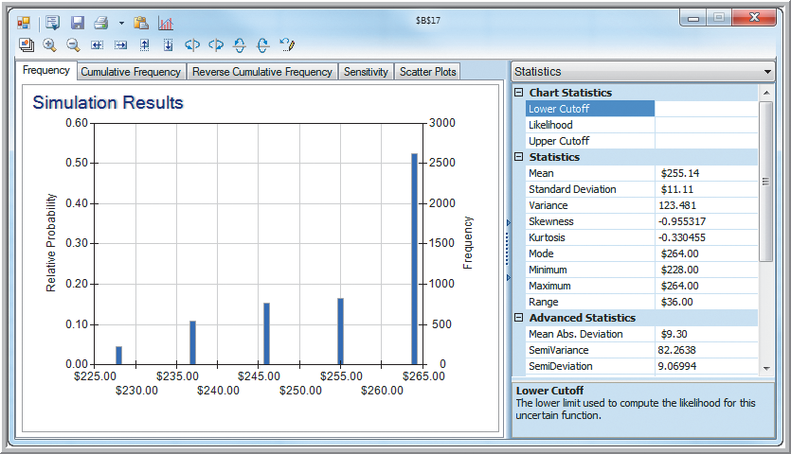
Newsvendor Model
Example 11.15 (continued) Using a Fitted Distribution for Monte Carlo Simulation
Original purchase quantity = 44
Figure 11.23

Slide 47
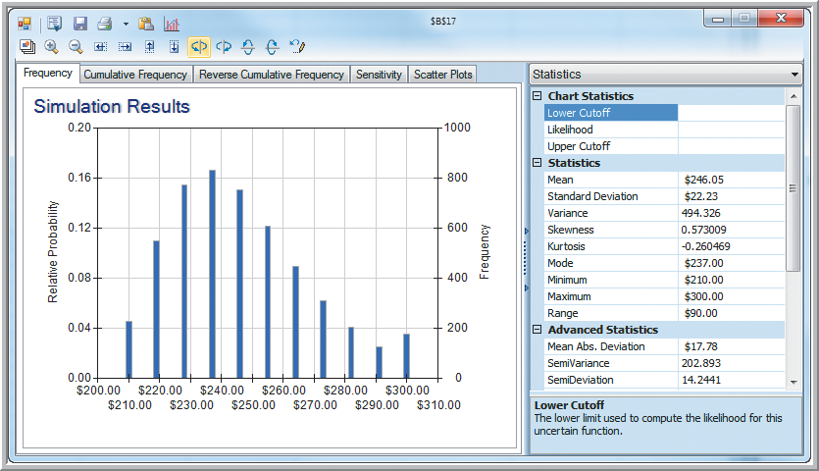
Newsvendor Model
Example 11.15 (continued) Using a Fitted Distribution for Monte Carlo Simulation
Specifying purchase quantity = 50
Figure 11.24

Slide 48
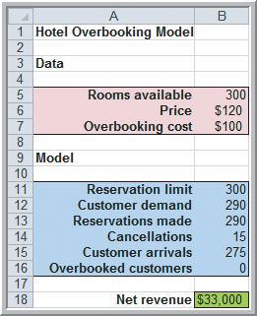
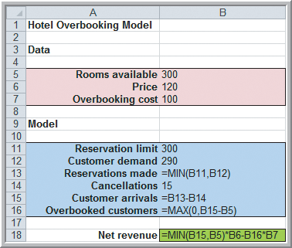
Overbooking Model
Hotel Overbooking Model from Chapter 8
Net revenue = 120(min{300,D})−100(max{0,D−300})
Figure 8.5

Slide 49
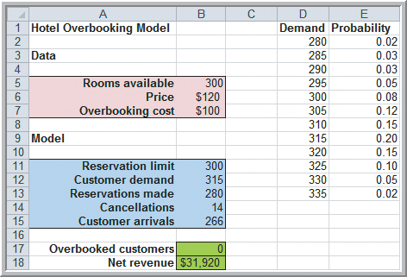
Overbooking Model
Hotel Overbooking Model with Uncertain Demand
Historical data has been used to define a custom distribution for demand
Figure 11.25

Slide 50
Overbooking Model
Example 11.16 Defining a Custom Distribution in Risk Solver Platform
Generate demand using a custom distribution.
Select B12 (demand).
Risk Solver
Distributions
Custom
Values: D2:D13
Weights: E2:E13
=PsiDiscrete($D$2:$D$13, E$2:$E$13)
=PsiBinomial(B13, 0.04)
=MAX(0,B15-B5)+PsiOutput()
=MIN(B15,B5)*B6-B16*B7+PsiOutput()
Figure 11.25
Generate cancellations using a binomial distribution.

Slide 51
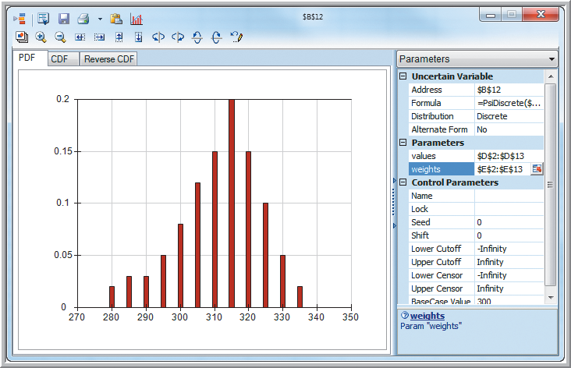
Overbooking Model
Example 11.16 (continued) Defining a Custom Distribution in Risk Solver Platform
Custom distribution for demand
Figure 11.26

Slide 52
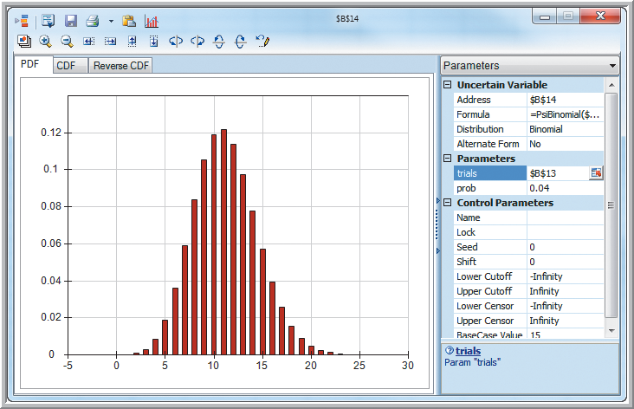
Overbooking Model
Example 11.16 (continued) Defining a Custom Distribution in Risk Solver Platform
Binomial distribution for cancellations
Figure 11.27

Slide 53
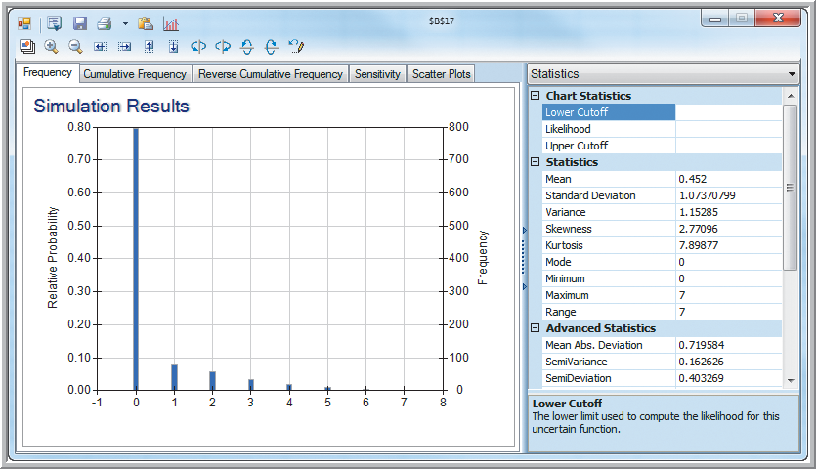
Overbooking Model
Example 11.16 (continued) Defining a Custom Distribution in Risk Solver Platform
Number of overbooked customers
Figure 11.28

Slide 54
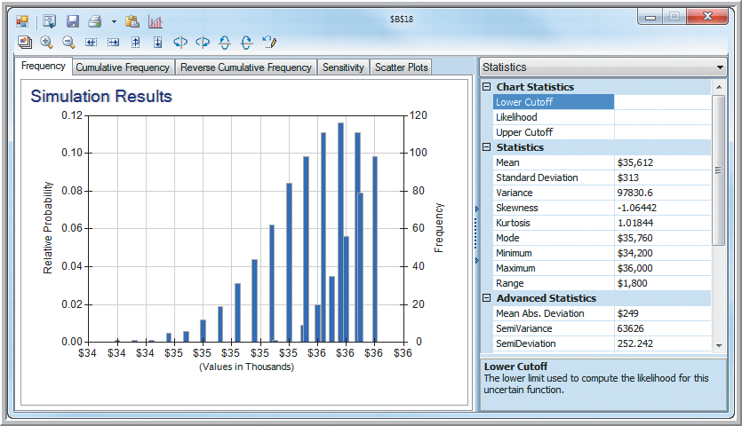
Overbooking Model
Example 11.16 (continued) Defining a Custom Distribution in Risk Solver Platform
Net
revenue
Figure 11.29

Slide 55
Cash Budget Model
Cash Budgeting
The process of projecting and summarizing a company’s cash inflows and outflows expected during a planning horizon.
Most cash budgets are based on sales forecasts.
Because of the inherent uncertainty in sales forecasts, Monte Carlo simulation is an appropriate tool for modeling cash budgets.

Slide 56
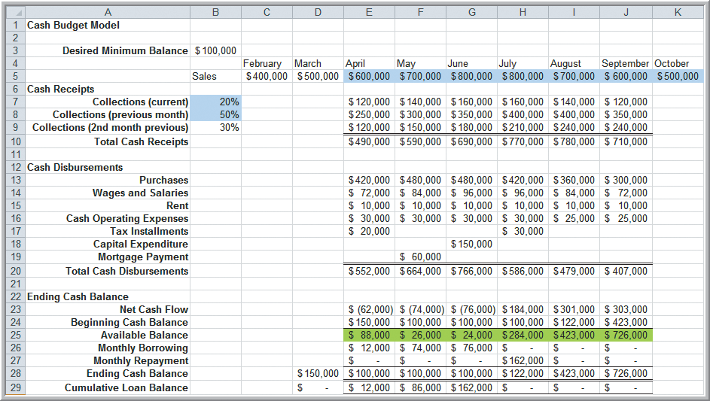
Cash Budget Model
Expected Cash Inflows and Outflows Example
Figure 11.30

Slide 57
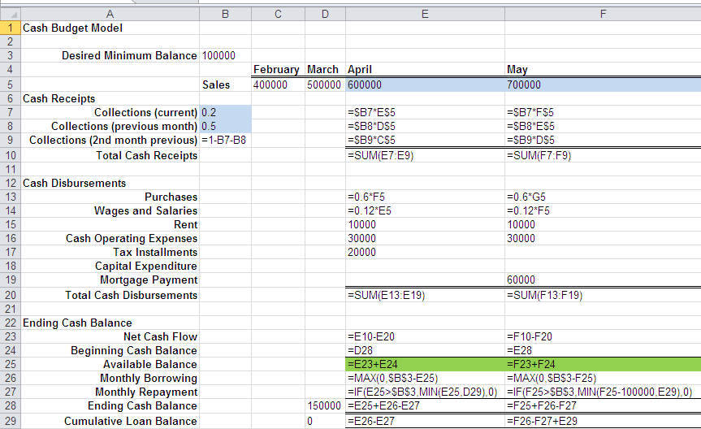
Cash Budget Model
Formulas for the Cash Budget Model
From Figure 11.30

Slide 58
Cash Budget Model
Example 11.17 Simulating the Cash Budget Model
Sales in April-October are normally distributed with a standard deviation equal to 10% of the mean values shown in cells E5:K5.
Percent of sales collected in the first month following sales (B7) are uniform between 15% and 20%.
Percent of sales collected in the second month (B8) are uniformly distributed between 40% and 50%.
All remaining revenues are collected in the third month following sales (B9).
Available Balances (E25:J25) are the output variables.

Slide 59
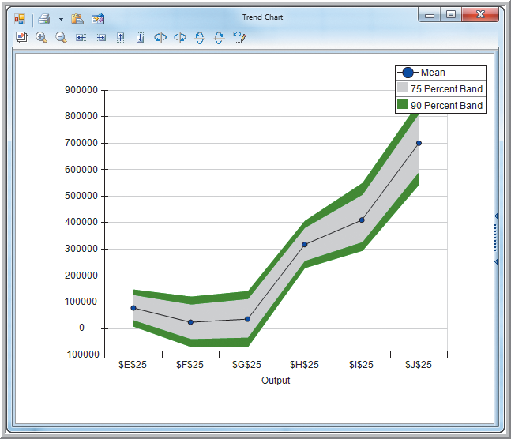
Cash Budget Model
Example 11.17 (continued)
Simulating the Cash Budget Model
Trend chart of available balances April-October
shows a possibility of negative balances in the first 3 months.
Figure 11.31

Slide 60
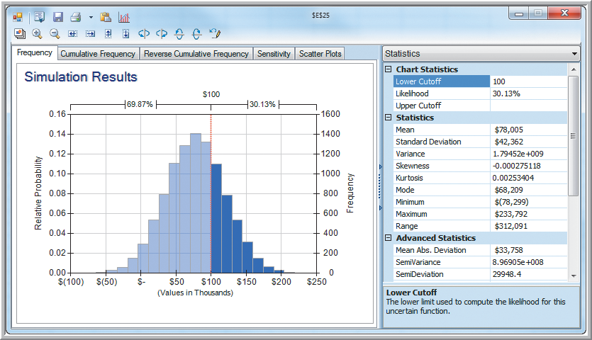
Cash Budget Model
Example 11.17 (continued) Simulating the Cash Budget Model
April Available Balance
Figure 11.32

Slide 61
Cash Budget Model
Example 11.18 Incorporating Correlations in Risk Solver Platform
Suppose sales in adjacent months (April, May), (May, June), …, (September, October) have a correlation coefficient of 0.6.
Set up the following correlation matrix.
Figure 11.33

Slide 62
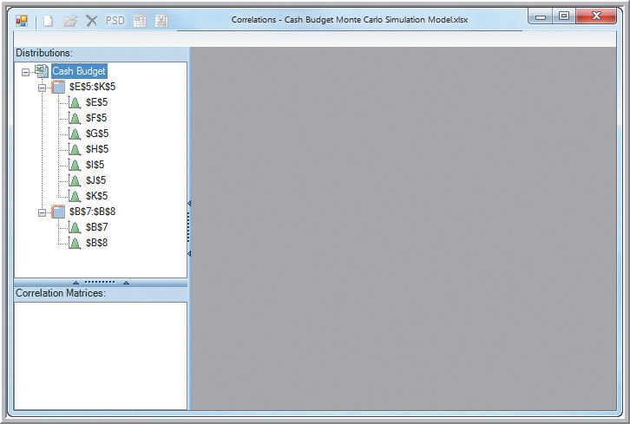
Cash Budget Model
Example 11.18 (continued) Incorporating Correlations in Risk Solver Platform
Select E5:K5
(Sales cells) Risk Solver
Correlations
Matrices
New
Highlight the
correlation
matrix cells
C33:I39
Figure 11.34

Slide 63
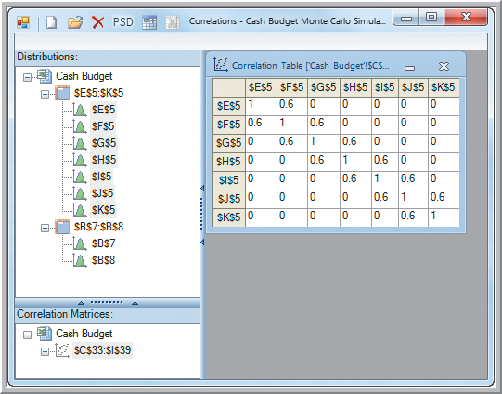
Cash Budget Model
Example 11.18 (continued) Incorporating Correlations in Risk Solver Platform
Click Validate or PSD (positive semidefinite)
Risk Solver
adjusts the
correlations
to ensure mathematical consistency.
Figure 11.35

Slide 64
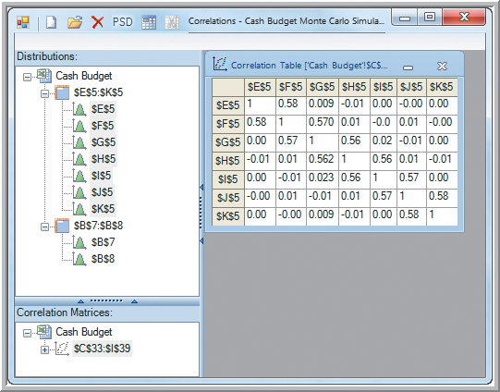
Cash Budget Model
Example 11.18 (continued) Incorporating Correlations in Risk Solver Platform
Updated Correlation Matrix
Formulas in cells E5:K5 are updated:
Formula Cell E5:
=PsiNormal(600000,60000,
PsiCorrMatrix($C$33:$I$39,1))
Figure 11.36

Slide 65
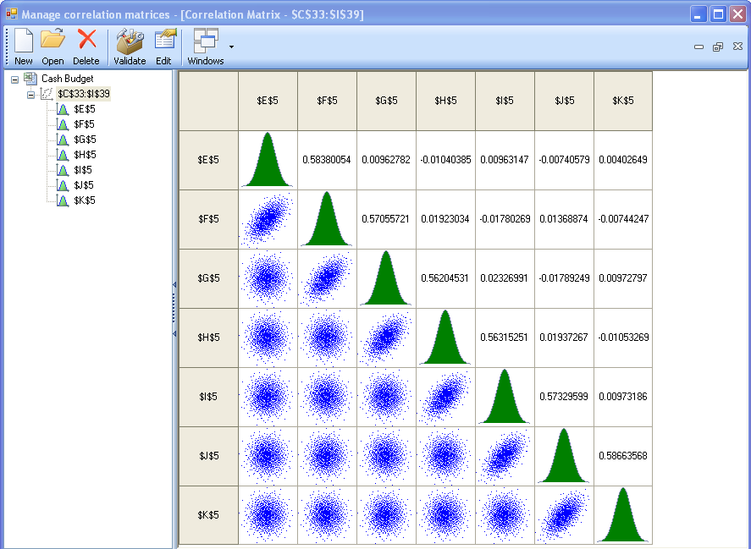
Cash Budget Model
Example 11.18 (continued) Incorporating Correlations in Risk Solver Platform
Validated correlation matrix in regular
(not Premium)
Risk Solver

Slide 66
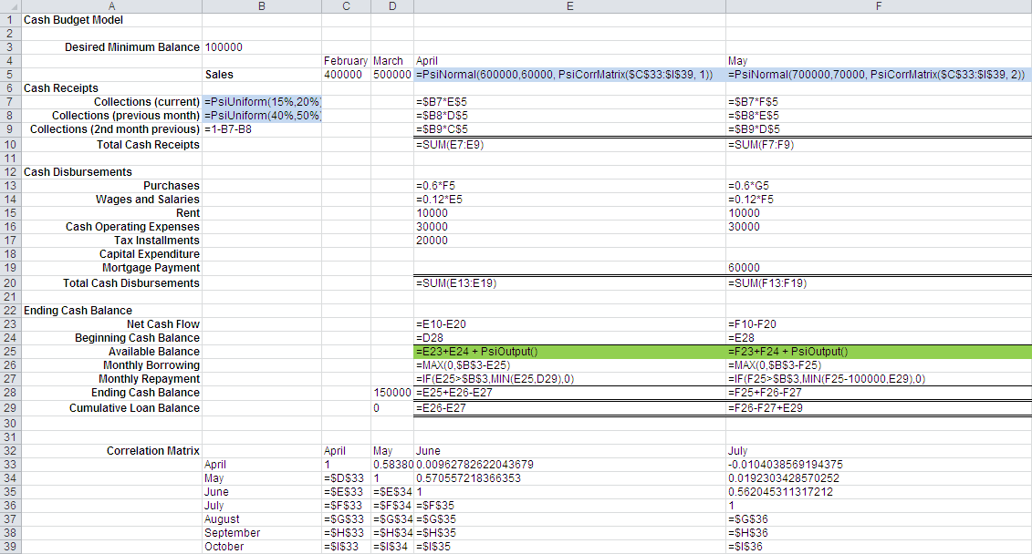
Cash Budget Model
Example 11.18 (continued) Incorporating Correlations in Risk Solver Platform

Slide 67
Cash Budget Model
Example 11.17 (continued) Simulating the Cash Budget Model
April Available Balance

Slide 68
Monte Carlo Simulation
Analytics in Practice:
Implementing Large-Scale
Monte Carlo Spreadsheet Models
Hypo Real Estate Bank International is based in Stuttgart, Germany.
Hypo uses sophisticated Monte Carlo simulation models for real estate credit risk analysis.
SFS (Specialized Finance System) software has improved insight into structuring new loans, making them less risky and more profitable.

Slide 69
Chapter - Key Terms
Box-whisker chart
Flaw of averages
Marker line
Monte Carlo simulation
Overlay chart
Risk
Risk analysis
Sensitivity chart
Trend chart
Uncertain function

