Slide 1
Tableau Lab 2
Calculations and Parameters

Slide 2
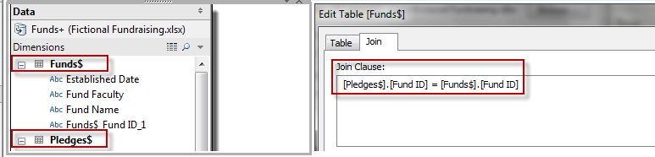
Data Set
The fundraising data set uses a JOIN to combine two worksheets - Funds and Pledges - from one source Excel workbook. The column common between the two worksheets, Fund ID, was used as the linking field.

Slide 3
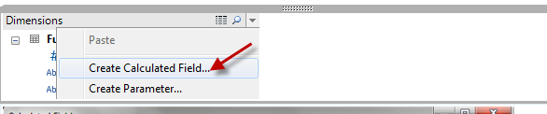
Calculated Fields
To create a calculated field, click on the dropdown arrow icon near the magnifying lens in the Dimensions window and select "Create Calculated Field..."

Slide 4
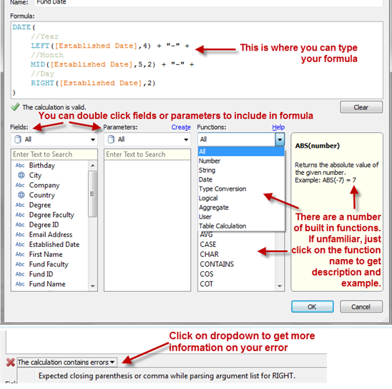
Calculated Fields
In the Formula text area, you can include fields, parameters and functions.
- Fields are the columns available from your data sources. You can double click them to include them in your formula, or simply type the name in.
- Parameters are user-driven values. You can include your user's input in the formula, and allow users to change the input via a parameter control on a worksheet or dashboard.
- Functions provide specific functionalities and computations. Tableau has a library of functions that you can use. If you are unfamiliar with these, you can click on a function name and its name, syntax, and an example will show up in the right hand descriptions pane.

Slide 5
Parameters
You can add interactivity and allow your users to interact with your worksheets and dashboards using parameters. Parameters are values that can change and drive other information in your views.

Slide 6
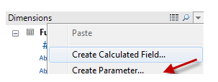
Parameters
To create a parameter, click on the dropdown arrow icon near the magnifying lens in the Dimensions window and select "Create Parameter..."

Slide 7
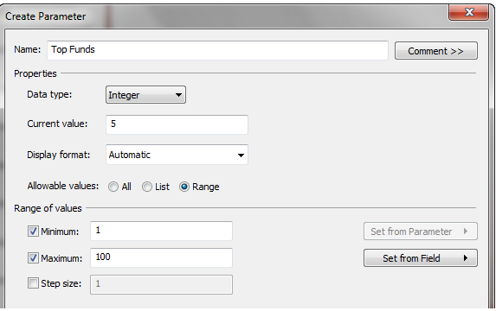
Parameters
This opens up a parameter dialog box. In this window, you can fill in the Name, Properties, and depending on the allowable values, a few more settings.
In the Formula text area, you can include fields, parameters and functions.
The data types can be Integer, Float, String, Boolean, Date and Date & time. The display formats can be changed accordingly.
You can also constrain the allowable values to a list, or a range.

Slide 8
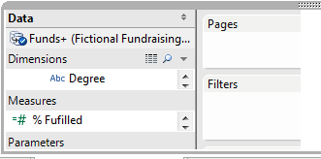
Parameters
If you want your users to control the parameter value, you will need to show the parameter control.
To do this, right click on the parameter in the Parameters section, and select "Show Parameter Control"

Slide 9
Data Type
Data type or simply type is a classification identifying one of various types of data
Tableau supports string, date/datetime, number, and boolean data types.
These data types are automatically handled in the proper fashion.
However, if you create calculated fields of your own, you need to be aware of how to use and combine the different data types in formulas.
For example, you cannot add a string to a number.
Also, many functions that are available to you when you define a calculation only work when they are applied to specific data types.
For example, the DATEPART() function can accept only a date/datetime data type as an argument.
So, you can write DATEPART('year',#April 15,2004#) and expect a valid result: 2004.
You cannot write DATEPART('year',"Tom Sawyer") and expect a valid result. In fact, this example returns an error because "Tom Sawyer" is a string, not a date/datetime.

Slide 10
STRING
A sequence of zero or more characters. For example, "Wisconsin", "ID-44400", and "Tom Sawyer" are all strings.
Strings are recognized by single or double quotes.
The quote character itself can be included in a string by repeating it. For example, ‘O''Hanrahan’.

Slide 11
DATE/DATETIME
A date or a datetime. For example "January 23, 1972" or "January 23, 1972 12:32:00 AM".
If you would like a date written in long-hand style to be interpreted as a a date/datetime, place the # sign on either side of it.
For instance, “January 23, 1972” is treated as a string data type but #January 23, 1972# is treated as a date/datetime data type.

Slide 12
BOOLEAN
A field that contains the values TRUE or FALSE.
An unknown value arises when the result of a comparison is unknown.
For example, the expression 7 > Null yields unknown.
Unknown booleans are automatically converted to Null

Slide 13
Float and Integer
Float - Stands for floating point
The number can contain a decimal component
Integer – whole number

Slide 14
IIF(
SUM([Pledge Amount]) >= 100000,
//if condition is true
"Major Gift Donor",
//otherwise
"Regular Donor"
)

