Slide 1
Excel and VBA Creating an Excel Application
Complete a software development life cycle
Use the Excel Object Model in VBA code
Create forms
Use financial functions
Create function procedures
Initialize, display, and close forms
Create or search a list in a worksheet
Prepare an application for distribution
Notes:
In chapter 2, Creating an Excel application you will explore the software development life cycle (SDLC) to create an application in Excel. Also, you will create forms, use financial functions, create function procedures, create a list, and prepare an application for distribution.

Slide 2
Completing a Software Development Life Cycle
Software developers use the software development life cycle (SDLC) to develop applications. Steps in the SDLC include:
1. Plan the application.
2. Design the user interface.
3. Write code to handle events.
4. Run and test the application to verify that it produces the intended results.
Notes:
It is good practice to follow a structured application development process. The software development life cycle (SDLC) is a structured process for planning, designing, testing, and implementing an application.

Slide 3
Step 1: Plan the Application
What information to obtain from the user?
How to manage and store user input?
How the applications act upon this information (calculations, data storage, and results)?
How to return the program results to the user?
Define the User Inputs and Outputs?
Notes:
Addressing these questions helps you design a custom application. Although the applications you customize in this chapter are relatively simple, getting into the practice of following the SDLC will help you as you learn to design more complex applications.

Slide 4
Step 2: Design the User Interface
The user interface includes all the controls that provide access to your application:
Forms for entering and editing data
Buttons for performing actions
Navigating between worksheets
Exiting the application
Notes:
When designing the user interface the developer will plan instructions for the user of the application, plan out any input forms necessary for data input and calculations, and display the calculated worksheets.

Slide 5
Step 3: Write the Code
Write the VBA code to handle the following:
Procedures
Functions
Click events
Input forms
Change property attributes
Notes:
The third step in designing an application is writing the VBA code procedures that handle
events and perform actions. The procedures created will associate each button’s
Click event and, in the case of the form for entering data, the Change events for two
controls.

Slide 6
Step 4: Run and Test the Application
Test your applications before distributing them.
Prepare test cases in which you define particular input values to enter.
Determine if the application produces the expected output.
Notes:
When testing a custom application, check for the following:
• Usability: the interface is intuitive and easy to use, controls are clearly labeled, and the
flow of controls is easy to read
• Accuracy: the calculations produce correct values based on input values entered
• Protection: the application anticipates user events and protects the application from modification that adversely impacts its use

Slide 7
Using the Excel Object Model in VBA Code
An object represents an element of the host application.
In Excel, objects can include worksheets, cells, charts, or forms.
The object model organizes all objects into an object hierarchy.
A collection is a group of objects with similar characteristics and behaviors.
Notes:
The object model is a framework that organizes objects into a hierarchy. An object is an element, such as a worksheet cell, within a host application. A collection is a group of objects with similar characteristics and behaviors.

Slide 8
Understanding Object Hierarchy
Indicate the worksheet (“Payment”)
Indicate the workbook that contains the worksheet (“Loan Calculator.xlsx”)
Indicate the Range (“B9”)
Indicate the Application object to directly identify the workbook.
Notes:
Assume you are creating a VBA procedure that needs to obtain a value from the Payment worksheet. The worksheet is a member of the Worksheets collection. Therefore, you specify the Worksheets object with the worksheet object name enclosed in quotation marks within the parentheses.
If you are working with two workbooks that both have a worksheet named Payment, you need to indicate which worksheet you want to manipulate, by indicating the name of the workbook.
When you reference multiple objects in a hierarchy, the top-level object is referenced first. A period (dot) separates the object references.

Slide 9
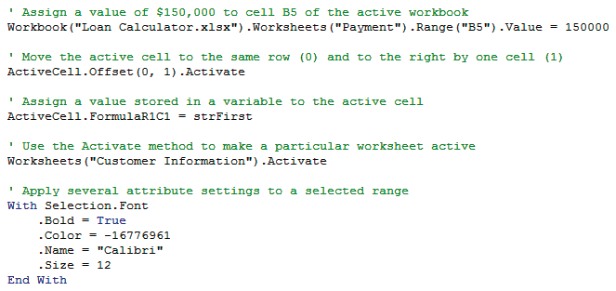
Manipulate Object Properties, Methods, and Events
Sample VBA code to manipulate properties
Notes:
Line 1 of the code in the example Code Window shows how to write code to change the value in a range (cell B5) in a specific worksheet (Payment) in a specific workbook (Loan Calculator). Line 2 of the code uses ActiveCell.Offset to move the active cell to the same row (0) and to the right one cell (1) and use the Activate method to activate that cell. Line 3 of the code uses ActiveCell.FormulaR1C1 to assign the content of the variable strFirst to the active cell. Line 4 of the code uses the Activate method to activate a specific worksheet (Customer Information). The last block of the code applies several Font property values (Bold, Color, Name, and Size) to a selected range at one time.

Slide 10
Manipulate Object Properties, Methods, and Events
A property is an attribute of an object that defines one of the object’s characteristics such as size or color
A method is an action that an object can perform.
An event is an action occurring at run time that triggers a program instruction.
Notes:
To change an object’s characteristics, you can use an assignment statement to set the value of a property. The object reference and property name are separated by a period, and an equal sign assigns a value to the property. An example of a method, the Worksheet objects have an Activate method, which makes a specified worksheet the active sheet. Range objects have a Clear method, which clears all the cells in a range. Recall that VBA is an event-driven language in which program statements execute at run time to process information or perform actions in response to events.

Slide 11
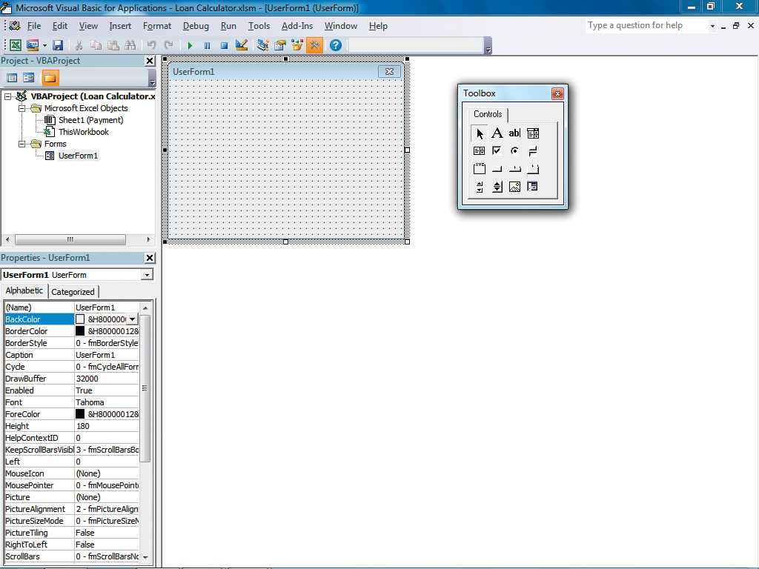
Creating Forms
Add a UserForm object to an Excel workbook.
Click Insert on the VBA menu bar, and then select UserForm.
Set the form’s properties, such as Name and Caption.
Notes:
By default, a UserForm is given the name UserForm1 or another integer value if more than one form has been added to an application. Adding a UserForm to an application also opens the Control Toolbox so that you can add controls to your form. After you insert a new UserForm object, you should set the form’s properties. Most of the form properties control the appearance of the form.

Slide 12
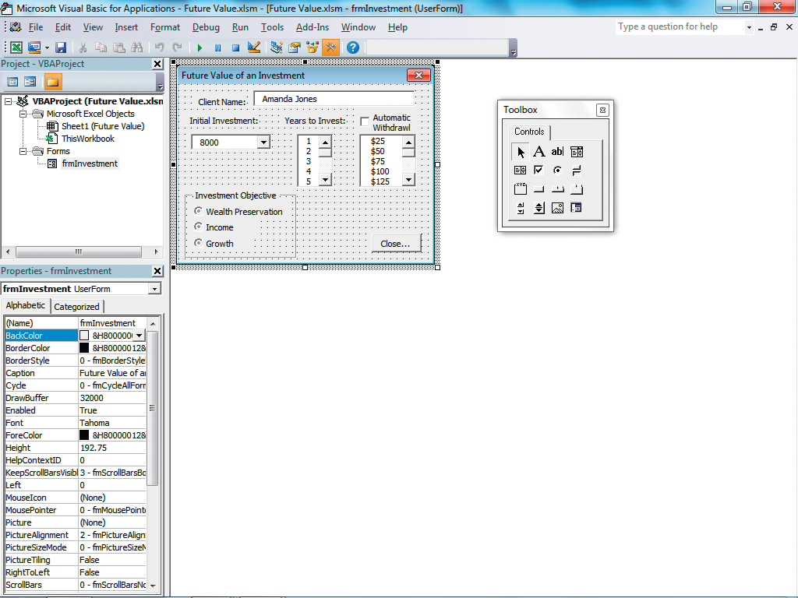
Creating Forms (Cont.)
Add controls to Forms
The Toolbox, contains the standard controls:
Text boxes or buttons
To add a control to a form, click a control icon in the Toolbox, then drag to create the control on the form.
Notes:
Common form controls include labels, text boxes, buttons, list boxes, check boxes, options buttons, and image controls. Each control provides specific functionality to a form. To add a control to a form, click a control icon in the Toolbox, and then drag to create the control on the form. Use the sizing handles to resize the control. You can also adjust the alignment, spacing, and appearance of the control using commands on the Format menu.

Slide 13
Creating Forms (Cont.)
An important property of all objects and controls is the Name property.
Used to reference the object in the program code
Example: cmdExit for a command button
The Properties window is used to change the control’s properties.
Displays the properties and current settings for the selected object
Notes:
The Name property is an object or control’s attribute with which you reference that object in code. You should have names long enough to be meaningful but short enough to be easily understood. The Modified Hungarian Notation is the most common standard for naming controls in Visual Basic. This convention precedes the name of each instance of a control with a three-character prefix to the control and a descriptive title for the control. The three-character prefix appears in lowercase, and the descriptive title starts with an uppercase character. In the example, cmdExit, lower case cmd represents the Command Button control and the Exit, represents the button name.

Slide 14
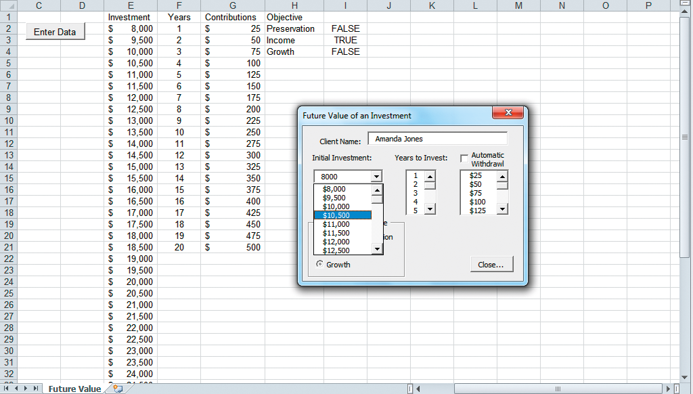
Use Bound and Unbound Controls
A bound control is connected to a data source in the application.
The data source can be a cell or a range of cells.
An unbound control is not connected to data in the application.
Notes:
A bound control is connected to a data source in the host application. An unbound control is not connected to a data source in the host application. The ControlSource property is an attribute that defines the cell to which a control is bound. The RowSource property specifies items through a worksheet range that will appear in a list box or combo box at run time.

Slide 15
Setting Other Control Properties
The Enabled property determines if a control can receive focus and if that control can respond to the user.
The TabStop property determines whether a control receives focus when the Tab key is pressed.
The TabIndex property determines the order in which a control receives the focus.
The TextAlign property specifies the alignment of a caption appearing in a label.
Notes:
Setting Control Properties ensures that the Control functions correctly for the users and allows for the use of the Tab key for quick data entry.

Slide 16
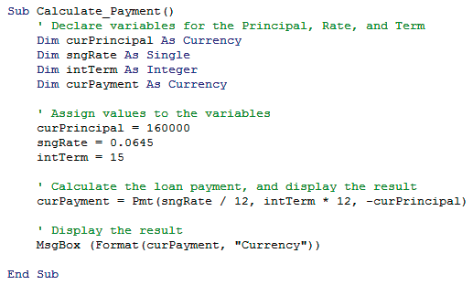
Using Financial Functions
Excel and VBA include a set of financial functions for performing calculations related to:
Payments
Investments
Depreciation of assets
Notes:
By taking advantage of Excel and VBA functions, your custom application can perform virtually any task. Examples of VBA Financial functions include: IPmt, Pmt, PPmt calculates payments; NPV, PV calculates present value; Rate calculates an interest rate; and DDB, SLN, SYD calculates depreciation.

Slide 17
Creating Function Procedures
A function procedure begins with the Function statement and concludes with the End Function statement.
A function procedure returns a value back to the calling procedure.
Functions can be used multiple times in an application.
Notes:
A calling procedure is a statement within a procedure that calls or executes a function.
A function returns a value back to the calling procedure.

Slide 18
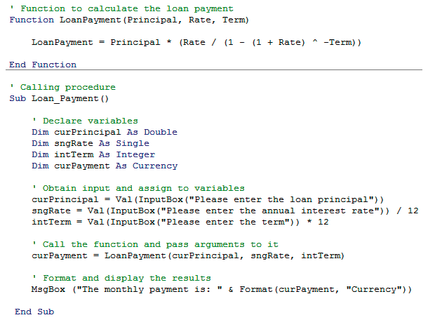
Example Function Procedure
Notes:
The Loan_Payment sub procedure is the main procedure. The procedure declares four variables. The procedure also displays input boxes to obtain the values from the user, and converts the data to values before storing the values in the declared variables. The procedure calls the function LoanPayment and also passes three pieces of data, curPrincipal, sngRate, and intTerm to the function. The function LoanPayment accepts the values into three arguments, Principal, Rate, and Term. The values in the three arguments are used to calculate the loan payment. The result is returned to the calling procedure and placed in curPayment.

Slide 19
Insert Controls on a Worksheet
A worksheet control, such as a command button, is used to open the form and initialize the application.
The first task is to insert a button on the worksheet that displays and initializes the user form.
The second task is to edit the control and set properties.
Notes:
To insert a control, click the Developer tab, click Insert in the Controls group, and then click the icon for the type of control you want to insert. When you add a control from the Control Toolbox to an Excel worksheet, the control is in Design mode, which enables you to edit the control. You can also display the Properties window for a control in Design mode.

Slide 20
Show, Hide, and Unload Forms
The form displays as a modal form.
A modal form disables all other worksheet objects until the form is closed.
All data entry and editing must be done while the form is open.
The Show method displays the form.
The Hide method closes the form, but does not remove it from memory.
To unload a form from memory, use the Unload frmFormName statement.
Notes:
The command button that displays the data entry form handles a click event that opens the
form from the worksheet. The Show method displays the form. The Hide method closes the form. To unload a form from memory, use the statement Unload frmFormName.

Slide 21
Creating or Searching a List
Programmers can write VBA code that creates a list.
Programmers also write VBA code to search within an existing list in a worksheet.
Use a repetition structure (i.e., loop) to create a list.
Each iteration through the loop, data is entered on the next blank line in the list.
Notes:
Sometimes, it is useful to write VBA code that creates a list or search within an existing list
in a worksheet. For example, you might want to create an amortization table that lists each monthly payment’s details for a particular loan. You can use a repetition structure (i.e., loop) to create a list where through each iteration, data is entered on the next blank line in the list.

Slide 22
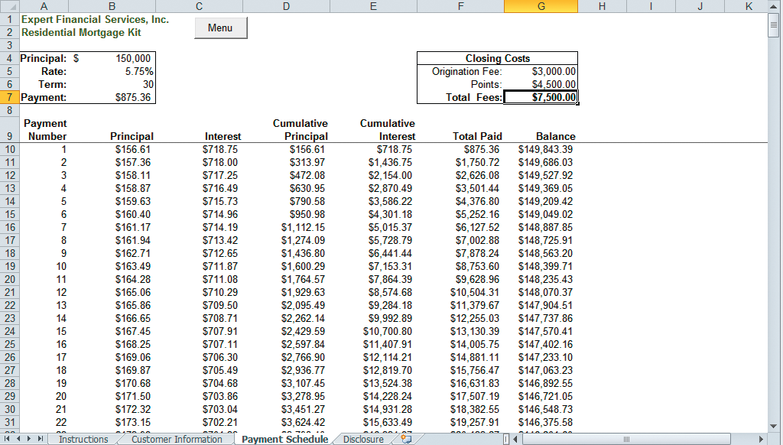
Creating or Searching a List (Cont.)
Loan details
Closing costs
List created through
repetition structure
Notes:
The Payment Schedule worksheet to display the loan principal, term, rate, monthly payment, and closing costs. It also displays the following details for each monthly payment:
the payment number, the amount of the monthly payment that applies to the loan principal,
the amount of the monthly payment that applies to the loan interest, the principal paid to date, the interest paid to date, the total principal and interest paid to date, and the outstanding loan balance.

Slide 23
Preparing an Application for Distribution
When all data entry is through the form, the worksheets need to have protection set.
The formula bar and row and column headings can be hidden.
This improves the user interface and prevents users from trying to make changes directly to worksheet cells.
Do final testing of the application for functionality.
Notes:
When you create a custom application you should test its functionality before you distribute it. However, before testing the application, you should prepare the application for distribution.

