Slide 1
Data Analytics

Slide 2
What is Data Analytics?
Analytics is the use of:
data,
information technology,
statistical analysis,
quantitative methods, and
mathematical or computer-based models
to help managers gain improved insight about their business operations and make better, fact-based decisions.
Business Analytics (BI) is a subset of Data Analytics

Slide 3
What is Business Analytics?
Business Analytics Applications
Management of customer relationships
Financial and marketing activities
Supply chain management
Human resource planning
Pricing decisions
Sport team game strategies

Slide 4
What is Business Analytics?
Importance of Business Analytics
There is a strong relationship of BA with:
- profitability of businesses
- revenue of businesses
- shareholder return
BA enhances understanding of data
BA is vital for businesses to remain competitive
BA enables creation of informative reports

Slide 5
Scope of Business Analytics
Descriptive analytics
- uses data to understand past and present
Predictive analytics
- analyzes past performance
Prescriptive analytics
- uses optimization techniques

Slide 6
Scope of Business Analytics
Retail Markdown Decisions
Most department stores clear seasonal inventory by reducing prices.
The question is:
When to reduce the price and by how much?
Descriptive analytics: examine historical data for similar products (prices, units sold, advertising, …)
Predictive analytics: predict sales based on price
Prescriptive analytics: find the best sets of pricing and advertising to maximize sales revenue

Slide 7
Data for Business Analytics
DATA
- collected facts and figures
DATABASE
- collection of computer files containing data
INFORMATION
- comes from analyzing data

Slide 8
Data for Business Analytics
Metrics are used to quantify performance.
Measures are numerical values of metrics.
Discrete metrics involve counting
- on time or not on time
- number or proportion of on time deliveries
Continuous metrics are measured on a continuum
- delivery time
- package weight
- purchase price

Slide 9
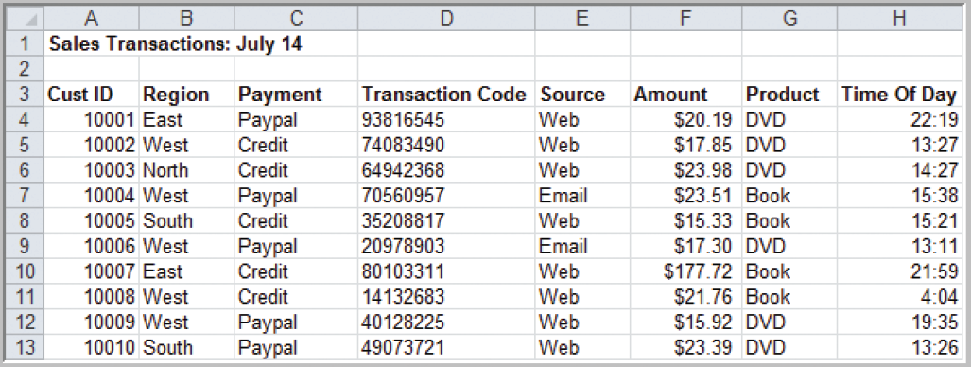
Data for Business Analytics
A Sales Transaction Database File
Records
Figure 1.1
Entities
Fields or Attributes

Slide 10
What is Big Data?
Information from multiple internal and external sources:
Transactions
Social media
Enterprise content
Sensors
Mobile devices
Companies leverage data to adapt products and services to:
Meet customer needs
Optimize operations
Optimize infrastructure
Find new sources of revenue
Can reveal more patterns and anomalies
IBM estimates that by 2015 4.4 million jobs will be created globally to support big data
1.9 million of these jobs will be in the United States

Slide 11
Types of Data

Slide 12
When collecting or gathering data we collect data from individuals cases on particular variables.
A variable is a unit of data collection whose value can vary.
Variables can be defined into types according to the level of mathematical scaling that can be carried out on the data.
There are four types of data or levels of measurement:
1. Categorical (Nominal) | 2. Ordinal
3. Interval | 4. Ratio
Notes:
When thinking about research we are looking at gathering knowledge through some form of observation.
Research in the scientific sense, as talked about in the first lecture, involves the systematic measurement of these observations.
When we observe something we understand that observation in terms of its attributes for example, colour or texture, and we look at how that attribute varies across our observations.
So, when we collect or gather data we collect information from individual cases (people, organisations, businesses and so on) about particular variables.
Level of mathematical scaling? The level of mathematical precision with which the values of a variable can be expressed.

Slide 13
Data for Business Analytics
Classifying Data Elements in a Purchasing Database
Figure 1.2

Slide 14
Data for Business Analytics
(continued)
Classifying Data Elements in a Purchasing Database
Figure 1.2
Ratio
Ratio
Ratio
Ratio
Categorical
Categorical
Categorical
Interval
Interval
Categorical

Slide 15
Categorical (Nominal) data
Nominal or categorical data is data that comprises of categories that cannot be rank ordered – each category is just different.
The categories available cannot be placed in any order and no judgement can be made about the relative size or distance from one category to another.
Categories bear no quantitative relationship to one another
Examples:
- customer’s location (America, Europe, Asia)
- employee classification (manager, supervisor,
associate)
What does this mean? No mathematical operations can be performed on the data relative to each other.
Therefore, nominal data reflect qualitative differences rather than quantitative ones.

Slide 16
Nominal data
Examples:
What is your gender? (please tick)
Male
Female
Did you enjoy the film? (please tick)
Yes
No

Slide 17
Nominal data
Systems for measuring nominal data must ensure that each category is mutually exclusive and the system of measurement needs to be exhaustive.
Variables that have only two responses i.e. Yes or No, are known as dichotomies.
Notes:
Mutually exclusive: each observation (person, case, score) cannot fall into more than one category.
Exhaustive: the system of categories system should have enough categories for all the observations.

Slide 18
Ordinal data
Ordinal data is data that comprises of categories that can be rank ordered.
Similarly with nominal data the distance between each category cannot be calculated but the categories can be ranked above or below each other.
No fixed units of measurement
Examples:
- college football rankings
- survey responses
(poor, average, good, very good, excellent)
What does this mean? Can make statistical judgements and perform limited maths.
Notes:
Ordinal data works with the same assumptions as nominal data but is more complex in that here, whilst still comprising of categories, now the categories
themselves can be rank-ordered i.e. one category has more or less of some underlying quality than being in another category.
What does this mean? We can make statistical judgements about the relative position of one value to another and can perform limited mathematical calculations.

Slide 19
Ordinal data
Example:
How satisfied are you with the level of service you have received? (please tick)
Very satisfied
Somewhat satisfied
Neutral
Somewhat dissatisfied
Very dissatisfied

Slide 20
Interval and ratio data
Both interval and ratio data are examples of scale data.
Scale data:
data is in numeric format ($50, $100, $150)
data that can be measured on a continuous scale
the distance between each can be observed and as a result measured
the data can be placed in rank order.
Notes:
Ordinal data can be ranked – similarly interval and ratio data also operate on a mechanism of scale. The key difference is that with interval and ratio data the data is numerical and has numerically equal distances between each category. For example, a 5cm difference in height between 150cm and 155cm is the same as a 5cm difference between 15cm and 20cm.
Imagine a 30cm ruler – it shows equal distance between each mark i.e. 10 1mm markers between each cm.

Slide 21
Interval data
Ordinal data but with constant differences between observations
Ratios are not meaningful
Examples:
Time – moves along a continuous measure or seconds, minutes and so on and is without a zero point of time.
Temperature – moves along a continuous measure of degrees and is without a true zero.
SAT scores
Notes:
Temperature and true zero – whilst there is a zero degrees this is a measure of temperature!

Slide 22
Ratio data
Ratio data measured on a continuous scale and does have a natural zero point.
Ratios are meaningful
Examples:
monthly sales
delivery times
Weight
Height
Age

Slide 23
Types of Analytics

Slide 24
Decision Models
Model:
An abstraction or representation of a real system, idea, or object
Captures the most important features
Can be a written or verbal description, a visual display, a mathematical formula, or a spreadsheet representation

Slide 25
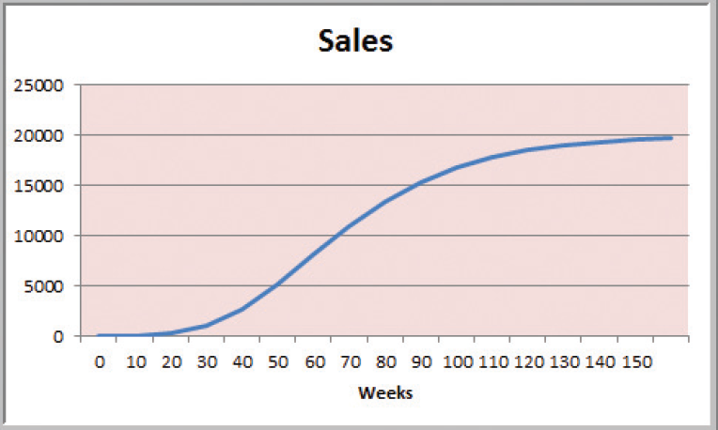
Decision Models
Figure 1.3

Slide 26
Decision Models
A decision model is a model used to understand, analyze, or facilitate decision making.
Types of model input
- data
- uncontrollable variables
- decision variables (controllable)

Slide 27
Decision Models
Descriptive Decision Models
Simply tell “what is” and describe relationships
Do not tell managers what to do
An Influence Diagram for Total Cost

Slide 28
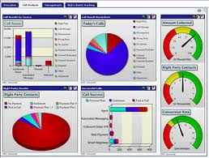
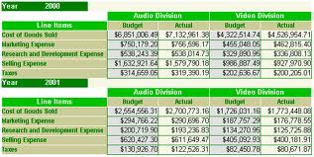
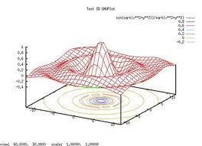
Descriptive Analytics
Descriptive analytics, such as reporting/OLAP, dashboards, and data visualization, have been widely used for some time.
They are the core of traditional BI.
What has occurred?
Descriptive analytics, such as data visualization, is important in helping users interpret the output from predictive and predictive analytics.
Notes:
Descriptive analytics, such as reporting/OLAP, dashboards, and data visualization, have been widely used for some time. They are the core of traditional BI.

Slide 29
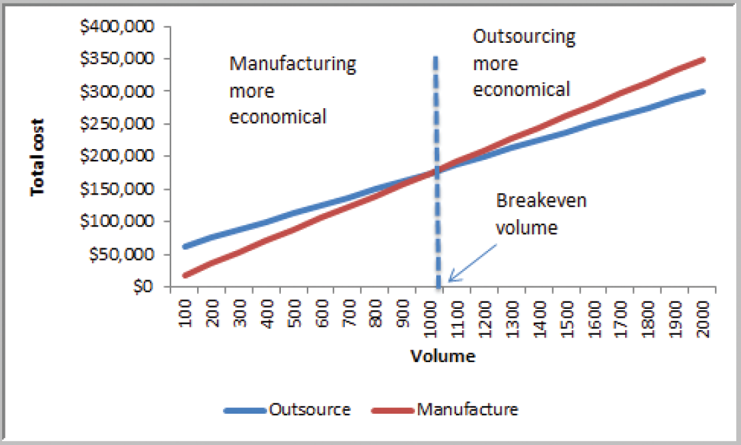
Decision Models
A Break-even Decision Model
TC(manufacturing) = $50,000 + $125*Q
TC(outsourcing) = $175*Q
Breakeven Point:
Set TC(manufacturing)
= TC(outsourcing)
Solve for Q = 1000 units
Figure 1.7

Slide 30
Decision Models
Predictive Decision Models often incorporate uncertainty to help managers analyze risk.
Aim to predict what will happen in the future.
Uncertainty is imperfect knowledge of what will happen in the future.
Risk is associated with the consequences of what actually happens.

Slide 31
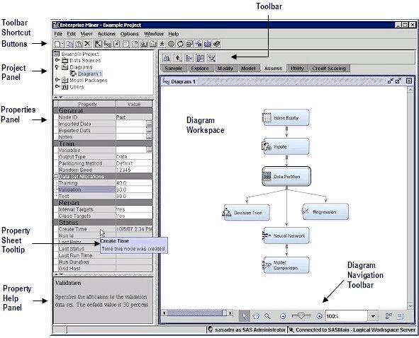
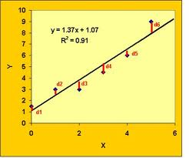
Predictive Analytics
Algorithms for predictive analytics, such as regression analysis, machine learning, and neural networks, have also been around for some time.
Prescriptive analytics are often referred to as advanced analytics.
What will occur?
Marketing is the target for many predictive analytics applications.
Descriptive analytics, such as data visualization, is important in helping users interpret the output from predictive and prescriptive analytics.
Notes:
Algorithms for predictive analytics, such as regression analysis, machine learning, and neural networks, have also been around for some time. Recently, however, software products have made them much easier to understand and use. They have also been integrated into specific applications, such as for campaign management. Marketing is the target for many predictive analytics applications. Descriptive analytics, such as data visualization, is important in helping users interpret the output from predictive and predictive analytics. Prescriptive analytics are often referred to as advanced analytics.

Slide 32
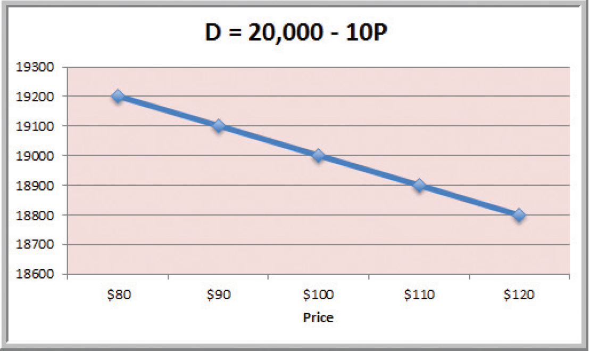
Decision Models
A Linear Demand Prediction Model
As price increases, demand falls.
Figure 1.8

Slide 33
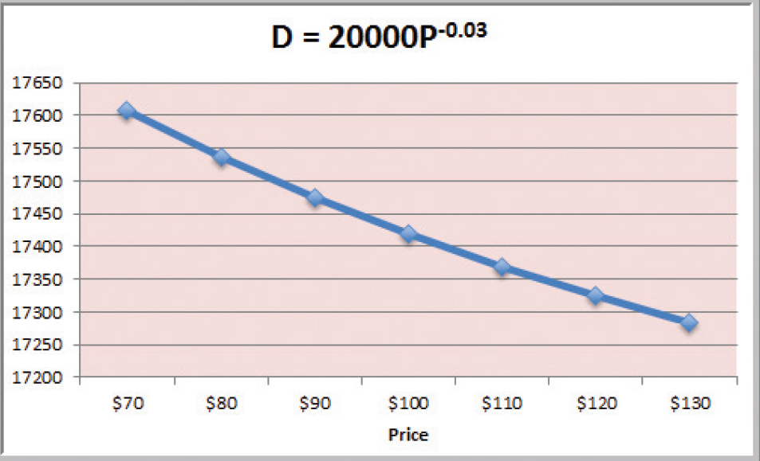
Decision Models
A Nonlinear Demand Prediction Model
Assumes price elasticity (constant ratio of % change in demand to % change in price)
Figure 1.9

Slide 34
Decision Models
Prescriptive Decision Models help decision makers identify the best solution.
Optimization - finding values of decision variables that minimize (or maximize) something such as cost (or profit).
Objective function - the equation that minimizes (or maximizes) the quantity of interest.
Constraints - limitations or restrictions.
Optimal solution - values of the decision variables at the minimum (or maximum) point.

Slide 35
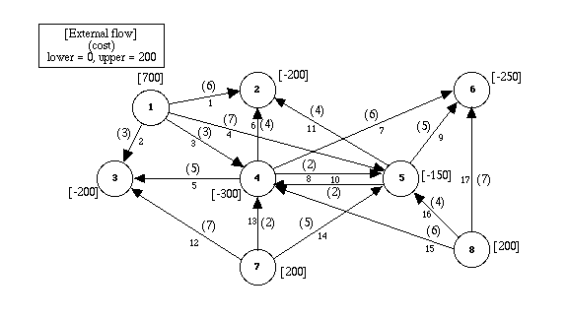
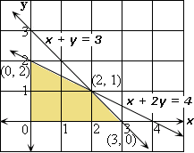
Prescriptive Analytics
Prescriptive analytics are often referred to as advanced analytics.
Regression analysis, machine learning, and neural networks
Often for the allocation of scarce resources
What should occur?
For example, the use of mathematical programming for revenue management is common for organizations that have “perishable” goods (e.g., rental cars, hotel rooms, airline seats).
Harrah’s has been using revenue management for hotel room pricing for some time.
Notes:
Prescriptive analytics provide an optimal solution, often for the allocation of scarce resources. They, too, have been in academia for a long time but are now finding wider use in practice. For example, the use of mathematical programming for revenue management is common for organizations that have “perishable” goods (e.g., rental cars, hotel rooms, airline seats). Harrah’s has been using revenue management for hotel room pricing for some time.

Slide 36
Organizational Transformation
Brought about by opportunity or necessity
The firm adopts a new business model enabled by analytics
Analytics are a competitive requirement
Notes:
This is the most interesting target. It occurs when a company either sees an opportunity or faces a problem that requires a new business model that can only be executed using analytics. To an extent, analytics is the business. Without analytics, the business model cannot be execute and the company cannot compete.

Slide 37
2013 Academic Research
A 2011 TDWI report on Big Data Analytics found that 85% of respondents indicated that their firms would be using advanced analytics within three years
A 2011 IBM/MIT Sloan Management Review research study found that top performing companies in their industry are much more likely to use analytics rather than intuition across the widest range of possible decisions.
Notes:
The relationship between the use of data and analytics in decision making and a variety of organizational performance measures is described in a 2011 study by Brynjolfsson, Hitt, and Kim in the Social Science Research Network (SSRN).
Also, A 2010 IBM/MIT Sloan Management Review research study found that top performing companies in their industry are much more likely to use analytics rather than intuition across the widest range of possible decisions.
A 2011 TDWI report on Big Data Analytics found that 85% of respondents indicated that their firms would be using advanced analytics within three years.
A 2011 IDC study found that analytics is one of the top two IT priorities for this year.

Slide 38
Conditions that Lead to Analytics-based Organizations
The nature of the industry
Seizing an opportunity
Responding to a problem

Slide 39
Complex Systems
Tackle complex problems and provide individualized solutions
Products and services are organized around the needs of individual customers
Dollar value of interactions with each customer is high
There is considerable interaction with each customer
Examples: IBM, World Bank, Halliburton

Slide 40
Volume Operations
Serves high-volume markets through standardized products and services
Each customer interaction has a low dollar value
Customer interactions are generally conducted through technology rather than person-to-person
Are likely to be analytics-based
Examples: Amazon.com, eBay, Hertz
Notes:
Analytics are critical to high volume companies competing in the marketplace.

Slide 41
The Nature of the Industry: Online Retailers
BI Applications
Analysis of clickstream data
Customer profitability analysis
Customer segmentation analysis
Product recommendations
Campaign management
Pricing
Forecasting
Dashboards
Notes:
Online retailers like Amazon.com and Overstock.com are great examples of high volume operations who rely on analytics to compete. As soon as you enter, their sites a cookie is placed on your PC and all clicks are recorded. Based on your clicks and any search terms, recommendation engines decide what products to display. After you purchase an item, they have additional information that is used in marketing campaigns. Customer segmentation analysis is used in deciding what promotions to send you. How profitable you are influences how the customer care center treats you. A pricing team helps set prices and decides what prices are needed to clear out merchandise. Forecasting models are used to decide how many items to order for inventory. Dashboards monitor all aspects of organizational performance.

Slide 42
The Nature of the Industry
Online retailers like Amazon.com and Overstock.com are high volume operations who rely on analytics to compete.
When you enter their sites a cookie is placed on your PC and all clicks are recorded.
Based on your clicks and any search terms, recommendation engines decide what products to display.
After you purchase an item, they have additional information that is used in marketing campaigns.
Customer segmentation analysis is used in deciding what promotions to send you.
How profitable you are influences how the customer care center treats you.
A pricing team helps set prices and decides what prices are needed to clear out merchandise.
Forecasting models are used to decide how many items to order for inventory.
Dashboards monitor all aspects of organizational performance
Notes:
Online retailers like Amazon.com and Overstock.com are great examples of high volume operations who rely on analytics to compete. As soon as you enter, their sites a cookie is placed on your PC and all clicks are recorded. Based on your clicks and any search terms, recommendation engines decide what products to display. After you purchase an item, they have additional information that is used in marketing campaigns. Customer segmentation analysis is used in deciding what promotions to send you. How profitable you are influences how the customer care center treats you. A pricing team helps set prices and decides what prices are needed to clear out merchandise. Forecasting models are used to decide how many items to order for inventory. Dashboards monitor all aspects of organizational performance.

Slide 43
Analytics Help the Cincinnati Zoo Know Its Customers
What management, organization, and technology factors were behind the Cincinnati Zoo losing opportunities to increase revenue?
Why was replacing legacy point-of-sale systems and implementing a data warehouse essential to an information system solution?
How did the Cincinnati Zoo benefit from business intelligence? How did it enhance operational performance and decision making? What role was played by predictive analytics?
Visit the IBM Cognos Web site and describe the business intelligence tools that would be the most useful for the Cincinnati Zoo.

