Slide 1
Why Project Management? (Chapter 1 and More)

Slide 2
Project Management Overview
This material is based on the Fifth Edition of the Guide to the Project Management Body of Knowledge (PMBOK® Guide*) published by the Project Management Institute (PMI*) in 2013.
*PMI and PMBOK are registered marks of Project Management Institute, Inc.

Slide 3
Learning Objectives
After completing this chapter, students will be able to:
Understand why project management is becoming such a powerful and popular practice in business.
Recognize the basic properties of projects, including their definition.
Understand why effective project management is such a challenge.
Differentiate between project management practices and more traditional, process-oriented business functions.
Recognize the key motivators that are pushing companies to adopt project management practices.

Slide 4
CONTENTS
Module 1: Elements of Project Management
Module 2: The Project Management Context
Module 3: Project Organizational Influences
Module 4: The I/S Organizational Context

Slide 5
Elements of Project Management

Slide 6
Project Management Institute (PMI®)
The world’s leading project management professional organization
Administers the globally recognized PMP® (Project Management Professional) certification
Publishes the Guide to the Project Management Body of Knowledge – known more colloquially as the PMBOK® Guide
The material in this series is based on the 5th Edition of the PMBOK® Guide
*PMI, PMP and PMBOK are registered marks of Project Management Institute, Inc.

Slide 7
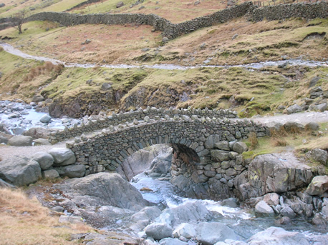
What is a Project?
A project has:
Requirements
A Schedule
A Budget
Closure Criteria

Slide 8
Elements of Projects
Complex, one-time processes
Limited by budget, schedule, and resources
Developed to resolve a clear goal or set of goals
Customer-focused

Slide 9
Process vs. Project Work
Process
Ongoing, day-to-day activities to produce goods and services
Use existing systems, properties, and capabilities
Typically repetitive
Project
Take place outside the normal, process-oriented world
Unique and separate from routine, process-driven work
Continually evolving
A project is a temporary endeavor undertaken to create a unique product or service.

Slide 10
Project Management …
Project management is the application of knowledge, skills, tools, and techniques to project activities to meet project requirements.
Guide to the Project Management Body of
Knowledge (PMBOK® Guide)

Slide 11
Project Definitions Summarized
A project can be considered any series of activities and tasks that have:
Specific objectives to be completed within certain specifications,
Defined start and end dates,
Funding limits,
Human and nonhuman resources, and
Multifunctional focus.

Slide 12
Elements of Projects
Complex, one-time processes
Limited by budget, schedule, and resources
Developed to resolve a clear goal or set of goals
Customer-focused

Slide 13
General Project Characteristics
Entail crossing functional and organization boundaries
Traditional management functions of planning, organizing, motivating, directing, and controlling apply
Principal outcomes are the satisfaction of customer requirements within technical, cost, and schedule objectives
Terminated upon successful completion of performance objectives

Slide 14
Project Success Rates
Software & hardware projects fail at a 65% rate,
Over half of all IT projects become runaways,
Only 30% of technology-based projects and programs are a success.
Only 2.5% of global businesses achieve 100% project success and over 50% of global business projects fail,
Average success of business-critical application development projects is 32%, and
Approximately 42% of the 1,200 Iraq reconstruction projects were eventually terminated due to mismanagement or shoddy construction

Slide 15
Why are Projects Important?
Shortened product life cycles
Narrow product launch windows
Increasingly complex and technical products
Emergence of global markets
Economic period marked by low inflation

Slide 16
Project Life Cycles
Man Hours
Conceptualization
Planning
Execution
Termination
Fig 1.3 Project Life Cycle Stages

Slide 17
Project Life Cycles
Conceptualization - the development of the initial goal and technical specifications.
Planning – all detailed specifications, schedules, schematics, and plans are developed
Execution – the actual “work” of the project is performed
Termination – project is transferred to the customer, resources reassigned, project is closed out.

Slide 18
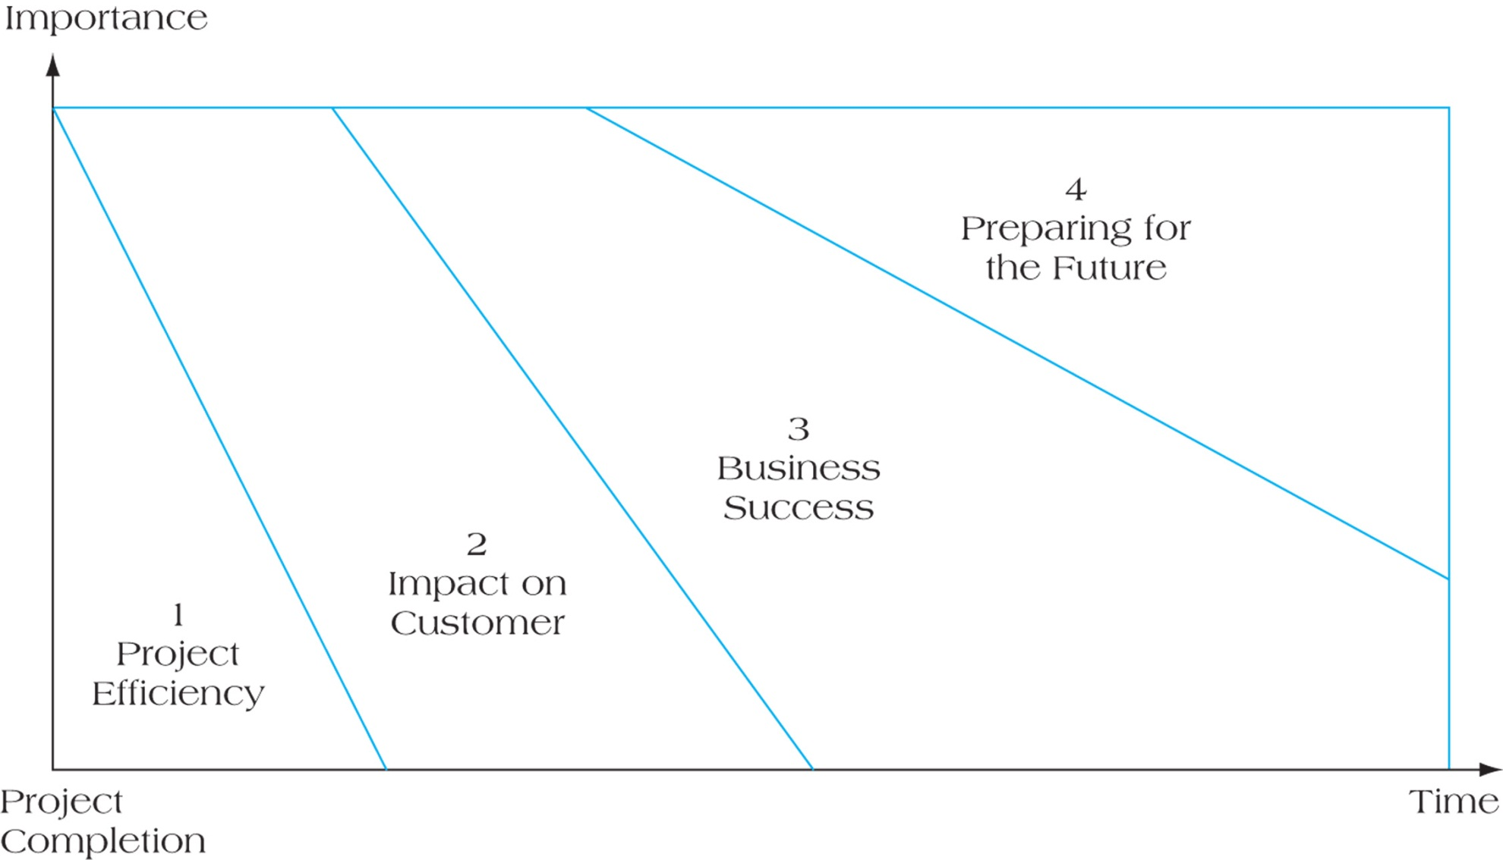
Four Dimensions of Project Success
FIGURE 1.7

Slide 19
Six Criteria for IT Project Success
System quality
Information quality
Use
User satisfaction
Individual impact
Organizational impact

Slide 20
A Sampling of Project Management Tasks
Insuring involvement of all stakeholders
Resource allocation
Resource planning
Schedule planning
Monitoring progress of the work and adjusting the work plan accordingly
Team development and leadership
Risk management
Managing client and customer interactions and expectations
Change management

Slide 21
Importance of Processes
The effective and reliable application of knowledge and skills is greatly enhanced by a well-defined set of processes
Such a set of processes can help to ensure that the application of the appropriate knowledge skills repeatedly produces the desired outcomes over a wide range of project types as well as over a wide range of project teams.
In short, robust and well-defined processes are a key component to ensuring high degrees of predictability and repeatability in the successful management of projects within any organization

Slide 22
Definition of a Process
A systematic series of activities directed towards causing an end result, such that one or more inputs will be acted upon to create one or more outputs.
Guide to the Project Management Body of
Knowledge (PMBOK® Guide)

Slide 23
Accomplishing Tasks through Processes
The PMBOK® Guide identifies a total of 47 fundamental project management processes
These processes are logically grouped in two complementary ways: by major process group and by project management knowledge area
There are five process groups
There are ten knowledge areas
The knowledge areas are integrated across various process groups

Slide 24
Project Manager Responsibilities
Selecting a team
Developing project objectives and a plan for execution
Performing risk management activities
Cost estimating and budgeting
Scheduling
Managing resources

Slide 25
Knowledge
Areas
Project Management Process Groups
Initiating Planning Executing Monitoring/Controlling Closing
Integration
Management
Develop Project Charter
Develop Project Management Plan
Direct and Manage Project Work
Monitor and Control Project Work
Perform Integrated Change Control
Close Project or Phase
Scope
Management
Plan Scope Management
Collect Requirements
Define Scope
Create WBS
Validate Scope
Control Scope
Plan Schedule Management
Define Activities
Sequence Activities
Estimate Activity Resources
Estimate Activity Durations
Develop Schedule
Control Schedule
Adapted from PMBOK® Guide
Time
Management
Cost
Management
Plan Cost Management
Estimate Costs
Determine Budget
Control Costs
Quality
Management
Plan Quality Management
Perform Quality Assurance
Control Quality
Human Resource
Management
Plan Human Resource Management
Acquire Project Team
Develop Project Team
Manage Project Team
Communications
Management
Plan Communications Management
Manage Communications
Control Communications
Plan Risk Management
Identify Risks
Quantitative Risk Analysis
Qualitative Risk Analysis
Plan Risk Responses
Control Risks
Risk
Management
Procurement
Management
Plan Procurement Management
Conduct Procurements
Control Procurements
Close Procurements
Stakeholder
Management
Identify Stakeholders
Plan Stakeholder Management
Manage Stakeholder Engagement
Control Stakeholder Engagement

Slide 26
The Five Project Management Process Groups
Monitoring/Controlling
Planning
Initiating
Closing
Adapted from the Guide to the Project Management Body of Knowledge (PMBOK® Guide)
Executing

Slide 27
Process Groups are not Phases
It is important to make a basic point: The project management process groups are not project phases
It is often tempting to identify phases and process groups, but there are some distinct differences between the two
A primary difference is that the process groups are inter-related in more essential ways than phases
In fact the Planning, Executing, and Controlling/Monitoring process groups have an inherent iterative relationship in all projects

Slide 28
The Iterative Heart of the Matter
The Iteration is driven by the Monitoring and Controlling Process. This process involves monitoring a project so problems can be corrected and plans updated.
Monitoring/Controlling
Planning
Initiating
Closing
Executing

Slide 29
Project Management at a High Level
There are three high-level three major activities that every project manager must focus on:
Discover and understand the project requirements
Address the needs, concerns, and expectations of project stakeholders as the project proceeds
Balance competing project constraints throughout the project

Slide 30
Project Management Constraints
What are some of the major competing constraints that every project will involve?
The project schedule
The project budget
The scope of the work to be done
The quality of the project deliverables
Resource availability
Major risks inherent in the project
Stakeholder characteristics

Slide 31
Project Management Constraints (cont’d)
Balancing these constraints is not an easy task, because they are always inter-related
If any one of them changes, at least one (and perhaps more) of the others is likely to change as well:
If the project schedule slips, this will almost certainly have an effect on the project budget as work must be re-arranged and re-planned
Similarly, if the schedule and budget change, it is highly likely that the scope of work, or the quality (perhaps both), will be impacted
Clearly, resource availability can have direct effect on the project schedule, which puts into play all the cascading effects just described
And, when risk events actually occur, there will most certainly be impacts on one or several of the other factors

Slide 32
Project Management Constraints (cont’d)
Of course, the bottom-line responsibility of the project manager is to see that the project requirements are satisfied on schedule and on budget
So the project manager’s life is greatly complicated by the inter-relationships among the various major project constraint factors

Slide 33
Project Planning is Iterative
As conditions change, competing constraints must be managed
So a project plan must be progressively monitored and elaborated
Progressive elaboration allows a project manager to better match the project plan to reality as the project evolves
Notes:
© The KTP Company, 2005
33

Slide 34
Project Management Triple Constraints
The specific project will determine the constraints on which the project manager should focus
However, in every project, the project manager must pay close attention the so-called Triple Constraints of project management
Triple
Constraints
Time
Cost
A Balancing Act
Quality
(Scope, Performance)

