Slide 1
Determining Effective Data Display with Charts

Slide 2
Chart Types Covered
Column
Line
Pie
Stock
XY (Scatter)
Area
Bubble

Slide 3
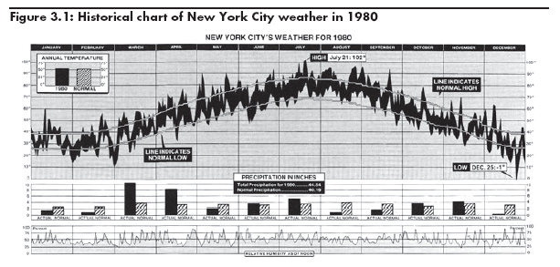
Visualizing Data

Slide 4
Data Graphics Principles

Slide 5
Data Graphics Principles
“Above all else show the data”
Reminder not to clutter a chart by adding unneeded illustration or decoration.
“Maximize the data-ink ratio”
Refers to the portion of ink that is devoted to displaying the data vs. the portion of graphic that can be removed without losing the data.

Slide 6
Data Graphics Principles
“Erase non-data-ink”
Non-data-ink is a part of the chart that decorates more than informs.
“Erase redundant data ink”
Redundant data ink is ink that repeats information.
“Revise and edit”
Revise and edit charts like you would a piece of writing.

Slide 7
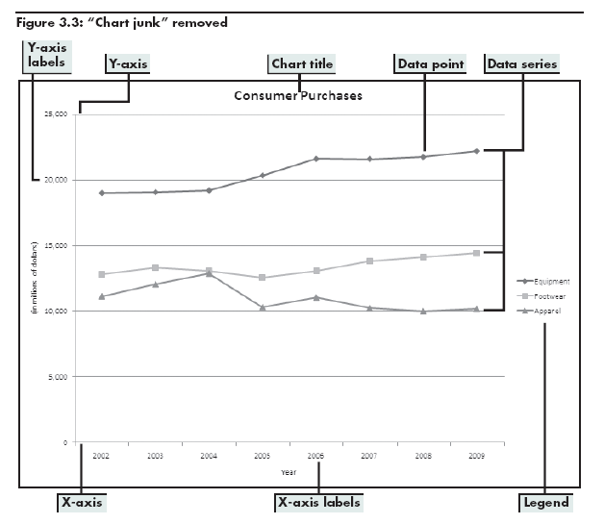
Data Graphics Principles

Slide 8
Effective Charting in Excel
Creating Chart in Excel
Select data to display
Click Insert tab on Ribbon
Click a button in Charts group or dialog box launcher

Slide 9
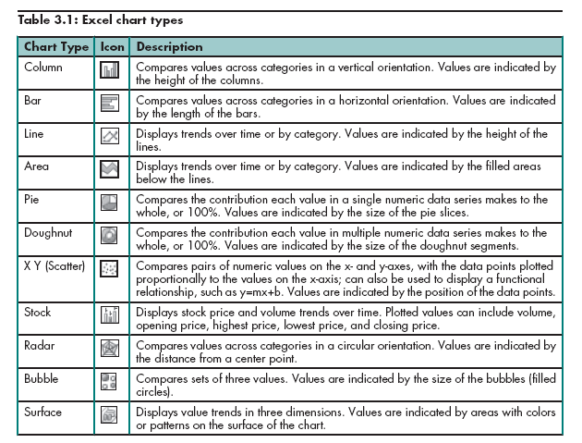
Chart Types

Slide 10
Understanding Line and Column Charts
Line chart- displays trends over time or by category.
Column chart- compares values across categories in a vertical orientation.

Slide 11
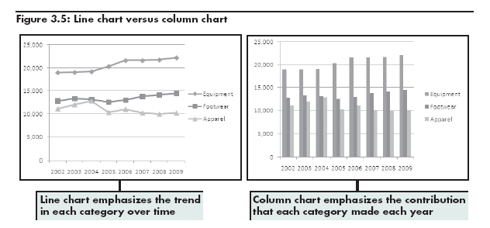
Understanding Line and Column Charts

Slide 12
Comparing Line and XY (Scatter) Charts
XY (Scatter) charts plot numeric values on both the X- and Y- axes based on the value of the data.
Whereas a line chart plots numeric values on one axis and category labels equidistantly on the other axis.

Slide 13
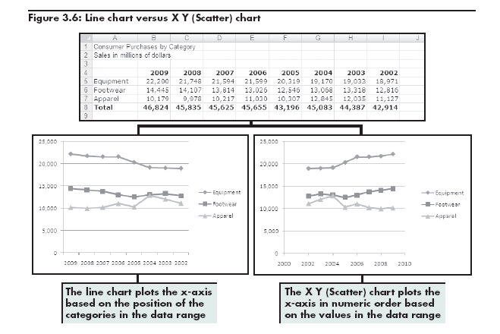
Comparing Line and XY (Scatter) Charts

Slide 14
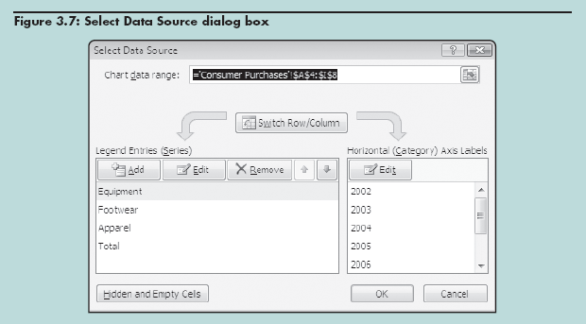
Changing the Chart Source Data

Slide 15
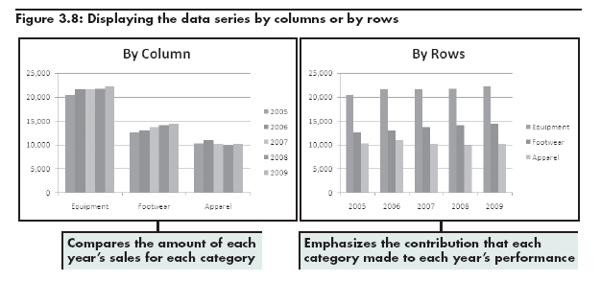
Results of Changing Source Data

Slide 16
Specifying Chart Layout Options
Click chart to display Chart Tools contextual tabs
Chart Tools Layout Tab
Options grouped by Labels, Axes, and Background

Slide 17
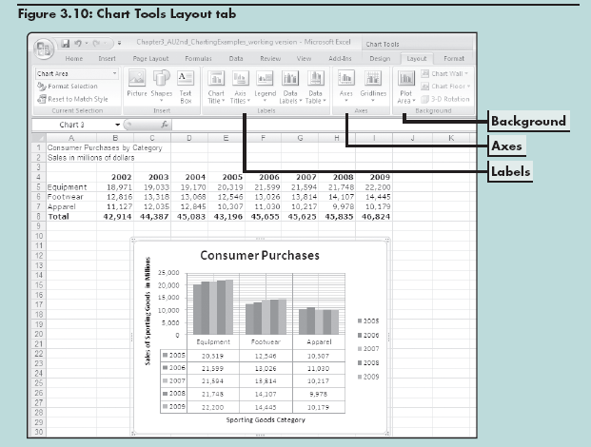
Specifying Chart Options

Slide 18
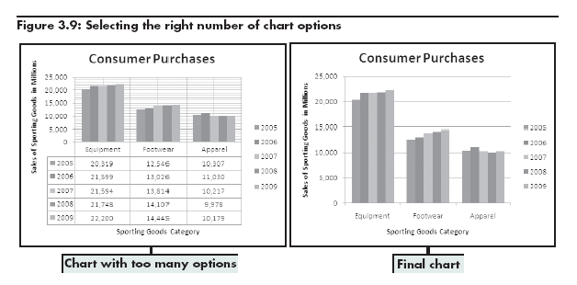
Specifying Chart Options

Slide 19
Chart Options
Area chart- combines the features of a line chart with a bar or column chart by filling in the area below the line, and displaying the trend values over time or categories.
Pie chart- displays the percentage contribution that each category makes to a whole or 100%.

Slide 20
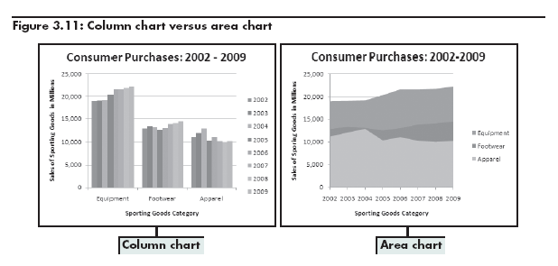
Column Charts and Area Charts

Slide 21
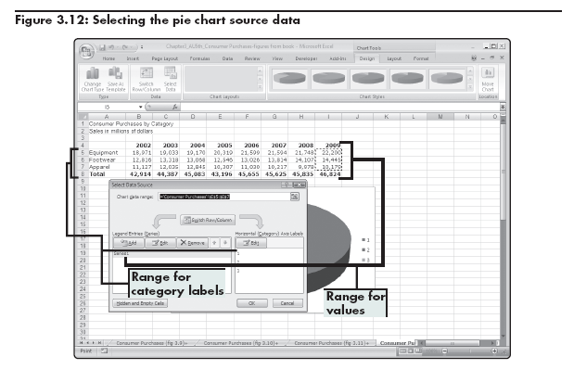
Selecting Pie Chart Source Data

Slide 22
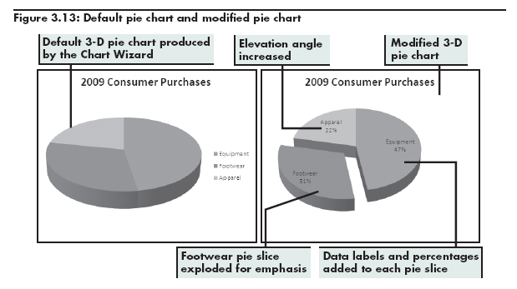
Pie Charts

Slide 23
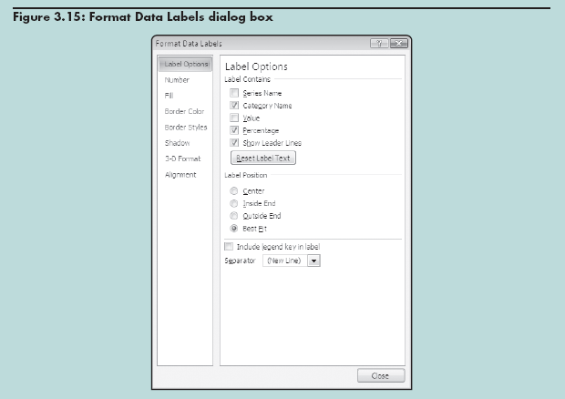
Formatting Data Labels

Slide 24
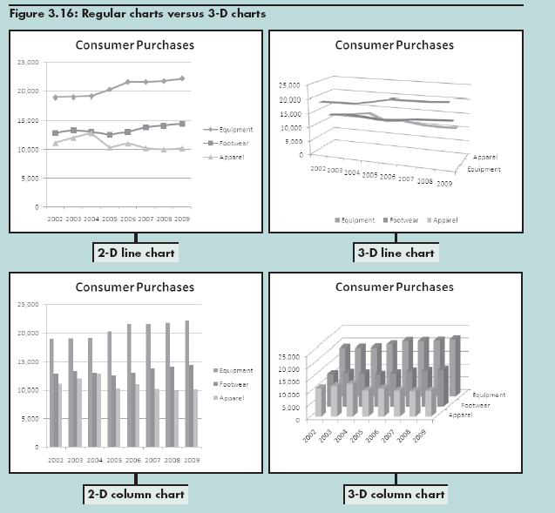
Working with 3-D Charts
2-D Line chart
3-D Line chart
2-D Column chart
3-D Column chart

Slide 25
Summary 1
Using charts to illustrate quantitative information adds visual analysis to problem solving
How choice of chart type can influence viewer’s perception of information presented
Differences between main chart types
Different interpretation of data can result from use of different chart type

Slide 26
Objectives: Evaluating Chart Sub-Types
Examine the effectiveness of different chart sub-types
Evaluate the stacked and 100% stacked sub-types
Explore the Pie of Pie and Bar of Pie sub-types
Create various stock charts to display financial data
Clarify data with trendlines and moving averages

Slide 27
Examining Sub-types for Various Chart Types
Stacked charts | Illustrate cumulative effects of data in categories Available for line, bar, column, area charts
Summing to 100% (100% stacked sub-type) | Illustrate cumulative (rather than individual) contribution for each category as a percentage Available for line, bar, column, area charts Combines features of a pie chart with features of line, column, or area charts Similar to pie except pieces are in a column instead of a circle

Slide 28
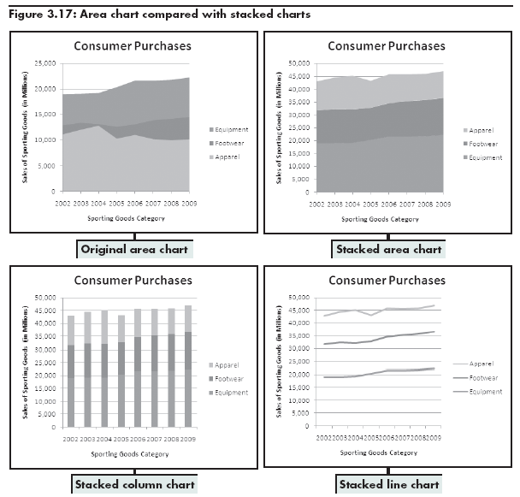
Adding Things Up: Stacked Chart Options
Original area chart
Stacked area chart
Stacked column chart
Stacked line chart

Slide 29
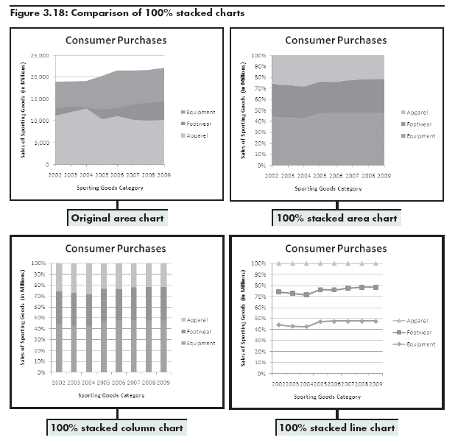
Summing to 100%: Alternatives to Pie Charts
Original area chart
100% stacked area chart
100% stacked column chart
100% stacked line chart

Slide 30
Summing to 100%: Alternatives to Pie Charts
Showing the cumulative contribution for each category as a percentage can reduce confusion over whether the line on the chart represents the individual or cumulative contribution to the whole.

Slide 31
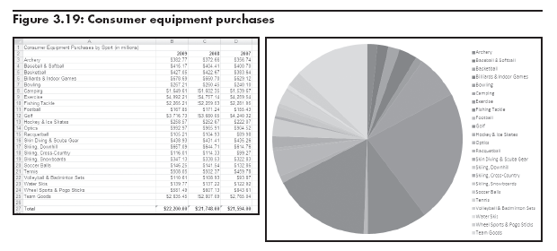
Slicing the Pie Too Thin: Summarizing Too Much Detail in Pie Charts
An excessive number of pie slices makes the chart cluttered and confusing.

Slide 32
Pie of Pie and Bar of Pie Chart Sub-Types
Decrease number of pie segments to improve visual display of data
Use Format Data Series dialog box to select options for splitting data series
Position
Value
Percent Value
Custom

Slide 33
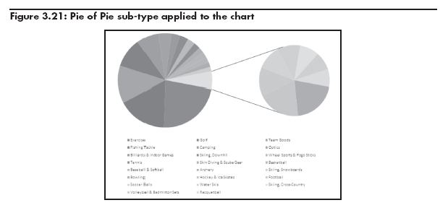
Pie of Pie Sub-Type

Slide 34
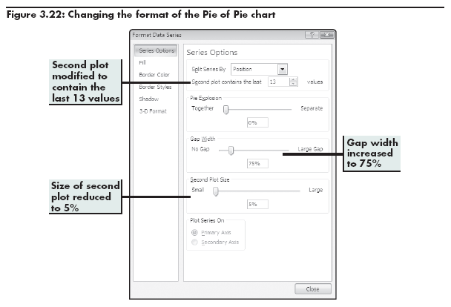
Using Format Data Series to Change the Format

Slide 35
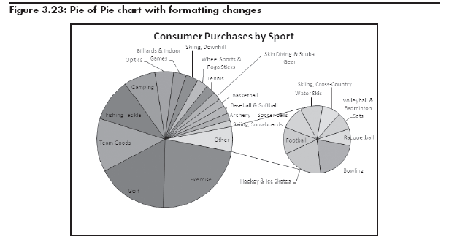
Applied Formatting Changes

Slide 36
Doughnut Charts
Show individual percentages contained in a pie chart for more than one series

Slide 37
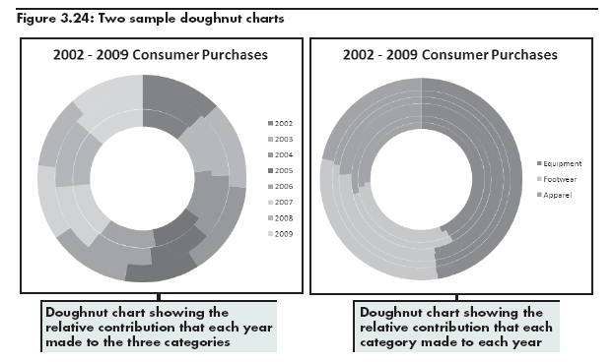
Doughnut Charts

Slide 38
Monitoring a Business with Stock Charts
Excel stock reporting charts are somewhat based on the candlestick plot format
Stock chart sub-types
High-Low-Close
Open-High-Low-Close
Volume-High-Low-Close
Volume-Open-High-Low-Close

Slide 39
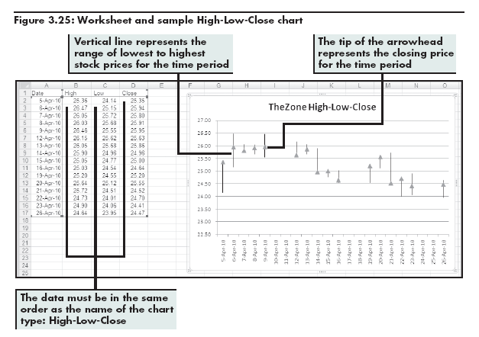
Sample High-Low-Close Chart

Slide 40
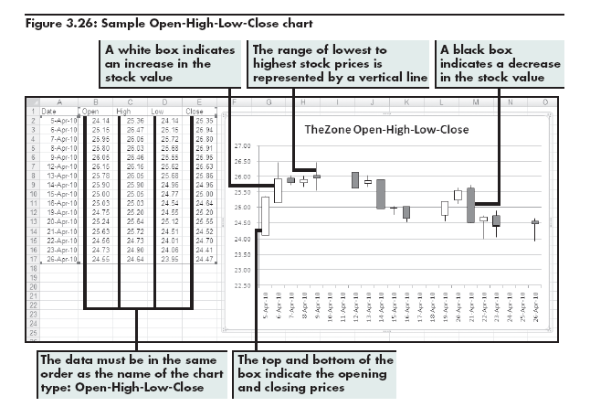
Sample Open-High-Low-Close Chart

Slide 41
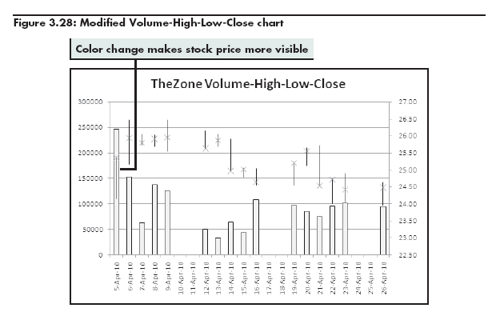
Sample Volume-High-Low-Close Chart

Slide 42
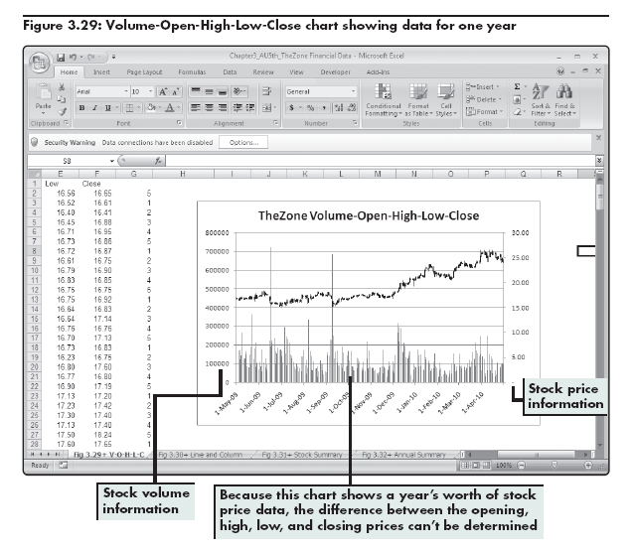
Sample Volume-Open-High-Low-Close Chart

Slide 43
Adding Trendlines and Moving Averages
Trendlines
Graphically illustrate trends in data using a statistical technique known as regression
Moving average line
Used to smooth out the data, making it easier to spot trends

Slide 44
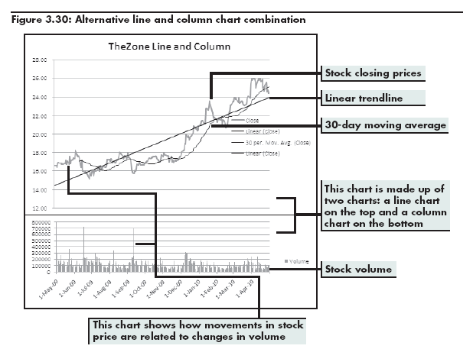
Adding Trendlines and Moving Averages

Slide 45
Summary 2
Chart sub-types for line, column, and area charts (stacked and 100% stacked)
Pie of Pie and Bar of Pie chart sub-types
Sub-types of stock charts
Clarifying data in stock charts using trendlines and moving averages

Slide 46
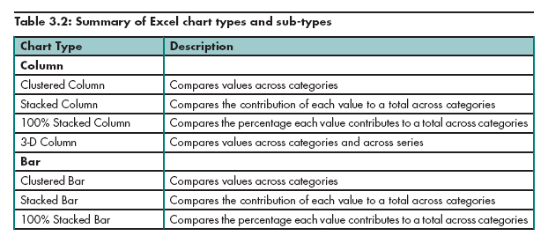
Chart Summary

Slide 47
