Slide 1
Foundations of Business Intelligence: Databases and Information Management

Slide 2
Problem: HP’s numerous systems unable to deliver the information needed for a complete picture of business operations, lack of data consistency
Solutions: Build a data warehouse with a single global enterprise-wide database; replacing 17 database technologies and 14,000 databases in use
Created consistent data models for all enterprise data and proprietary platform
Demonstrates importance of database management in creating timely, accurate data and reports
Illustrates need to standardize how data from disparate sources are stored, organized, and managed
Notes:
The chapter opening case discusses HP’s difficulties in collecting and tracking timely, consistent data from across the entire enterprise. This case illustrates some of the common challenges regarding data management that face numerous companies.
Ask students how HP’s data inconsistencies arose and what the effect of data inconsistency was.
As the text says “An effective information system provides users with accurate, timely, and relevant information.” Ask students to define and explain why these three characteristics (accurate, timely, relevant) are important.

Slide 3
File organization concepts
Computer system organizes data in a hierarchy
Field: Group of characters as word(s) or number
Record: Group of related fields
File: Group of records of same type
Database: Group of related files
Record: Describes an entity
Entity: Person, place, thing on which we store information
Attribute: Each characteristic, or quality, describing entity
E.g., Attributes Date or Grade belong to entity COURSE
Notes:
This slide describes standard units of data be stored by a computer in an information system. (The smallest units common to all applications are bits and bytes – a bit stores a single binary digit, 0 or 1, and a byte stores a group of digits to represent a single character, number, or other symbol). This hierarchy is illustrated by the graphic on the next slide.
Ask students to come up with some other entities that might be found in a university database (Student, Professor, etc.)

Slide 4
The Data Hierarchy
A computer system organizes data in a hierarchy that starts with the bit, which represents either a 0 or a 1. Bits can be grouped to form a byte to represent one character, number, or symbol. Bytes can be grouped to form a field, and related fields can be grouped to form a record. Related records can be collected to form a file, and related files can be organized into a database.
Figure 6-1
Notes:
This graphic illustrates the hierarchy of data found in a database. It shows the student course file grouped with files on students’ personal histories and financial backgrounds to create a student database.

Slide 5
Problems with the traditional file environment (files maintained separately by different departments)
Data redundancy and inconsistency
Data redundancy: Presence of duplicate data in multiple files
Data inconsistency: Same attribute has different values
Program-data dependence:
When changes in program requires changes to data accessed by program
Lack of flexibility
Poor security
Lack of data sharing and availability
Notes:
This slide discusses the problems in data management that occur in a traditional file environment. In a traditional file environment, different functions in the business (accounting, finance, HR, etc.) maintained their own separate files and databases.
Ask students to describe further why data redundancy, inconsistency pose problems? What kinds of problems happen when data is redundant or inconsistence. Ask students to give an example of program-data dependence. What makes the traditional file environment inflexible?

Slide 6
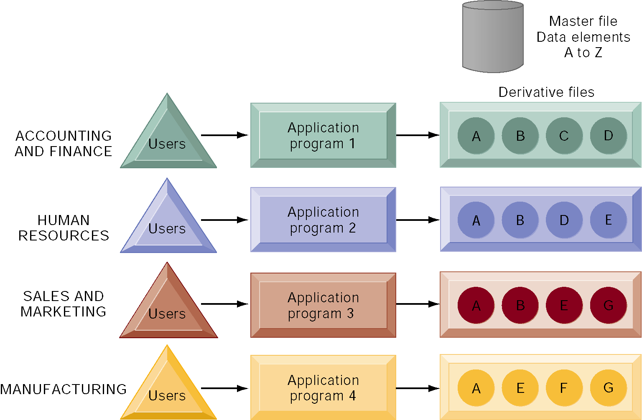
Traditional File Processing
The use of a traditional approach to file processing encourages each functional area in a corporation to develop specialized applications and files. Each application requires a unique data file that is likely to be a subset of the master file. These subsets of the master file lead to data redundancy and inconsistency, processing inflexibility, and wasted storage resources.
Figure 6-2
Notes:
This graphic illustrates a traditional environment, in which different business functions maintain separate data and applications to store and access that data. Remember from the opening case that HP had over 14,000 databases.
Ask students what kinds of data might be shared between accounting/finance and HR. What about between sales and marketing and manufacturing?

Slide 7
Database
Collection of data organized to serve many applications by centralizing data and controlling redundant data
Database management system
Interfaces between application programs and physical data files
Separates logical and physical views of data
Solves problems of traditional file environment
Controls redundancy
Eliminates inconsistency
Uncouples programs and data
Enables organization to central manage data and data security
Notes:
This slide defines and describes databases and DBMS. Ask students to explain what the difference is between a database and a DBMS. What is the physical view of data? What is the logical view of data?

Slide 8
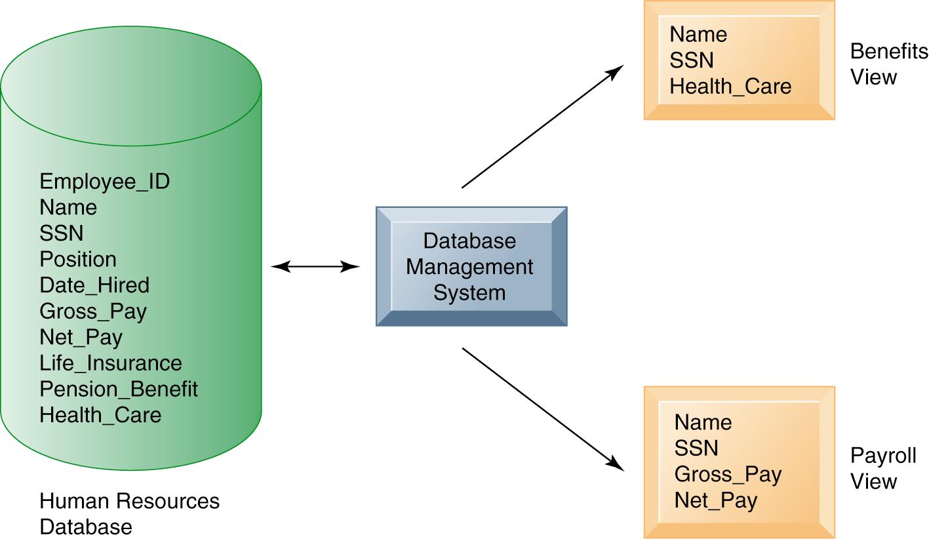
Human Resources Database with Multiple Views
A single human resources database provides many different views of data, depending on the information requirements of the user. Illustrated here are two possible views, one of interest to a benefits specialist and one of interest to a member of the company’s payroll department.
Figure 6-3
Notes:
This graphic illustrates what is meant by providing different logical views of data. The orange rectangles represent two different views in an HR database, one for reviewing employee benefits, the other for accessing payroll records. The students can think of the green cylinder as the physical view, which shows how the data are actually organized and stored on the physical media. The physical data do not change, but a DBMS can create many different logical views to suit different needs of users.

Slide 9
The Database Approach to Data Management
Relational DBMS
Represent data as two-dimensional tables called relations or files
Each table contains data on entity and attributes
Table: grid of columns and rows
Rows (tuples): Records for different entities
Fields (columns): Represents attribute for entity
Key field: Field used to uniquely identify each record
Primary key: Field in table used for key fields
Foreign key: Primary key used in second table as look-up field to identify records from original table
Notes:
This slide introduces the most common type of DBMS in use with PCs, servers, and mainframes today, the relational database. Ask students why these DBMS are called relational. Ask students for examples of RDBMS software popular today and if they have every used any of this software. You can walk students through an example data base that you have prepared in Access or use one of the exercise data tables found at the end of the chapter. Identify rows, fields, and primary key.

Slide 10
The Database Approach to Data Management
Relational Database Tables
A relational database organizes data in the form of two-dimensional tables. Illustrated here are tables for the entities SUPPLIER and PART showing how they represent each entity and its attributes. Supplier_Number is a primary key for the SUPPLIER table and a foreign key for the PART table.
Figure 6-4A
Notes:
The graphic on this slide and the next illustrates two tables in a relational DBMS. Ask students what the entity on this slide and the next are.
The key field in the Supplier table is the Supplier number. What is the purpose of the key field?

Slide 11
The Database Approach to Data Management
Relational Database Tables (cont.)
Figure 6-4B
Notes:
This slide shows the second part of the graphic on the previous slide. Notice that the foreign key in this table is the primary key in the Suppliers table. What is the purpose of the foreign key. Can multiple records have the same foreign key?

Slide 12
The Database Approach to Data Management
Operations of a Relational DBMS
Three basic operations used to develop useful sets of data
SELECT: Creates subset of data of all records that meet stated criteria
JOIN: Combines relational tables to provide user with more information than available in individual tables
PROJECT: Creates subset of columns in table, creating tables with only the information specified
Notes:
This slide describes how information is retrieved from a relational database. These operations (SELECT, JOIN, PROJECT) are like programming statements and are used by DBMS developers. For example, looking at the last two slides showing the Supplier and Parts table, you would use what kind of an operation to show the Parts records along with the appropriate supplier’s name? Access has wizards for these commands.

Slide 13
The Database Approach to Data Management
The Three Basic Operations of a Relational DBMS
The select, project, and join operations enable data from two different tables to be combined and only selected attributes to be displayed.
Figure 6-5
Notes:
This graphic illustrates the result from combining the select, join, and project operations to create a subset of data. The SELECT operation retrieves just those parts in the PART table whose part number is 137 or 150. The JOIN operation uses the foreign key of the Supplier_Number provided by the PART table to locate supplier data from the Supplier Table for just those records selected in the SELECT operation. Finally, the PROJECT operation limits the columns to be shown to be simply the part number, part name, supplier number, and supplier name (orange rectangle).

Slide 14
The Database Approach to Data Management
Object-Oriented DBMS (OODBMS)
Stores data and procedures as objects
Capable of managing graphics, multimedia, Java applets
Relatively slow compared with relational DBMS for processing large numbers of transactions
Hybrid object-relational DBMS: Provide capabilities of both OODBMS and relational DBMS
Notes:
This slide discusses another type of DBMS. Ask students why one would want to store multimedia or Java applets in a database? What types of businesses or organizations might want to use OODBMS.

Slide 15
The Database Approach to Data Management
Capabilities of Database Management Systems
Data definition capability: Specifies structure of database content, used to create tables and define characteristics of fields
Data dictionary: Automated or manual file storing definitions of data elements and their characteristics
Data manipulation language: Used to add, change, delete, retrieve data from database
Structured Query Language (SQL)
Microsoft Access user tools for generation SQL
Many DBMS have report generation capabilities for creating polished reports (Crystal Reports)
Notes:
This slide discusses the three main capabilities of a DBMS, its data definition capability, the data dictionary, and a data manipulation language.
Ask students to describe what characteristics of data would be stored by a data dictionary. (Name, description, size, type, format, other properties of a field. For a large company a data dictionary might also store characteristics such as usage, ownership, authorization, security, users.)
Note that the data manipulation language is the tool that requests operations such as SELECT and JOIN to be performed on data.

Slide 16
The Database Approach to Data Management
Example of an SQL Query
Illustrated here are the SQL statements for a query to select suppliers for parts 137 or 150. They produce a list with the same results as Figure 6-5.
Figure 6-7
Notes:
This graphic shows an example SQL statement that would be used to retrieve data from a database. In this case, the SQL statement is retrieving records from the PART table illustrated on Slide 14 (Figure 6-5) whose Part Number is either 137 or 150.
Ask students to relate what each phrase of this statement is doing. (For example, the statement says to take the following columns: Part_Number, Part_Name, Supplier Number, Supplier Name, from the two tables Part and Supplier, when the following two conditions are true …)

Slide 17
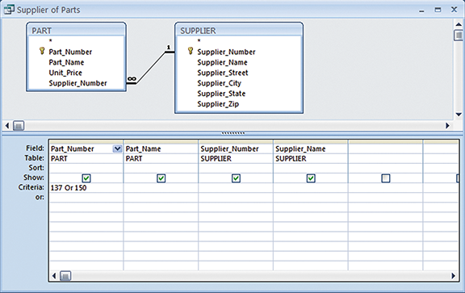
The Database Approach to Data Management
An Access Query
Illustrated here is how the query in Figure 6-7 would be constructed using query-building tools in the Access Query Design View. It shows the tables, fields, and selection criteria used for the query.
Figure 6-8
Notes:
This graphic illustrates a Microsoft Access query that performs the same operation as the SQL query in the last slide. The query pane at the bottom shows the fields that are requested (Fields), the relevant Tables (Table), the fields that will be displayed in the results (Show), and the criteria limiting the results to Part numbers 137 and 150 (Criteria).

Slide 18
The Database Approach to Data Management
Designing Databases
Conceptual (logical) design: abstract model from business perspective
Physical design: How database is arranged on direct-access storage devices
Design process identifies
Relationships among data elements, redundant database elements
Most efficient way to group data elements to meet business requirements, needs of application programs
Normalization
Streamlining complex groupings of data to minimize redundant data elements and awkward many-to-many relationships
Notes:
This slide describes activities involved in designing a database. To create an efficient database, you must know what the relationships are among the various data elements, the types of data that will be stored, and how the organization will need to manage the data. Note that the conceptual database design is concerned with how the data elements will be grouped, what data in what tables will make the most efficient organizations.

Slide 19
The Database Approach to Data Management
An Unnormalized Relation for Order
An unnormalized relation contains repeating groups. For example, there can be many parts and suppliers for each order. There is only a one-to-one correspondence between Order_Number and Order_Date.
Figure 6-9
Notes:
The graphics on this slide and the next illustrate the process of normalization. Here, one table lists the relevant data elements for the entity ORDER. These include all of the details about the order, the part, the supplier.
An order can have include more than one part, and it may be that several parts are supplied by the same supplier. However, using this table, the supplier’s name, and other information might need to be stored several times on the order list.

Slide 20
The Database Approach to Data Management
Normalized Tables Created from Order
After normalization, the original relation ORDER has been broken down into four smaller relations. The relation ORDER is left with only two attributes and the relation LINE_ITEM has a combined, or concatenated, key consisting of Order_Number and Part_Number.
Figure 6-10
Notes:
This graphic shows the normalized tables. The Order table has been broken down into four smaller, related tables. Notice that the Order table contains only two unique attributes, Order Number and Order Date. The multiple items ordered are stored using the Line_Item table. The normalization means that very little data has to be duplicated when creating orders, most of the information can be retrieved by using keys to the Part and Supplier tables.
It is important to note that relational database systems try to enforce referential integrity rules to ensure that relationships between coupled tables remain consistent. When one table has a foreign key that points to another table, you may not add a record to
the table with the foreign key unless there is a corresponding record in the linked table. For example, foreign key Supplier_Number links the PART table to the SUPPLIER table. Referential integrity means that a new part can’t be added to the part table without a valid supplier number existing in the Supplier table. It also means that if a supplier is deleted, any corresponding parts must be deleted also.

Slide 21
The Database Approach to Data Management
Entity-relationship diagram
Used by database designers to document the data model
Illustrates relationships between entities
Distributing databases: Storing database in more than one place
Partitioned: Separate locations store different parts of database
Replicated: Central database duplicated in entirety at different locations
Notes:
This slide continues the discussion about designing databases. One technique database designers use in modeling the structure of the data is to use an entity-relationship diagram (illustrated on the next slide). Symbols on the diagram illustrate the types of relationships between entities. Ask students what different types of relationships there are between entities. (One-to-one, one-to-many, many-to-many.)

Slide 22
The Database Approach to Data Management
An Entity-Relationship Diagram
This diagram shows the relationships between the entities ORDER, LINE_ITEM, PART, and SUPPLIER that might be used to model the database in Figure 6-10.
Figure 6-11
Notes:
This graphic shows an example of an entity relationship diagram. It shows that one ORDER can contain many LINE_ITEMs. (A PART can be ordered many times and appear many times as a line item in a single order.) Each LINE ITEM can contain only one PART. Each PART can have only one SUPPLIER, but many PARTs can be provided by the same SUPPLIER.

Slide 23
The Database Approach to Data Management
Distributing databases
Two main methods of distributing a database
Partitioned: Separate locations store different parts of database
Replicated: Central database duplicated in entirety at different locations
Advantages
Reduced vulnerability
Increased responsiveness
Drawbacks
Departures from using standard definitions
Security problems
Notes:
This slide continues the discussion about designing databases. One consideration in designing a database is deciding where the physical data will be stored.
Ask students what vulnerability is reduced when distributing databases. Why would a distributed database increase responsiveness to users? What types of security problems might there be?

Slide 24
Using Databases to Improve Business Performance and Decision Making
Very large databases and systems require special capabilities, tools
To analyze large quantities of data
To access data from multiple systems
Three key techniques
Data warehousing
Data mining
Tools for accessing internal databases through the Web
Notes:
This slide discusses how very large databases are used to produce valuable information for firms. The text give the example of how, by analyzing data from customer credit card purchases, Louise’s Trattoria, a Los Angeles restaurant chain, learned that quality was
more important than price for most of its customers, who were college educated and liked fine wine. The chain responded to this information by introducing vegetarian dishes, more seafood selections, and more expensive wines, raising sales by more than 10 percent.

Slide 25
Using Databases to Improve Business Performance and Decision Making
Data warehouse:
Stores current and historical data from many core operational transaction systems
Consolidates and standardizes information for use across enterprise, but data cannot be altered
Data warehouse system will provide query, analysis, and reporting tools
Data marts:
Subset of data warehouse
Summarized or highly focused portion of firm’s data for use by specific population of users
Typically focuses on single subject or line of business
Notes:
This slide discusses the use of data warehouses, and data marts, by firms.
Ask students why having a data warehouse is an advantage for firms hoping to perform business analyses on the data? Why does there have to be a repository of data that is separate from the transaction database?

Slide 26
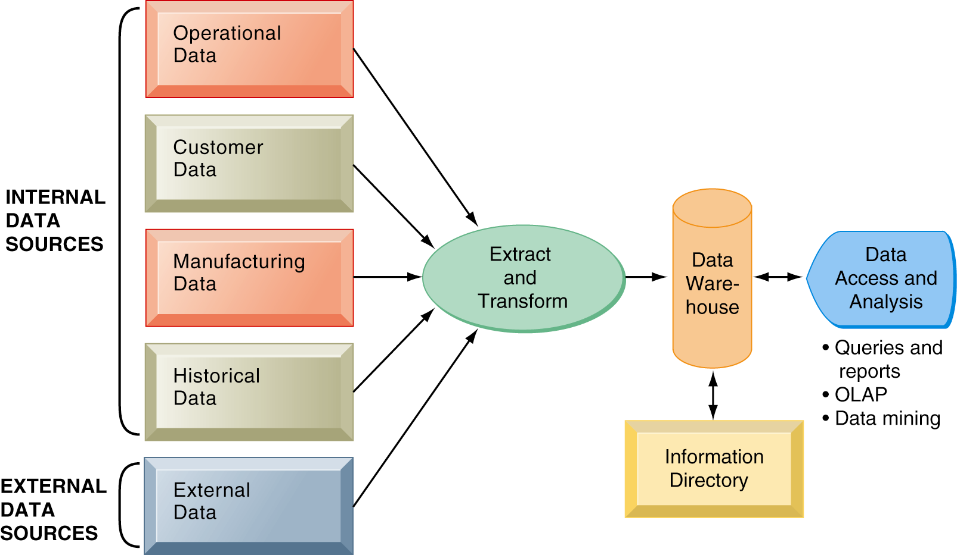
Using Databases to Improve Business Performance and Decision Making
Components of a Data Warehouse
The data warehouse extracts current and historical data from multiple operational systems inside the organization. These data are combined with data from external sources and reorganized into a central database designed for management reporting and analysis. The information directory provides users with information about the data available in the warehouse.
Figure 6-13
Notes:
This graphic illustrates the components of a data warehouse system. It shows that the data warehouse extracts data from multiple sources, both internal and external, and transforms it as needed for the data warehouse systems. To extract meaningful information from the data warehouse, additional tools, such as queries and reports, OLAP, and data mining are required. The information directory provides users with information about what data is in the warehouse.

Slide 27
Using Databases to Improve Business Performance and Decision Making
The IRS Uncovers Tax Fraud with a Data Warehouse
Read the Interactive Session: Organizations, and then discuss the following questions:
Why was it so difficult for the IRS to analyze the taxpayer data it had collected?
What kind of challenges did the IRS encounter when implementing its CDW? What management, organization, and technology issues had to be addressed?
How did the CDW improve decision making and operations at the IRS? Are there benefits to taxpayers?
Do you think data warehouses could be useful in other areas of the federal sector? Which ones? Why or why not?
Notes:
This Interactive Session looks at the IRS’s creation of a data warehouse to organize all of its records and illustrates the vast improvements that an organization can experience when it implements a centralized, searchable data source.

Slide 28
Using Databases to Improve Business Performance and Decision Making
Business Intelligence:
Tools for consolidating, analyzing, and providing access to vast amounts of data to help users make better business decisions
E.g., Harrah’s Entertainment analyzes customers to develop gambling profiles and identify most profitable customers
Principle tools include:
Software for database query and reporting
Online analytical processing (OLAP)
Data mining
Notes:
This slide discusses the role of business intelligence in helping firm’s make better decisions. The text uses the example of Harrah’s Entertainment:
“For instance, Harrah’s Entertainment, the second-largest gambling company in its industry, continually analyzes data about its customers gathered when people play its slot machines or use Harrah’s casinos and hotels. Harrah’s marketing department uses this information to build a detailed gambling profile, based on a particular customer’s ongoing value to the company. This information guides management decisions about how to cultivate the most profitable customers, encourage those customers to spend more, and attract more customers with high revenue-generating potential. Business intelligence has improved Harrah’s profits so much that it has become the centerpiece of the firm’s business strategy.”

Slide 29
Using Databases to Improve Business Performance and Decision Making
Business Intelligence
Figure 6-14
A series of analytical tools works with data stored in databases to find patterns and insights for helping managers and employees make better decisions to improve organizational performance.
Notes:
This graphic illustrates the process of transforming data into business intelligence. The business intelligence tools do not necessarily find clear-cut answers, but can find patterns and relationships in data that can greatly improve business decisions and offer insight into the business environment.

Slide 30
Using Databases to Improve Business Performance and Decision Making
Online analytical processing (OLAP)
Supports multidimensional data analysis
Viewing data using multiple dimensions
Each aspect of information (product, pricing, cost, region, time period) is different dimension
E.g., how many washers sold in East in June compared with other regions?
OLAP enables rapid, online answers to ad hoc queries
Notes:
This slide discusses online analytical processing, one of the three principle tools for gathering business intelligence.
Ask students to come up with additional examples of what a multidimensional query might be.

Slide 31
Using Databases to Improve Business Performance and Decision Making
Multidimensional Data Model
Figure 6-15
The view that is showing is product versus region. If you rotate the cube 90 degrees, the face that will show is product versus actual and projected sales. If you rotate the cube 90 degrees again, you will see region versus actual and projected sales. Other views are possible.
Notes:
This graphic illustrates the concept of dimensions as it relates to data.

Slide 32
Using Databases to Improve Business Performance and Decision Making
Data mining:
More discovery driven than OLAP
Finds hidden patterns, relationships in large databases and infers rules to predict future behavior
E.g., Finding patterns in customer data for one-to-one marketing campaigns or to identify profitable customers.
Key areas where businesses are leveraging data mining include:
Customer segmentation
Marketing and promotion targeting
Market basket analysis
Collaborative filtering
Customer churn
Fraud detection
Financial modeling
Hiring and promotion
Notes:
This slide discusses another business intelligence tool driven by databases, data mining. Data mining provides insights into data that cannot be discovered through OLAP, by inferring rules from patterns in data.
Ask students to describe the types of information listed:
Associations: Occurrences linked to single event
Sequences: Events linked over time
Classification: Recognizes patterns that describe group to which item belongs
Clustering: Similar to classification when no groups have been defined; finds groupings within data
Forecasting: Uses series of existing values to forecast what other values will be

Slide 33
Data mining:. Types of information obtainable from data mining
Associations- An association algorithm creates rules that describe how often events have occurred together.
Example: When a customer buys a hammer, then 90% of the time they will buy nails.
Sequences- Events linked over time
Classification - Recognizes patterns that describe group to which item belongs-
Example: A bank wants to classify its Home Loan Customers into groups according to their response to bank advertisements. The bank might use the classifications “Responds Rarely, Responds Sometimes, Responds Frequently”.
Clustering - Similar to classification, but when no groups have been defined; finds groupings within data
Example: Insurance company could use clustering to group clients by their age, location and types of insurance purchased.
The categories are unspecified and this is referred to as ‘unsupervised learning’
Forecasting - Uses series of existing values to forecast what other values will be
We’ll do this in class with regression analysis
Regression deals with the prediction of a value, rather than a class
Example: Find out if there is a relationship between smoking patients and cancer related illness.
Notes:
This slide discusses another business intelligence tool driven by databases, data mining. Data mining provides insights into data that cannot be discovered through OLAP, by inferring rules from patterns in data.
Ask students to describe the types of information listed:
Associations: Occurrences linked to single event
Sequences: Events linked over time
Classification: Recognizes patterns that describe group to which item belongs
Clustering: Similar to classification when no groups have been defined; finds groupings within data
Forecasting: Uses series of existing values to forecast what other values will be

Slide 34
Data Mining
A data mining and business analytics team should possesses three critical skills:
Information technology
Statistics
Business knowledge

Slide 35
Using Databases to Improve Business Performance and Decision Making
Predictive analysis
Uses data mining techniques, historical data, and assumptions about future conditions to predict outcomes of events
E.g., Probability a customer will respond to an offer or purchase a specific product
Text mining
Extracts key elements from large unstructured data sets (e.g., stored e-mails)
Notes:
This slide discusses business intelligence techniques related to data mining. Predictive analysis uses data mining techniques. The text provides the example of the U.S. division of The Body Shop, which used predictive analysis to identify customers who were more likely to purchase from catalogs. This helped the company create a more targeted mailing list, improving their response rate.
While data mining describes analysis of data in databases, there are other types of information that can be “mined,” such as text mining and Web mining. Ask students what other types of unstructured textual data sets a company might store, and what kind of useful information might be extracted from them.

Slide 36
Artificial Intelligence
Data Mining has its roots in a branch of computer science known as artificial intelligence (AI)
The goal of AI is create computer programs that are able to mimic or improve upon functions of the human brain

Slide 37
Artificial Intelligence
Neural network: An AI system that examines data and hunts down and exposes patterns, in order to build models to exploit findings
Expert systems: AI systems that leverage rules or examples to perform a task in a way that mimics applied human expertise
Genetic algorithms: Model building techniques where computers examine many potential solutions to a problem, iteratively modifying various mathematical models, and comparing the mutated models to search for a best alternative

Slide 38
Using Databases to Improve Business Performance and Decision Making
Web mining
Discovery and analysis of useful patterns and information from WWW
E.g., to understand customer behavior, evaluate effectiveness of Web site, etc.
Techniques
Web content mining
Knowledge extracted from content of Web pages
Web structure mining
E.g., links to and from Web page
Web usage mining
User interaction data recorded by Web server
Notes:
This slide continues the exploration of mining stored data for valuable information. In addition to text mining, there are several ways to mine information on the Web. The text uses the example of marketers using Google Trends and Google Insights for Search services, which track the popularity of various words and phrases used in Google search queries, to learn what people are interested in and what they are interested in buying. What type of Web mining is this? Why might a marketer be interested in the number of Web pages that link to a site?

Slide 39
Using Databases to Improve Business Performance and Decision Making
Databases and the Web
Many companies use Web to make some internal databases available to customers or partners
Typical configuration includes:
Web server
Application server/middleware/CGI scripts
Database server (hosting DBM)
Advantages of using Web for database access:
Ease of use of browser software
Web interface requires few or no changes to database
Inexpensive to add Web interface to system
Notes:
This slide looks at how companies utilize the Web to access company databases. Ask students to describe the flow of information from a company’s databases to the Web page a user is accessing data on. Why is browser software easy to use? Why is it less expensive to add a Web interface to a database-driven information system?

Slide 40
Managing Data Resources
Establishing an information policy
Firm’s rules, procedures, roles for sharing, managing, standardizing data
E.g., What employees are responsible for updating sensitive employee information
Data administration: Firm function responsible for specific policies and procedures to manage data
Data governance: Policies and processes for managing availability, usability, integrity, and security of enterprise data, especially as it relates to government regulations
Database administration : Defining, organizing, implementing, maintaining database; performed by database design and management group
Notes:
This slide discusses the firm’s need for an information policy in order to ensure that firm data is accurate, reliable, and readily available. Note that while the database administration group establishes and creates the physical database, the data administration function is responsible for logical database design and data dictionary development. Why would this function be better placed with the data administration group?

Slide 41
Managing Data Resources
Ensuring data quality
More than 25% of critical data in Fortune 1000 company databases are inaccurate or incomplete
Most data quality problems stem from faulty input
Before new database in place, need to:
Identify and correct faulty data
Establish better routines for editing data once database in operation
Notes:
This slide discusses the importance of data quality. Ask students for personal examples of what happens when a company’s data is faulty. The text provides an example of 20% of U.S. mail and commercial package deliveries being returned because of faulty addresses.

Slide 42
Managing Data Resources
Data quality audit:
Structured survey of the accuracy and level of completeness of the data in an information system
Survey samples from data files, or
Survey end users for perceptions of quality
Data cleansing
Software to detect and correct data that are incorrect, incomplete, improperly formatted, or redundant
Enforces consistency among different sets of data from separate information systems
Notes:
This slide continues the discussion of data quality and examines ways to improve the firm’s data quality. Ask students what types of data quality problems there are (data that is incomplete, inaccurate, improperly formatted, redundant). Ask students if user perceptions of quality are as important as statistical evidence of data quality problems. What is another word for data cleansing?

Slide 43
Privacy Concerns
Effective Data Mining requires large sources of data
To achieve a wide spectrum of data, must link multiple data sources
Linking sources leads can be problematic for privacy as follows: If the following histories of a customer were linked:
Shopping History
Credit History
Bank History
Employment History
The users’ life story can be painted from the collected data
Hiring, loan, other decision are made by data collected on individuals.
What happens if the data is not correct?
Data aggregators (data brokers) – it’s legal to buy and sell personal data.
Is this ethical?

