Slide 1
Improving Decision Making and Managing Knowledge
Notes:
There are four video cases available for this chapter:
Improving Decision Making and Managing Knowledge
Case 1 L’Oréal: Knowledge Management Using Microsoft SharePoint
Case 2 IdeaScale Crowdsourcing: Where Ideas Come to Life
Case 3 Antivia: Community-based Collaborative Business Intelligence
Case 4 IBM and Cognos: Business Intelligence and Analytics for Improved Decision Making

Slide 2
Student Learning Objectives
What are the different types of decisions, and how does the decision-making process work?
How do information systems help people working individually and in groups make decisions more effectively?
What are the business benefits of using intelligent techniques in decision making and knowledge management?
Notes:
This chapter focuses on the information systems that support decision making in a firm and discusses the value of improved decision making in an organization. Ask the students to describe different types of decisions and whether some types of decisions are less valuable than others. What types of decisions, in a work framework, have students encountered in their own employment situations? Ask students to reveal what decisions they made on their last job.

Slide 3
Student Learning Objectives
What types of systems are used for enterprise-wide knowledge management, and how do they provide value for businesses?
What are the major types of knowledge work systems, and how do they provide value for firms?
Notes:
This chapter is also about managing knowledge. This will seem a strange idea to many students. How can you possibly “manage knowledge?” You should point out that libraries are “repositories of knowledge” as is the Internet. It’s where you go when you want to know something. Those places you go are evidence of knowledge management that people encounter every day. Firms also are repositories of knowledge. Most public firms’ knowledge is worth as much or more than their book value (value of physical plant and equipment). Knowing how to do things right is an important asset for any firm. Firms that can create, store, disseminate, and renew their knowledge base are advantaged in the market place. Building systems to help firms manage knowledge is a major software niche market place.

Slide 4
P&G Moves from Paper to Pixels for Knowledge Management
Problem: large number of physical paper documents slowed down research and development.
Solutions: deploy an electronic document management system.
Notes:
P&G is a great example of a public company that relies on knowledge, and invests heavily in knowledge management. P&G is the world’s largest manufacturer of consumer personal products, like Crest toothpaste and Tide.

Slide 5
P&G Moves from Paper to Pixels for Knowledge Management
eLab Notebook uses Adobe LiveCycle software to create a searchable archive of PDF files and embeds usage rights within documents.
Demonstrates IT’s role in knowledge management.
Illustrates digital technology’s role increasing productivity and organizing knowledge.

Slide 6
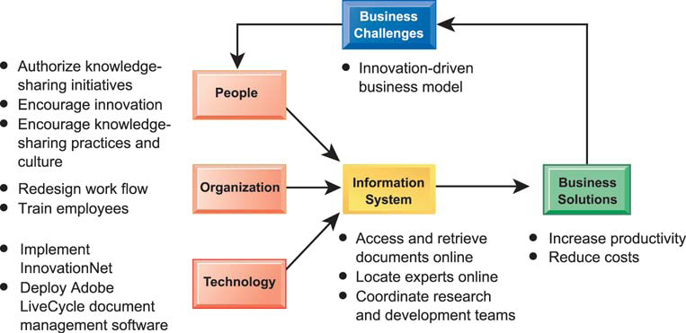
P&G Moves from Paper to Pixels for Knowledge Management

Slide 7
Decision Making and Information Systems
Business Value of Improved Decision Making
Possible to measure value of improved decision making.
Decisions made at all levels of the firm.
Some are common, routine, and numerous.
Although value of improving any single decision may be small, improving hundreds of thousands of “small” decisions adds up to large annual value for the business.
Notes:
Ask students what kinds of decisions they made on their previous or current jobs. Even if they are seemingly insignificant decisions, try to encourage students to express their decision making experience. You might also ask them to think about a McDonald’s restaurant. Have they ever watched the employees perform their jobs? They could observe that the success of McDonalds rests upon employees making a large number of seemingly minor decisions, small decisions, that add up to billions of dollars in firm revenue.

Slide 8
Decision Making and Information Systems
Business Value of Improved Decision Making
Decision | Maker | Number / year | Value of decision | Annual value to firm
Allocate support to most valuable customers. | Accounts manager | 12 | $100,000 | $1,200,000
Predict call center daily demand. | Call Center management | 4 | 150,000 | 600,000
Decide parts inventory level daily. | Inventory manager | 365 | 5,000 | 1,825,000
Identify competitive bids from major suppliers. | Senior management | 1 | 2,000,000 | 2,000,000
Schedule production to fill orders. | Manufacturing manager | 150 | 10,000 | 1,500,000
Notes:
Although there are “big” infrequent decisions of significant value, there are thousands of smaller decisions that add up to a large value. In other words, systems that make ordinary employees better decision makers can be as valuable or more valuable as systems that improve decision making of senior executives.

Slide 9
Decision Making and Information Systems
Types of Decisions
Unstructured
Decision maker must provide judgment to solve problem
Novel, important, nonroutine
No well-understood or agreed-upon procedure for making them
Structured
Repetitive and routine
Involve definite procedure for handling them so do not have to be treated as new
Semistructured
Only part of problem has clear-cut answer provided by accepted procedure
Notes:
This slide discusses the importance of improved decision making and describes the three types of decisions that are made in an organization. It’s not just “big decisions” that can cost the firm a great deal, or reap big rewards. Smalls decision made hundreds of times a year can be just as valuable as a single decision made once a year. The different levels in an organization tend to make different types of decisions, and require different types of support to make these decisions. Ask students to provide examples of each type of decision. Give students examples of decisions and ask what category the decision fall into and why.

Slide 10
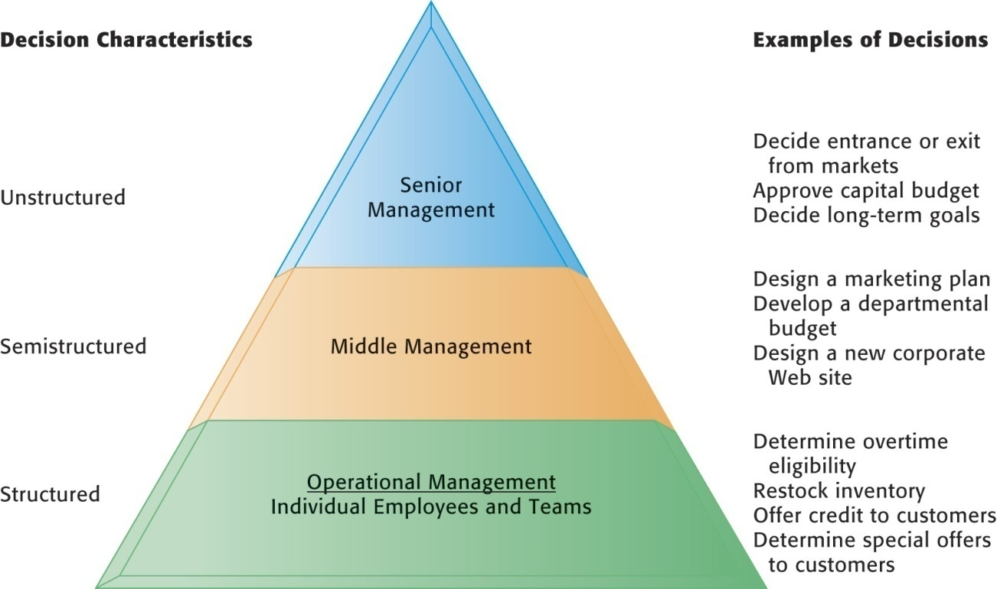
Decision Making and Information Systems
Information Requirements of Key Decision-Making Groups in a Firm
Senior managers, middle managers, operational managers, and employees have different types of decisions and information requirements.
Figure 10-1
Notes:
This graphic illustrates the three types of decision makers within an organization. Ask students to describe in their own words how to tell what category a decision falls into. If a structured decision is given separately to two employees, should they each come up with the same answer? What about semistructured decisions? Unstructured decisions? Which of the types of decisions could most easily be handled by computer software?

Slide 11
Decision Making and Information Systems
The Decision-Making Process
Intelligence
Discovering, identifying, and understanding the problems occurring in the organization—why is there a problem, where, what effects it is having on the firm
Design
Identifying and exploring various solutions
Choice
Choosing among solution alternatives
Implementation
Making chosen alternative work and monitoring how well solution is working
Notes:
This slide describes the process of decision making as a series of four stages. It is important to note that if an implemented solution doesn’t work, the decider can return to an earlier stage in the process and repeat as needed. Give the students an example decision, such as “what college should I apply to” and ask them to describe the actions taken at each of the four stages.

Slide 12
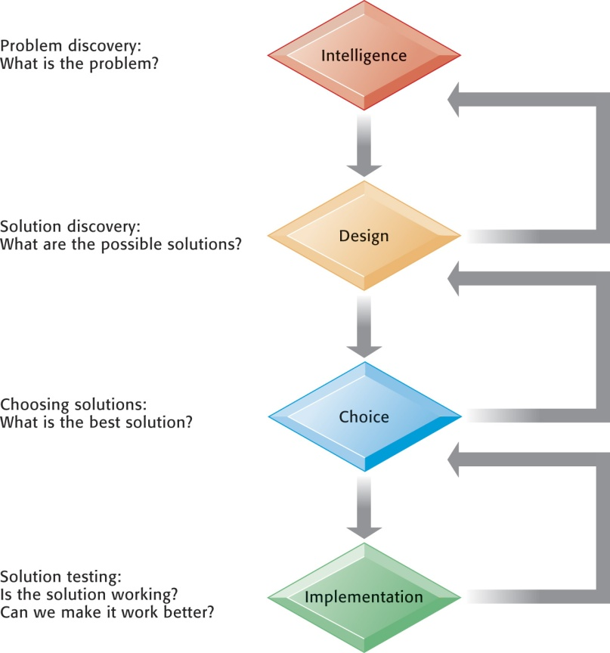
Decision Making and Information Systems
Stages in Decision Making
The decision-making process can be broken down into four stages.
Figure 10-2
Notes:
This graphic illustrates the four stages of decision making introduced in the previous slide, emphasizing that steps can be repeated as needed, depending on the outcome at each stage. You can ask students for a decision they have made in the past and then apply this framework. It could be a decision about which college to attend, which car to buy, or what computer to buy.

Slide 13
Decision Making and Information Systems
Quality Dimensions of Decisions
Accuracy
Decision reflects reality.
Comprehensiveness
Decision reflects a full consideration of the facts and circumstances.
Fairness
Decision faithfully reflects the concerns and interests of affected parties.

Slide 14
Decision Making and Information Systems
Quality Dimensions of Decisions
Speed (efficiency)
Decision making is efficient with respect to time and other resources.
Coherence
Decision reflects rational process that can be explained to others and made understandable.
Due process
Decision is the result of a known process and can be appealed to a higher authority.

Slide 15
Decision Making and Information Systems
Systems and Technologies for Supporting Decisions
Management information systems (MIS)
Decision-support systems (DSS)
Executive support systems (ESS)
Group-decision support systems (GDSS)
Intelligent techniques
Notes:
This slide introduces the four types of systems that are designed to support decision making. Some of these systems were briefly introduced in Chapter 2. GDSS are specialized systems that provide a group electronic environment for collective decision making. Ask students to distinguish between MIS, DSS, and ESS. Why are TPS not considered a decision-support system?

Slide 16
Systems for Decision Support
Management Information Systems (MIS)
Help managers monitor and control a business by providing information on the firm’s performance.
Typically produce fixed, regularly scheduled reports based on data from TPS.
E.g., summary of monthly or annual sales for each of the major sales territories of a company.
Exception reports: highlighting exceptional conditions only.
Notes:
This slide describes MIS, which were discussed at longer length in Chapter 2. MIS help managers make higher quality decisions by providing them with monthly or regular reports, and comparing performance to projections.

Slide 17
Systems for Decision Support
Decision-Support Systems (DSS)
Support semistructured and unstructured problem analysis.
Earliest DSS were model-driven:
“What-if” analysis: model is developed, various input factors are changed, and the output changes are measured.
Data-driven DSS:
Use OLAP and data mining to analyze large pools of data in major corporate systems.
Notes:
This slide discusses DSS, which were introduced in Chapter 2. Ask students to differentiate between ESS and DSS. What types of decisions might be handled better by using a model, and what types better by mining data?

Slide 18
Systems for Decision Support
Interactive Session: People
Data-Driven Schools
Read the Interactive Session and then discuss the following questions:
Identify and describe the problem discussed in this case.
How do data-driven DSS provide a solution to this problem? What are the inputs and outputs of these systems?
What people, organization, and technology issues must be addressed by this solution?
How successful is this solution? Explain your answer.
Should all school districts use such a data-driven approach to education? Why or why not?

Slide 19
Systems for Decision Support
Components of DSS
DSS database: collection of current or historical data from a number of applications or groups
DSS software system
Software tools that are used for data analysis
OLAP tools
Data mining tools
Mathematical and analytical models
DSS user interface
Notes:
This slide describes the three main components of a DSS. It is important to note that, because of the need for analyzing and manipulating data, DSS typically operate with extracts or copies of production databases so that using the DSS does not interfere with critical operational systems.

Slide 20
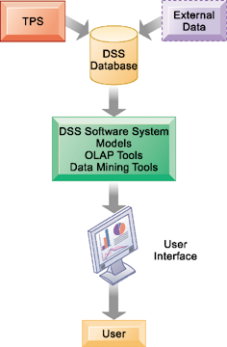
Decision Making and Information Systems
Overview of a Decision-Support System
The main components of the DSS are the DSS database, the DSS software system, and the user interface. The DSS database may be a small database residing on a PC or a large data warehouse.
Figure 10-3
Notes:
This graphic illustrates the components of the DSS, and emphasizes the source of DSS data—primarily TPS data and external data, typically in a database separate from production databases.

Slide 21
Systems for Decision Support
Models: abstract representation that illustrates the components or relationships of a phenomenon
Statistical modeling helps establish relationships.
E.g., relating product sales to differences in age, income, or other factors
Optimization models, forecasting models
Sensitivity analysis models
Ask “what-if” questions repeatedly to determine the impact on outcomes of changes in one or more factors.
E.g., what happens if we raise product price by 5 percent

Slide 22
Decision Making and Information Systems
Sensitivity Analysis
This table displays the results of a sensitivity analysis of the effect of changing the sales price of a necktie and the cost per unit on the product’s break-even point. It answers the question, “What happens to the break-even point if the sales price and the cost to make each unit increase or decrease?”
Figure 10-4
Notes:
This graphic illustrates the results of a sensitivity analysis of changing the sales price of a necktie—it answers the question “What happens to the break-even point if the sales price and the cost to make each unit increase or decrease?”

Slide 23
Systems for Decision Support
Using Spreadsheet Tables to Support Decision Making
Spreadsheet tables can answer multiple dimensions of questions.
Time of day and average purchase
Payment type and average purchase
Payment type, region, and source
Pivot table
Displays two or more dimensions of data in a convenient format
Notes:
Spreadsheets are the most widely used computer-based decision tool that uses quantitative data. It is used throughout the financial industry, but also in scientific applications by engineers and scientists. You should ask your students to talk about how they use spreadsheets on the job.

Slide 24
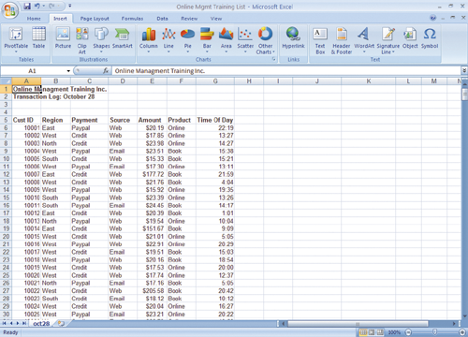
Decision Making and Information Systems
Sample List of Transactions for Online Management Training Inc. on October 28, 2009
This list shows a portion of the order transactions for Online Management Training Inc. on October 28, 2009.
Figure 10-5
Notes:
This graphic shows a Microsoft Excel spreadsheet with sales data from a hypothetical online training company. Data captured includes customer ID, region, payment type, advertising source, amount of purchase, product purchased, and time of day. Excel’s PivotTable function allows you to sort and analyze this data to create meaningful information. Types of questions that you might want to find out from this data include “Where are our customers from?” “What form of payment is more common?” and “Are there regional differences in the average purchase?”

Slide 25
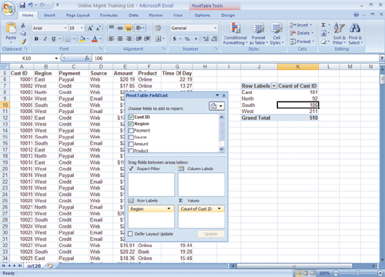
Decision Making and Information Systems
A Pivot Table That Examines the Regional Distribution of Customers
This pivot table was created using Excel 2007 to quickly produce a table showing the relationship between region and number of customers.
Figure 10-6
Notes:
This graphic shows the same Microsoft Excel spreadsheet with a PivotTable with one dimension—it shows where customers come from in terms of region.

Slide 26
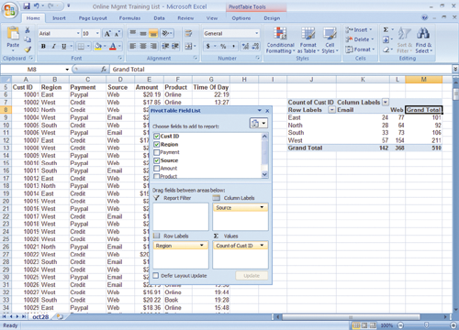
Decision Making and Information Systems
A Pivot Table That Examines Customer Regional Distribution and Advertising Source
In this pivot table, we can examine where customers come from in terms of region and advertising source. It appears nearly 30 percent of the customers respond to e-mail campaigns, and there are some regional variations.
Figure 10-7
Notes:
This graphic shows the same Microsoft Excel spreadsheet with a PivotTable with two dimensions—it shows where customers come from in terms of region and advertising source.

Slide 27
Systems for Decision Support
Data Visualization and Geographic Information Systems (GIS)
Data visualization tools:
Present data in graphical form to help users see patterns and relationships in large quantities of data.
Geographic information systems (GIS):
Use data visualization technology to analyze and display data in the form of digitized maps.
Support decisions that require knowledge about the geographic distribution of people or other resources.
SmartMonet.com Map the Market

Slide 28
SmartMoney.com Map the Market
The map is a powerful new tool for spotting investment trends and opportunities. This quick-start guide will show you how to interpret the map, drill down for detailed information and customize your view. For advanced tips, see our article, Secrets to Using the Map of the Market.
The market at a glance The map lets you watch more than 500 stocks at once, with data updated every 15 minutes. Each colored rectangle in the map represents an individual company. The rectangle's size reflects the company's market cap and the color shows price performance. (Green means the stock price is up; red means it's down. Dark colors are neutral). Move the mouse over a company rectangle and a little panel will pop up with more information. For example, the picture at left shows a group of technology companies. The mouse is pointing to a dark rectangle, representing Oracle. Notice that the green rectangle at the upper left is much bigger than the others. Exactly which Redmond-based software behemoth it represents is left as an exercise for the reader. Click to drill down Want to know more about an individual company? Click on it to bring up a menu like this one. The first two options let you focus on a specific sector or industry. (In the menu at right you could choose a map of technology stocks in general, or software stocks in particular.) The other menu items will take you to our interactive research tools for news, detailed financial data and historical graphs.

Slide 29
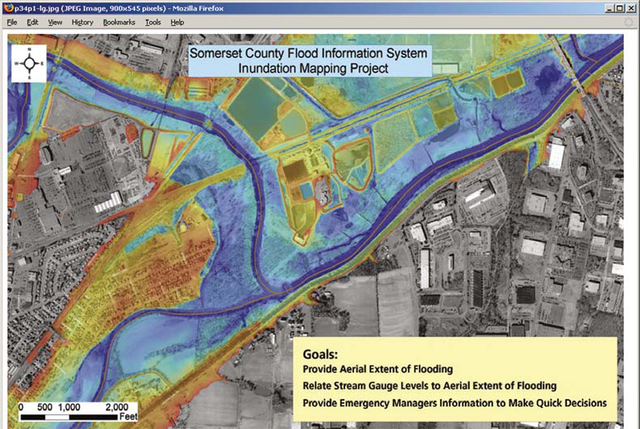
Decision Making and Information Systems
Somerset County, New
Jersey, developed a GIS
based on ESRI software
to provide Web access
to geospatial data about
flood conditions. The system provides information that helps emergency responders and county residents prepare for floods and enables emergency managers to make decisions more quickly.
Notes:
Arguably, one of the fastest growing business intelligence tools involve location-based applications which can describe visually the distribution of some phenomenon or behavior, from crime to shopping to car trips.

Slide 30
Systems for Decision Support
Web-Based Customer Decision-Support Systems (CDSS)
Realtor.com
Support customers in the decision-making process,
Include: search engines, intelligent agents, online catalogs, Web directories, newsgroups, e-mail, and so on
Many firms have customer Web sites where all the information, models, or other analytical tools for evaluating alternatives are concentrated in one location.
E.g., T. Rowe Price online tools, guides for college planning, retirement planning, estate planning, and so on
Notes:
We normally think of decision-support systems as helping the firm, but helping customers with decision-making tools in areas like comparative pricing, retirement planning, mortgage calculation, and car purchasing, are all examples of DSS for customers. What CDSS have students encountered online? Did they find them useful? Why or why not? Are there any drawbacks to using a CDSS?

Slide 31
Systems for Decision Support
Executive Support Systems (ESS)
Bring together data from many different internal and external sources, often through a portal.
Digital dashboard: gives senior executives a picture of the overall performance of an organization.
Drill down capability: enables an executive to zoom in on details or zoom out for a broader view.
Used to monitor organizational performance, track activities of competitors, identify changing market conditions, spot problems, identify opportunities, and forecast trends.
Notes:
ESS are designed to give managers an overview of their company. Much of the value of ESS is found in their flexibility and ability to analyze, compare, and highlight trends. Using an ESS brings a much greater amount of information about the company and external influences, and in a timelier fashion, to management, and greatly improves management performance. It can also change the role of management, in enabling decisions to be made at lower levels as well as the ability to review lower-level performance more easily. In what cases would pushing decisions to a lower level be an advantage and in what scenarios might this prove unwise?

Slide 32
Systems for Decision Support
Group Decision-Support Systems (GDSS)
Interactive, computer-based systems that facilitate solving of unstructured problems by set of decision makers.
Used in conference rooms with special hardware and software for collecting, ranking, storing ideas and decisions.
Promote a collaborative atmosphere by guaranteeing contributors’ anonymity.
Support increased meeting sizes with increased productivity.
Notes:
This slide discusses GDSS, a third type of system that support decision making. What types of problems might a group encounter when trying to make a decision as a group? What kinds of decisions might need to be made as a group?

Slide 33
Intelligent Systems for Decision Support
Intelligent techniques for enhancing decision making
Many based on artificial intelligence (AI)
Computer-based systems (hardware and software) that attempt to emulate human behavior and thought patterns
Include:
Expert systems
Case-based reasoning
Fuzzy logic
Neural networks
Genetic algorithms
Intelligent agents

Slide 34
Intelligent Systems for Decision Support
Expert systems
Model human knowledge as a set of rules that are collectively called the knowledge base
200 to 10,000 rules, depending on complexity
The system’s inference engine searches through the rules and “fires” those rules that are triggered by facts gathered and entered by the user.
Useful for dealing with problems of classification in which there are relatively few alternative outcomes and in which these possible outcomes are all known in advance
Notes:
This slide describes expert systems, one type of intelligent technique. Ask students why expert systems are best used in highly structured decision-making situations. Ask students to provide an example of a decision that could not be solved by an expert system. Choice of music, potential spouses or mates, new product decisions, or designing a new marketing campaign might be good examples of poorly structured decision situations.

Slide 35
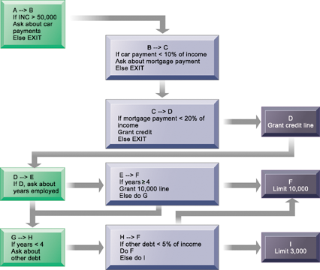
Intelligent Systems for Decision Support
Rules in an Expert System
An expert system contains a set of rules to be followed when used. The rules are interconnected; the number of outcomes is known in advance and is limited; there are multiple paths to the same outcome; and the system can consider multiple rules at a single time. The rules illustrated are for a simple credit-granting expert system.
Figure 10-8
Notes:
This graphic illustrates the use of if/then rules in an expert system. Ask students to demonstrate an understanding of if/then rules, by analyzing a common decision as a series of if/then statements; for example, the decision to accept an invitation to socialize on a weeknight, or the decision of what to make for dinner.

Slide 36
Intelligent Systems for Decision Support
Case-based reasoning
Knowledge and past experiences of human specialists are represented as cases and stored in a database for later retrieval.
System searches for stored cases with problem characteristics similar to new one, finds closest fit, and applies solutions of old case to new case.
Successful and unsuccessful applications are tagged and linked in database.
Used in medical diagnostic systems, customer support.
Notes:
This slide discusses a second type of intelligent technique, case-based reasoning. What would be the difference in how a CBR system would be used in medical diagnosis versus an expert system? Ask students which of the two techniques would be better at medical diagnosis and why?

Slide 37
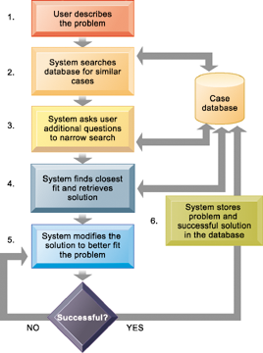
Intelligent Systems for Decision Support
How Case-Based Reasoning Works
Case-based reasoning represents knowledge as a database of past cases and their solutions. The system uses a six-step process to generate solutions to new problems encountered by the user.
Figure 10-9
Notes:
This graphic demonstrates the six main steps in case based reasoning. Ask the students to compare expert systems with CBR. What are the benefits and drawbacks in CBR as a technique? What types of problems lend themselves to CBR?

Slide 38
Intelligent Systems for Decision Support
Fuzzy logic
Rule-based technology that represents imprecision in categories (e.g., “cold” versus “cool”) by creating rules that use approximate or subjective values
Describes a particular phenomenon or process linguistically and then represents that description in a small number of flexible rules
Provides solutions to problems requiring expertise that is difficult to represent in the form of crisp IF-THEN rules
E.g., Sendai, Japan subway system uses fuzzy logic controls to accelerate so smoothly that standing passengers need not hold on
Notes:
This slide discusses a third type of intelligent technique—fuzzy logic. The text discusses the use of fuzzy logic to control room temperature automatically using imprecise values for temperature, humidity, outdoor wind, and outdoor temperature, in order to evaluate current room conditions and respond appropriately. Ask students what might be the imprecise values used in the fuzzy logic for camera autofocus, medical fraud detection, and subway acceleration. Could fuzzy logic be used in medical diagnosis? How would this work?

Slide 39
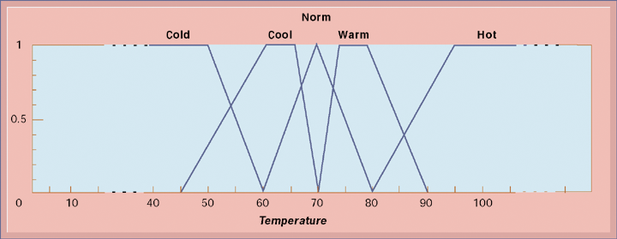
Intelligent Systems for Decision Support
Fuzzy Logic for Temperature Control
The membership functions for the input called temperature are in the logic of the thermostat to control the room temperature. Membership functions help translate linguistic expressions, such as warm, into numbers that the computer can manipulate
Figure 10-10
Notes:
This graphic illustrates how a fuzzy logic system for room air conditioning might represent the imprecise values for temperature. Ask students what the benefit is of using imprecise values?

Slide 40
Intelligent Systems for Decision Support
Neural networks
Use hardware and software that parallel the processing patterns of a biological brain.
“Learn” patterns from large quantities of data by searching for relationships, building models, and correcting over and over again the model’s own mistakes.
Humans “train” the network by feeding it data for which the inputs produce a known set of outputs or conclusions.
Machine learning
Useful for solving complex, poorly understood problems for which large amounts of data have been collected.
Notes:
This slide discusses a fourth intelligent technique—neural networks. Ask students whether neural networks could be used in medical diagnosis? How would this work? To some extent, data-mining techniques have replaced neural networks in situations requiring pattern recognition. For instance, credit card companies sift through mountains of transaction data to identify which charging patterns are unlikely for each and every charge card customer.

Slide 41
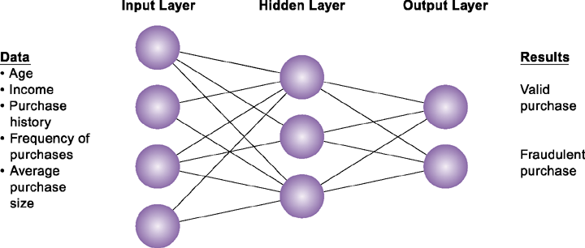
Intelligent Systems for Decision Support
How a Neural Network Works
A neural network uses rules it “learns” from patterns in data to construct a hidden layer of logic. The hidden layer then processes inputs, classifying them based on the experience of the model. In this example, the neural network has been trained to distinguish between valid and fraudulent credit card purchases.
Figure 10-11
Notes:
This graphic illustrates how a neural network works—by using an internal, hidden layer of logic that examines existing data and assigning a classification to that set of data. For example, given one or more specific combinations of age, income, purchase history, frequency of purchases, and average purchase size, a neural network might determine that a new credit card purchase was likely to be fraudulent. What are the benefits and drawbacks of using this type of technique?

Slide 42
Intelligent Systems for Decision Support
Genetic algorithms
Find the optimal solution for a specific problem by examining very large number of alternative solutions for that problem.
Based on techniques inspired by evolutionary biology: inheritance, mutation, selection, and so on.
Work by representing a solution as a string of 0s and 1s, then searching randomly generated strings of binary digits to identify best possible solution.
Used to solve complex problems that are very dynamic and complex, involving hundreds or thousands of variables or formulas.
Notes:
This slide discusses a fifth type of intelligent technique—genetic algorithms. Ask students whether genetic algorithms might be useful in medical diagnosis. Why or why not? Ask students to differentiate between the various intelligent techniques discussed this far—expert systems, CBR, fuzzy logic, neural networks, and genetic algorithms.

Slide 43
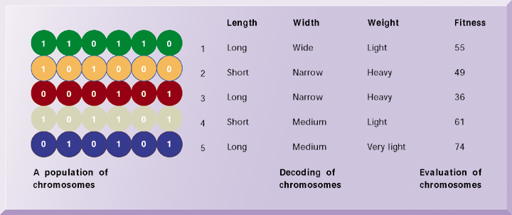
Intelligent Systems for Decision Support
The Components of a Genetic Algorithm
This example illustrates an initial population of “chromosomes,” each representing a different solution. The genetic algorithm uses an iterative process to refine the initial solutions so that the better ones, those with the higher fitness, are more likely to emerge as the best solution.
Figure 10-12
Notes:
This graphic illustrates the components of a genetic algorithm—“chromosomes”, each with a variety of characteristics that can be compared for overall fitness in a given situation. Ask students what types of problems genetic algorithms are suited for.

Slide 44
Intelligent Systems for Decision Support
Interactive Session: Technology
Reality Mining
Read the Interactive Session and then discuss the following questions:
Why might businesses be interested in location-based mobile networking?
What technological developments have set the stage for the growth of Sense Networks and the success of their products?
Do you feel that the privacy risks surrounding Citysense are significant? Would you sign up to use Sense Networks services? Why or why not?

Slide 45
Intelligent Systems for Decision Support
Intelligent agents
Programs that work in the background without direct human intervention to carry out specific, repetitive, and predictable tasks for user, business process, or software application
Shopping bots MySimon.com
Procter & Gamble (P&G) programmed group of semiautonomous agents to emulate behavior of supply-chain components, such as trucks, production facilities, distributors, and retail stores and created simulations to determine how to make supply chain more efficient
Notes:
This slide discusses the use of intelligent agents to carry out repetitive tasks for a user or system. Shopping bots discussed in an earlier chapter are an example of an intelligent agent. As an example of agent-based modeling, Procter & Gamble used agent-based modeling to improve coordination among supply-chain members.

Slide 46
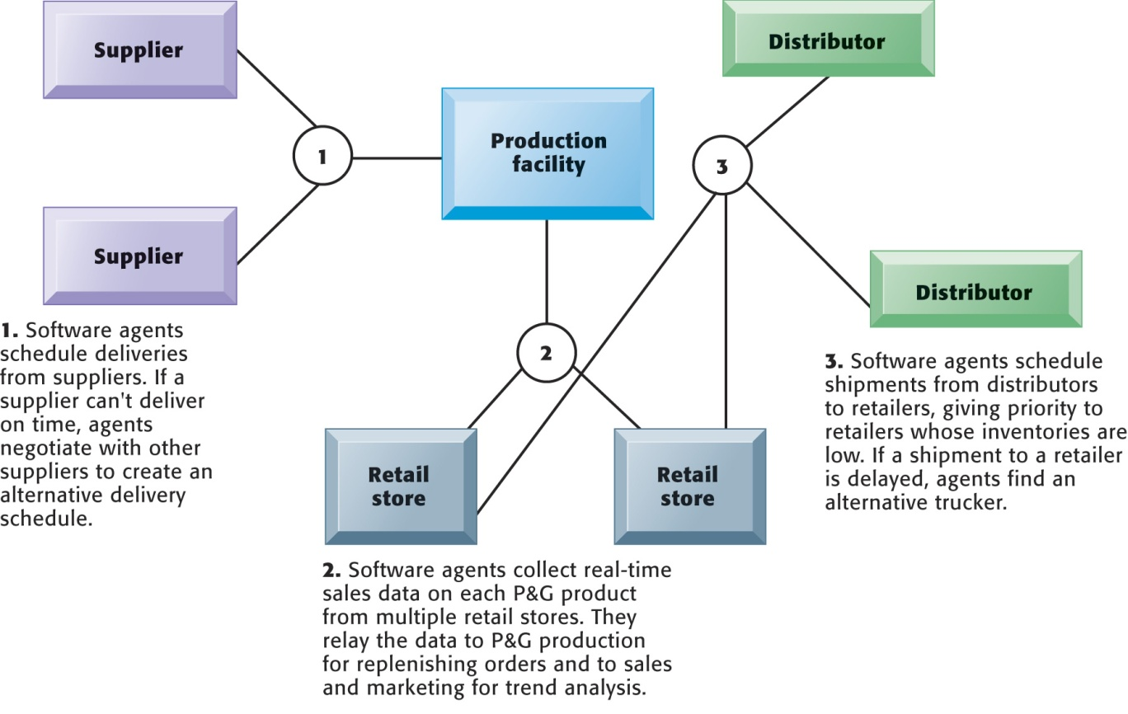
Intelligent Systems for Decision Support
Intelligent Agents in P&G’s Supply Chain Network
Intelligent agents are helping Procter & Gamble shorten the replenishment cycles for products, such as a box of Tide.
Figure 10-13
Notes:
This graphic illustrates Procter & Gamble’s use of intelligent agents in its supply chain network. Given that intelligent-agent modeling mimics the behavior of a number of “actors” in a given situation, what other types of situations might benefit from this type of analysis?

Slide 47
Systems for Managing Knowledge
Knowledge management
Business processes developed for creating, storing, transferring, and applying knowledge
Increases the ability of organization to learn from environment and to incorporate knowledge into business processes and decision making
Knowing how to do things effectively and efficiently in ways that other organizations cannot duplicate is major source of profit and competitive advantage
Notes:
This slide defines the term knowledge management and describes the process from acquiring knowledge to applying it as a value chain, and is followed by slides detailing each stage. Each stage of the chain adds more value to the raw data and information. Ask the students to differentiate between the stages, and how each stage could incorporate more value? For example, how does knowledge, once it is stored, incorporate more value than the previous stage knowledge that is being acquired?

Slide 48
Systems for Managing Knowledge
Enterprise-Wide Knowledge Management Systems
Three kinds of knowledge
Structured: structured text documents (reports, presentations)
Semistructured: e-mail, voice mail, digital pictures, bulletin-board postings
Tacit knowledge (unstructured): knowledge residing in heads of employees, rarely written down
Enterprise-wide knowledge management systems
Deal with all three types of knowledge
General-purpose, firm-wide systems that collect, store, distribute, and apply digital content and knowledge
Notes:
Enterprise knowledge systems are generally very large databases that attempt to collect all the “valuable” information and knowledge of individuals and groups in the firm. This can include customer and vendor knowledge, case studies, PowerPoint slides, and internal reports.

Slide 49
Systems for Managing Knowledge
Enterprise-Wide Knowledge Management Systems
Enterprise content management systems
Capabilities for knowledge capture, storage
Repositories for documents and best practices
Capabilities for collecting and organizing semistructured knowledge such as e-mail
Classification schemes
Key problem in managing knowledge
Each knowledge object must be tagged for retrieval

Slide 50
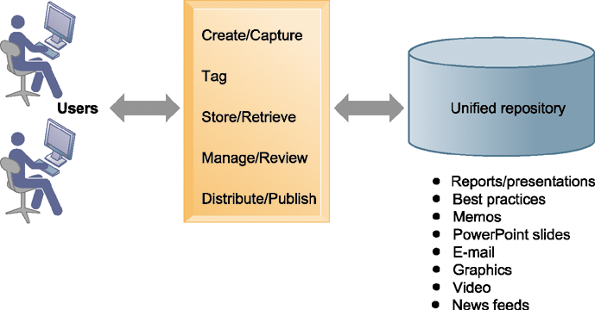
Intelligent Systems for Decision Support
An Enterprise Content Management System
An enterprise content management system has capabilities for classifying, organizing, and managing structured and semistructured knowledge and making it available throughout the enterprise.
Figure 10-14
Notes:
This graphic illustrates the functions of an enterprise content management system. Users interact with the system to both input knowledge, manage it, and distribute it. These management systems can house a wide variety of information types, from formal reports to graphics, as well as bring in external content resources such as news feeds. Ask students what types of documents would need to be stored by a hospital, bank, law firm, and so on.

Slide 51
Systems for Managing Knowledge
Enterprise-Wide Knowledge Management Systems
Digital asset management systems
Manage unstructured digital data like photographs, graphic images, video, audio
Knowledge network systems (Expertise location and management systems)
Provide online directory of corporate experts in well-defined knowledge domains
Use communication technologies to make it easy for employees to find appropriate expert in firm.
Notes:
Enterprise content management systems can include or consist of capabilities for the creation and management of unstructured knowledge—knowledge-network systems. Ask the students to give examples of unstructured knowledge, given a type of industry or company: a law firm, an advertising firm, a school. What might be the difficulties in establishing a knowledge network system in a company? Contrast this network (crowd centered) approach to a top down structured knowledge management system.

Slide 52
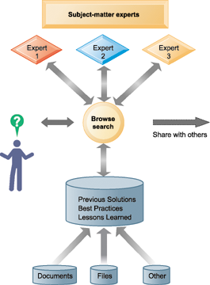
Intelligent Systems for Decision Support
An Enterprise Knowledge Network System
A knowledge network maintains a database of firm experts, as well as accepted solutions to known problems, and then facilitates the communication between employees looking for knowledge and experts who have that knowledge. Solutions created in this communication are then added to a database of solutions in the form of frequently asked questions (FAQs), best practices, or other documents.
Figure 10-15
Notes:
This graphic illustrates the various elements that form a knowledge network system. The user can search for accepted solutions in a FAQ or best practices document or contact an expert in the relevant subject matter. Ask the students to provide examples of undocumented, unstructured knowledge they acquired, either in a classroom setting or at work, that would be valuable to peers. What kind of tools would enable sharing this information? In search for an answer to a business problem, would they rather talk with an expert in their firm, or search a database? Students may differ on this.

Slide 53
Systems for Managing Knowledge
Enterprise-Wide Knowledge Management Systems
Collaboration tools
Social bookmarking: allow users to save their bookmarks publicly and tag with keywords.
Folksonomies
Learning management systems (LMS)
Provide tools for management, delivery, tracking, and assessment of various types of employee learning and training.
Notes:
This slide discusses learning management systems, which enable companies to track and manage employee learning. Ask students what are the benefits and drawbacks of using an LMS with centralized reporting.

Slide 54
Systems for Managing Knowledge
Knowledge Work Systems (KWS)
Specialized systems for knowledge workers
Requirements of knowledge work systems:
Specialized tools
Powerful graphics, analytical tools, and communications and document management
Computing power to handle sophisticated graphics or complex calculations
Access to external databases
User-friendly interfaces
Notes:
This slide discusses the second main type of knowledge management system, the knowledge work system, and identifies the importance of knowledge workers to an organization and its knowledge creation. Ask the students why each of the three roles listed is important to an organization. Can all companies benefit from knowledge workers, or only design, science, and engineering firms?

Slide 55
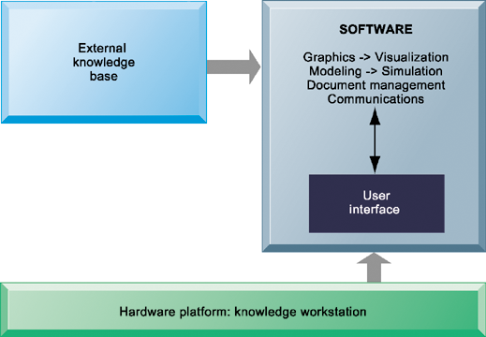
Intelligent Systems for Decision Support
Requirements of Knowledge Work Systems
Knowledge work systems require strong links to external knowledge bases in addition to specialized hardware and software.
Figure 10-16
Notes:
This graphic illustrates the main components of a knowledge work station: having the need for both specialized software and hardware, access to external information, and an easy-to-use interface. What types of external knowledge might be valuable to an engineer, a financial analyst, a medical researcher?

Slide 56
Systems for Managing Knowledge
Knowledge Work Systems (KWS)
Examples of knowledge work systems
Computer-aided design (CAD) systems
Virtual reality systems
Virtual Reality Modeling Language (VRML)
Investment workstations
Notes:
Ask if any of your students have worked with an engineering work station, or CNC (computer numerically controlled machine tool). Or have any worked with a financial workstation that financial planners often use (really just a fast PC with software for financial planning).

