Slide 1
E-Commerce: Digital Markets, Digital Goods
Notes:
There are two video cases available for this chapter:
Case 1 M-Commerce: The Past, Present, and Future
Case 2 Ford AutoXchange B2B Marketplace

Slide 2
E-commerce and the Internet
E-Commerce Today
E-commerce: use of the Internet and Web to transact business; digitally enabled transactions.
Began in 1995 and grew exponentially; still growing even in a recession.
Companies that survived the dot-com bubble burst and now thrive.
Notes:
This slide discusses what e-commerce is, and what the state of e-commerce is today. The text states that e-commerce history mirrors those of other technology innovations. What other innovations is e-commerce similar to? Students probably will not know about the early days of radio and TV, but perhaps they will remember cassette music, VHS video tapes, and even CDs which though still with us, are definitely declining in sales.
The book discusses new trends in e-commerce. Ask the students to work with you to list some of these new trends in e-commerce.

Slide 3
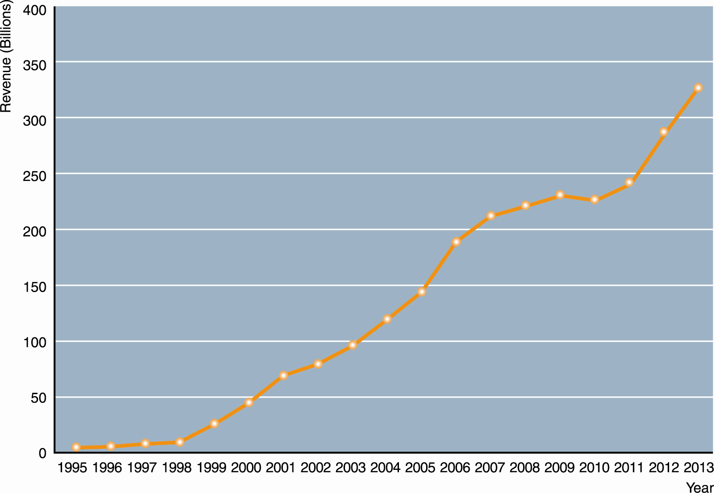
E-commerce and the Internet
The Growth of E-Commerce
Figure 9-1
Notes:
This graphic illustrates the continuing growth of e-commerce. The Growth of E-commerce Retail e-commerce revenues grew 15 percent to 25 percent a year until the recession of 2008–2009, when they slowed measurably to a small positive number around 3 percent in 2009. This was much better than traditional retail commerce which actually shrank in this recession. In 2010-2011, e-commerce revenues are expected to begin growing again at an estimated 10 percent annual clip.

Slide 4
E-commerce and the Internet
Why E-Commerce Is Different
Ubiquity
Internet/Web technology available everywhere: work, home, and so on, anytime.
Effect:
Marketplace removed from temporal, geographic locations to become “marketspace”
Enhanced customer convenience and reduced shopping costs
Notes:
This slide discusses reasons why e-commerce has grown so quickly—because of the unique nature of the Internet and e-commerce, which are richer and more powerful than previous technology revolutions like radio and TV.
Ask students what the effects are of these unique features listed on this and following slides.
Ubiquity: Marketplace removed from temporal, geographic locations to become “marketspace”. Enhanced customer convenience and reduced shopping costs
Global reach: Commerce enabled across cultural and national boundaries seamlessly and without modification. Marketspace includes, potentially, billions of consumers and millions of businesses worldwide.
Universal standards: Disparate computer systems easily communicate with one another. Lower market entry costs—costs merchants must pay to bring goods to market. Lower consumers’ search costs—effort required to find suitable products.
Richness: Possible to deliver rich messages with text, audio, and video simultaneously to large numbers of people. Video, audio, and text marketing messages can be integrated into single marketing message and consumer experience.

Slide 5
E-commerce and the Internet
Unique Features of E-commerce Technology
Global reach
The technology reaches across national boundaries, around Earth
Effect:
Commerce enabled across cultural and national boundaries seamlessly and without modification.
Marketspace includes, potentially, billions of consumers and millions of businesses worldwide.

Slide 6
E-commerce and the Internet
Unique Features of E-commerce Technology
Universal standards
One set of technology standards: Internet standards
Effect:
Disparate computer systems easily communicate with one another.
Lower market entry costs—costs merchants must pay to bring goods to market.
Lower consumers’ search costs—effort required to find suitable products.

Slide 7
E-commerce and the Internet
Unique Features of E-commerce Technology
Richness
Supports video, audio, and text messages
Effect:
Possible to deliver rich messages with text, audio, and video simultaneously to large numbers of people.
Video, audio, and text marketing messages can be integrated into single marketing message and consumer experience.

Slide 8
E-commerce and the Internet
Unique Features of E-commerce Technology
Interactivity
The technology works through interaction with the user
Effect:
Consumers engaged in dialog that dynamically adjusts experience to the individual.
Consumer becomes co-participant in process of delivering goods to market.
Notes:
This slide continues the discussion of the unique features of the Internet and e-commerce.
Ask students what the effects are of the four features listed on this and following slides.
Interactivity: Consumers engaged in dialog that dynamically adjusts experience to the individual. Consumer becomes co-participant in process of delivering goods to market.
Information density: Greater price transparency. Greater cost transparency. Enables merchants to engage in price discrimination.
Personalization/Customization: Personalized messages can be sent to individuals as well as groups. Products and services can be customized to individual preferences.
Social technology: new Internet social and business models enable user content creation and distribution, and support social networks.

Slide 9
E-commerce and the Internet
Unique Features of E-commerce Technology
Information density
Large increases in information density—the total amount and quality of information available to all market participants
Effect:
Greater price transparency
Greater cost transparency
Enables merchants to engage in price discrimination

Slide 10
E-commerce and the Internet
Unique Features of E-commerce Technology
Personalization/Customization
Technology permits modification of messages, goods
Effect:
Personalized messages can be sent to individuals as well as groups.
Products and services can be customized to individual preferences.

Slide 11
E-commerce and the Internet
Unique Features of E-commerce Technology
Social technology
The technology promotes user content generation and social networking
Effect:
New Internet social and business models enable user content creation and distribution, and support social networks.

Slide 12
Key Concepts in E-commerce: Digital Markets and Digital Goods In a Global Marketplace
Digital markets reduce
Information asymmetry - when one party in a transaction has more information that is important for the transaction than the other party
Search costs - the effort to find suitable products
Transaction costs - the cost of participating in a market
Menu costs - merchants’ costs of changing prices
Digital markets enable
Price discrimination - selling the same goods, or nearly the same goods, to different targeted groups at different prices
Dynamic pricing - the price of a product varies depending on the demand characteristics of the customer or the supply situation of the seller
Disintermediation - the removal of organizations or business process layers responsible for intermediary steps in a value chain.
Notes:
This slide introduces digital markets and discusses the effects of digital markets on the ways companies conduct business. Ask students to define the terms listed here, and also to explain how each of these effects (lowered information asymmetry, etc.) are created by digital markets. Go through each of the three types of costs involved in any marketplace. Students may not be familiar with these words, but they will be familiar with the phenomenon. For instance, all students will recognize that it takes time and money to go to a mall to find a shirt (this is search cost). The same shirt can be bought on the Web today with minimal search costs.
Information asymmetry: when one party in a transaction has more information that is important for the transaction than the other party.
Search costs: the effort to find suitable products.
Transaction costs: the cost of participating in a market.
Menu costs: merchants’ costs of changing prices.
Price discrimination: selling the same goods, or nearly the same goods, to different targeted groups at different prices.
Dynamic pricing: the price of a product varies depending on the demand characteristics of the customer or the supply situation of the seller.
Disintermediation: the removal of organizations or business process layers responsible for intermediary steps in a value chain.

Slide 13
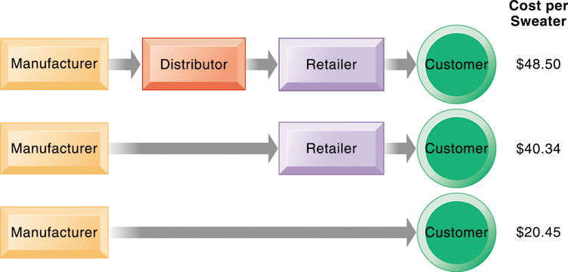
E-commerce and the Internet
The Benefits of Disintermediation to the Consumer
The typical distribution channel has several intermediary layers, each of which adds to the final cost of a product, such as a sweater. Removing layers lowers the final cost to the consumer.
Figure 9-2
Notes:
This graphic illustrates how disintermediation reduces prices to consumers. It also allows manufacturers to earn more profit for the product by eliminating the middle man. Are middle men really necessary? You should ask students who they think is a “middle man.” Wal-Mart is, for instance, a distributor and retailer. Do they provide an important function? Why can’t manufacturers just ignore Wal-Mart and sell directly to the customer? Even though market disintermediation sounds like a good thing because costs and prices go down, for the most part manufacturers kept their distribution partners and channels. Wal-mart is still needed by manufacturers like P&G to sell soap.

Slide 14
E-commerce and the Internet
Key Concepts in E-commerce: Digital Markets and Digital Goods In a Global Marketplace
Digital goods
Goods that can be delivered over a digital network
E.g., music tracks, video, software, newspapers, books
Cost of producing first unit almost entire cost of product: marginal cost of producing 2nd unit is about zero
Costs of delivery over the Internet very low
Marketing costs remain the same; pricing highly variable
Industries with digital goods are undergoing revolutionary changes (publishers, record labels, etc.)
Notes:
This slide continues the discussion of key concepts in e-commerce, looking at digital goods and how these compare with traditional goods.
Ask students how their purchases of digital goods have changed over the past five years. Are digital goods equal in value to their traditional counterparts? What benefits and drawbacks do they have? Music for instance used to be a physical product (record or CD) not a digital product or digital service.

Slide 15
E-commerce: Business and Technology
Types of E-commerce
Business-to-consumer (B2C)
Business-to-business (B2B) Grainger.com
Consumer-to-consumer (C2C)
Mobile commerce (m-commerce)
Use of wireless mobile devices for purchasing goods and services.
M-commerce is especially well-suited for location-based applications and services
Notes:
This slide introduces the types of e-commerce. B2C, B2B, and C2C e-commerce are categorized according to the nature of the participants. M-commerce is a category based on the nature of the connection to the Internet. Ask students to provide examples of the different types of e-commerce listed here. Most students will find it hard to come up with a B2B example. One place you can visit on the Web is grainger.com, one of the largest B2B marketplaces in the United States. Another is mcmaster.com, and also elemica.com (chemical industry).

Slide 16
E-commerce: Business and Technology
E-commerce Business Models
Portal - revenue: advertising
E-tailer – traditional sales over the web
Content provider - revenue: access fees, advertising
Transaction broker – eSchwab (charges for transaction)
Service provider - revenue: subscription fees, advertising
Community provider -
Notes:
This slide continues the discussion of new Internet business models. Ask students to give examples of these business models. For each model, ask students about their experience, or ask for examples for each model. Ask how these business models create revenue. For instance,
Content provider—revenue: access fees, advertising
Portal—revenue: advertising
Service provider—revenue: subscription fees, advertising

Slide 17
E-commerce: Business and Technology
E-commerce Revenue Models
Advertising
Sales
Subscription
Free/Fremium
Transaction fee
Affiliate
Notes:
This slide and the next several slides discuss new business models that are enabled by the Internet and e-commerce. Although many of the new business models are pure-play, some, especially in the retail industry, are clicks-and-mortar.
Some of the new models take advantage of the Internet’s communication capabilities, such as the social networking sites. Ask students what other sites take advantage of the Internet’s communication abilities.
Ask students to differentiate between banner ads and popup ads.

Slide 18
E-commerce: Business and Technology
Web 2.0, Social Networking, and the Wisdom of Crowds
Most popular Web 2.0 service: social networking
Social networking sites sell banner ads, user preference information, and music, videos and e-books.
Social shopping sites
Swap shopping ideas with friends (Kaboodle, ThisNext)
Wisdom of crowds (crowd sourcing)
Large numbers of people can make better decisions about topics and products than a single person.
Prediction markets: peer-to-peer betting markets on specific outcomes (elections, sales figures, designs for new products)
LinkedIn is the largest professional and business social network that members often use to recruit employees and find jobs.
Notes:
Most students will be well aware of social networking technologies, but have they heard of prediction markets? Ask them to investigate this further on their own time. How can these techniques and phenomenon be used by business firms? LinkedIn is the largest professional and business social network that members often use to recruit employees and find jobs.

Slide 19
E-commerce: Business and Technology
E-commerce Marketing
Internet provides marketers with new ways of identifying and communicating with customers.
Long tail marketing: ability to reach a large audience inexpensively.
Behavioral targeting: tracking online behavior of individuals on thousands of Web sites.
Advertising formats include search engine marketing, display ads, rich media, and e-mail.
Collaborative filtering - a method of making automatic predictions (filtering) about the interests of a user by collecting preferences from many users .The assumption is that if a person A has the same opinion as a person B on an issue, A is more likely to have B's opinion on a different issue x than to have the opinion on x of a person chosen randomly
Notes:
Ask students to explain why marketers are looking to analyze blog content, and content from chat rooms and message boards. Have students describe and evaluate their experiences with advertising on social networks, via e-mail and other online formats.

Slide 20
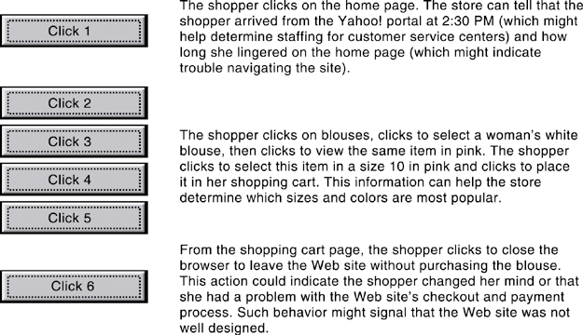
E-commerce: Business and Technology
Web Site Visitor Tracking (Clickstream)
E-commerce Web sites have tools to track a shopper’s every step through an online store. Close examination of customer behavior at a Web site selling women’s clothing shows what the store might learn at each step and what actions it could take to increase sales.
Extensive metrics exist for various types of user behavior, from the time spent on a Web page to the number of products ordered and placed in a shopping cart but not purchased.
Notes:
This graphic illustrates how clickstream tracking works and what the store can tell about the activities of a shopper on their Web site. Extensive metrics exist for various types of user behavior, from the time spent on a Web page to the number of products ordered and placed in a shopping cart but not purchased.

Slide 21
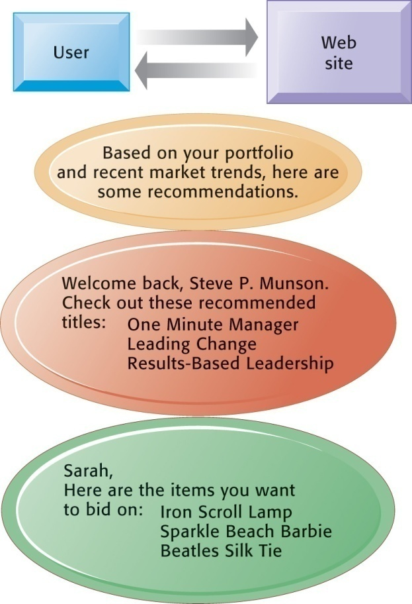
E-commerce: Business and Technology
Web Site Personalization
Firms can create unique personalized Web pages that display content or ads for products or services of special interest to individual users, improving the customer experience and creating additional value.
Notes:
This graphic illustrates some of the types of personalization that clickstream tracking can make possible. Have students found suggestions made by a Web site useful in their experience? You can go to Amazon.com and illustrate how recommender systems work. Search for a product, and then scroll to the bottom of the page where Amazon’s recommender will tell you what other people who looked at the current page actually bought. Netflix is also an excellent site to demonstrate personalization.

Slide 22
E-commerce: Business and Technology
Business-to-Business Electronic Commerce: New Efficiencies and Relationships
Electronic data interchange (EDI)
Computer-to-computer exchange of standard transactions such as invoices, purchase orders.
Major industries have EDI standards that define structure and information fields of electronic documents for that industry.
More companies increasingly moving away from private networks to Internet for linking to other firms.
E.g., procurement: businesses can now use Internet to locate most low-cost supplier, search online catalogs of supplier products, negotiate with suppliers, place orders, and so on
Notes:
This slide looks at changes brought to B2B e-commerce by Internet technologies. Note that the Internet and Web technology enable businesses to create new electronic storefronts for selling to other businesses with multimedia graphic displays and interactive features similar to those for B2C commerce. Alternatively, businesses can use Internet technology to create extranets or electronic marketplaces for linking to other businesses for purchase and sale transactions.

Slide 23
E-commerce: Business and Technology
Electronic Data Interchange (EDI)
Companies use EDI to automate transactions for B2B e-commerce and continuous inventory replenishment. Suppliers can automatically send data about shipments to purchasing firms. The purchasing firms can use EDI to provide production and inventory requirements and payment data to suppliers.
Notes:
This graphic illustrates how EDI is used by firms and their suppliers to automate transactions for both B2B e-commerce and continuous replenishment. EDI is still widely used but it has limitations outlined in the book and is not designed for supporting marketplace operations where you have hundreds of vendors and buyers.

Slide 24
E-commerce: Business and Technology
Business-to-Business Electronic Commerce: New Efficiencies and Relationships
Private industrial networks (private exchanges)
Large firm using extranet to link to its suppliers, distributors, and other key business partners
Owned by buyer
Permits sharing of:
Product design and development
Marketing
Production scheduling and inventory management
Unstructured communication (graphics and e-mail)
Notes:
This slide continues the discussion of ways the Internet and Web technologies have changed B2B e-commerce. One way is in using an extranet to link to the firm’s suppliers. The text provides the example of VW Group Supply, which links the Volkswagen Group and its suppliers. VW Group Supply handles 90 percent of all global purchasing for Volkswagen, including all automotive and parts components.

Slide 25
E-commerce: Business and Technology
Business-to-Business Electronic Commerce: New Efficiencies and Relationships
Net marketplaces (e-hubs)
Single market for many buyers and sellers.
Industry-owned or owned by independent intermediary.
Generate revenue from transaction fees, other services.
Use prices established through negotiation, auction, RFQs, or fixed prices.
May focus on direct or indirect goods.
May be vertical or horizontal marketplaces.
Notes:
This slide continues the discussion of ways the Internet and Web technologies have changed B2B e-commerce, in this case by the ability to create Net marketplaces. Ask students to distinguish between and provide examples of direct and indirect goods. (Direct goods are goods used in a production process, such as sheet steel for auto body production. Indirect goods are all other goods not directly involved in the production process, such as office supplies or products for maintenance and repair.)
Ask students to distinguish between vertical and horizontal marketplaces.

Slide 26
E-commerce: Business and Technology
Social e-commerce:
Based on digital social graph
Mapping of all significant online relationships
Four features of social e-commerce driving its growth
Social sign-on
Collaborative shopping
Network notification
Social search (recommendations)
This animation shows the different types of relations between social objects. User Evais a friend of Adam and Kate, though Adamand Kate are not friends themselves. Peter'sphoto was "liked" by many users, including Eva. Also Eva listened to the Last.fm radio and watched the video from YouTube.
Notes:
Ask your class who has a Facebook page. A forest of hands will rise. How many have purchase something while on their Facebook page, or clicks routinely on ads? Generally, people do not go to Facebook to buy things and are not clicking on display ads (less than 2% of users).

Slide 27
E-commerce: Business and Technology
Social media:
Fastest growing media for branding and marketing
Social network marketing:
Seeks to leverage individuals influence over others in social graph
Target is a social network of people sharing interests and advice
Social networks have huge audiences
Facebook: 150 million U.S. visitors monthly
But companies are finding that old-school methods such as e-mail, display ads, and search engines are still the most cost effective tools for selling goods and services.
Click-through rates on search ads are five times higher than ads on Facebook
Generally, people do not go to Facebook to buy things and are not clicking on display ads (less than 2% of users).
Notes:
Facebook and Google’s +1 social network are rapidly growing. Facebook reached 800 million worldwide, with 200 million in the United States. In the space of its first six months, LinkedIn has 40 million monthly visitors.

Slide 28
The Mobile Digital Platform and Mobile E-commerce
M-commerce
In 2012 is 10% of all e-commerce
Fastest growing form of e-commerce
Some areas growing at 50%
Four billion mobile phone users worldwide
Main areas of growth
Retail sales at top Mobile 400 (Amazon, eBay, etc.)
Sales of digital content (music, TV, etc.)
Local search for restaurants, museums, stores
Notes:
This slide introduces m-commerce, the use of wireless mobile devices for purchasing goods and services. Ask students what applications and services they use with their cell-phones. Have any purchased games or entertainment, and from what companies? Have any used OpenTable on a smartphone?

Slide 29
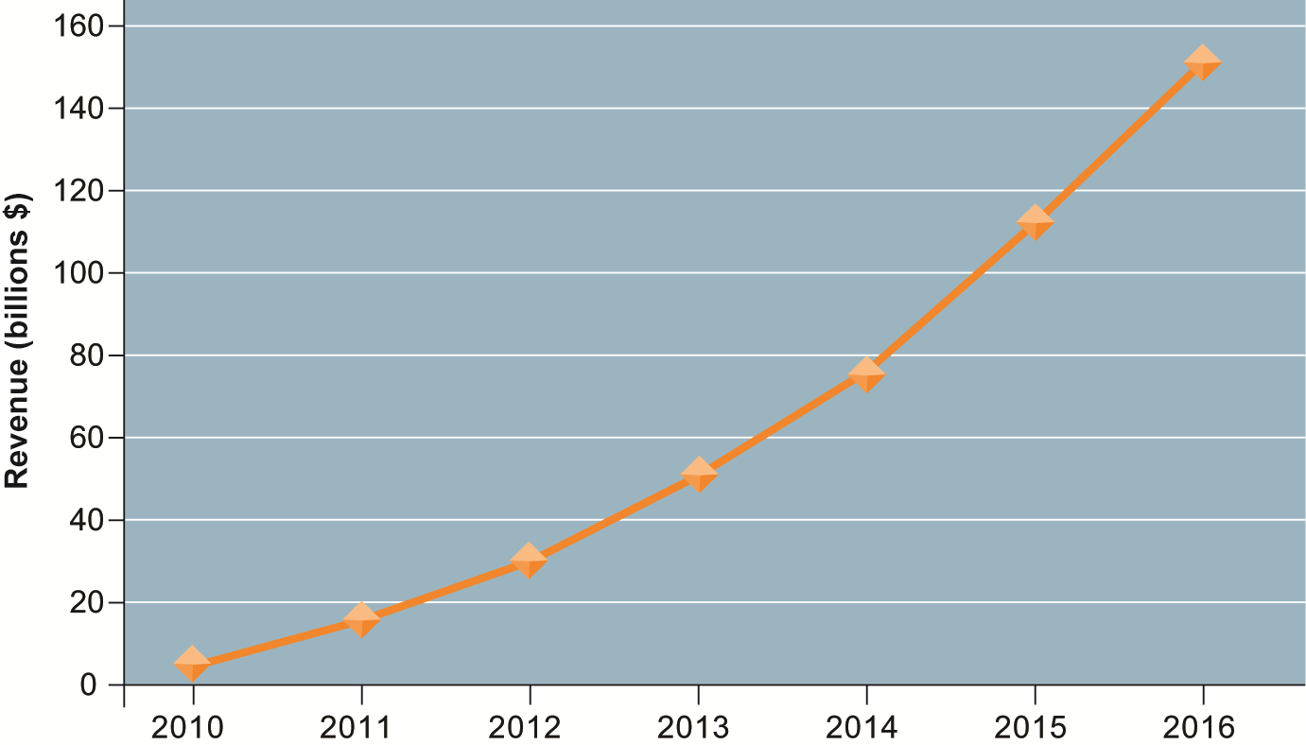
Consolidated Mobile Commerce Revenues
Figure 10-9
Mobile e-commerce is the fastest growing type of B2C e-commerce although it represents only a small part of all e-commerce in 2011.
Notes:
This graph illustrates the surging growth of m-commerce sales from today to 2016. In the early years prior to 2009, m-commerce in the United States was very small and not growing rapidly. Cell phones, especially smartphones, have changed that. Have any of the students purchased something using their cell phone or mobile laptop computer? How many students are using a smartphone? How many have used a smartphone app to compare prices while shopping at stores?

Slide 30
Building an E-commerce Web Site
Pieces of the site-building puzzle
Assembling a team with the skills required to make decisions about:
Technology
Site design
Social and information policies
Hardware, software, and telecommunications infrastructure
Customer’s demands should drive the site’s technology and design.
Notes:
Building a Web site involves a number of considerations. If its an e-commerce site, customer preferences should be the driving force behind the design. What are customers looking for, how can they find it on your site, and how easily can they purchase on your site? How will you choose the technology? What about your sites information policy? What’s that? If you don’t know, your customers will surely expect you to know.

Slide 31
Building an E-commerce Web Site
Business objectives
The capabilities the site should have
Business decisions should drive technology
Example: execute a transaction payment
System functionality
Technology needed to achieve objective
Example: a shopping cart or other payment system
Information requirement
Specific data and processes needed
Example: secure credit card clearing, multiple payment options
Notes:
Building an e-commerce site begins with understanding the business first, then using the technology to support the business.

Slide 32
Building an E-commerce Web Site
Alternatives in building the Web site:
Completely in-house
Mixed responsibility
Completely outsourced
Co-location
Web site budgets
Several thousand to millions per year
50% of budget is system maintenance and content creation
Notes:
One of the most important decisions managers make in e-commerce is concerns how to build the Web site. There are a number of options. Although technology costs for building Web sites have fallen dramatically, so also have labor costs. There are now plenty of skilled Web designers, programmers, and network administrators (although here the labor market is a bit tighter). Which options are most appropriate for particular kinds of companies?
What is best for a small business with a handful of employees?
What is best for a single individual with little technical experience? What is best for a medium-size business with a handful of locations?

Slide 33
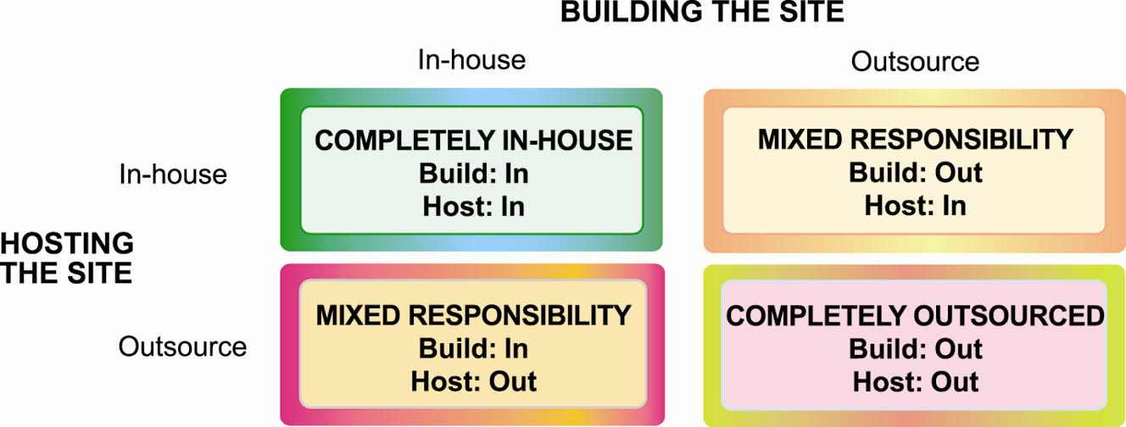
Choices in Building and Hosting Web Sites
Figure 10-10
You have a number of alternatives to consider when building and hosting an e-commerce site.

Slide 34
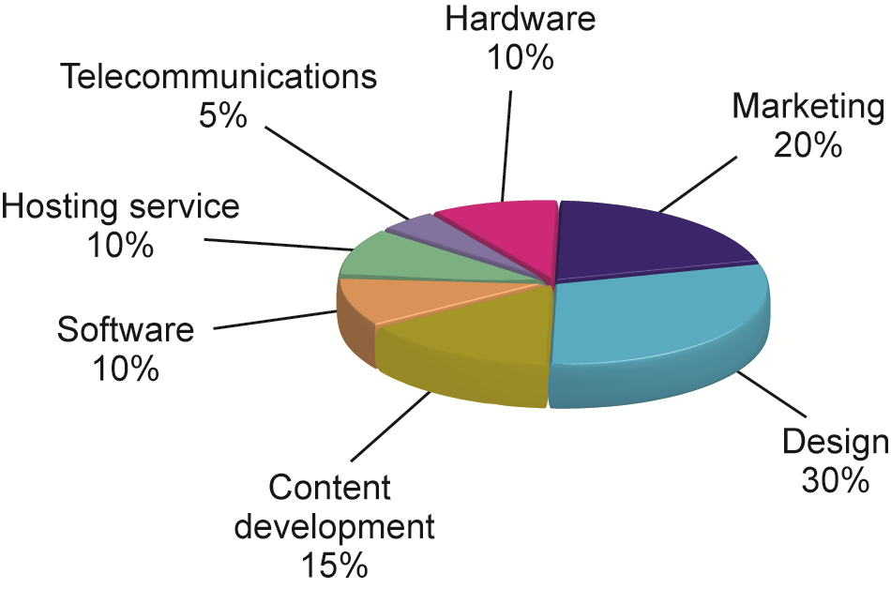
Components of a Web Site Budget
Figure 10-11
Notes:
Every site is different and this example of a Web site budget should be considered as just an example. In the past, content development has usually been underbudgeted. As it turns, obtaining content for many contemporary visual sites, and associated text, can be quite expensive.

