Slide 1
EDI: Electronic Data Interchange
What is EDI?
Exchange of electronic data between companies using precisely defined transactions
Set of hardware, software, and standards that accommodate the EDI process

Slide 2
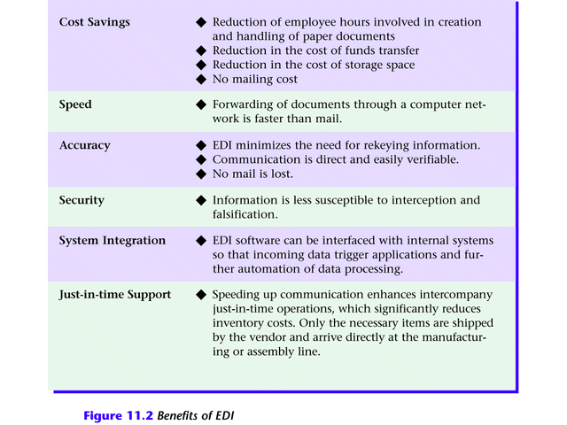
Electronic Data Interchange
Figure 11.2 Benefits of EDI

Slide 3
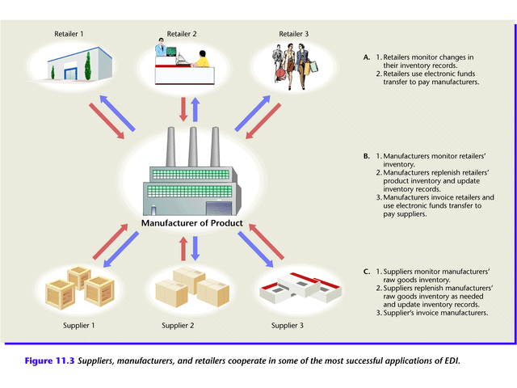
Electronic Data Interchange
Figure 11.3 Suppliers, manufacturers, and retailers cooperate in some of the most successful applications of EDI.

Slide 4
Electronic Data Exchange
How does EDI work? (Figure 11.4)
Supplier’s proposal sent electronically to purchasing organization.
Electronic contract approved over network.
Supplier manufactures and packages goods, attaching shipping data recorded on a bar code.
Quantities shipped and prices entered in system and flowed to invoicing program; invoices transmitted to purchasing organization

Slide 5
Electronic Data Exchange
Manufacturer ships order.
Shipment notice EDI transaction sent (not shown)
Purchasing organization receives packages, scans bar code, and compares data to invoices actual items received.
Payment approval transferred electronically.
Bank transfers funds from purchaser to supplier’s account using electronic fund transfer (EFT).

Slide 6
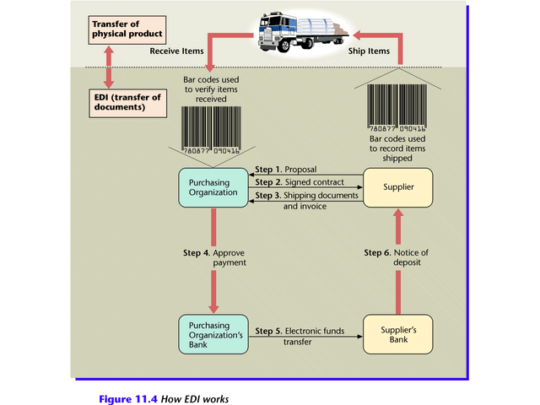
Electronic Data Interchange
Figure 11.4

Slide 7
Electronic Data Interchange
EDI Standards
EDI requires companies to agree on standards
Compatible hardware and software
Agreed upon electronic form format
Established EDI standards
Automotive Industry Action Group (AIAG)
X.12 de facto umbrella standard in U.S. and Canada
EDI for Administration, Commerce, and Trade (EDIFACT) umbrella of standards in Europe

Slide 8
Electronic Data Interchange
How to Subscribe to EDI
Larger companies purchase hardware and software
Medium and small companies seek third-party service
Value-added networking (VAN)
Managed network services available for a fee

Slide 9
Electronic Data Interchange
EDI on the Web
Advantages of Web EDI
Lower cost
More familiar software
Worldwide connectivity
Disadvantages of Web EDI
Low speed
Poor security

Slide 10
Electronic Data Interchange
The Importance of EDI
Need for timely, reliable data exchange in response to rapidly changing markets
Emergence of standards and guidelines
Spread of information into many organizational units
Greater reliability of information technology
Globalization of organizations

