Slide 1
Intelligent Systems for Decision Support

Slide 2
Intelligent Systems for Decision Support
Intelligent techniques for enhancing decision making
Many based on artificial intelligence (AI)
Computer-based systems (hardware and software) that attempt to emulate human behavior and thought patterns
Include:
Expert systems
Case-based reasoning
Neural networks
Genetic algorithms
Intelligent agents
ESS (Executive Support)
Visualization Software
AI and Expert Systems VIDEO

Slide 3
Intelligent Systems for Decision Support
Expert systems
Model human knowledge as a set of rules that are collectively called the knowledge base
200 to 10,000 rules, depending on complexity
The system’s inference engine searches through the rules and “fires” those rules that are triggered by facts gathered and entered by the user.
Useful for dealing with problems of classification in which there are relatively few alternative outcomes and in which these possible outcomes are all known in advance
Should be used only in highly structured decision making situations
Notes:
This slide describes expert systems, one type of intelligent technique. Expert systems are best used in highly structured decision-making situations. What kind of problem could not be solved by an expert system. Choice of music, potential spouses or mates, new product decisions, or designing a new marketing campaign might be good examples of poorly structured decision situations.

Slide 4
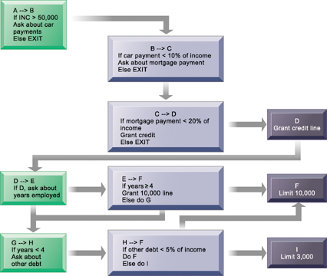
Intelligent Systems for Decision Support
Dog Breed Advisor
(If/then) Rules in an Expert System
An expert system contains a set of rules to be followed when used. The rules are interconnected; the number of outcomes is known in advance and is limited; there are multiple paths to the same outcome; and the system can consider multiple rules at a single time. The rules illustrated are for a simple credit-granting expert system.
Notes:
This graphic illustrates the use of if/then rules in an expert system. Demonstrate an understanding of if/then rules, by analyzing a common decision as a series of if/then statements; for example, the decision to accept an invitation to socialize on a weeknight, or the decision of what to make for dinner.

Slide 5
Decision Trees
Decision tree
Hierarchical arrangement of criteria that predict a classification or value
Basic idea of a decision tree
Select attributes most useful for classifying something on some criteria that create disparate groups
More different or pure the groups, the better the classification

Slide 6
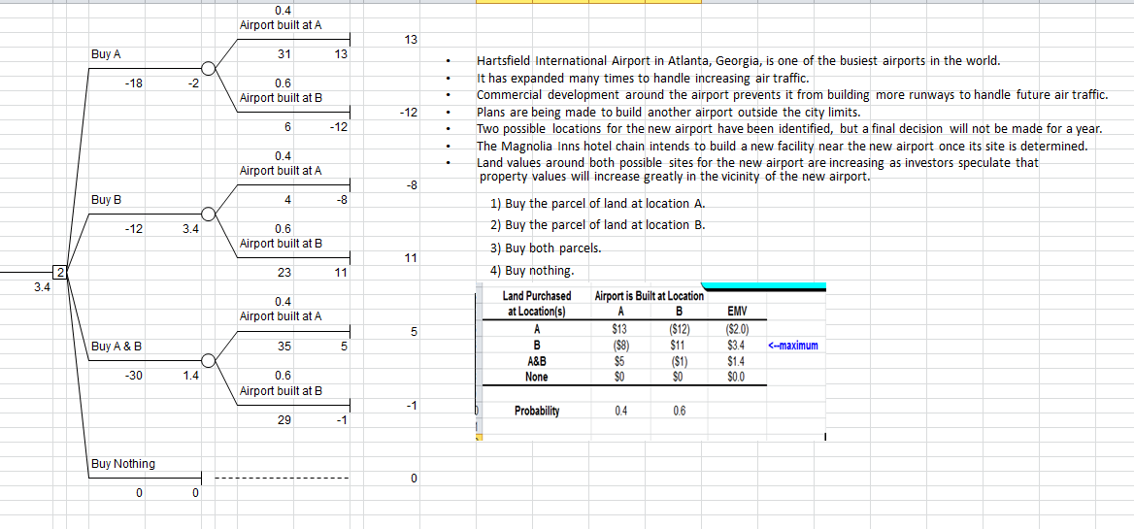

Slide 7
Problems of Expert Systems
Difficult and expensive to develop. They require many labor hours from both experts in the domain under study and designers of expert systems. High opportunity cost of tying up domain experts.
Difficult to maintain. Nature of rule-based systems creates unexpected consequences when adding a new rule in middle of hundreds of others. A small change can cause very different outcomes.
No expert system has the same diagnostic ability as knowledgeable, skilled, and experienced doctors. Rules/actions change frequently.

Slide 8
Intelligent Systems for Decision Support
Case-based reasoning
Knowledge and past experiences of human specialists are represented as cases and stored in a database for later retrieval.
System searches for stored cases with problem characteristics similar to new one, finds closest fit, and applies solutions of old case to new case.
Successful and unsuccessful applications are tagged and linked in database.
Used in medical diagnostic systems, customer support.
Notes:
This slide discusses a second type of intelligent technique, case-based reasoning. What would be the difference in how a CBR system would be used in medical diagnosis versus an expert system? Which of the two techniques would be better at medical diagnosis and why?

Slide 9
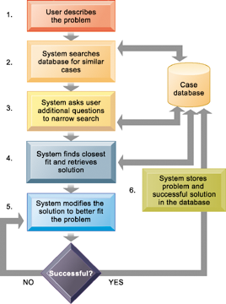
Intelligent Systems for Decision Support
How Case-Based Reasoning Works
Examples:
Appliance Call Center automation at General Electric
SMART: Support management automated reasoning technology for Compaq customer service
Case-based reasoning represents knowledge as a database of past cases and their solutions. The system uses a six-step process to generate solutions to new problems encountered by the user.
Notes:
This graphic demonstrates the six main steps in case based reasoning. Ask the students to compare expert systems with CBR. What are the benefits and drawbacks in CBR as a technique? What types of problems lend themselves to CBR?

Slide 10
Neural networks
Use hardware and software that parallel the processing patterns of a biological brain.
One of the data mining tools
“Learn” patterns from large quantities of data by searching for relationships, building models, and correcting over and over again the model’s own mistakes.
Humans “train” the network by feeding it data for which the inputs produce a known set of outputs or conclusions.
Machine learning
Useful for solving complex, poorly understood problems for which large amounts of data have been collected.
Used to predict values and make classifications such as “good prospect” or “poor prospect” customers
Complicated set of nonlinear equations
To some extent, data-mining techniques have replaced neural networks in situations requiring pattern recognition.
credit card companies sift through mountains of transaction data to identify which charging patterns are unlikely for each and every charge card customer.
Notes:
This slide discusses a fourth intelligent technique—neural networks. Can neural networks could be used in medical diagnosis? How would this work? To some extent, data-mining techniques have replaced neural networks in situations requiring pattern recognition. For instance, credit card companies sift through mountains of transaction data to identify which charging patterns are unlikely for each and every charge card customer.

Slide 11
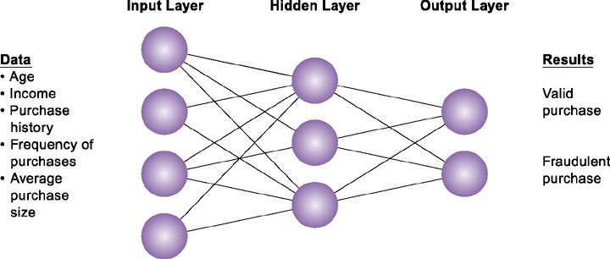
Intelligent Systems for Decision Support
How a Neural Network Works
A neural network uses rules it “learns” from patterns in data to construct a hidden layer of logic. The hidden layer then processes inputs, classifying them based on the experience of the model. In this example, the neural network has been trained to distinguish between valid and fraudulent credit card purchases.
Notes:
This graphic illustrates how a neural network works—by using an internal, hidden layer of logic that examines existing data and assigning a classification to that set of data. For example, given one or more specific combinations of age, income, purchase history, frequency of purchases, and average purchase size, a neural network might determine that a new credit card purchase was likely to be fraudulent. What are the benefits and drawbacks of using this type of technique?

Slide 12
Intelligent Systems for Decision Support
Genetic algorithms (Solver is an example)
Find the optimal solution for a specific problem by examining very large number of alternative solutions for that problem.
Based on techniques inspired by evolutionary biology: inheritance, mutation, selection, and so on.
Work by representing a solution as a string of 0s and 1s, then searching randomly generated strings of binary digits to identify best possible solution.
Used to solve complex problems that are very dynamic and complex, involving hundreds or thousands of variables or formulas.
Notes:
This slide discusses a fifth type of intelligent technique—genetic algorithms. Would genetic algorithms might be useful in medical diagnosis. Why or why not? Differentiate between the various intelligent techniques discussed this far—expert systems, CBR, fuzzy logic, neural networks, and genetic algorithms.

Slide 13
Intelligent Systems for Decision Support
Intelligent agents Video
Programs that work in the background without direct human intervention to carry out specific, repetitive, and predictable tasks for user, business process, or software application
Shopping bots MySimon.com
Procter & Gamble (P&G) programmed group of semiautonomous agents to emulate behavior of supply-chain components, such as trucks, production facilities, distributors, and retail stores and created simulations to determine how to make supply chain more efficient
Notes:
This slide discusses the use of intelligent agents to carry out repetitive tasks for a user or system. Shopping bots are an example of an intelligent agent. As an example of agent-based modeling, Procter & Gamble used agent-based modeling to improve coordination among supply-chain members.

Slide 14
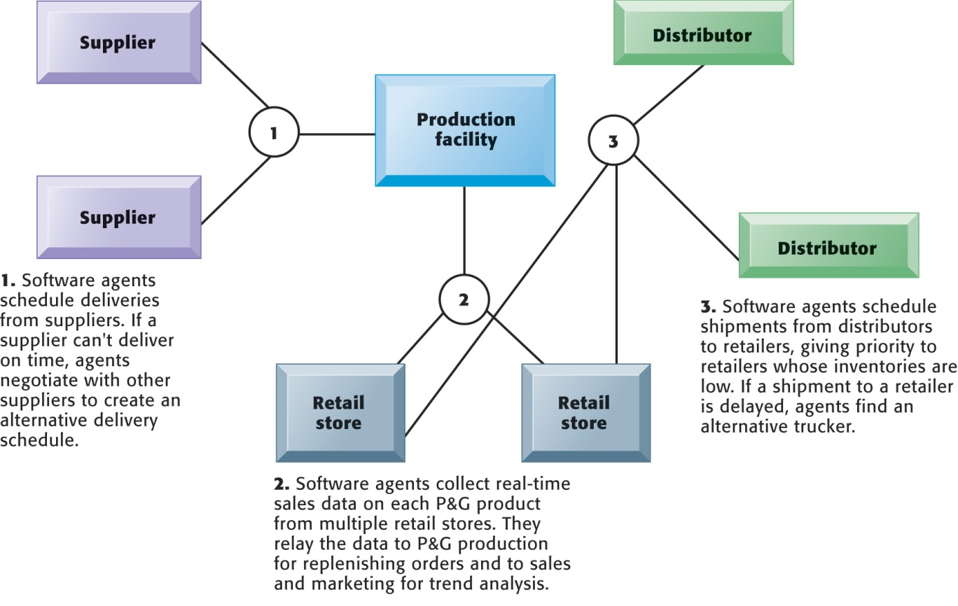
Intelligent Agents in P&G’s Supply Chain Network
to improve coordination among supply-chain members
Intelligent agents are helping Procter & Gamble shorten the replenishment cycles for products, such as a box of Tide.
Notes:
This graphic illustrates Procter & Gamble’s use of intelligent agents in its supply chain network. Given that intelligent-agent modeling mimics the behavior of a number of “actors” in a given situation, what other types of situations might benefit from this type of analysis?

Slide 15
Executive Support and KPIs
Executive support systems (ESS) help managers and executives focus on performance information that maximizes resources within the organization to improve the profitability and success of the company.
There are two parts to developing an ESS:
understand exactly what the most important performance information(KPIs – Key Performance Indicators) is and
develop systems capable of delivering that information to the right people in an easy-to-use format.
What are some key performance indicators (KPI) for Furman? enrollment numbers and the number of students in each academic discipline are obvious
Less obvious KPI might be drop-out rates or the number of students switching majors.
Before you can develop an ESS, you need to understand exactly what data you should track.

Slide 16
The Balanced Score Card
A balanced scorecard focuses on measurable outcomes on four dimensions of a business’s performance:
financial,
business process,
customer, and
learning and growth.
Each dimension uses key performance indicators (KPIs) to understand how well an organization is performing on any of the dimensions at any time.
The framework of a balanced scorecard requires managers to focus on more than just financial performance.
They must focus on things they are able to influence at the present time like
customer satisfaction,
business process efficiency, or
employee training.
The KPIs are developed by senior executives and are automatically provided to users through an executive support systems

Slide 17
Visualization Software
Tableau
Intro to Tableau
Video
http://www.perceptualedge.com/examples.php

