Slide 1
Databases and Information Systems
Notes:
This chapter explores the basic building blocks from which databases are created. We discuss important features of databases and the types of database programs organizations use. We also discuss the various types of information systems that use databases and explore modern data storage designs, such as data warehouses. Finally, we examine how data can be further analyzed (or “mined”) to yield information beyond the original scope of the database design.

Slide 2
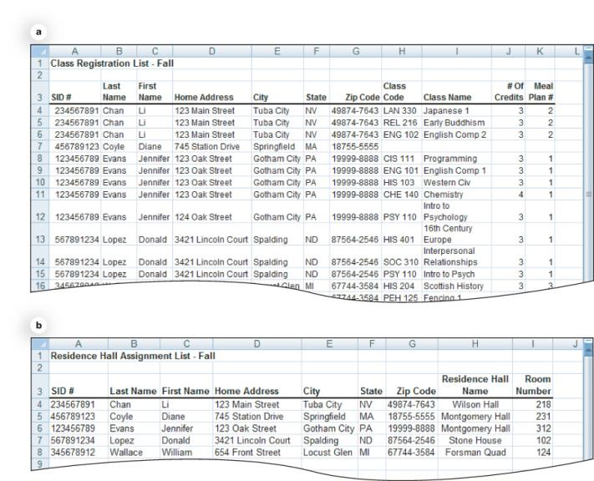
Life Without Databases: Lists
Lists are often sufficient for simple tasks
Not appropriate for complex information
Multiple lists lead to
Data redundancy
Data inconsistency
Duplicate data
Sorting issues
Incomplete data
Notes:
A simple list created in Microsoft Excel (as a spreadsheet) or in Microsoft Word (as a table) is often sufficient to organize simple tasks.
When complex information needs to be organized or more than one person needs to access it, a list no longer is efficient.
Data duplicated between two lists causes data redundancy.
Each time information in the list changes, multiple lists might need to be updated. It would be easy to overlook one or more lists or even one or more rows in the same list. This would lead to a state of data inconsistency.
If data is entered twice, any reports that are generated based on this list will be inaccurate because of the duplicate data.
Reorganizing (or sorting) multiple lists can be labor intensive.
A final problem with lists is how to handle incomplete data.

Slide 3
Databases
Collections of related data
Easily stored, sorted, organized, and queried
Turn data into information
Notes:
Databases are collections of related data that can be easily stored, sorted, organized, and queried.
By creating an organized structure for data, we hope to make data more meaningful and therefore more useful. In other words, we are attempting to turn data into information.

Slide 4
Advantages of Using Databases
Store and retrieve large quantities of information
Enable information sharing
Provide data centralization
Promote data integrity
Allow for flexible use of data
Notes:
Without databases, you could not store and retrieve large quantities of information easily. Even very large databases can provide the information you request in seconds.
Databases provide additional advantages:
They enable information sharing.
They provide data centralization.
They promote data integrity.
They allow the flexible use of data.

Slide 5
Disadvantages of Databases
Complex to construct
Time consuming
Expensive
Privacy concerns
Notes:
Databases are more complex to construct and administer than lists are.
Databases can be time consuming and expensive to set up. It is helpful to have an experienced database administrator assist with the construction of large databases.
Data privacy concerns arise when using databases.
Despite the increased complexity of databases and the issues surrounding privacy, the advantages of databases far outweigh the administrative disadvantages.

Slide 6
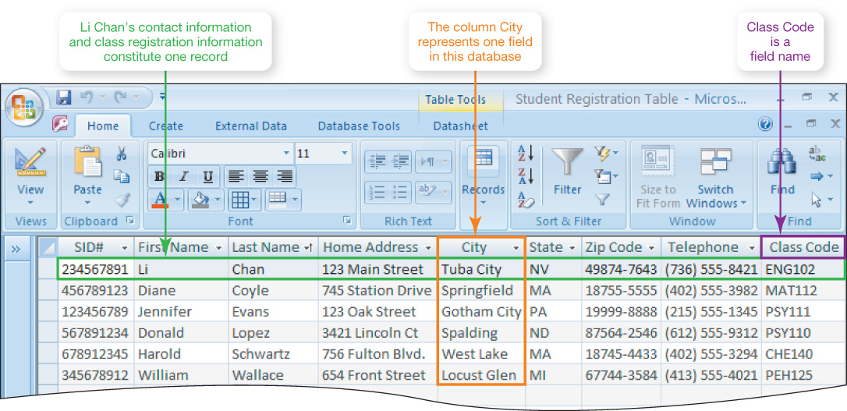
Database Terminology
Field: A category of information, displayed in columns
Record: A group of related fields
Notes:
A category of information in a database is stored in a field. Fields are displayed in columns.
Each field is identified by a field name, which is a way of describing the field.
In a database, fields have other characteristics (aside from the field name) that describe them, such as field data type and field size.

Slide 7
Database Terminology
Data type: Type of data that can be stored in a field
Data Type | Used to Store | Example of Data Stored in the Field
Text | Alphabetic or alphanumeric data | Mary, CIS110
Numeric | Numbers | 256, 1.347, $5600
Computational | Computational formulas | Credit hours x per-credit tuition charges
Date | Dates in standard date notation | 4/15/2012
Memo | Long blocks of text | Four score and seven years ago our fathers brought forth on this continent a new nation, conceived in liberty, and dedicated to the proposition that all men are created equal.
Object | Multimedia files or documents | MP3 file, AVI file
Hyperlink | A hyperlink to a Web page on the Internet | www.pearsonhighered.com/techinaction
Notes:
When fields are created in a database, the user assigns those fields a data type. The data type indicates what type of data can be stored in the field. Common data types are as follows:
Text fields hold any combination of letters or numbers and are most often used to hold text. Although text fields can contain numbers (such as telephone numbers), they are stored as text and therefore cannot be used for numbers that will be used in calculations.
Numeric fields store numbers. Values in numeric fields can be used to perform calculations. In MS Access, currency is handled as a separate data type.
Computational fields are numeric fields that store the contents of a calculation, which is generated with a formula in the numeric field. This is similar to a formula computation in a spreadsheet cell.
Date fields hold date data, such as birthdays and due dates.
Memo fields are text fields used to hold long pieces of text.
Object fields hold objects, such as pictures, video clips, or entire documents.
Hyperlink fields store hyperlinks to Web pages.
Access adds two other data types, AutoNumber and Lookup Wizard. AutoNumber counts records as they are added, and Lookup Wizard creates a lookup field.

Slide 8
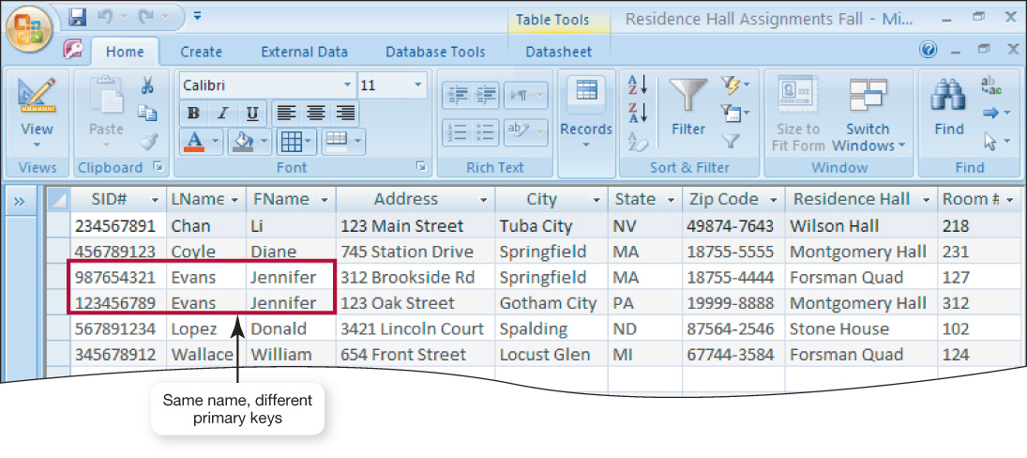
Database Terminology
Table: A group of related records
Primary key: A field value unique to a record
Notes:
A group of related records is called a table. Tables usually are organized by a common subject.

Slide 9
Database Types
Relational databases
Organize data in tables
Link tables to each other through their primary keys
Object-oriented databases
Store data in objects
Also store methods for processing data
Handle unstructured data
Notes:
The three major types of databases in use are relational, object-oriented, and multidimensional databases. Of these three, relational databases have the largest market share.
A relational database organizes data in table format by logically grouping similar data into relations (or tables that contain related data). In relational databases, tables are logically linked to each other by including their primary keys in other tables with related information.
An object-oriented database stores data in objects, not in tables. Objects contain not only data, but also methods for processing or manipulating that data. This allows object-oriented databases to store more types of data (such as unstructured data) and to access that data faster than relational databases do.
Whereas relational databases excel in the storage of structured (analytical) data (such as “Bill” or “345”), object-oriented databases are more adept at handling unstructured data. Unstructured data includes nontraditional data such as audio clips (including MP3 files), video clips, pictures, and extremely large documents.

Slide 10
Database Types
Multidimensional databases
Store data in multiple dimensions
Organize data in a cube format
Can easily be customized
Process data much faster
Notes:
A multidimensional database stores data in multiple dimensions, as opposed to a relational database, which stores data in two-dimensional tables.
Multidimensional databases organize data in a cube format. Each data cube has a measure attribute, which is the main type of data the cube is tracking.
The two main advantages of multidimensional databases are that they can easily be customized to provide information to a variety of users and they can process data much faster than pure relational databases can.

Slide 11
Database Management Systems (DBMS)
Application software designed to capture and analyze data
Four main operations of a DBMS:
Creating databases and entering data
Viewing and sorting data
Extracting data
Outputting data
Notes:
A DBMS is specially designed application software (such as Oracle Database or Microsoft Access) that interacts with the user, other applications, and the database to capture and analyze data. The four main operations of a DBMS are:
Creating databases and entering data
Viewing (or browsing) and sorting data
Extracting (or querying) data
Outputting data

Slide 12
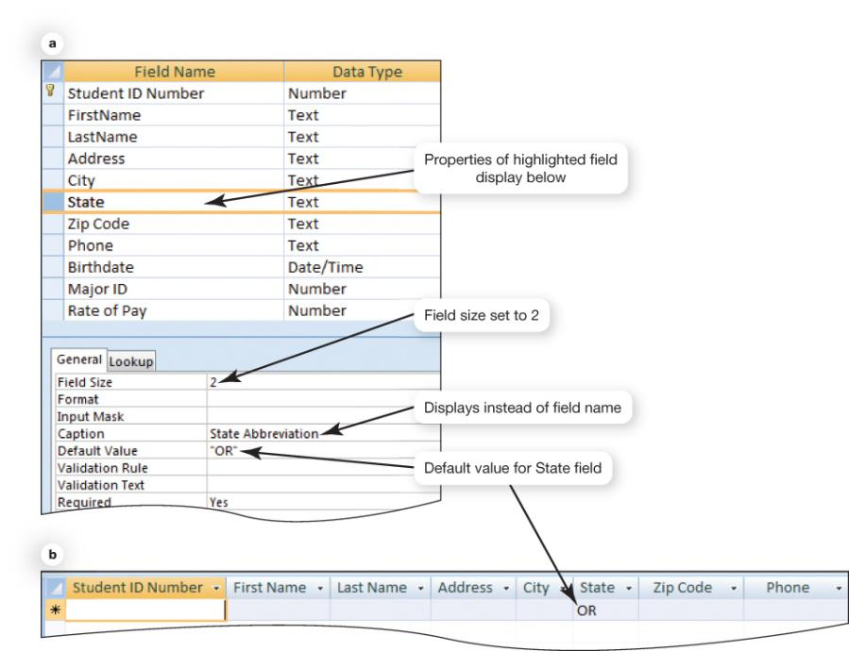
Creating Databases and Entering Data
Create field names
Identify each type of data
Data dictionary (or database schema)
Notes:
To create a database with a DBMS, you must first define the data to be captured. Therefore, you must create a description of the data. This description is contained in the database’s files and is referred to as the data dictionary (or the database schema).
The data dictionary defines the name, data type, and length of each field in a database. Describing the data helps categorize and analyze it and to set parameters for entering valid data into the database.

Slide 13
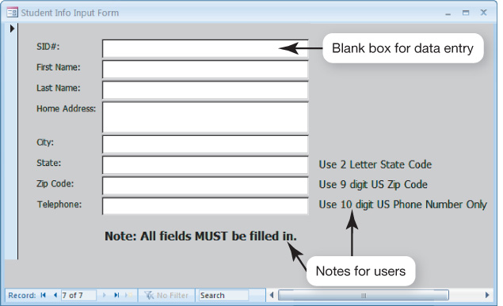
Creating Databases and Entering Data
Create individual records
Key in
Import
Input form
Notes:
After you create a data dictionary for each table (or file) in the database and establish the fields you want the database to contain, you can begin creating individual records in the database. You can key the info directly into the database, or you can import the data electronically from other application files.
For small databases or databases in which no electronic information is to be imported, you can create an input form to speed data entry. An input form provides a view of the data fields to be filled, with appropriate labels to assist database users in populating the database.

Slide 14
Data Validation
Validation
Process of ensuring that data entered into the database is correct (or at least reasonable) and complete
Validation rules
Range checks
Completeness checks
Consistency checks
Alphabetic/numeric checks
Notes:
One feature of most DBMSs is the capability to perform data validation. Validation is the process of ensuring that data entered into the database is correct (or at least reasonable) and complete.
Validation rules/checks are set up in the student database to alert the user to clearly wrong entries.
Common types of validation checks include range, completeness, consistency, and alphabetic and numeric checks.
Range checks ensure that the data entered into the database falls within a certain range of numbers.
Completeness checks ensure that all fields defined as “required” have data entered into them.
Consistency checks compare the values of data in two or more fields to see if these values are reasonable.
Alphabetic checks confirm that only textual characters are entered in a field. Numeric checks confirm that only numbers are entered in a field.

Slide 15
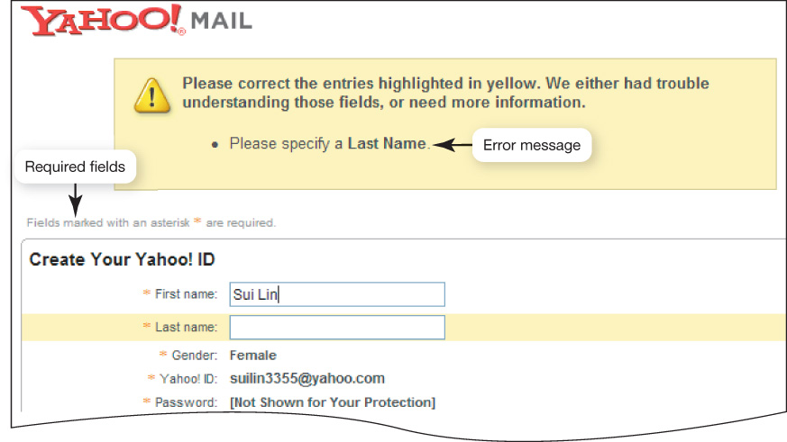
Data Validation
Example of a completeness check
Notes:
A database completeness check, like this one shown for Yahoo! Mail, ensures that all fields defined as “required” have data entered into them.

Slide 16
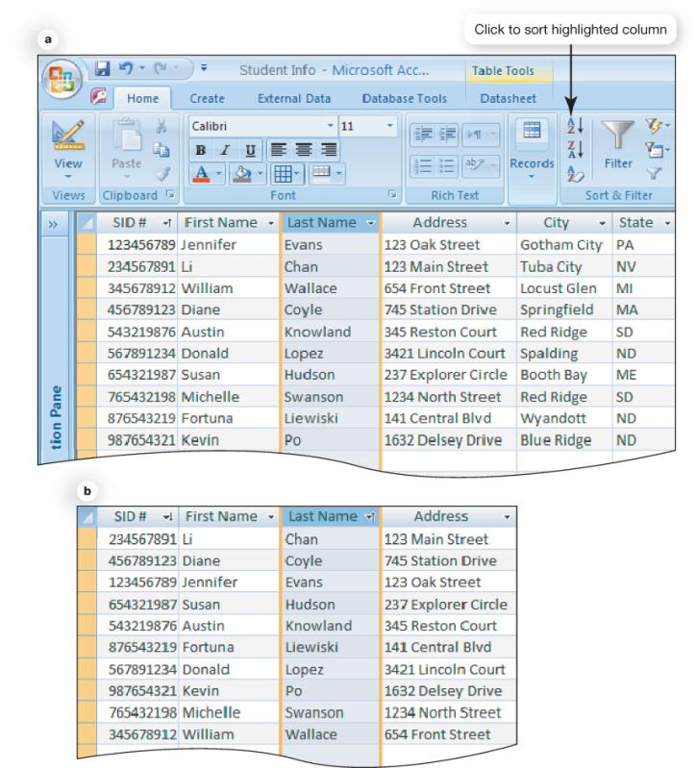
Viewing and Sorting Data
Browse through records
Sort records by field name
Notes:
Displaying the tables on screen and browsing through the data (viewing records) is an option with most databases.
You can easily sort a database into the order that you need. Sorting a database merely involves organizing it in a new fashion.

Slide 17
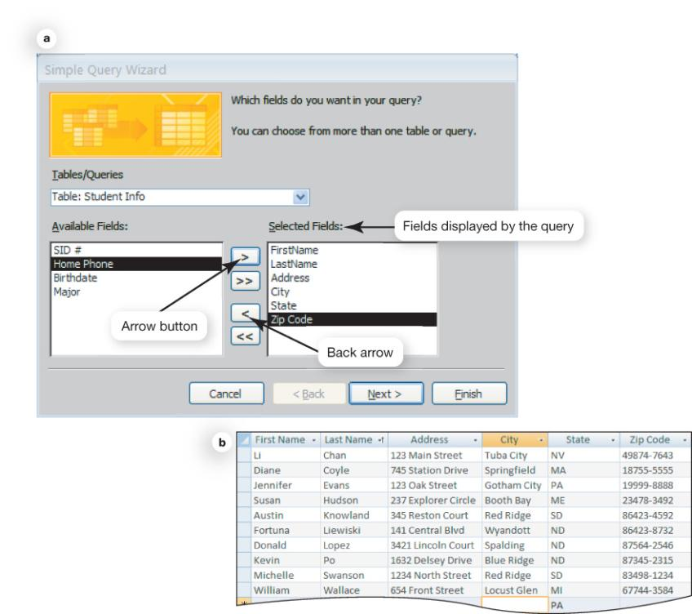
Extracting or Querying Data
Query
A question or inquiry
Provides records based on criteria
Structured Query Language (SQL)
Notes:
A database query is a question or inquiry you ask the database so that it provides you with the records you wish to view.
When you query a database, you instruct it to search for a particular piece of data. Queries also enable you to have the database select and display records that match certain criteria.
All modern DBMSs contain a query language that the software uses to retrieve and display records. The most popular query language today is Structured Query Language, or SQL.

Slide 18
Structured Query Language
Used to extract records from databases
Original version developed in mid-1970s and called SEQUEL
SQL was introduced as commercial product by Oracle in 1979.
Uses relational algebra to extract data
Notes:
To extract records from a database, you use a query language. Almost all relational and object relational databases today use structured query language, or SQL.
E. F. Codd, who has been called the father of relational databases, proposed a standardized query language when working at IBM in the mid-1970s. The original language was called SEQUEL, short for structured English query language. The idea was to make queries easy by using English language–like sentence structure.
Oracle first introduced SQL in a commercial database product in 1979. It has been the de facto standard language for relational databases since then.
SQL uses relational algebra to extract data from databases. Relational algebra is the use of English-like expressions that have variables and operations, much like algebraic equations.

Slide 19
Outputting Data
Reports
Printed (or electronic) output
Summary data reports
Export data
Notes:
For any database, the most common form of output is a printed (or electronic) report.
Businesses routinely summarize the data within their databases and compile summary data reports.
Database systems can also be used to export data to other applications. Exporting data involves putting it into an electronic file in a format that another application can understand.

Slide 20
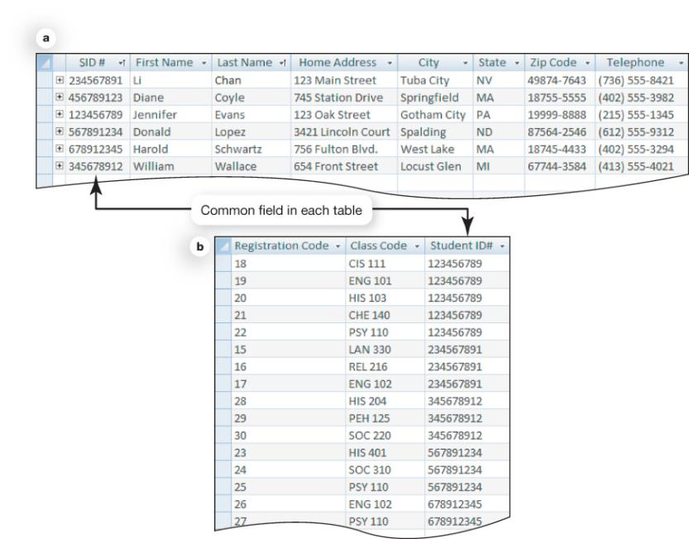
Relational Database Operations
Relational databases organize data into tables
Relationships are links between tables with related data
Common field(s) need to exist between tables
Notes:
Relational databases operate by organizing data into various tables based on logical groupings.
In relational databases, the links between tables that define how the data is related are referred to as relationships.
To establish a relationship between two tables, the tables must have a common field (or column). The fields do not have to have the same field name as long as they contain the same data.

Slide 21
Types of Relationships
One-to-one
For each record in a table, only one corresponding record in a related table
One-to-many
Only one instance of a record in one table; many instances in a related table
Many-to-many
Records in one table related to many records in another
Notes:
Relationships in databases can take three forms: one-to-one, one-to-many, or many-to-many.
A one-to-one relationship indicates that for each record in a table, there is only one corresponding record in a related table. For example, a parking space can be occupied by only one car at a time, so a table that links assigned parking spaces to a table of faculty members would have a one-to-one relationship. One-to-one relationships occur most frequently in relational databases.
A one-to-many relationship is characterized by a record in one table being related to multiple records in another table. For example, students can register for many classes, but each registration record can be related to only one student.
Many-to-many relationships are characterized by records in one table being related to multiple records in a second table and vice versa. For instance, a table of students could be related to a table of student employers. The employers could employ many students, and students could work for more than one employer.

Slide 22
Relational Database Operations
Normalization of data (recording data once) reduces data redundancy
Foreign key: The primary key of one table is included in another to establish relationships with that other table
Notes:
In databases, the goal is to reduce data redundancy by recording data only once. This process is called normalization of the data.
To get tables to work together, a foreign key is used. A foreign key is the primary key of another table that is included in another table for the purpose of establishing relationships with that other table.

Slide 23
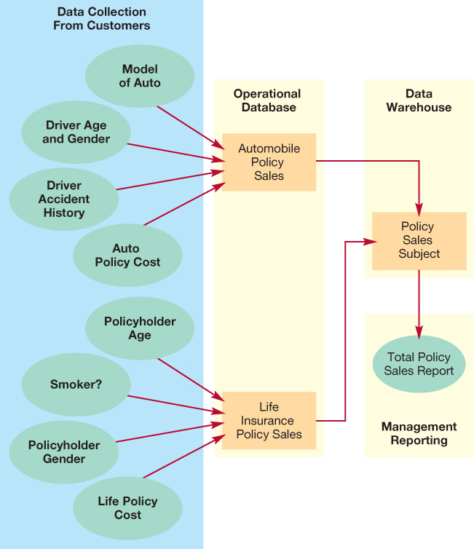
Data Storage
Data warehouse
Large-scale repository of data
Organizes all the data related to an organization
Data organized by subject
Notes:
A data warehouse is a large-scale electronic repository of data that contains and organizes in one place all the data related to an organization. Individual databases contain a wealth of information, but each database’s information usually pertains to one topic.
Data warehouses consolidate information from disparate sources to present an enterprise-wide view of business operations.
Data in the data warehouse is organized by subject. Most databases focus on one specific operational aspect of business operations.

Slide 24
Populating Data Warehouses
Source data
Internal sources
Company databases, etc.
External sources
Suppliers, vendors, etc.
Customers or Web site visitors
Clickstream data
Notes:
Source data for data warehouses can come from three places:
Internal sources (such as company databases)
External sources (suppliers, vendors, and so on)
Customers or visitors to the company Web site
Companies can use software on their Web sites to capture information about each click that users make as they navigate through the site. This information is referred to as clickstream data.

Slide 25
Data Staging
Data staging
Extract data from source
Reformat the data
Store the data
Software programs and procedures created to extract the data and reformat it for storage
Notes:
No two source databases are the same. Therefore, although two databases might contain similar information (such as customer names and addresses), the format of the data most likely is different in each database. Therefore, source data must be “staged” before entering the data warehouse.
Data staging consists of three steps:
1. Extraction of the data from source databases
2. Transformation (reformatting) of the data
3. Storage of the data in the warehouse
Many software programs and procedures may need to be created to extract the data from varied sources and to reformat it for storage in the data warehouse.

Slide 26
Data Marts
Small slices of data
Data for a single department or for use by specific employee groups
Notes:
Looking for the data you need in a data warehouse can be daunting when there are terabytes of data. Therefore, small slices of the data warehouse, called data marts, are often created.
Whereas data warehouses have an enterprise-wide depth, the information in data marts pertains to a single department or are used by a specific employee group.

Slide 27
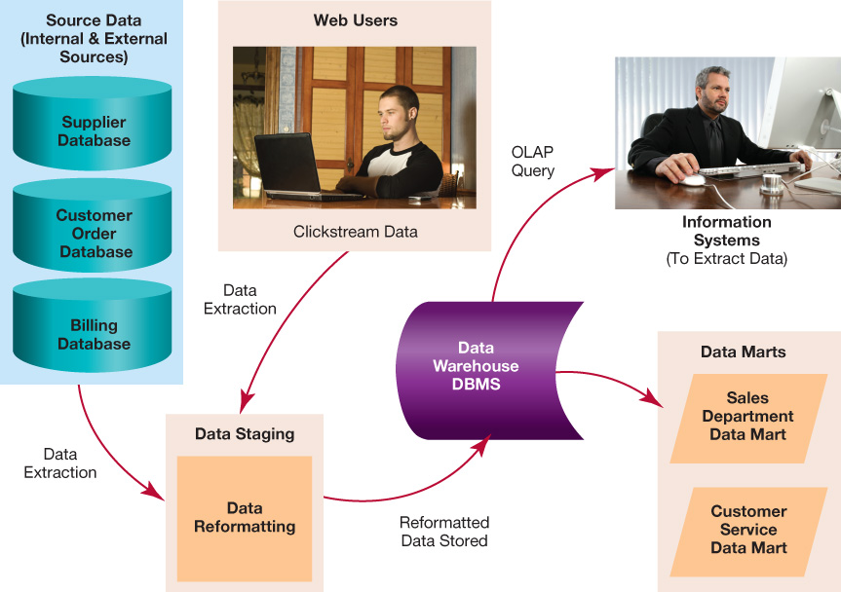
Data Warehouse Process
Notes:
In this case, we see the data warehouse DBMS at the center of things, collecting properly formatted data and responding to queries using a special query tool called Online Analytical Processing (OLAP), a standard for viewing data warehouse items. Data marts for departmental information are also set up by the DBMS.

Slide 28
Managing Data: Information Systems
Information systems
Software-based solutions used to gather and analyze information
Functions performed by information systems include
Acquiring data
Processing data into information
Storing data
Providing output options
Notes:
Information systems are software-based solutions used to gather and analyze information. Databases, data marts, and data warehouses are integral parts of information systems because they store the information that makes information systems functional.
All information systems perform similar functions, including
Acquiring data
Processing that data into information
Storing the data
Providing the user with output options with which to make the information meaningful and useful

Slide 29
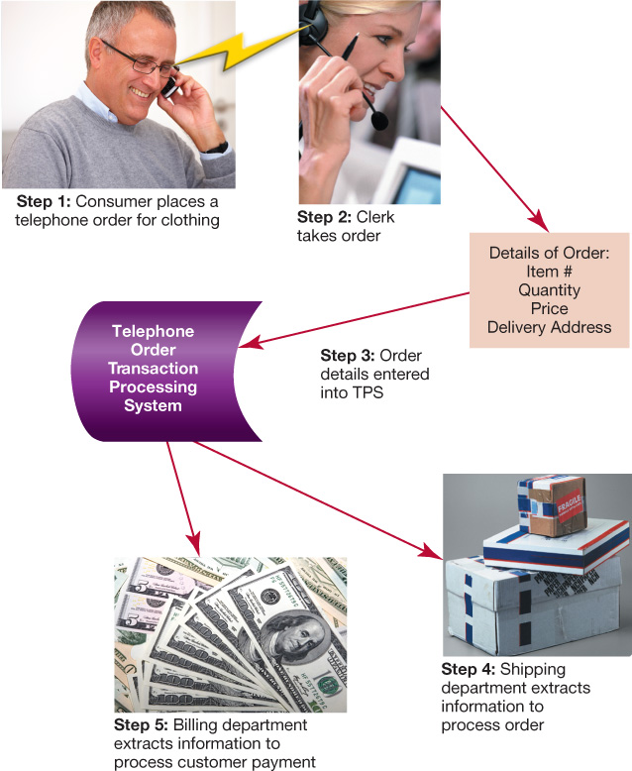
Transaction Processing Systems (TPSs)
Keep track of everyday business activities
Batch processing
Real-time processing
Notes:
A transaction processing system (TPS) is used to keep track of everyday business activities.
Batch processing means that transaction data is accumulated until a certain point is reached, and then a number of transactions are processed all at once. Batch processing is appropriate for activities that are not time sensitive.
For most activities, processing and recording transactions in a TPS occur in real time. Real-time processing means that the database is queried and updated while the transaction is taking place. This online transaction processing (OLTP) ensures that the data in the TPS is as up to date as possible.

Slide 30
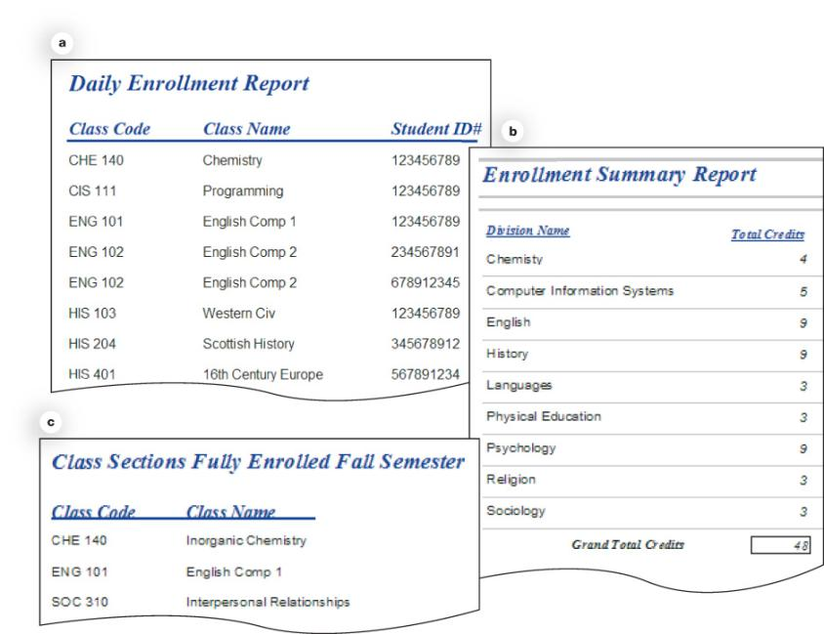
Management Information Systems (MISs)
Provide timely and accurate information for managers in making business decisions
Detail report:
Transactions that occur during a period of time
Summary report:
Consolidated detailed data
Exception report:
Unusual conditions
Notes:
A management information system (MIS) provides timely and accurate information that enables managers to make critical business decisions. Today’s MISs are often built in as a feature of TPSs. The MIS provides a number of reports.
Detail reports provide a list of the transactions that occurred during a certain time period.
Summary reports provide a consolidated picture of detailed data.
Exception reports show conditions that are unusual or that need attention from users of the system.

Slide 31
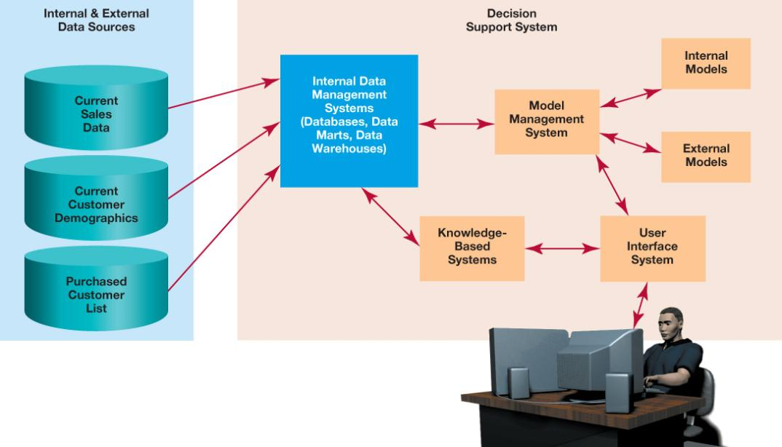
Decision Support Systems (DSSs)
Help managers develop solutions for specific problems
Notes:
A decision support system (DSS) is designed to help managers develop solutions for specific problems.
Not only does a DSS use data from databases and data warehouses, but it also enables users to add their own insights and experiences and apply them to the solution.
Data can be fed into the DSS from a variety of sources.
Internal data sources are maintained by the same company that operates the DSS.
External data sources include any source not owned by the company that owns the DSS, such as customer demographic data purchased from third parties, mailing lists, or statistics compiled by the federal government.
Internal and external data sources provide a stream of data that is integrated into the DSS for analysis.

Slide 32
Model Management Systems
Software that assists in building management models in DSSs
Can be built to describe any business situation
Typically contain financial and statistical analysis tools
Notes:
A model management system is software that assists in building management models in DSSs. A management model is an analysis tool that provides a view of a particular business situation (through the use of internal and external data) for the purposes of decision making.
Internal models (such as a spreadsheet that shows current classroom utilization on a college campus) are developed inside the organization.
External models (such as statistics about student populations in two-year colleges in the United States) are purchased from third parties.

Slide 33
Knowledge-Based Systems
Expert system: Replicates human experts
Natural language processing (NLP) system: Enables users to communicate with computers using a natural spoken or written language
Artificial intelligence (AI): Branch of computer science that deals with attempting to create computers that think like humans
Support concept of fuzzy logic
Notes:
A knowledge-based system provides additional intelligence that supplements the user’s own intellect and makes a DSS more effective. It can be an expert system, which tries to replicate the decision-making processes of human experts to solve specific problems.
Another type of knowledge-based system is a natural language processing (NLP) system. NLP systems enable users to communicate with computer systems using a natural spoken or written language as opposed to using computer programming languages.
Artificial intelligence (AI) is the branch of computer science that deals with attempting to create computers that think like humans. To date, no computers have been constructed that can replicate the thinking patterns of a human brain.
Fuzzy logic enables a system to be more flexible and to consider a wider range of possibilities than would conventional algorithmic thinking.

Slide 34
Data Mining
Process by which great amounts of data are analyzed and investigated
Objective is to spot patterns or trends within the data
Notes:
Data mining is the process by which great amounts of data are analyzed and investigated. The objective is to spot significant patterns or trends within the data that would otherwise not be obvious.
The main reason businesses mine data is to understand their customers better.

Slide 35
Data Mining Methods
Classification
Define data classes
Estimation
Assign a value to data
Affinity grouping or association rules
Determine which data goes together
Clustering
Organize data into subgroups
Description and visualization
Get a clear picture of what is happening
Notes:
Data mining enables managers to sift through data in a number of ways, with each method producing different information on which managers can base their decisions.
The following are five things managers do to make their data meaningful.
Classification. Before mining, managers define data classes that they think will be helpful in spotting trends. They then apply these class definitions to all unclassified data to prepare it for analysis.
Estimation. Estimation enables managers to assign a value, based on some criterion, to data. For example, assume a bank wants to send out credit card offers to people who are likely to be granted a credit card. The bank may run the customers’ data through a program that assigns them a score based on where they live, their household income, and their average bank balance. This provides managers with an estimate of the most likely credit card prospects so that they can include them in the mailing.
Affinity grouping or association rules. When mining data, managers can also determine which data goes together. In other words, they can apply affinity grouping or association rules to the data. For example, suppose analysis of a sales database indicates that two items are bought together 70 percent of the time. Based on this data, managers might decide that these items should be pictured on the same page in the next mail-order catalog they send out.
Clustering. Clustering involves organizing data into similar subgroups, or clusters. It is different from classification in that there are no predefined classes. The data-mining software makes the decision about what to group together, and it is up to managers to determine whether the clusters are meaningful. For example, the data mining software may identify clusters of customers with similar buying patterns. Further analysis of the clusters may reveal that certain socioeconomic groups have similar buying patterns.
Description and visualization. Often, the purpose of data mining is merely to describe data so managers can visualize it. Sometimes having a clear picture of what is going on with the data helps people interpret it in new and different ways.

Slide 36
Data Ethics
Is data private any more?
Daily life is recorded in many disparate databases
Credit card transactions
Banking transactions
Frequent buyer cards
Toll records
Prescription history and medical records
Data convergence
Notes:
As databases have become commonplace, there is an ever-increasing amount of information about you and your habits located in various databases. Every time you purchase something with a credit card, there is a record of that transaction, and both the merchant from whom you purchased the item and the credit card company have information about your buying habits.
All banking transactions are handled by computers (and hence databases) in the United States, and there is a high probability that your employer is electronically transferring your pay to your bank by direct deposit. And if you engage in online banking and bill paying, then there is another electronic trail of your financial life being generated in databases.
Think you can avoid scrutiny by paying cash? Not if you are a member of a frequent buyer club (popular with supermarkets and drug stores for granting discounts) and provide the checkout clerk with your personal information in exchange for coupons or a few dollars off your purchases. And you never can be sure what this data might be used for.
The majority of physicians, hospitals, and pharmacies in the United States track medical records in electronic databases.
Discrete pieces of data such as filling your gas tank last Thursday or buying a copy of War and Peace last month don’t mean much in and of themselves. But with so much data in electronic form, it is getting much easier to combine data from various data sources and build powerful profiles of an individual to which data mining techniques can be applied.

Slide 37
Protecting Your Data
What can you do? Ask the following questions:
For what purpose is the data being gathered?
Are the reasons for gathering the data legitimate or important to you?
How will the information gathered be protected once it has been obtained?
Will the information collected be used for purposes other than those for which it was originally collected?
Could the information asked for be used for identity theft?
Are organizations that already have your data safeguarding it?
Notes:
For what purpose is the data being gathered? When the clerk at the electronics superstore asks for your zip code, ask why she wants it (it is probably for some marketing purpose).
Are the reasons for gathering the data legitimate or important to you? For warranty purposes on a large-screen TV, you might need to give a clerk your address and zip code. For purchasing a CD, is asking for your zip code really a legitimate request? However, disclosing medical information to key people (such as your pharmacist) may be important to receiving good care and therefore is extremely important to you. If you don’t see the advantage, then ask more questions or don’t reveal the information.
How will the information gathered be protected once it has been obtained? Ask about data protection policies before you give information. Most Web sites provide access to their data protection policies—readily available through clickable links or pop-up boxes—when they ask for information. If an organization doesn’t have a data protection policy, then be wary of providing them sensitive information unless there is a compelling advantage to doing so (such as receiving good medical care). And data protection doesn’t just refer to keeping data secure. It also means restricting access to the data to employees of the organization that need to use that data. A shipping clerk might need to see your address, for example, but doesn’t need to see your credit card information.
Will the information collected be used for purposes other than the purpose for which it was originally collected? This might be covered in a data protection policy. If it isn’t, then ask about it. Will your information be sold to other companies? Will it be used for marketing other products to you?
Could the information asked for be used for identity theft? Identity thieves usually need Social Security numbers and your birth date to open credit card accounts in your name. Be especially wary when asked for this information and make sure there is a legitimate need for this information. Most organizations and businesses are shying away from using Social Security numbers to track customers because of the risk of identity theft.
Are organizations that already have your data safeguarding it? Don’t just consider new requests for information. Think about organizations that already have your information and monitor their performance. Have they been in the news lately because of a major data breach (inadvertently exposing information to inappropriate or unauthorized individuals)? You might want to consider switching institutions (such as a bank) if they have poor track records of data security.

