Slide 1
Netflix in Two Acts: The Making of an E-commerce Giant

Slide 2
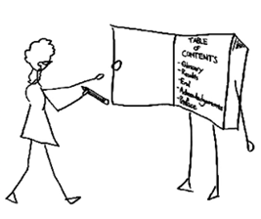
Learning Objectives
Understand the basics of the Netflix business model
Recognize the downside the firm may have experienced from an early IPO
Appreciate why other firms found Netflix’s market attractive, and why many analysts incorrectly suspected Netflix was doomed

Slide 3
Learning Objectives
Understand how many firms have confused brand and advertising, why branding is particularly important for online firms, and the factors behind Netflix’s exceptional brand strength
Understand the “long tail” concept, and how it relates to Netflix’s ability to offer the customer a huge (the industry’s largest) selection of movies
Know what collaborative filtering is, how Netflix uses collaborative filtering software to match movie titles with the customer’s taste, and in what ways this software helps Netflix garner a sustainable competitive advantage

Slide 4
Learning Objectives
List and discuss the several technologies Netflix uses in its operations to reduce costs and deliver customer satisfaction and enhance brand value
Understand the role that scale economies play in Netflix’s strategies, and how these scale economies pose an entry barrier to potential competitors
Understand the role that market entry timing has played in the firm’s success

Slide 5
Learning Objectives
Understand the shift from atoms to bits, and how this is impacting a wide range of industries
Recognize the various key issues holding back streaming video models
Know the methods that Netflix is using to attempt to counteract these challenges

Slide 6
Introduction
When Netflix went public, financial disclosure rules forced the firm to reveal how profitable it was
Rivals such as Blockbuster and Wal-Mart showed up
Competitors underestimated Netflix because:
It was an Internet pure play without a storefront
Its overall customer base was microscopic in comparison

Slide 7
Introduction
Newcomers mimicked Netflix with cheaper rival efforts forcing Netflix to cut prices
Netflix survived big competitors, a price war, and spending on the rise

Slide 8
Why Study Netflix?
It gives us a chance to examine how technology helps firms craft and reinforce a competitive advantage

Slide 9
How Netflix Works
Netflix settled on a DVD-by-mail service model
It charges a flat-rate monthly subscription
Customers don’t pay mailing expenses and late fees
Videos arrive in Mylar envelopes containing:
Prepaid postage
Return address
After watching the video, consumers:
Slip the DVD back into the envelope
Drop the disc in the mail

Slide 10
How Netflix Works
Users make their video choices in their “request queue” at Netflix.com
Consumers use the Web site to:
Rate videos
Specify movie preferences
Get video recommendations
Check out DVD details
Share their viewing habits and review

Slide 11
Tech and Timing: Creating Killer Assets
Building a great brand online starts with offering exceptional value
Advertising builds awareness, but brands are built through customer experience
Subscribers expectations from Netflix:
Huge selection
Ability to find what they want
Timely arrival
Ease of use and convenience
Fair price
Technology drives all of these capabilities
Technology is at the center of the firm’s brand building efforts

Slide 12
Selection: The Long Tail in Action
Netflix offers its customers a selection of over 100,000 DVD titles
Traditional retailers cannot offer this because of shelf space constraints
Traditional retailers can determine their breakeven point by considering:
Number of customers that can reach a location
Store size
Store inventory
Payback from inventory
Cost to own and operate the store

Slide 13
Selection: The Long Tail in Action
Internet firms can have just a few highly automated warehouses
Long tail: A phenomenon whereby firms can make money by offering a near-limitless selection

Slide 14
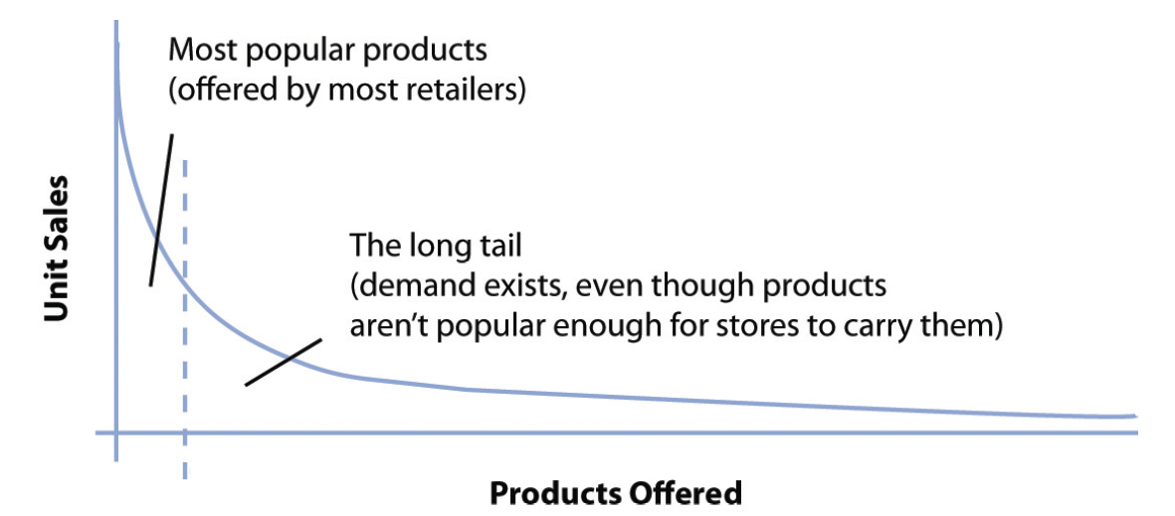
Figure 4.2 - The Long Tail

Slide 15
Selection: The Long Tail in Action
The long tail works because:
Cost of production and distribution drop
It gives the firm a selection advantage that traditional stores cannot match
Geographic constraints go away and untapped markets open up

Slide 16
Selection: The Long Tail in Action
Netflix has used the long tail to create close ties with film studios
Studios earn a percentage of the subscription revenue
Netflix gets DVDs at a very low cost
Studios do not spend on additional marketing

Slide 17
Cinematch: Technology Creates a Data Asset that Delivers Profits
Netflix uses a proprietary recommendation system called Cinematch
Each time a DVD is returned, Cinematch asks the customer to rate it
Collaborative filtering: A classification of software that monitors trends among customers and uses this data to personalize an individual customer’s experience
It can be mimicked by competitors

Slide 18
Cinematch: Technology Creates a Data Asset that Delivers Profits
The data provided by Cinematch is a switching cost
To see how strong switching costs are is to examine Netflix’s churn rate
Churn rate: The rate at which customers leave a product or service
In mid-2008, churn rates for Netflix’s most active regions were below 3 percent
Netflix’s marketing costs benefit from satisfied customers, as referrals are a better choice than advertisements
Netflix launched a crowdsourcing effort known as The Netflix Prize

Slide 19
A Look at Operations
Technology lies at the heart of Netflix’s warehouse operations
Netflix has a network of fifty-eight ultra high-tech distribution centers
Distribution centers are all located close to U.S.P.S. facilities
Trucks collect DVD shipments from these U.S.P.S. hubs and return the DVDs to the nearest Netflix center
Scanners pick out incoming titles
Netflix presorts outgoing mail before dropping it off at U.S.P.S. facilities
All DVDs are hand-inspected for cracks and smudges
Warehouse processes are linked to Cinematch

Slide 20
A Look at Operations
Staff members are expected to focus on improving the firm’s processes
Quality management features are built into systems
Netflix can monitor and record the circumstances surrounding any failures

Slide 21
Killer Asset Recap: Understanding Scale
Netflix’s size gives it a huge scale advantage
Scale economies allow firms to:
Lower prices
Spend more on customer acquisition, new features, or other efforts
Smaller rivals have an uphill fight
Established firms end up straddling markets

Slide 22
Killer Asset Recap: Understanding Scale
By moving first, Netflix gained scale advantages
Largest network of distribution centers
Largest customer base
The firm’s industry-leading strength in brand and data assets

Slide 23
Act II: Netflix and the Shift from Mailing Atoms to Streaming Bits
Many media products are created as bits (digital files)
When we buy a CD, DVD, book or newspaper, we’re buying physical atoms that are a container for the bits

Slide 24
Access to Content
When Netflix launched its streaming video option, only 17,000 videos were offered
Legal issues involved in securing the digital distribution rights
Windowing restricts the number of titles available
Wal-Mart uses its bargaining power to encourage studios to:
Hold content from competing windows
Limit offering titles at competitive pricing during the new release period

Slide 25
But how does it get to the TV?
Netflix initially developed a prototype set top box
It then developed a software platform that allowed firms to build Netflix access into their devices
Advantages of the atoms to bits model
Netflix will eliminate a huge chunk of its shipping and handling costs
Bandwidth costs are minimal

Slide 26
But how does it get to the TV?
Disadvantages of the atoms to bits model
Wrangling licensing costs is a challenge
The switch to Blu-ray DVDs means that Netflix will be forced to carry two sets of video inventory
Standard
High-definition

