Slide 1
PROTECTING INFORMATION RESOURCES

Slide 2
Spyware and Adware
Spyware
Software that secretly gathers information about users while they browse the Web
Can be used maliciously
Install antivirus or antispyware software
Adware
Form of spyware
Collects information about the user to display advertisements in the Web browser

Slide 3
Phishing
Phishing
Sending fraudulent e-mails that seem to come from legitimate sources
Direct e-mail recipients to false Web sites
To capture private information

Slide 4
Keystroke Loggers
Keystroke loggers
Monitor and record keystrokes
Can be software or hardware devices
Sometimes used by companies to track employees’ use of e-mail and the Internet
Can be used for malicious purposes
Some antivirus and antispyware programs protect against software keystroke loggers

Slide 5
Sniffing and Spoofing
Sniffing
Capturing and recording network traffic
Often used by hackers to intercept information
Spoofing
Attempt to gain access to a network by posing as an authorized user to find sensitive information

Slide 6
Computer Crime and Fraud
Computer fraud
Unauthorized use of computer data for personal gain
Social networking sites
Used for committing computer crime
Examples
Denial-of-service attacks
Identity theft
Software piracy
Distributing child pornography
E-mail spamming

Slide 7
Computer Crime and Fraud (cont’d.)
Writing or spreading viruses, worms, Trojan programs, and other malicious code
Stealing files
Changing computer records
Virus hoaxes
Sabotage
Company insiders commit most computer crimes

Slide 8
Computer and Network Security: Basic Safeguards
Critical for most organizations
Especially in recent years, with hackers becoming more numerous and adept at stealing and altering private information
Hackers use a variety of tools to break into computers and networks
Sniffers, password crackers, and rootkits (a stealthy type of software, often malicious, designed to hide the existence of certain processes or programs from normal methods of detection and enable continued privileged access to a computer)
Journals Phrack and 2600: The Hacker Quarterly

Slide 9
Computer and Network Security: Basic Safeguards (cont’d.)
Comprehensive security system
Protects an organization’s resources
Including information and computer and network equipment, e-mails, invoices transferred via electronic data interchange (EDI), new product designs, marketing campaigns, and financial statements
Threats:
Include sharing passwords with co-workers, leaving a computer unattended while logged on to the network, or even spilling coffee on a keyboard

Slide 10
Computer and Network Security: Basic Safeguards (cont’d.)
Comprehensive security system
Includes hardware, software, procedures, and personnel that collectively protect information resources
Confidentiality
System must not allow disclosing information to anyone who isn’t authorized to access it
Secure government agencies
Businesses
E-commerce

Slide 11
Computer and Network Security: Basic Safeguards (cont’d.)
Integrity
Ensures the accuracy of information resources in an organization
Financial transactions
Availability
Ensures that computers and networks are operating
Authorized users can access the information they need

Slide 12
Computer and Network Security: Basic Safeguards (cont’d.)
Three levels of security
Level 1: front-end servers
Available to both internal and external users. E-mail and Web servers
Protect against unauthorized access
Level 2: back-end systems
Users work stations and internal DB servers must be protected
Level 3: corporate network
Protect against intrusion, DoS attacks and unauthorized access
Fault-tolerant systems
Combination of hardware and software for improving reliability
Uninterruptible power supply (UPS)
Redundant array of independent disks (RAID)
Mirror disks
Uses 2 disks containing the same data so that if one fails the other is available
Less expensive than RAID

Slide 13
Security Threats: An Overview
Some threats can be controlled completely or partially, but some can’t be controlled
Categories
Unintentional
Intentional

Slide 14
Intentional Threats
Viruses
Worms
Trojan programs
Logic bombs
Backdoors
Blended threats (e.g., worm launched by Trojan)
Rootkits
Denial-of-service attacks
Social engineering

Slide 15
Viruses
Type of malware
Estimating the dollar amount of damage viruses cause can be difficult
Usually given names
I Love You, Michelangelo
Virus: Consists of self-propagating program code that’s triggered by a specified time or event

Slide 16
Viruses (cont’d.)
Seriousness of viruses varies
Transmitted through a network and e-mail attachments
Bulletin or message boards
Virus hoaxes
Can cause as much damage as real viruses
Indications of a computer infected by a virus
Best measure against viruses
Installing and updating antivirus programs

Slide 17
Worms
Travels from computer to computer in a network
Does not usually erase data
Independent programs that can spread themselves without having to be attached to a host program
Replicates into a full-blown version that eats up computing resources
Well-known worms
Code Red, Melissa, and Sasser

Slide 18
Trojan Programs and Logic Bombs
Trojan program
Named after the Trojan horse the Greeks used to enter Troy during the Trojan War
Contains code intended to disrupt a computer, network, or Web site
Usually hidden inside a popular program
Logic bomb
Type of Trojan program used to release a virus, worm, or other destructive code
Triggered at a certain time or by an event

Slide 19
Backdoors and Blended Threats
Backdoor
Programming routine built into a system by its author
Enables the author to bypass security and sneak back into the system later to access programs or files
Users aren’t aware a backdoor has been activated
Blended threat
Combines the characteristics of several malicious codes with vulnerabilities on public/private networks
Goal is not to just start/transmit an attack, but to spread it
Multi-layer security system can guard from threats

Slide 20
Denial-of-Service Attacks
Floods a network or server with service requests
Prevent legitimate users’ access to the system
Target Internet servers
Distributed denial-of-service (DDoS) attack
Hundreds or thousands of computers work together to bombard a Web site with thousands of requests for information in a short period
Difficult to trace

Slide 21
Social Engineering
Using “people skills” to trick others into revealing private information
Takes advantage of the human element of security systems
Use the private information they’ve gathered to break into servers and networks and steal data
Commonly used social-engineering techniques
“Dumpster diving” and “shoulder surfing”
Choice Point example
ChoicePoint is in the business of gathering personal data about consumers that it sells to insurance companies, banks, government agencies, and businesses. Buyers of that data use it to determine insurance premiums and interest rates, do pre-employment screening, etc.
It turns out that scammers have been posing as small businesses to improperly access data about individuals. The scammers would open accounts with ChoicePoint masquerading as small businesses and then improperly use the sensitive personal data for identity fraud.
145,000 American consumer records at ChoicePoint were compromised.

Slide 22
Protecting Against Data Theft and Data Loss
Portable storage media
Theft or loss of media
Stealing company data
(memory sticks, USB drives, CDs etc.)
Guidelines to protect against these risks

Slide 23
Security Measures and Enforcement: An Overview
Biometric security measures
Nonbiometric security measures
Physical security measures
Access controls
Virtual private networks
Data encryption
E-commerce transaction security measures
Computer Emergency Response Team

Slide 24
Biometric Security Measures
Use a physiological element unique to a person
Biometric devices and measures
Facial recognition
Fingerprints
Hand geometry (compare length of each finger, webbing between fingers, translucence of fingertips)
Iris analysis
Palm prints
Retinal scanning
Signature analysis
Vein analysis (analyze the pattern of veins in wrist and back of hand)
Voice recognition

Slide 25
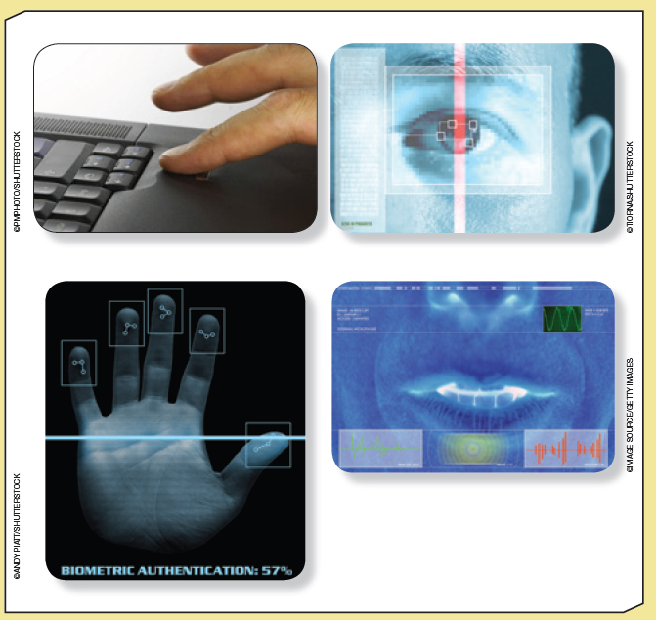
Examples of Biometric Devices

Slide 26
Nonbiometric Security Measures
Main security measures:
Callback modems
Firewalls
Intrusion detection systems

Slide 27
Callback Modems
Verify whether a user’s access is valid by:
Logging the user off
Calling the user back at a predetermined number
Useful in organizations with many employees who work off-site

Slide 28
Firewalls
Combination of hardware and software
Acts as a filter or barrier between a private network and external computers or networks
Network administrator defines rules for access
Examine data passing into or out of a private network
Decide whether to allow the transmission based on users’ IDs, the transmission’s origin and destination, and the transmission’s contents

Slide 29
Basic Firewall Configuration

Slide 30
Firewalls (cont’d.)
Possible actions after examining packet
Reject the incoming packet
Send a warning to the network administrator
Send a message to the sender that the attempt failed
Allow the packet to enter (or leave) the private network
Main types of firewalls
Packet-filtering firewalls
Application-filtering firewalls
Proxy servers
Software that acts as an intermediary between 2 systems (network users and Internet). Protects network against unauthorized access from outside the network
Can also be used as a firewall that scans for malware and viruses
Can also block requests from certain servers

Slide 31
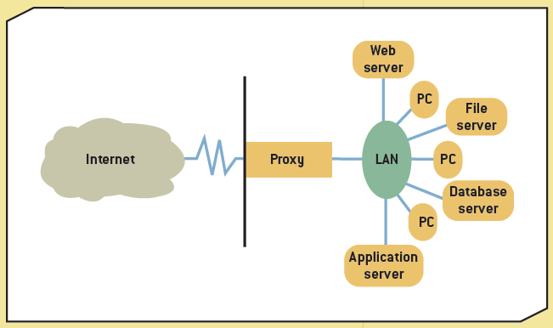
Proxy Server

Slide 32
Intrusion Detection Systems
Protect against both external and internal access
Usually placed in front of a firewall
Prevent against DoS attacks
Monitor network traffic
“Prevent, detect, and react” approach
Require a lot of processing power and can affect network performance

Slide 33
Physical Security Measures
Primarily control access to computers and networks
Include
Cable shielding –
braided layers around cable to protect it from interference
Corner bolts
Electronic trackers –
connected to computer at outlet. If power cord is disconnected an alarm sounds or a camera records what happened
Identification (ID) badges
Proximity-
release door openers- transmitter in employee badge and will unlock door within a certain radius
Room shielding –
nonconductive material sprayed in computer room which reduces signals which can be transmitted
Steel encasements –
Fit over entire computer and can be locked

Slide 34
Lost and Stolen Laptops
Recommendations:
Install cable locks and use biometric measures
Only store confidential data when necessary
Use passwords
Encrypt data
Install security chips – disable laptop if unauthorized user trys to access it. Some send signal and a GPS alert showing location of laptop

Slide 35
Access Controls
Terminal resource security
Software feature that erases the screen and signs the user off automatically after a specified length of inactivity
Password
Combination of numbers, characters, and symbols that’s entered to allow access to a system
Length and complexity determines its vulnerability to discovery
Guidelines for effective passwords

Slide 36
Virtual Private Networks
Provides a secure “tunnel” through the Internet
For transmitting messages and data via a private network
Remote users have a secure connection to the organization’s network
Low cost
Slow transmission speeds

Slide 37
Data Encryption
Transforms data, called plaintext or cleartext, into a scrambled form called ciphertext
Rules for encryption determine how simple or complex the transformation process should be
Known as the “encryption algorithm”
Protocols
Secure Sockets Layer (SSL)-
security on Internet (https) or padlock icon on status bar
Transport Layer Security (TLS)-
security over public networks

Slide 38
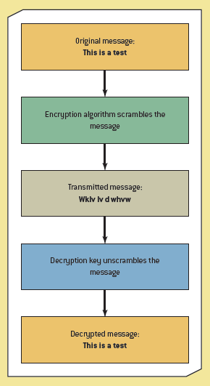
Using Encryption

Slide 39
Data Encryption (cont’d.)
Key size
Between 32 and 168 bits
Main types of encryption
Asymmetric also called “public key encryption”
Public key known to everyone
Private key known only to recipient
Message encrypted with public key can only be decrypted with same algorithm used with public key but also needs the private key
Slower, requires a lot of processing power
Symmetric – “secret key”.
Same key used to encrypt and decrypt.
Advanced Encryption Standard uses 56-bit key. The technique used by U.S Government

Slide 40
E-commerce Transaction Security Measures
Three factors are critical for security:
Authentication – of credit cards
Confirmation- verify orders and receipt of shipments
Nonrepudiation – needed in case there is a dispute. Digital signitures are used
Transaction security
Confidentiality - only the sender and recipient can read message
Authentication – how can recipient know message came from sender
Integrity – data’s content has not been changed
Nonrepudiation of origin – sender can’t deny sending data
Nonrepudiation of receipt - recipient can’t deny receiving data

Slide 41
Computer Emergency Response Team
Developed by the Defense Advanced Research Projects Agency
Focuses on security breaches and DoS attacks
Offers guidelines on handling and preventing these incidents
Cyber Incident Response Capability (CIRC)
http://www.doecirc.energy.gov/aboutus.html

Slide 42
Guidelines for a Comprehensive Security System
Train employees
Guidelines and steps involved
People
Procedures
Equipment and technology

Slide 43
Business Continuity Planning
Outlines procedures for keeping an organization operational
Prepare for disaster
Plan steps for resuming normal operations as soon as possible

Slide 44
Summary
Impact of IT tools on privacy
Use of IT tools to commit computer crimes
Basic safeguards, fault-tolerant systems
Intentional security threats
Biometric, nonbiometric, and physical security measures; access controls, firewalls, intrusion detection systems
Establish comprehensive security system and business continuity plan

