Slide 1
Using Information Systems to Achieve Competitive Advantage
Porter’s Competitive Forces Model
One way to understand competitive advantage
Five competitive forces shape fate of firm
Traditional competitors
Competitors in market space continuously devise new products, new efficiencies, switching costs.
New market entrants
Some industries have low barriers to entry:
E.g., food industry versus microchip industry
Newer companies may have advantages:
Newer equipment, younger workforce, and so on.
Notes:
Porter’s model is the best known model of competitive advantage. Now more than thirty years old, it still provides a nice summary of the strategic situation of firms in a larger business environment. The model focuses on industry structure (or the environment of the firm) as the main determinant of management decisions about corporate strategies. Managers don’t just make up strategies out of thin air. They look at the competitive situation in their industry, and then consider ways of coping and succeeding in that environment.

Slide 2
Using Information Systems to Achieve Competitive Advantage
Porter’s Competitive Forces Model
Substitute products and services
Substitutes customers can purchase if your prices too high.
E.g., Internet music service versus CDs.
Customers
Can customers easily switch to competitor’s products?
Can customers force firm and competitors to compete on price alone (transparent marketplace).
Suppliers
The more suppliers a firm has, the greater control it can exercise over suppliers.

Slide 3
Using Information Systems to Achieve Competitive Advantage
Information System Strategies for Dealing with Competitive Forces
Basic strategy: Align IT with business objectives
75 percent of businesses fail to align their IT with their business objectives, leading to lower profitability.
To align IT:
Identify business goals and strategies.
Break strategic goals into concrete activities and processes.
Identify metrics for measuring progress.
Determine how IT can help achieve business goals.
Measure actual performance.
Notes:
Information systems often play a critical role in defining and achieving strategic objectives of the firm. Sometimes, IS is tangential: Coca Cola for instance is not an intense technology user, and maintains its differentiated product through marketing and branding efforts. Other firms are intensely using IS to achieve competitive advantages, from Wal-Mart to Facebook, Amazon, and Google.
The first step in using information systems to serve your firm is to make sure the IS objectives are lined up with the business objectives.

Slide 4
Using Information Systems to Achieve Competitive Advantage
Information System Strategies for Dealing with Competitive Forces
Low-cost leadership
Use information systems to achieve the lowest operational costs and the lowest prices.
E.g. Wal-Mart
Inventory replenishment system sends orders to suppliers when purchase recorded at cash register.
Minimizes inventory at warehouses, operating costs.
Efficient customer response system.
Did low cost leadership work for JetBlue? – until capacity problems occurred during flight cancellations
Notes:
In the physical retail industry, including groceries, the keys to success are efficiency in moving product through your pipeline, minimizing inventory and time delays between receipt of the goods, and the customer purchase.

Slide 5
Using Information Systems to Achieve Competitive Advantage
Information System Strategies for Dealing with Competitive Forces
Product differentiation
Use information systems to enable new products and services, or greatly change the customer convenience in using your existing products and services.
E.g., Google’s continuous innovations, Apple’s iPhone.
Use information systems to customize, personalize products to fit specifications of individual consumers.
Dell
Mass customization at Lands’ End
Notes:
Ask students to help you make a list of companies that have really unique products or services. It’s fun to ask students for local firms on this list. There may be a really unique pizza store, theater, or restaurant in the neighborhood to help illustrate the point about product differentiation as a competitive strategy.

Slide 6
Using Information Systems to Achieve Competitive Advantage
Information System Strategies for Dealing with Competitive Forces
Focus on market niche. (requires good CRM system)
Use information systems to enable specific market focus, and serve narrow target market better than competitors.
Analyzes customer buying habits, preferences
Advertising pitches to smaller and smaller target markets
E.g., Hilton Hotel’s OnQ System
Analyzes data collected on guests to determine preferences and guest’s profitability
Notes:
Ask students for Web stores that appeal to a very small niche market, e.g., people with unique hobbies, special interests, or different political and cultural views.

Slide 7
Using Information Systems to Achieve Competitive Advantage
Information System Strategies for Dealing with Competitive Forces
Strengthen customer and supplier intimacy.
Strong linkages to customers and suppliers increase switching costs and loyalty
Toyota: uses IS to facilitate direct access from suppliers to production schedules
Permits suppliers to decide how and when to ship suppliers to Chrysler factories, allowing more lead time in producing goods.
Amazon: keeps track of user preferences for purchases, and recommends titles purchased by others
Notes:
Ask students to describe and discuss firms that they believe really “care about the customer” or offer great customer service. If this proves difficult, ask them to talk about companies with really poor customer service. In these discussions, ask students how IS could help improve the relationship with the customer.

Slide 8
Using Information Systems to Achieve Competitive Advantage
Information System Strategies for Dealing with Competitive Forces
Some companies pursue several strategies at same time.
Dell emphasizes low cost plus customization of products.
Successfully using IS to achieve competitive advantage requires precise coordination of technology, organizations, and people.
Notes:
Some firms pursue multiple strategies although many pursue a single strategy. Apple, for instance, pursues highly differentiated products that it sells at a premium price. It rarely if ever pursues a low cost strategy, but does produce a number of niche products. General Motors pursues both high-priced differentiated products (GMC Yukons and Cadillac) and low-priced economy cars (Chevy Aveo).

Slide 9
Using Information Systems to Achieve Competitive Advantage
The Internet’s Impact on Competitive Advantage
Enables new products and services
Transforms industries
Increases bargaining power of customers and suppliers (price transparency) (disintermediation –eliminate middleman)
Intensifies competitive rivalry
Creates new opportunities for building brands and large customer bases
Notes:
Ask students to help you put together a list of industries that have been greatly impacted by the Internet and the Web. Then for each industry, ask them to describe how the Internet has changed the industry. How has the Internet changed that industry from a consumer perspective?

Slide 10
Using Information Systems to Achieve Competitive Advantage
The Internet’s Impact on Competitive Advantage
Existing competitors: widens market, increasing competitors, reducing differences, pressure to compete on price
New entrants: reduces barriers to entry (e.g., need for sales force declines), provides technology for driving business processes
Substitute products and services: facilitates creation of new products and services
Customers’ bargaining power: bargaining power shifts to customer
Suppliers’ bargaining power: procurement over Internet raises power over suppliers, suppliers can benefit from reduced barriers to entry and elimination of intermediaries

Slide 11
Using Information Systems to Achieve Competitive Advantage
The Business Value Chain Model
Highlights specific activities in a business where competitive strategies can best be applied and where information systems are likely to have a strategic impact.
Primary activities
Support activities
Benchmarking
Best practices
Notes:
Porter’s industry analysis is not the only competitive strategy model. In the business chain (really a business process model), firms achieve competitive advantages by being more efficient. This does not mean low-priced. The gains from efficiency may be retained by the firm as greater profits, depending on the competitive situation. For instance, Wal-Mart adopts a business value chain model to achieve the lowest prices, but not so low as to report lower profits.

Slide 12
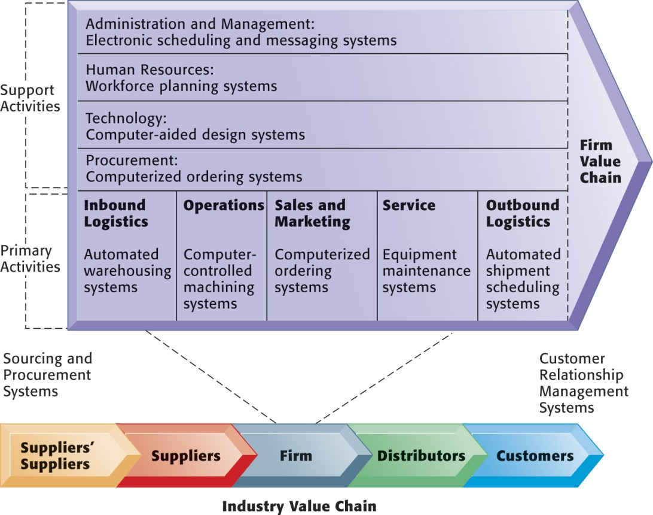
Using Information Systems to Achieve Competitive Advantage
The Value Chain Model
This figure provides examples of systems for both primary and support activities of a firm and of its value partners that would add a margin of value to a firm’s products or services.
Figure 3-2
Notes:
You can ask a single student to describe the business value chain in a business where they now work, or did work. Then ask the student to talk about how information systems were used in each step of the value chain.

Slide 13
Using Information Systems to Achieve Competitive Advantage
Synergies, Core Competencies, and Network-Based Strategies
Synergies:
When output of some units can be used as inputs to other units
When two firms can pool markets and expertise (e.g., recent bank mergers)
Lower costs and generate profits
Enabled by information systems that ties together disparate units so they act as whole
Notes:
Other competitive strategy models don’t focus on business processes and value chains, but instead focus on the core competency of a firm. Most times we don’t think about what firms are really good at, but the idea is for the firm to focus on what it really does well, better than anyone else, and to succeed by being the most efficient producer of best quality products and services. At the very least, firms should not be involved in a host of businesses where they are at best mediocre players. The role of IT in these models of competition is usually as a tool for achieving best-in-class products and services. This can include using IT as a collaboration tool, coordinating tool, and knowledge aggregator or store for the firm so that knowledge can be widely shared.

Slide 14
Using Information Systems to Achieve Competitive Advantage
Synergies, Core Competencies, and Network-Based Strategies
Core competency:
Activities for which firm is world-class leader.
E.g., world’s best miniature parts designer, best package delivery service.
Relies on knowledge that is gained over many years of experience as well as knowledge research.
Any information system that encourages the sharing of knowledge across business units enhances competency.
E.g., Procter & Gamble uses intranet to help people working on similar problems share ideas and expertise.

Slide 15
Using Information Systems to Achieve Competitive Advantage
Synergies, Core Competencies, and Network-Based Strategies
Network-based strategies:
Network economics:
Marginal costs of adding another participant are near zero, whereas marginal gain is much larger
E.g., larger number of participants in Internet, greater value to all participants
Virtual company:
Uses networks to link people, resources, and ally with other companies to create and distribute products without traditional organizational boundaries or physical locations
Notes:
Network competitive strategies focus usually on Internet opportunities and companies. Here the emphasis is on products or services that can “go viral,” that is, take advantage of the fact that there are millions of people online, and if they generate positive messages about your product, in a few hours several million people will know about it. This explains why some services like Twitter, Facebook, and YouTube have grown with truly hockey-stick curves. Another different Internet (network) strategy is to use the Internet to find partners and collaborators who can magnify the power of your smaller firm.

Slide 16
Using Information Systems to Achieve Competitive Advantage
Disruptive Technologies: Riding the Wave
Disruptive technologies:
Technologies with disruptive impact on industries and businesses, rendering existing products, services and business models obsolete:
Personal computers
World Wide Web
Internet music services
First movers versus fast followers
First movers of disruptive technologies may fail to see potential, allowing second movers to reap rewards (fast followers)
Fast follower learns fro mistakes of first mover
Notes:
Most technologies throughout history have been “disruptive” in the sense that their use produces superior products and services at a fraction of the cost. Certainly automobiles were a disruptive technology a hundred years ago which rather completely eliminated the buggy industry. The Internet is no different in rendering certain industries obsolete and unable to compete. Ask students to make a list with your help on industries that have been disrupted by the Internet.

Slide 17
Competing on a Global Scale
The Internet and Globalization
Prior to the Internet, competing globally was only an option for huge firms able to afford factories, warehouses, and distribution centers abroad.
The Internet drastically reduces costs of operating globally.
Globalization benefits:
Scale economies and resource cost reduction
Higher utilization rates, fixed capital costs, and lower cost per unit of production
Speeding time to market
Notes:
Certainly one of the more disruptive impacts of the Internet has been to spread jobs out across a world labor market, with industrial jobs moving to the lowest-wage countries. In the past, communication barriers were so severe that it would be impossible to coordinate product and service development in both the United States and China, or India. Today, with instant Internet communications from e-mail, chat, and video cameras, the cost of operating globally has fallen, and even small firms work on a global basis today.

Slide 18
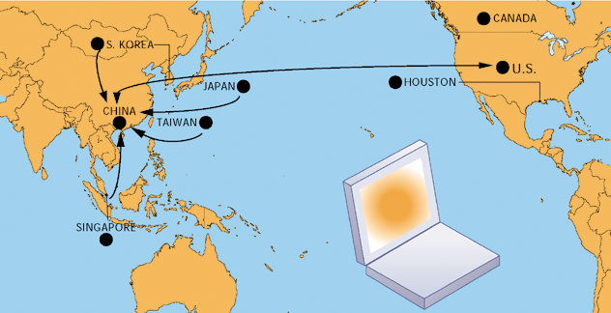
Competing on a Global Scale
An HP Laptop’s Path to Market
Figure 3-4
Hewlett-Packard and other electronics companies assign distribution and production of their products to a number of different countries.
Notes:
Most of the electronic products we use today are “global” in the sense that their design, production, and distribution take place across nearly all continents. Even automobiles increasingly are global collections.

Slide 19
Competing on a Global Scale
Global System Configurations
Centralized systems:
All development and operation at domestic home base
Duplicated systems:
Development at home base but operations managed by autonomous units in foreign locations
Decentralized systems:
Each foreign unit designs own solutions and systems
Networked systems:
Development and operations occur in integrated and coordinated fashion across all units

Slide 20
Competing on a Global Scale
Global Business Organization Systems Configurations
The large Xs show the dominant patterns, and the small Xs show the emerging patterns. For instance, domestic exporters rely predominantly on centralized systems, but there is continual pressure and some development of decentralized systems in local marketing regions.
Figure 3-5

Slide 21
Competing on Business Processes
Businesses are collections of business processes— ways of working and getting things done.
Some times they are written in manuals, but in many cases business processes are informal.
In order to use information systems effectively, you need to change business processes.
Before you can change processes, you need to change people’s attitudes and behaviors, and even the organization itself.
Notes:
If your company has the most efficient, highest quality processes that result in few errors, you have a competitive advantage. However, this advantage can disappear pretty quickly as your competition catches up, and they will catch up. One answer is a continuous, incremental improvement process that is ongoing and results in your processes always being at the leading edge.
A major point of this book is to let students know that you can’t just plug in computers and expect miracles. You need to think about your business processes and figure out how to improve, and then figure out how IT can help improve the processes even further.

Slide 22
Competing on Business Processes
Business process management = continuous improvement
Identify processes for change.
Analyze existing processes.
Design new process.
Implement new process.
Measure new process.
Notes:
Many people think business process management is self-evident, but it is not. There are thousands of business processes in a large business, and understanding which ones to change, why, and with what financial impact, is a challenge.

Slide 23
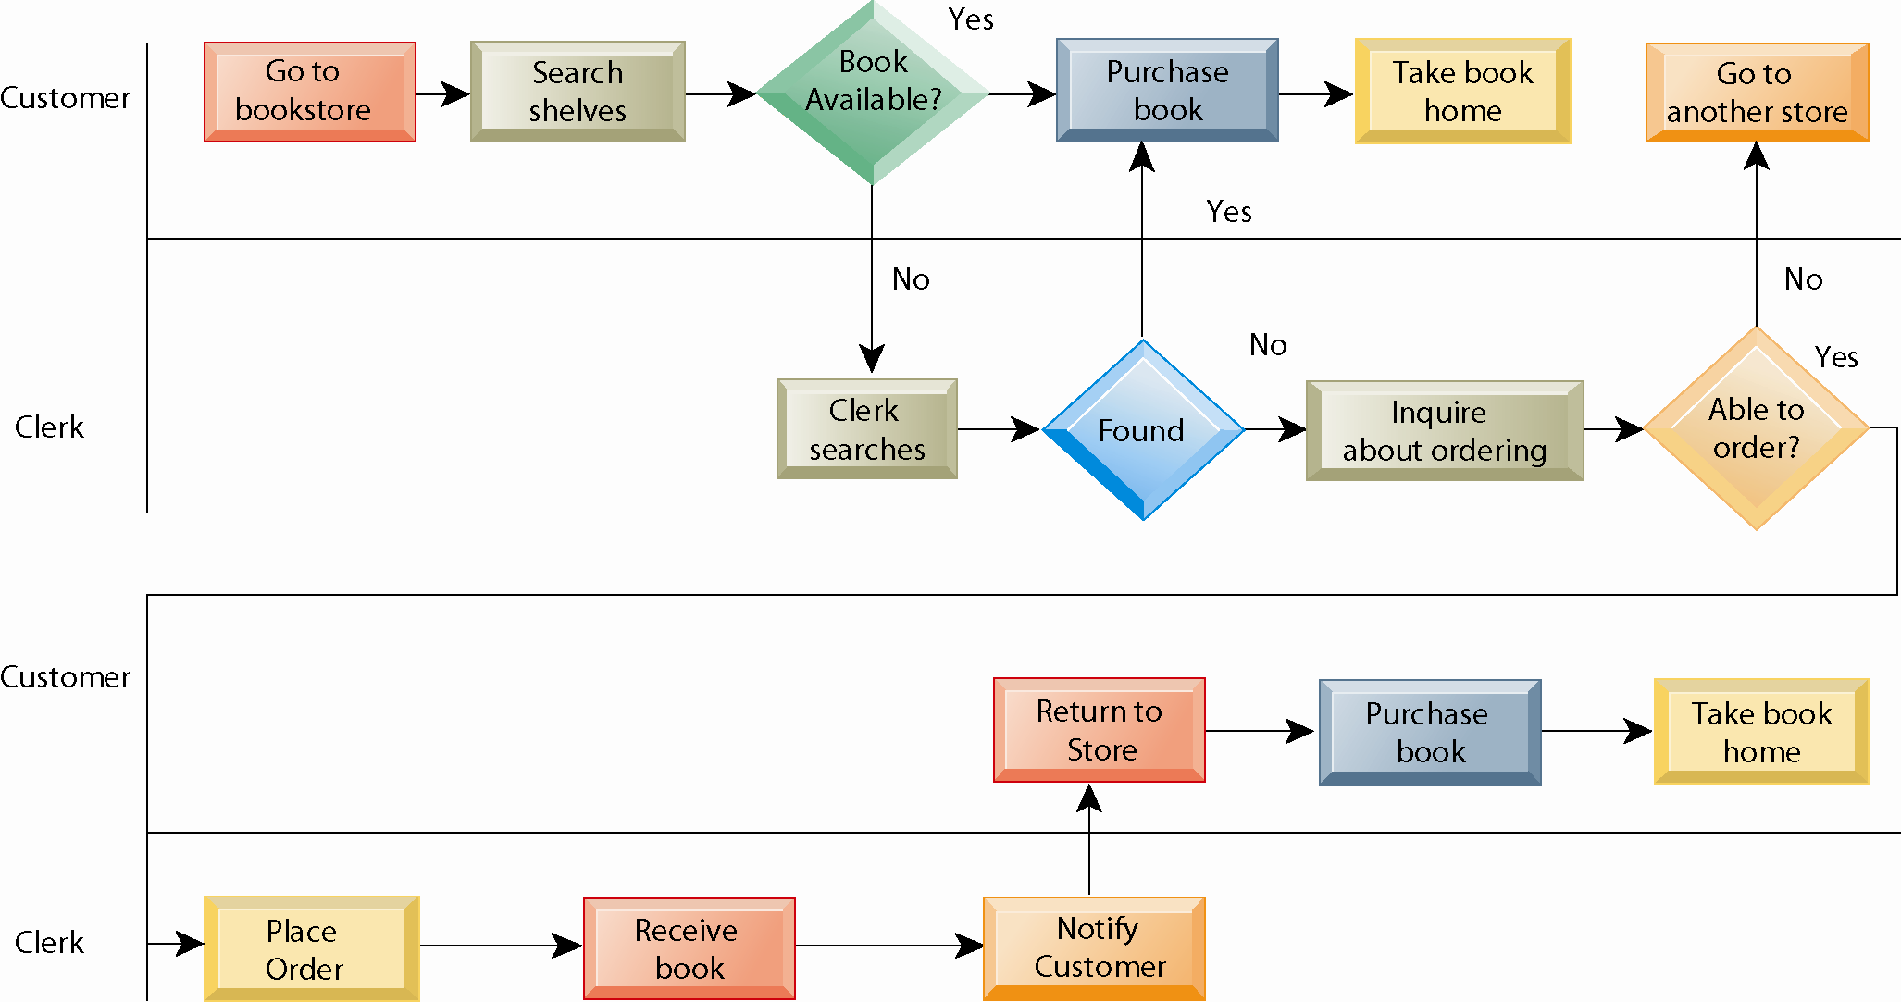
Competing on Business Processes
Figure 3-6
Notes:
As-Is Business Process for Purchasing a Book from a Physical Bookstore
Purchasing a book from a physical bookstore requires many steps to be performed by both the seller and the customer.

Slide 24
Competing on Business Processes
Figure 3-7
Notes:
Redesigned Process for Purchasing a Book Online
Using Internet technology makes it possible to redesign the process for purchasing a book so that it only has a few steps and
consumes much fewer resources.
Competing on business processes almost always means simplifying the process, reducing the number of people involved, reducing the decision time, expanding the remaining employees’ job responsibilities, and using information systems to speed the flow and quality of information.

Slide 25
Competing on Business Processes
Business Process Reengineering
A radical form of fast change
Not continuous improvement, but elimination of old processes, replacement with new processes, in a brief time period
Can produce dramatic gains in productivity, but increases organizational resistance to change
Notes:
“Reengineering” was at one point a highly regarded approach to high-speed dramatic change in business firms. It often resulted in profound simplification of antiquated business processes, resulting in severe disruptions to the work force which was decimated by layoffs. Most grand reengineering efforts did not produce the promised results, or produced results in very limited areas of the firm which had little impact on overall efficiency and productivity. Today industry and firm restructuring generally takes place through the impact of global markets on firms, and less by a planned form of social change.

