Slide 1
Building Information Systems

Slide 2
STUDENT OBJECTIVES
What are the core problem-solving steps for developing new information systems?
What are the alternative methods for building information systems?
What are the principal methodologies for modeling and designing systems?
How should information systems projects be selected and evaluated?
How should information systems projects be managed?

Slide 3
Problem Solving and Systems Development
New information systems are built as solutions to problems
Four steps to building an information system
Define and understand the problem.
Develop alternative solutions.
Choose a solution.
Implement the solution.
The first three steps are called systems analysis

Slide 4
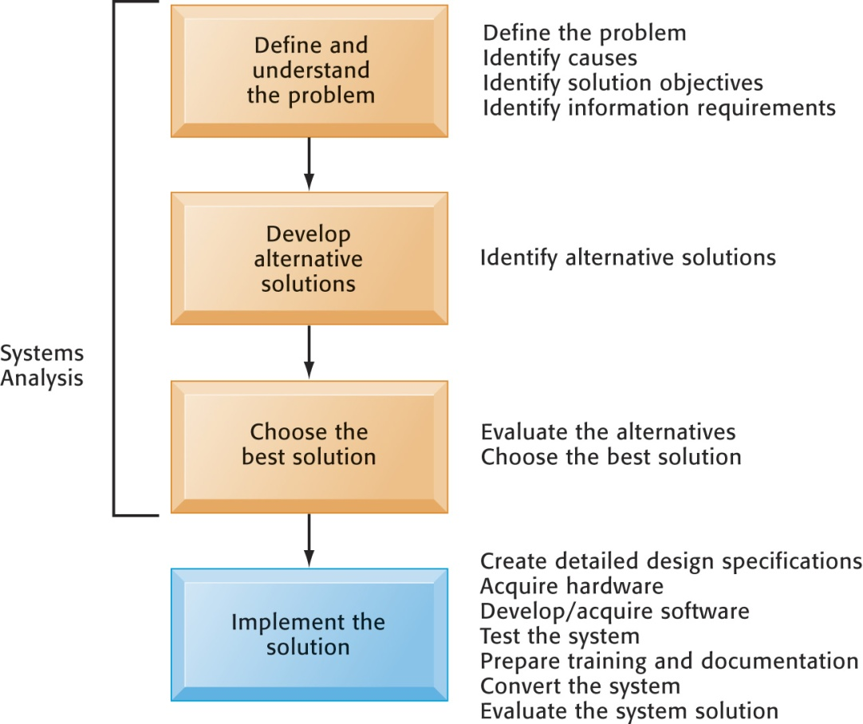
Problem Solving and Systems Development
Developing an Information System Solution
Developing an information system solution is based on the problem-solving process.
Figure 11-1

Slide 5
Problem Solving and Systems Development
Defining and Understanding the Problem
What caused the problem?
Why does it persist?
Why hasn’t it been solved?
What are the objectives of a solution?
Information requirements

Slide 6
Problem Solving and Systems Development
Developing Alternative Solutions
Paths to a solution determined by systems analysis.
Some solutions do not require an information system.
Some solutions require modification of existing systems.
Some solutions require new systems.

Slide 7
Problem Solving and Systems Development
Evaluating and Choosing Solutions
Feasibility issues
Feasibility study
Costs and benefits
Advantages and disadvantages
Business value of systems
Change management

Slide 8
Problem Solving and Systems Development
Implementing the Solution
Systems design
Completing implementation
Hardware selection and acquisition
Software development and programming
Testing
Training and documentation
Conversion
Production and maintenance
Managing the change

Slide 9
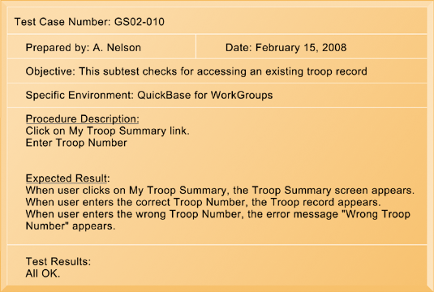
Alternative Systems-Building Approaches
A Sample Test Plan for the Girl Scout Cookie System
When developing a test plan, it is imperative to include the various conditions to be tested, the requirements for each condition tested, and the expected results. Test plans require input from both end users and information systems specialists.
Figure 11-2

Slide 10
Alternative Systems-Building Approaches
Traditional Systems Development Lifecycle
Oldest method for building information systems
Phased approach with formal stages
Waterfall approach
Formal division of labor
Used for building large, complex systems
Time consuming and expensive to use

Slide 11
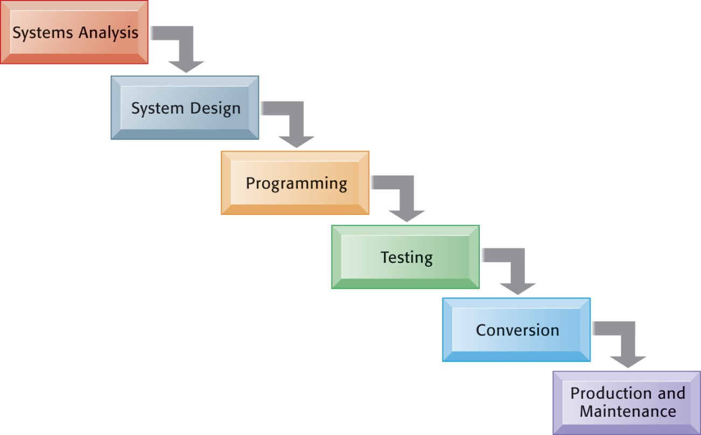
Alternative Systems-Building Approaches
The Traditional Systems Development Lifecycle
The systems development lifecycle partitions systems development into formal stages, with each stage requiring completion before the next stage can begin.
Figure 11-3

Slide 12
Alternative Systems-Building Approaches
Prototyping
Preliminary model built rapidly and inexpensively
Four-step process
Identify the user’s basic requirements.
Develop an initial prototype.
Use the prototype.
Revise and enhance the prototype.
Especially useful in designing a user interface

Slide 13
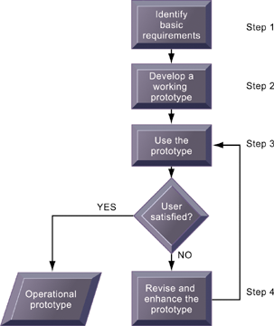
Alternative Systems-Building Approaches
The Prototyping Process
The process of developing a prototype consists of four steps. Because a prototype can be developed quickly and inexpensively, systems builders can go through several iterations, repeating steps 3 and 4, to refine and enhance the prototype before arriving at the final operational one.
Figure 11-4

Slide 14
Alternative Systems-Building Approaches
End-User Development
End users create simple information systems with little or no assistance from technical specialists.
Use fourth-generation languages, graphics languages, and PC software tools to access data, create reports, and develop information systems.
Completed more rapidly than systems developed with conventional tools
Organizational risks

Slide 15
Alternative Systems-Building Approaches
End-User Development
Allows end users to create simple information systems
Reduces time required to produce a finished application
Often leads to higher level of user involvement and satisfaction with systems
Also poses risks because systems are created so quickly, without formal development methodology, testing, documentation
Notes:
15

Slide 16
Alternative Systems-Building Approaches
Purchasing Solutions: Application Software Packages and Outsourcing
Request for Proposal (RFP)
Application software packages
Generalized systems for universal functions with standard processes
Customization
Outsourcing
Application service providers (ASPs)
Offshore outsourcing

Slide 17
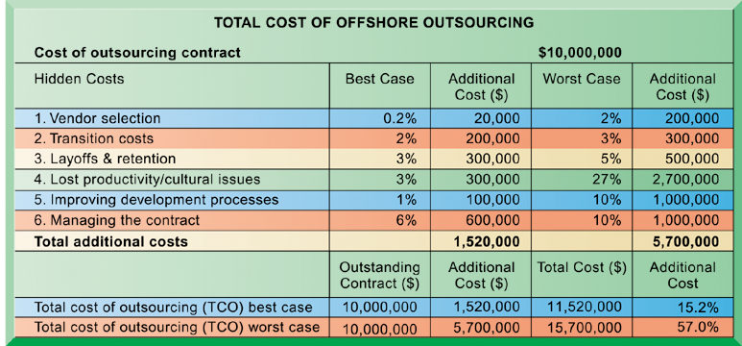
Alternative Systems-Building Approaches
Total Cost of Offshore Outsourcing
If a firm spends $10 million on offshore outsourcing contracts, that company will actually spend 15.2 percent in extra costs even under the best-case scenario. In the worst-case scenario, where there is a dramatic drop in productivity along with exceptionally high transition and layoff costs, a firm can expect to pay up to 57 percent in extra costs on top of the $10 million outlay for an offshore contract.
Figure 11-5

Slide 18
Alternative Systems-Building Approaches
Interactive Session: Technology
Zimbra Zooms Ahead with OneView
Read the Interactive Session and then discuss the following questions:
Describe the steps in Zimbra’s sales process. How well did its old marketing automation system support that process? What problems did it create? What was the business impact of these problems?
List and describe Zimbra’s requirements for a new marketing software package. If you were preparing the RFP for Zimbra’s new system, what questions would you ask?
How did the new marketing system change the way Zimbra ran its business? How successful was it?

Slide 19
Alternative Systems-Building Approaches
Rapid Application Development for E-Business
Agility and scalability
Rapid application development (RAD)
Creating workable systems in a very short period of time
Joint application design (JAD)
End users and information systems specialists working together on design

Slide 20
Modeling and Designing Systems
Structured methodologies
Data flow diagram
Process specifications
Structure chart
Object-oriented development
Based on concepts of class and inheritance
Component-based development and Web services
Computer-aided software engineering (CASE)

Slide 21
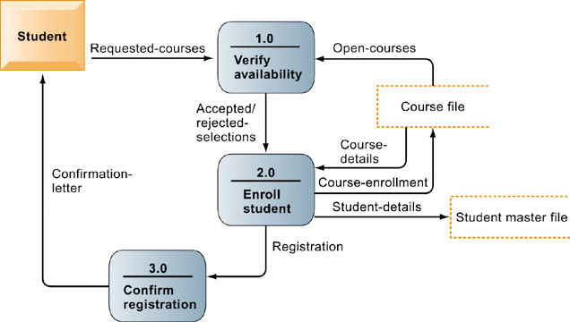
Modeling and Designing Systems
Data Flow Diagram for Mail-in University Registration System
The system has three processes: Verify availability (1.0), Enroll student (2.0), and Confirm registration (3.0). The name and content of each of the data flows appear adjacent to each arrow. There is one external entity in this system: the student. There are two data stores: the student master file and the course file.
Figure 11-6

Slide 22
Modeling and Designing Systems
High-Level Structure Chart for a Payroll System
This structure chart shows the highest or most abstract level of design for a payroll system, providing an overview of the entire system.
Figure 11-7

Slide 23
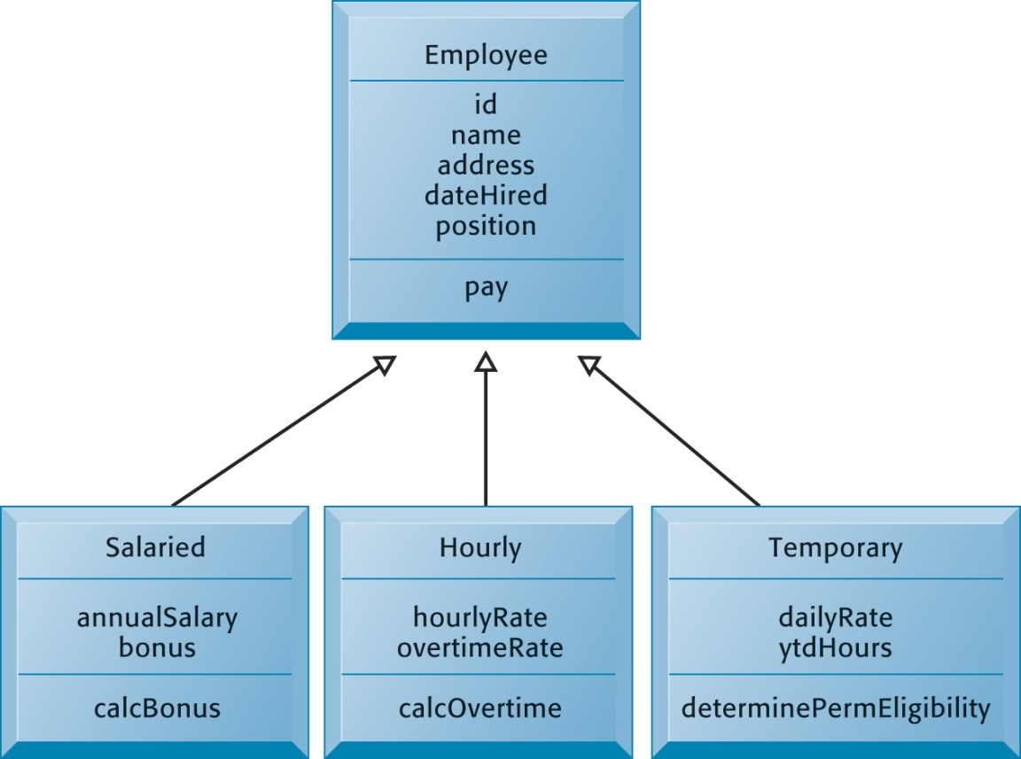
Modeling and Designing Systems
Class and Inheritance
This figure illustrates how classes inherit the common features of their superclass.
Figure 11-8

Slide 24
Modeling and Designing Systems
Object-Oriented Development
Uses the object as the basic unit of systems analysis and design
Class
Inheritance
More iterative and incremental than traditional structured development
Component-based development
Groups of objects assembled into software components
Used to create e-commerce applications
Notes:
24

Slide 25
Modeling and Designing Systems
Computer-Aided Software Engineering (CASE)
Provides software tools to automate the previously described methodologies
Reduces repetitive work in systems development
CASE tools facilitate clear documentation and coordination of team development efforts
Modest productivity benefits if tools are used correctly
Notes:
25

Slide 26
Project Management
Project
Planned series of related activities for achieving a specific business objective
Project Management
Application of knowledge, skills, tools, and techniques to achieve targets within specified budget and time constraints
Scope
Time
Cost
Quality
Risk
Project Management Objectives

Slide 27
Understanding the Business Value of Systems and Managing Change
Interactive Session: People
Kaiser Permanente Botches Its Kidney Transplant Center Project
Read the Interactive Session and then discuss the following questions:
Classify and describe the problems Kaiser faced in setting up the transplant center. What was the role of information systems and information management in these problems?
What were the people, organization, and technology factors responsible for those problems?
What steps would you have taken to increase the project’s chances for success?
Were there any ethical problems created by this failed project? Explain your answer.

Slide 28
Project Management
Selecting Projects:
Making the Business Case for a New System
Determining project costs and benefits
Tangible benefits
Intangible benefits
Capital budgeting methods
Information systems plan
Portfolio analysis
Scoring model

Slide 29
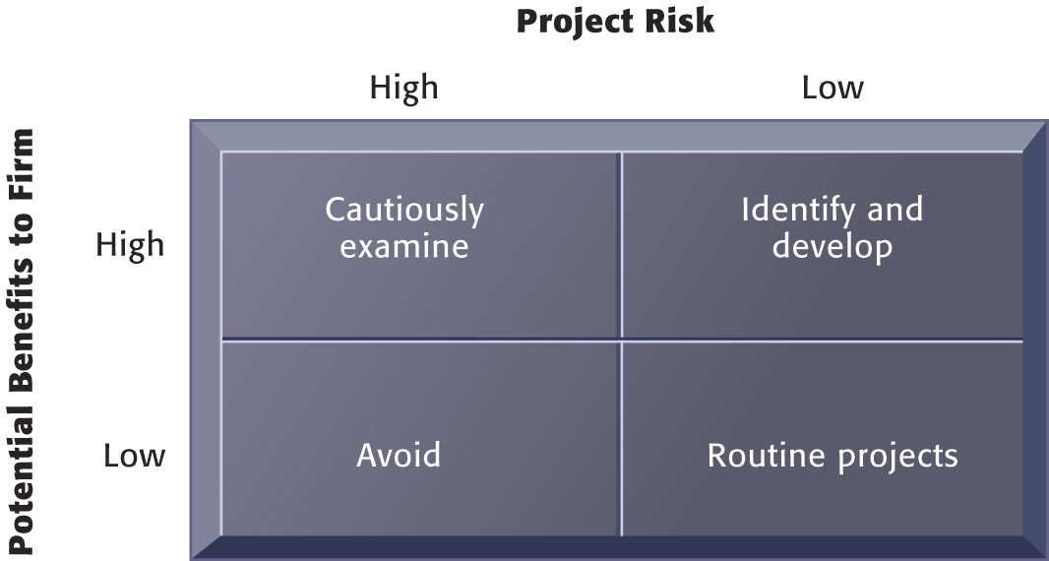
Project Management
A System Portfolio
Companies should examine their portfolio of projects in terms of potential benefits and likely risks. Certain kinds of projects should be avoided altogether and others developed rapidly. There is no ideal mix. Companies in different industries have different information systems needs.
Figure 11-9

Slide 30
Understanding the Business Value of Systems and Managing Change
Managing Project Risk and System-Related Change
Implementation and change management
Implementation
User-designer communications gap
Controlling risk factors
Formal planning and tools
Gantt Chart
PERT chart
Overcoming user resistance
Ergonomics
Organizational impact analysis

Slide 31
Project Management
A Gantt Chart
The Gantt chart in this figure shows the task, person-days, and initials of each responsible person, as well as the start and finish dates for each task. The resource summary provides a good manager with the total person-days for each month and for each person working on the project to manage the project successfully. The project described here is a data administration project.
Figure 11-10A

Slide 32
Project Management
A Gantt Chart
Figure 11-10B

Slide 33
Project Management
A Gantt Chart
Figure 11-10C

Slide 34
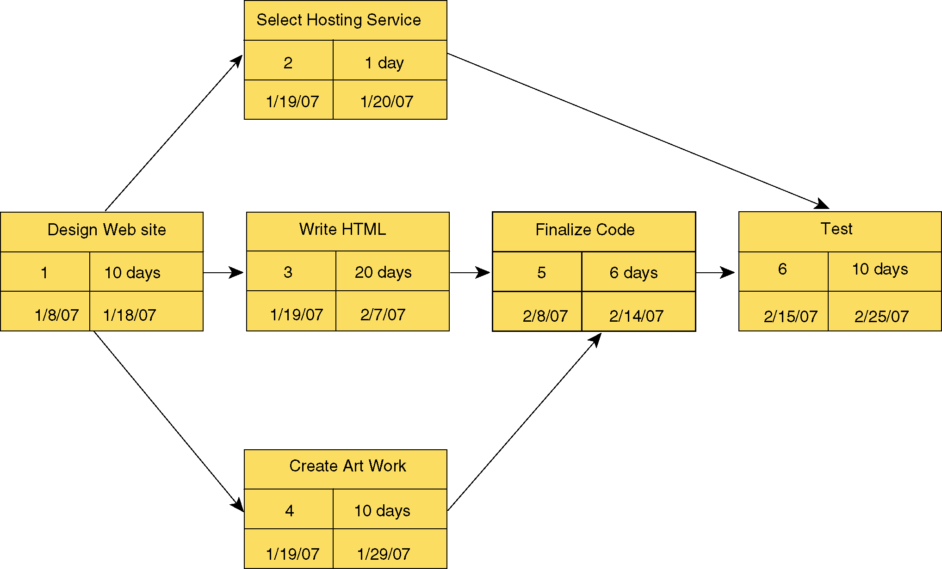
Project Management
A Gantt Chart
This is a simplified PERT chart for creating a small Web site. It shows the ordering of project tasks and the relationship of a task with preceding and succeeding tasks.
Figure 11-11

Slide 35
Understanding the Business Value of Systems and Managing Change
Managing Projects on a Global Scale
Project challenges for global systems are complicated by international environment
User info requirements, business processes, work cultures vary from country to country
Ways of convincing users to adopt global systems:
Permitting each country unit in a global corporation to develop one application in its home country first.
Develop transnational centers of excellence to perform business and systems analysis, design, testing.
Notes:
35

