Slide 1
System Development

Slide 2
Study Questions
Q1 What is systems development?
Q2 Why is systems development difficult and risky?
Q3 How do businesses use the systems development life cycle (SDLC) process?
Q4 How does systems development vary according to project scale?
Q5 What are trade-offs among requirements, schedule, and cost?
Q6 What are the major challenges when planning IS projects?
Q7 What are the major challenges when managing IS project?
Q8 2020?

Slide 3
What Is Systems Development?
Systems development, or systems analysis and design
Process of creating and maintaining information systems

Slide 4
Systems Development Is Not Just for Techies
Establishing the system’s goals, setting up the project, and determining requirements require business knowledge and management skill.
Tasks such as building computer networks and writing computer programs require technical skills.
Developing the other components requires nontechnical, human relations skills.

Slide 5
Nontechnical, Human Relations Skills Required
Creating data models requires the ability to interview users and understand their view of the business activities.
Designing procedures, especially those involving group action, requires business knowledge and an understanding of group dynamics.
Developing job descriptions, staffing, and training all require human resource and related expertise.
Coordinated teamwork of both specialists and nonspecialists with business knowledge.

Slide 6
Information Systems Are Never Off-the-Shelf
Information systems involve people and procedures, therefore procedures must be constructed or adapted to fit business and people, regardless of how computer programs are obtained.
You will have a key role in information systems development.
Ensuring that effective procedures exist for using the information system
Ensuring that personnel are properly trained and are able to use the IS effectively
Single most important criterion for information systems success is for users to take ownership of their systems.

Slide 7
Study Questions
Q1 What is systems development?
Q2 Why is systems development difficult and risky?
Q3 How do businesses use the systems development life cycle (SDLC) process?
Q4 How does systems development vary according to project scale?
Q5 What are trade-offs among requirements, schedule, and cost?
Q6 What are the major challenges when planning IS projects?
Q7 What are the major challenges when managing IS project?
Q8 2020?

Slide 8
Standish Group’s Study of IT Projects
In the 1990s the Standish Group conducted a survey of IT executive managers about the factors that they considered critical to IT project success. Each executive manager was asked to identify the single most important success factor in their experience.
The list of 10 success factors you just considered came from this study – they were the 10 most frequently cited ones.
Let’s see how your ranking compares with the ranking of the IT executive managers …

Slide 9
Ranking by IT Executive Managers
User Involvement 15.9%
Executive Management Support 13.9%
Clear Statement of Requirements 13.0%
Proper Planning 9.6%
Realistic Expectations 8.2%
Smaller Project Milestones 7.7%
Competent Staff 7.2%
Ownership 5.3%
Clear Vision & Objectives 2.9%
Hard-Working, Focused Staff 2.4%
All Other Factors (total) 13.9%
100.0%
See: http://www.standishgroup.com/sample_research/chaos_1994_2.php

Slide 10
The Standish Group’s Conclusion
The three major reasons that a project will succeed are user involvement, executive management support, and a clear statement of requirements. There are other success criteria, but with these three elements in place, the chances of success are much greater. Without them, chance of failure increases dramatically.
The Standish Group’s CHAOS Report, 1994
http://www.standishgroup.com/sample_research/chaos_1994_2.php

Slide 11
More on the Standish Group Study
Survey methodology was quite thorough
Respondents were IT executive managers
Sample size was 365 respondents
Over 8,000 application development projects represented in the sample

Slide 12
More on the Standish Group Study
Included large, medium, and small companies
Range of industry segments:
banking and securities,
manufacturing,
retail and wholesale,
heath care and insurance,
local, state, and federal organizations

Slide 13
The Standish Group Study (cont’d)
For purposes of the study, projects were classified into three resolution types:
Success: on-time and on-budget, with all features as initially specified.
Challenged: completed but over-budget, over schedule, with limited features.
Failed: canceled during the development cycle.

Slide 14
The Standish Group Study (cont’d)
Project Resolution by Type
success
challenged
failed

Slide 15
IT Executive Response to Main Cause for Challenged Projects
Lack of User Input 12.8%
Incomplete Requirements 12.3%
Changing Requirements 11.8%
Lack of Executive Support 7.5%
Technology Incompetence 7.0%
Lack of Resources 6.4%
Unrealistic Expectations 5.9%
Unclear Objectives 5.3%
Unrealistic Time Frames 4.3%
New Technology 3.7%
Other 23.0%
100.0%

Slide 16
IT Executive Response to Main Cause for Failed Projects
Incomplete Requirements 13.1%
Lack of User Involvement 12.4%
Lack of Resources 10.6%
Unrealistic Expectations 9.9%
Lack of Executive Support 9.3%
Changing Requirements 8.7%
Lack of Planning 8.1%
Didn't Need It Any Longer 7.5%
Lack of IT Management 6.2%
Technology Illiteracy 4.3%
Other 9.9%
100.0%

Slide 17
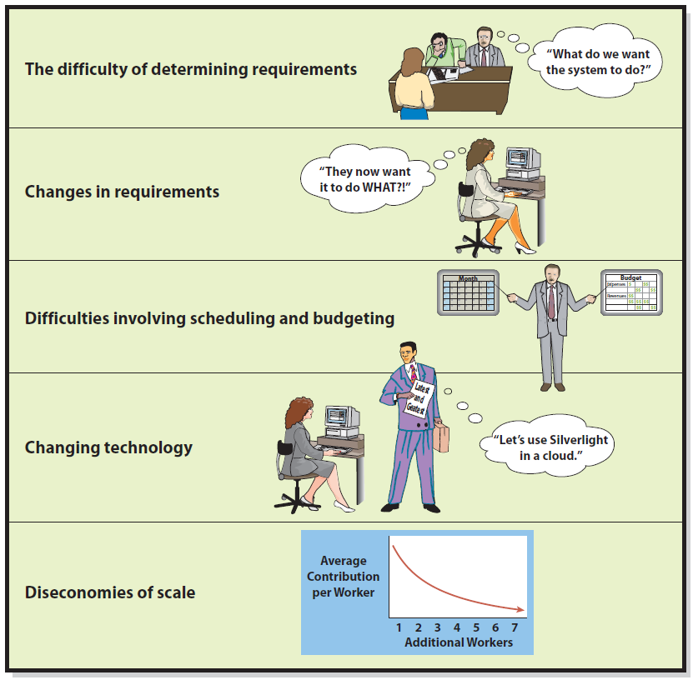
Why Is Systems Development Difficult and Risky?
Systems development is difficult and risky.
Many projects are never finished.
Some finish 200 to 300 percent over budget.
Others finish within budget and schedule, but never satisfactorily accomplish their goals.

Slide 18
Difficulty of Requirements Determination
What features do you want?
Do you really need them?
What kind of controls do you want?
What functions should it have?
What data do you have?
What information do you want provided?
Must create environment where difficult questions are asked and answered
Requirements analysis - 25% - 40% of software project costs are a result of requirement errors

Slide 19
Changes in Requirements
Development aims at moving target
Bigger the system and longer the project, the more requirements change
When requirements change, what should the development team do?
Stop work and rebuild system in accordance with new requirements?
If they do that, system will develop in fits and starts and might never be completed.
Or, should the team finish the system, knowing that it will be unsatisfactory the day it is implemented and will therefore need immediate maintenance?

Slide 20
Scheduling and Budgeting Difficulties
How long to build it?
How long to create data model?
How long to build database applications?
How long to do testing?
How long to develop and document procedures?
How long for training?
How much will it cost for labor?
What are the costs and benefits?
What’s the rate of return on investment?

Slide 21
Diseconomies of Scale
As development teams become larger, the average contribution per worker decreases.
Brooks’ Law
“Adding more people to a project makes the project later.”
When new staff are brought into a late project, they must be trained by productive members who lose productivity while they’re training new members.
Some tasks simply can’t be speeded up.

Slide 22
Is It Really So Bleak?
Yes and no
Significant challenges do exist that every development project must overcome.
Once a project is late and over budget, no good choice exists.
Although systems development is challenging, solid methodologies have emerged over the last 50 years and proven successful.

Slide 23
Study Questions
Q1 What is systems development?
Q2 Why is systems development difficult and risky?
Q3 How do businesses use the systems development life cycle (SDLC) process?
Q4 How does systems development vary according to project scale?
Q5 What are trade-offs among requirements, schedule, and cost?
Q6 What are the major challenges when planning IS projects?
Q7 What are the major challenges when managing IS project?
Q8 2020?

Slide 24
How Do Businesses Use the SDLC Process?
Systems investigation/planning
Management’s statement of objective and goals for new system
System Analysis - Requirements analysis
Identify features and functions
System Design - Component design
(hardware, software, network)
Based on approved user requirements
Implementation (programming, testing, conversion)
Purchase and/or build (code programs)
Testing
Conversion to new system
Production & Maintenance (fix or enhance)
Repair, add new features, maintain
See http://www.learn.geekinterview.com/it/sdlc/sdlc-methodology-steps.html

Slide 25
How Is System Definition Accomplished?
Team of users and IT professionals assigned to assess feasibility
Small business may hire consultant to work with managers and key employees
(a.) Define system goals for new system
Facilitate competitive strategy
Improve decision making

Slide 26
How Is System Definition Accomplished?
(b.) Define scope for new system
Defined by customers, users involved, business processes impacted, physical location, functional area
Clear definition of scope simplifies
Requirements determination
Coordination and other work

Slide 27
Assess Feasibility
Dimensions of feasibility
Cost feasibility
Approximated, “back-of-the-envelope” analysis
Purpose: eliminate infeasible ideas early
Consider cost of previous projects, operational and labor costs
Schedule feasibility
Ball park estimate
Technical feasibility
Is it technically likely to meet needs?
Organizational feasibility
Fit with customs, culture, charter, legal requirements of organization

Slide 28
Form a Project Team
Typical personnel on a development team are:
Manager (or mangers for larger projects)
System analysts
Programmers
Software testers
Users.
Depending on nature of project, team may also include hardware and communications specialists, database designers and administrators, and other IT specialists.

Slide 29
Form a Project Team
Team composition changes over time.
During requirements definition, the team will be heavy with systems analysts.
During design and implementation, it will be heavy with programmers, testers, and database designers.
During integrated testing and conversion, the team will be augmented with testers and business users.

Slide 30
Systems Analysts
IS professionals who understand both business and technology.
They are active throughout the systems development process and play a key role in moving the project through the systems development process.
Systems analysts integrate the work of the programmers, testers, and users.

Slide 31
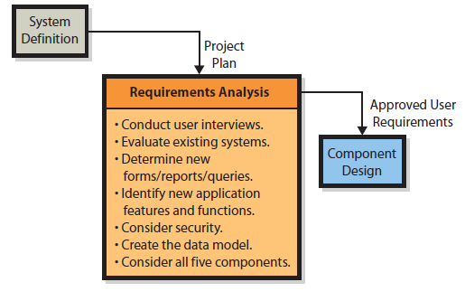
What Is the Users’ Role in the Requirements Phase?
Review and approve requirements

Slide 32
How Are the Five Components Designed?
Hardware design
Purchase it, lease it, or lease time from hosting service
Software design
Off-the-shelf, custom developed
Database design
Convert data model to a database design
Procedure design
Users and operations personnel
Normal, backup, failure recovery procedures
Design of job descriptions
Duties and responsibilities for new jobs and revised jobs coordinated with human resources policies

Slide 33
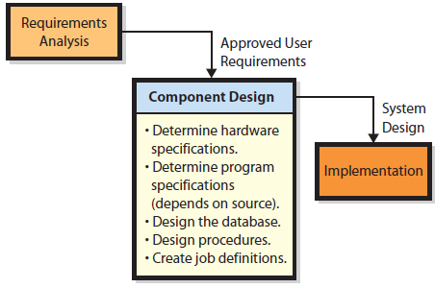
Design Tasks Pertain to Each of the Five IS Components

Slide 34
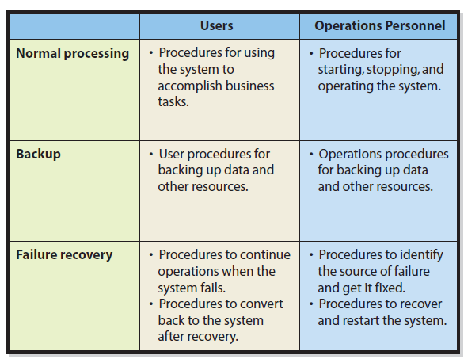
Procedures to Be Designed
Figure 10-7

Slide 35
How Is an Information System Implemented?
System testing
Test plan
Product Quality Assurance (PQA)
IT specialist constructs test plan with advice and assistance of users.
PQA test engineers perform testing and supervise user testing activity.
Users
Develop test plans and test cases
Final say on whether system is “production ready”
Beta testing
Last stage of testing
Complete, fully functioning

Slide 36
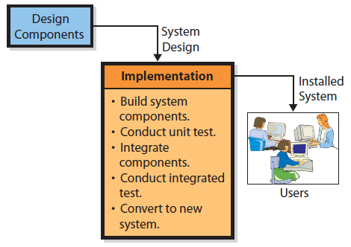
Implementation

Slide 37
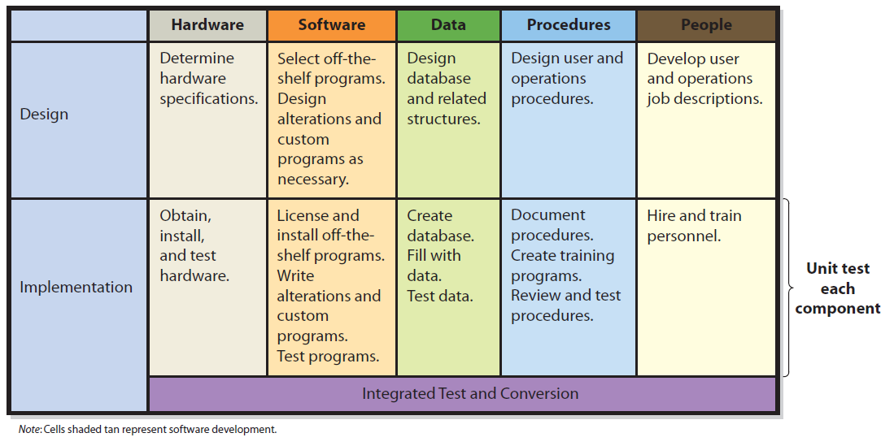
Design and Implementation for the Five IS Components
Figure 10-9

Slide 38
System Conversion Approaches
Pilot
Implement entire system in limited portion of business
MRV uses system for selected customers.
Advantage: limits exposure to business if system fails
Phased
System is installed in phases or modules.
Each piece is installed and tested.
Parallel
Complete new and old systems run simultaneously
Very safe, but expensive
Plunge (or direct)
High risk if new system fails, no old system to fall back on
Only used if new system is not vital to company operation

Slide 39
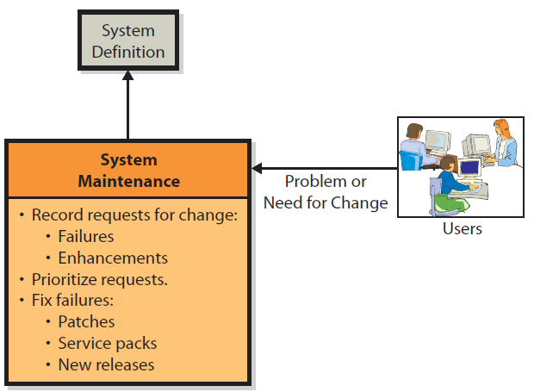
What Are the Tasks for System Maintenance?
Figure 10-10

Slide 40
What Are the Tasks for System Maintenance?
System problems priorities
Patch
Applied to all copies of a software product
Patches fix security and other critical problems
Usually bundled as “service packs”
Shipping software with defects is software industry practice
Minor enhancements
Adaptation to new requirements done via service packs
Major enhancements
Usually result in new version of software product
Hardware and database failures or enhancements

Slide 41
What Are Some of the Problems with the SDLC?
SDLC Waterfall
Sequence of nonrepeated phases
It rarely works smoothly, causing development team to go back and forth, raising costs and delaying project
Requirements documentation difficulty
Business requirements sometimes change making documented requirements incomplete or obsolete
“Analysis paralysis”—projects spend so much time on documentation that it hampers progress
Scheduling and budgeting difficulties
Time and cost estimates for large project are usually way off
People who make initial estimates know little about how long it will take or cost

Slide 42
Study Questions
Q1 What is systems development?
Q2 Why is systems development difficult and risky?
Q3 How do businesses use the systems development life cycle (SDLC) process?
Q4 How does systems development vary according to project scale?
Q5 What are trade-offs among requirements, schedule, and cost?
Q6 What are the major challenges when planning IS projects?
Q7 What are the major challenges when managing IS project?
Q8 2020?

Slide 43
How Does Systems Development Vary According to Project Scale?
SDLC
Can be applied to projects of any scale
Nature and characteristics of work may vary
Small-scale projects
Simpler requirements
Involve few business processes
Seldom has IT support
Consultants used
Frequently only on a part-time basis
Often have short-time duration
Staff may be inexperienced

Slide 44
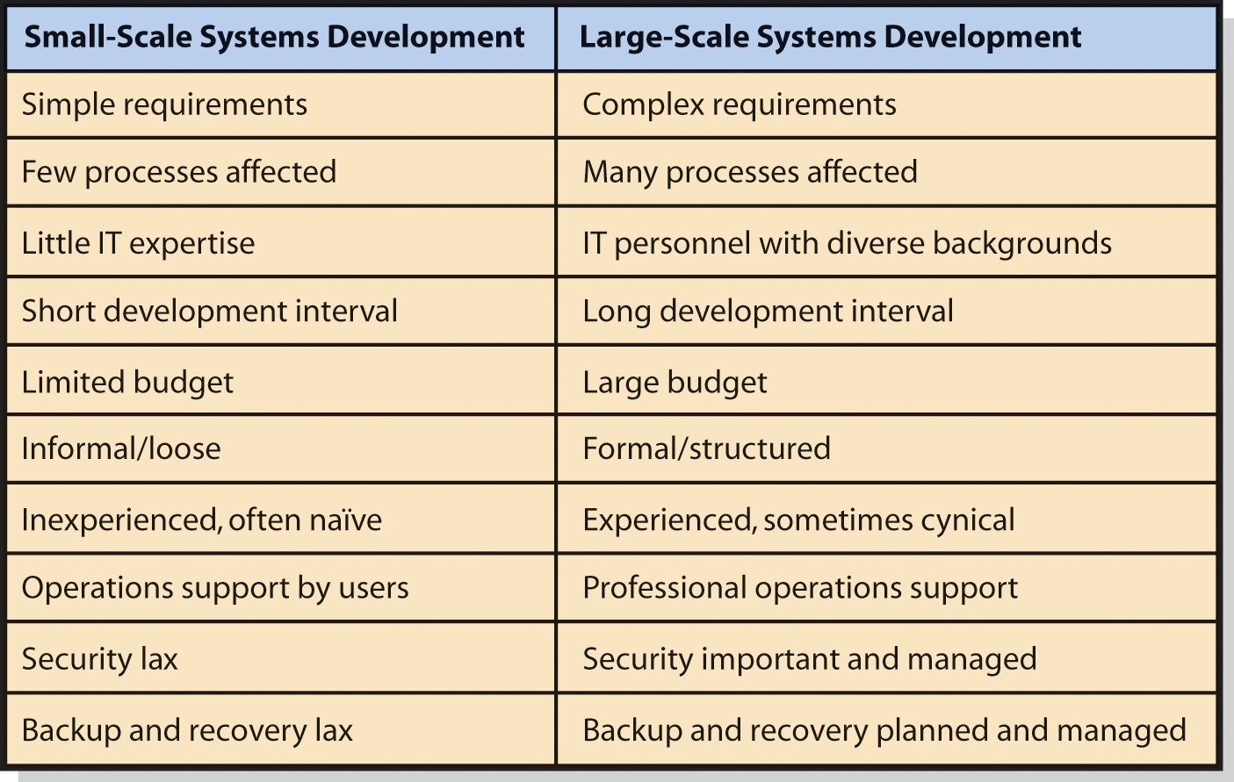
How Does Systems Development Vary According to Project Scale?
Figure CE18-1

Slide 45
Study Questions
Q1 What is systems development?
Q2 Why is systems development difficult and risky?
Q3 How do businesses use the systems development life cycle (SDLC) process?
Q4 How does systems development vary according to project scale?
Q5 What are the trade-offs among requirements, schedule, and cost?
Q6 What are the major challenges when planning IS projects?
Q7 What are the major challenges when managing IS project?
Q8 2020?

Slide 46
Trade-Offs in Requirements, Cost, and Time?
Balancing development drivers
Requirements (scope)
Cost
Time
Trade-offs
Elaborate requirements increase costs and time
Time can be reduced to a point w/o adding costs
Increasing time may reduce or increase costs
If schedule needs to be shortened, two alternatives available: reduce requirements or add labor
Adding more people creates diseconomies of scale (Brooks’ Law)

Slide 47
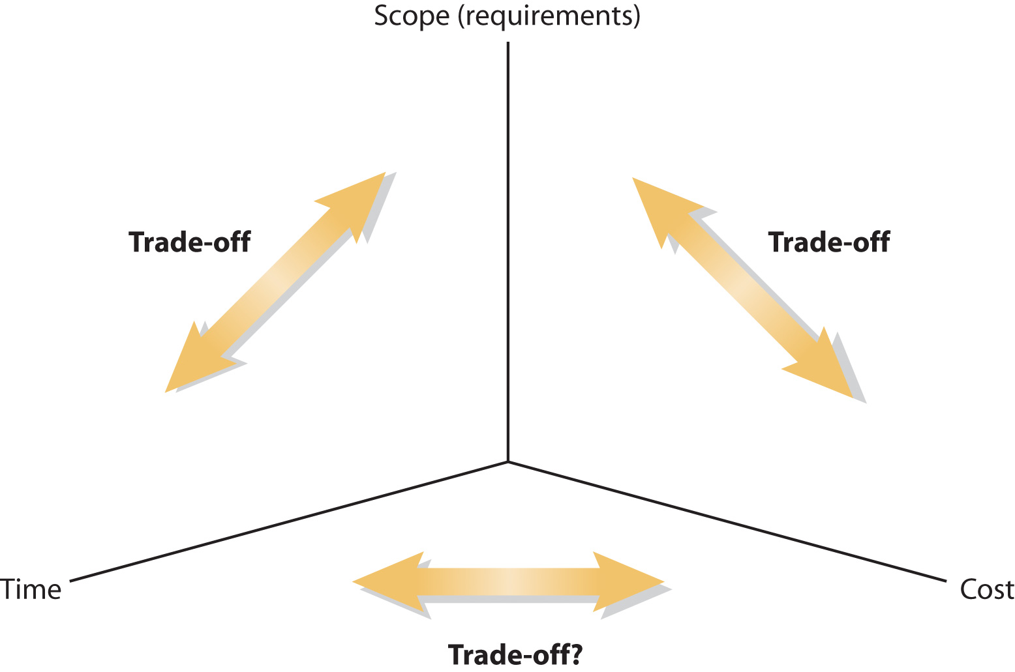
Trade-offs Among Requirements, Schedule, and Cost?
Insert Figure 10-12 here (Figure CE19-2 in Experiencing MIS 2/e)

Slide 48
Study Questions
Q1 What is systems development?
Q2 Why is systems development difficult and risky?
Q3 How do businesses use the systems development life cycle (SDLC) process?
Q4 How does systems development vary according to project scale?
Q5 What are trade-offs among requirements, schedule, and cost?
Q6 What are the major challenges when planning IS projects?
Q7 What are the major challenges when managing IS project?
Q8 2020?

Slide 49
Biggest Challenge for Planning a Large-Scale Systems Development Project?
Biggest challenge is scheduling
How long does it take to:
Develop a large data model?
Adapt data model to user satisfaction?
Develop a computer program? (Software pure “thought stuff”)
Scheduling errors accumulate
Difficult to do credible planning
Every task may be on critical path

Slide 50
Work-Breakdown Structure
Work-breakdown structure (WBS)
Hierarchy of tasks required to complete a project
Each task ends with deliverables
Documents, designs, prototypes, data models, database designs, working data entry screens, and so on
Identifies task dependencies
Estimate task duration, cost and labor needed
May be created with project management software, such as Microsoft Project

Slide 51
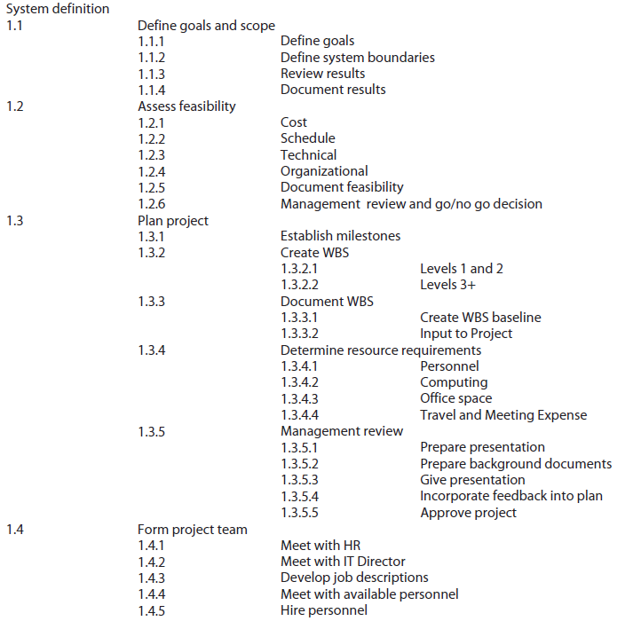
WBS for Definition Phase of Thin-Client Order-Entry System

Slide 52
Gantt Chart of WBS with Tasks, Dates, and Dependencies

Slide 53
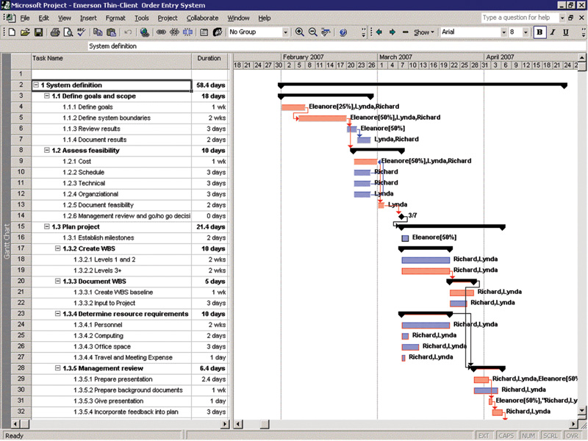
Gantt Chart of WBS with Labor Resources Assigned and Summed

Slide 54
Critical Path Analysis
Sequence of activities that determine earliest date a project can be completed
Longest path through the network of activities
Tasks dependencies compressed as much as possible
Tasks may be moved to noncritical paths to shorten critical path
Tasks on path that run late delay project
Move critical path tasks to noncritical path to shorten project schedule (sometimes)
Baseline WBS (final WBS)
Planned tasks, dependencies, durations, resource assignments
Actual dates, labor hours, resource costs added as project proceeds
Actual figures compared to baselines to determine if project is ahead/behind schedule or cost

Slide 55
But, Reality Always Intercedes
Biggest challenge is scheduling
How long does it take to:
Develop a large data model?
Adapt data model to user satisfaction?
Develop a computer program? (Software pure “thought stuff”)
Scheduling errors accumulate (e.g., snowball)
Difficult to do credible planning
Every task may be on critical path

Slide 56
Three Approaches to Deal with the Challenge
Avoid major schedule risks and never develop software in-house
Admit impossibility of scheduling and planning
Abandon SDLC and invest resources in project, managing as well as possible, accepting schedule that results
Project sponsors don’t like this approach
Use estimation techniques
Schedule data from similar past projects
Estimate lines of code to be written using number of function points in programs

Slide 57
Study Questions
Q1 What is systems development?
Q2 Why is systems development difficult and risky?
Q3 How do businesses use the systems development life cycle (SDLC) process?
Q4 How does systems development vary according to project scale?
Q5 What are trade-offs among requirements, schedule, and cost?
Q6 What are the major challenges when planning IS projects?
Q7 What are the major challenges when managing IS project?
Q8 2020?

Slide 58
Major Challenges When Managing IS Projects?
Coordination
Projects are often organized into independent groups that might reside in different locations.
Pure thought stuff leads to wasted hours, increased costs, poor morale.
Diseconomies of scale
Adding people leads to exponential interactions
Configuration control
Set of management policies, practices, tools to maintain control over resources
Loss of control expensive and disruptive
Unexpected events
Chance of disruption due to unanticipated events
Maintaining team morale

Slide 59
Major Challenges When Managing IS Projects?
Three approaches to deal with challenge
Avoid major schedule risks and never develop software in-house
Admit impossibility of scheduling and planning
Abandon SDLC and invest resources in project, managing as well as possible, accepting schedule that results
Project sponsors don’t like this approach
Use estimation techniques
Schedule data from similar past projects
Estimate lines of code to be written using number of function points in programs

Slide 60
Study Questions
Q1 What is systems development?
Q2 Why is systems development difficult and risky?
Q3 How do businesses use the systems development life cycle (SDLC) process?
Q4 How does systems development vary according to project scale?
Q5 What are trade-offs among requirements, schedule, and cost?
Q6 What are the major challenges when planning IS projects?
Q7 What are the major challenges when managing IS project?
Q8 2020?

Slide 61
2020?
Students in 2020 will still be learning the SDLC. They’ll be applying it to different technologies, for different purposes, but, like the scientific method, the process itself will remain the same.
Hopefully, your generation of business professionals will remember to take responsibility for system requirements.
Taking responsibility means understanding that the information system is built for your business function and managing requirements accordingly.
Information systems exist to facilitate business processes and to improve decision making. Every information system is simply a part of some larger business project.

Slide 62
2020?
Taking responsibility for requirements
Understand the system is built for supporting business functions, help organization achieve goals and objectives
Managing requirements is critical
Role of users
Cannot be passive recipients of IT services
Responsible for ensuring complete and accurate requirements
Responsible for managing requirements changes, avoiding scope (requirements) creep
Define testable conditions for functions and features
Evaluate data models, provide test data, sample scenarios
Conduct user testing (beta testing)
Final approval of system

Slide 63
The Real Estimation Process
Estimating is just “theory”, the average of many people’s guesses.
Project managers sum up estimates and take to management.
Management then negotiates the schedule and budget by reducing time a month or two.
Negatively impacts the project
Typically, project starts with optimistic schedules and ends up late.
Developers begin to not take project deadlines seriously.

Slide 64
Dealing with Uncertainty
Firm converted company’s billing system from an older technology system to the new world of database processing. Unfortunately, after they cut off the old system, serious flaws were found in the new one.
From mid-November to mid-January company was unable to send a bill. Customers who do not receive bills do not pay, and my client had a substantial cashflow problem.
Immediate cause of the problem, firm used the plunge conversion technique.

Slide 65
Dealing with Uncertainty
In this organization, management had little idea about how to communicate with IT, and the IT personnel had no experience in dealing with senior management. They talked past one another.
Senior management only needed to learn to manage their IS projects with the same discipline as they managed other departments.
Management adopted and began to implement policies and procedures to instill the following principles.

Slide 66
Dealing with Uncertainty
All future systems would be developed in small increments.
Business users, not IS, would take responsibility for the success of new systems.
Users would actively work with IS personnel throughout systems development, specially during the requirements phase.
Users would take an active role in project planning, project management, and project reviews.
No development phase would be considered complete until the work was reviewed and approved by user representatives and management.
Users would actively test the new system.

Slide 67
Active Review
Q1 What is systems development?
Q2 Why is systems development difficult and risky?
Q3 How do businesses use the systems development life cycle (SDLC) process?
Q4 How does systems development vary according to project scale?
Q5 What are trade-offs among requirements, schedule, and cost?
Q6 What are the major challenges when planning IS projects?
Q7 What are the major challenges when managing IS project?
Q8 2020?

Slide 68
Case Study: Slow Learners, or What?
1974 study of the causes of information systems failures
Interviewed personnel on several dozen projects and collected survey data on another 50 projects
Analysis of the data revealed that the single most important factor in its failure was a lack of user involvement. The second major factor was unclear, incomplete, and inconsistent requirements.
1994 Standish Group study (“The CHAOS Report”) on information systems failures found the leading causes of IS failure are, in descending order, (1) lack of user input, (2) incomplete requirements and specifications, and (3) changing requirements and specifications.
(http://standishgroup.com)

Slide 69
Case Study: Slow Learners, or What?
In 2004, a University of Maryland study analyzed 19 system failures to determine their cause.
Results indicate the first-priority cause of system failure was “poor requirements”; the second-priority cause was “failure to communicate with the customer” (http://therightrequirement.com)
In 2003, the IRS Oversight Board concluded the first cause of the IRS BSM failure (see Case Study 1, page 27) was “inadequate business unit ownership and sponsorship of projects. This resulted in unrealistic business cases and continuous project scope ‘creep.’”
Case Study video: “Slow learners or what?”

Slide 70
Case Study: Slow Learners, or What?
For over 35 years, studies have consistently shown that leading causes of system failures are a lack of user involvement and incomplete and changing requirements.
Yet, many businesses ignore the lessons from decades of research about the causes of IS failures.

