Slide 1
DIA Automated Baggage Handling System
MSNBC on Denver's Automated Baggage System

Slide 2
Background
November 1989: Airport construction begins
Estimated Date of completion: October 1993
Estimated cost: 2 billion dollars
One of the largest and most technologically advanced airports in the world
2X the size of Manhattan – 53 square miles
Selection of baggage handling system was initially the responsibility of each airline

Slide 3
Background
United Airlines contracts with BAE to create an automated baggage handling system for their terminal
In 1991 – 2 years after construction began, airport officials realize that only United has begun the process of incorporating a baggage handling system
Officials approach BAE in order to discuss feasibility of an airport-wide automated baggage handling system

Slide 4
Background
BAE contracts with airport officials to design and build an airport-wide baggage handling system for 193 million dollars to be completed within 21 months
Goals of the system
Deliver each bag individually – including transfers – automatically from check-in or the unloading of the aircraft to the outward bound aircraft or baggage claim
Maximum delivery times:
Wide body aircraft – 30 minutes
Narrow body aircraft – 20 minutes
Designed to allow transport of baggage anywhere within the airport to or from the main terminal within 10 minutes
Must move the baggage at a rate => the rate at which travelers move
Deliver over 1000 bags per minute

Slide 5
3 Methods of Moving Bags
Tug & Cart
Labor intensive
Manual Method
Telecars
Multiple luggage pieces in one cart
Not automatically sorted
Typically used in automated systems
DCV – Destination Coded Vehicles
Each cart contains a single piece of luggage
Automatically sorted
Not typically used or well tested
Little or no human interaction required
Selected for the Automated Baggage System at DIA

Slide 6
System Components
300 486-class computers distributed in eight control rooms
Raima Corp. database running on a Netframe systems fault-tolerant NF250 server
High speed fiber-optic Ethernet network
14 million feet of wiring
56 laser arrays
400 frequency readers
10,000 motors
92 PLCs to control motors and track switches
3,100 standard baggage carts (DCVs)
450 over-sized baggage carts (DCVs)
2,700 photocells
Over 17 miles of track
Over 6 miles of conveyors

Slide 7
Functionality of original design
Check-in
Bar code labels
Bag’s owner
Flight number
Final destination
Intermediate connections and airlines
Automated bar code scanner
Array of bar-code scanners arranged 360 degrees scan baggage
Typically able to scan 90% of luggage
Luggage unable to be scanned is routed to another conveyor to be manually scanned
Theoretically after reading the bar-code, the system will know where that bag is at all times

Slide 8
Baggage Handling Process
Conveyors
Hundreds of conveyors with junctions connecting all of them
Sort all of the bags from all of the different airlines and send them to DCVs that are headed to the proper terminal and gate
Conveyor can only advance when there is an empty cart onto which the leading bag can be placed
Conveyor speed depends on the rate of delivery of empty carts

Slide 9
Baggage Handling Process
DCVs
Metal cart with wheels on the bottom and a plastic tub on top (mounted on a pivot) that tilts into three positions for automatically loading, carrying and unloading baggage
Ride on a metal track like a roller coaster
Travel up to 24 mph
Slow to 4.5 mph for loading and 8.5 mph for unloading
Photo-electric sensors trigger laser scanner when DCV is present and associate the bag with the DCV
Located every 150 to 200 feet of track
Data from scanners is transmitted to a computer that translates it by using a look up table to match the flight number with the appropriate gate

Slide 10
Baggage Handling Process
DCVs
Tracking computer guides the DCV to its destination by communicating with the radio transponders mounted on the side of each DCV
DCVs move via linear induction motors mounted approximately every 50 feet of track
Tracked by computers
Control PLCs
Handle DCV merges into traffic
Control track switches
Monitor each of he system’s radio transponders
Track gate assignments for potential re-routing
Track obstructions or failures
Automatically detour around a stalled vehicle or jammed track

Slide 11
Baggage Handling Process
Two counter-circulating closed-loop tracks with multiple routing connections provide for future expansion and add redundancy to guard against unanticipated problems

Slide 12
Baggage Handling Process
Decentralized computing allows the baggage system to operate independently of the airport's information systems department
Only dependence within the systems involves coordination with the airlines’ flight reservation and information systems

Slide 13
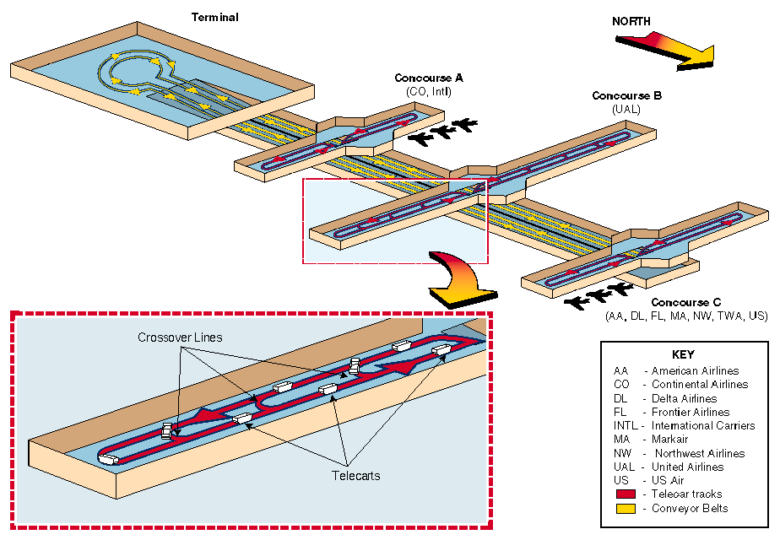

Slide 14
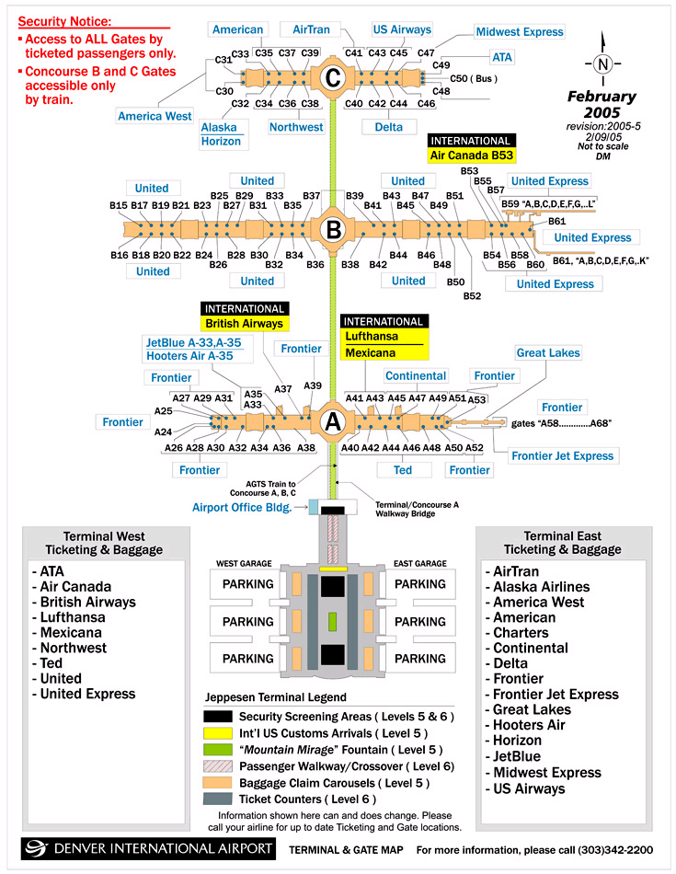

Slide 15
Performance Tests
Bags fell out of the DCVs causing the system to jam
Even with a system jam, bags continued to be unloaded because the photo eye at that location could not detect the pile of bags on the belt and could not signal the system to stop
DCVs crashed into one another – especially at intersections
DCV didn’t appear when summoned
Baggage incorrectly loaded and misrouted
Bags were loaded into DCVs that were already full so some bags fell on the tracks causing the carts to jam because the system lost track of which DCVs were loaded or unloaded during a previous jam and when the system came back on-line, it failed to show the DCVs were loaded
Timing between the conveyor belts and the moving DCVs was not properly synchronized causing bags to fall between the conveyor and the DCVs. Bags became wedged under the DCVs which were bumping into each other near the load point.

Slide 16
Result
Inadequate performance caused several delays in the airport’s opening totaling 16 months
Automated system was designed with no backup system in place
An additional 5 months was required to build a traditional tug and cart system at a cost of 51 million dollars
Debts came due prior to the airport’s opening costing the airport 1.1 million dollars day in interest and opportunity cost
Cost overrun totaled over 253 million dollars
Total Airport cost amounted to more than 4 billion dollars

Slide 17
What went wrong?
Despite its importance, the baggage handling system was an afterthought
The airport was 2 years into construction before the baggage system was considered
The system would have to be retrofit into the airport as it was designed initially including narrow tunnels and tunnels with sharp turns making it extremely difficult to navigate the DCVs

Slide 18
What went wrong?
The time constraint was impossible to overcome
The 21 month schedule precluded extensive physical testing or simulation of the full system design

Slide 19
More significant problems
Reliable Delivery
System consists of over a hundred waiting lines that feed into each other
Belt will only advance when there is an empty cart
Empty carts will only arrive after they have deposited their loads
Cascade of queues
Pattern of loads on the system are highly variable
Depend on the season, time of day, type of aircraft
The number of possible scenarios is enormous

Slide 20
More significant problems
Misreads
Compounded by the fact that not only are the scanners required to read data from the tags attached to the baggage, but the information must also be transmitted by radio to devices on each of the DCVs. This duality compounds the errors.

Slide 21
More significant problems
Complexity
System of this size providing time sensitive delivery of materials on such a large scale had never been done before
12x as many carts traveling 10x the speed of carts typically used at that time
Not just an increase in complexity relative to current systems, but a leap in complexity
System must track tens of thousands of bags going to hundreds of destinations – all in real time
Distributed computer system
In addition to regular error checking, software must guard against electrical disturbances in the communications, have multiple levels of redundancy and be able to recover from errors very rapidly

Slide 22
More significant problems
Line-Balancing problem
All lines of flow should have balanced service
Need to have sufficient empty carts to accommodate the bags coming off the conveyor belt
In a postmortem simulation, the inability of the system to provide adequate empty carts was the primary cause of its failure. A simulation was also completed prior to the start of the project, but due to a lack of communication, BAE was not notified by airport officials of the results; The results stated, in essence, that the system would not work as it was initially designed

Slide 23
Solutions
Short Term
Backup system
Unfortunately didn’t exist in this case
Reduce complexity (automate only outgoing bags)
Long Term
Is it so complex that a reduction in complexity will mean unacceptable performance or cost-effectiveness

Slide 24
Where is DIA’s automated baggage system today?
After 10 years and $600 million, the Denver airport goes back to reliable tugs and carts in 2005
Was the project feasible?
Video

