Slide 1
Introduction to Data Flow Diagrams

Slide 2
Modeling Business Processes with Data Flow
A common business process modeling technique utilizes Data Flow Diagrams (DFDs)
The emphasis in data flow modeling is on modeling function (i.e. the process that enables the flow of data)
DFDs can be used to create more detailed models of business processes identified within the Context DFD
Notes:
2
Teaching Notes:
You might mention that we will investigate other process modeling techniques – like flow charts and swim lanes – later in this program.

Slide 3
Getting Early Understanding of IT Projects …
Bound the problem
Identify in-the-large constraints
Identify major data -- in and out
A Context Data Flow Diagram (DFD) can provide each of these in a broad-based first cut
Data Store
Existing System
User 1
Proposed System
dataflows
User 2
Notes:
Teaching Note:
Emphasize form the beginning of this discussion about DFDs, that they are intended primarily as a communication tool within I/S – and NOT as a documentation tool.
Their CONCEPT diagram – which is different -- is intended as a documentation tool (and a communication tool) within I/S.
There is a slide at the end of this Module exploring this difference in a little more detail, so you can postpone any questions until that slide. I thought it was good to at least mention the difference here.
They will need to know the term context diagram for the CBAP Exam.

Slide 4
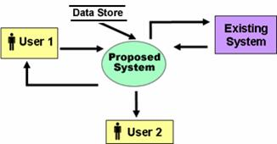
A Context DFD ...
Is a high-level functional model illustrating basic information flow
Shows the relationships of external entities, such as processes, data items, data bases, and existing systems, to the proposed system
Identifies all major input and output data flows of the proposed system, as well as the sources and destinations of these data flows
At a high-level, it answers the question: “What are we trying to do?”
It lays out the broad scope and outline of the system

Slide 5
Factors in Determining Scope
Organizational units affected by new system
Current systems that will interact with or change because of new system
People who are affected by new system
Range of potential system capabilities
Constraints on system

Slide 6
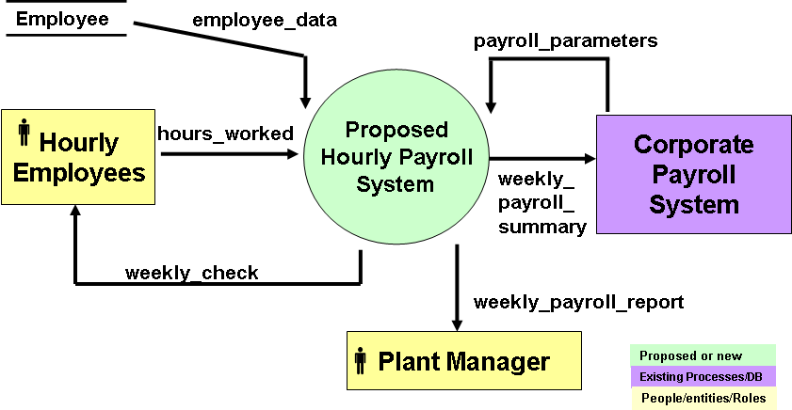
Context DFD – Illustrated
Consider the following possible Context DFD for a proposed new hourly payroll system .

Slide 7
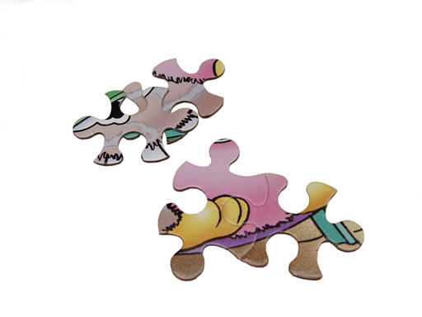
Team Exercise#2
What can you learn from a Context DFD?
Consider the proposed hourly payroll system illustrated in the previous Context DFD. Work as a team to address the following questions about the proposed system.
What kind of information do you think the new system might retrieve from the Employee data store?
What might be included in the payroll_parameters dataflow from the existing Corporate Payroll System?
What information might be included in the weekly_check dataflow?
How do you think the information needed for the weekly_check dataflow might be collected? Is this specified on the Context DFD? Should it be?
Give some examples of questions that are not answered by this Context DFD but possibly could be if you were to add a dataflow and/or another entity?
Do you think this Context DFD would facilitate the necessary communications as you begin to gain a better understanding of the new system?

Slide 8
Usefulness of the Context DFD
Enhances communication about the proposed system
Can be understood by a variety of stakeholders, including customers
Allows quick explorations of ideas, concepts, and understandings
Helps validate understanding with customers
Easy to modify and re-validate

Slide 9
Modeling the Processes Within the Proposed System
In order to gain a better understanding of the business requirements for the proposed new system, it may be useful to model the business processes the new system must capture
A Level 0 Data Flow Diagram (DFD) can provide such a model as illustrated on the following slide
In the Level 0 DFD model each of the numbered “bubbles” represents a major business process that helps define the business functionality of the new system
The arrows connecting the bubbles represent the flow of data through the interconnected processes
Yourdon Notation
Note: Gane-Sarson Notation is a bit different, but essentially equivalent.
9
Notes:
9

Slide 10
Match
Hours &
Emp_Data
1
Corporate
Payroll
System
hours_worked
payrate_parameters
hrs + emp-data
Hourly
Employee
2
ded_parameters
Compute
Gross
Pay
gross_pay
employee_data
Compute
Deductions
ded_data
3
Employee
weekly_payroll_summary
new_YTD
deductions
8
4
Create
Reports
Prepare
Check
Data
weekly_check
5
Update
YTD Data
6
weekly_payroll_report
Print
Check
payroll_data
7
Tabulate
Summaries
check_data
Plant Manager
Payroll System Level 1 Data Flow Diagram
Notes:
10

Slide 11
Leveled and Partitioned DFDs
One of the strengths of the DFD modeling technique is that it can employ a hierarchical (leveled) structure
DFDs also provide a method for partitioning a problem into logically coherent functional pieces
11
Notes:
11

Slide 12
Hierarchical Structure of DFDs
C
A
Process 3 is embedded in a larger DFD
3
B
3.2
x
w
y
3.4
A
3.1
3.5
C
z
B
3.3
This expanded diagram (drawn on a different sheet) provides a more detailed view of the sub-processes within process 3
12
Notes:
12

Slide 13
Limitations of Context DFD
Does not attempt to model functionality of the proposed system at a lower level
Not intended to be a detailed description
Does not include control or sequencing information (generally, this should be left to the design phase)
Photo by Anja Ranneberg, taken in Oamaru, New Zealand, where little blue penguins come ashore to breed at night.

Slide 14
Separating Analysis and Design
Context DFDs illustrate an important principle in system development: separate the what from the how
Analysis focuses on answering the “what questions”
It specifies in detail what we want to accomplish
The “how questions” should be left to design
In fact, there may be many ways to accomplish the outcomes that the analysis defines
What?
Analysis
Then
How?
Design

Slide 15
Team Activity
Consider a proposed new online system to automate seminar registration for a company that offers seminars at multiple sites and on multiple dates. Here are some features of the proposed system that were gathered at an initial one-hour meeting with the customer:
Seminar registration is now handled by mail or by phone, based on seminar brochures sent out in the mail. The customer wishes to implement an online (web-based) enrollment system.
A potential seminar enrollee should be able to go to the new web site, select a specific seminar and then pay for and enroll in it if space is available.
Payment would be made by online credit card transaction. The payment information and transaction approval is currently handled by the corporate financial system.
The system should send an email reminder to each paid participant a week before the seminar is scheduled for delivery.
The seminar manager requested a new daily report showing the current status of enrollment for all seminars being offered.

Slide 16
Team Activity con’t
Here is your task:
1. Create a Context DFD for this system.
2. Identify and include any additional likely data flows that you think of which aren’t mentioned here.
3. You should create any necessary data stores.
4. Remember that the Context DFD is primarily an iterative communication tool, so it is perfectly alright to make some assumptions in your first version, then let the customer(s) correct these when the diagram is presented.
Notes:
Teaching Notes:
IMPORTANT: Keep a copy of a consensus (or the best of the lot) Context diagram for use later in the program (SA525 in particular).
Some possible extensions they might discover or include:
What happens when a course is full? Is there a waiting list? If so, how does this work?
What happens when a credit card is refused?
If a seminar must be cancelled, does the system notify those enrolled? What about refunds?
What other reports are needed? Financial reports? Class rosters?

Slide 17
Team Activity 2
Prepare a context diagram to document the payroll processing at No-Wear Products:
As the analyst for No-Wear Products of Hibbing, Minnesota, you have been asked by your supervisor to document the company’s current payroll processing system. Based on your documentation, No-Wear hopes to develop a plan for revising the current information system to eliminate unnecessary delays in paycheck processing. Your best explanation of the system came from an interview with the head payroll clerk:
The payroll processing system at No-Wear Products is fairly simple. Time data are recorded in each department using time cards and clocks. However, when people forget to punch out at night and we have to record their time information by hand. At the end of the period, our payroll clerks enter the time card data into a payroll file for processing. Our clerks are good – though I’ve had to make corrections when they mess up the data entry.
Before the payroll file is processed for the current period, human resources sends us data on personnel changes, such as increases in pay rates and new employees. Our clerks enter this information into the payroll file so it is available for processing. Usually, when mistakes get back to us, it is because human resources is recording the wrong pay rate or an employee has left and the department forgets to remove the record.
The data are then processed and individual employee paychecks are generated. Several important reports are also generated for management – though I don’t know exactly what they do with them. In addition, the government requires regular federal and state withholding reports for tax purposes. Currently, the system generates these reports automatically which is nice.

Slide 18
Context DFD
Attendee Data Store
seminar_reminder
Email Sys
seminar_reminder
registration_decline
attendee_information
confirmation_of_cancellation
Proposed
System
catalog_search_req
payment_info
Corporate
Financial System
Seminar
Attendee
registration_req_w_cc
credit
action
cancellation_req
report_req
confirmation_of_seat
report
confirmation_of_cc_pmt
Seminar Mgr
seminar_information
search_results
Seminar Data Store

