Slide 1
User Interface Design

Slide 2
User Interface Design
Basic Principles of User-Centered Design
Understand the underlying business functions
Maximize graphical effectiveness
Profile the system’s users
Think like a user
Use prototyping
Storyboard
Usability metrics

Slide 3
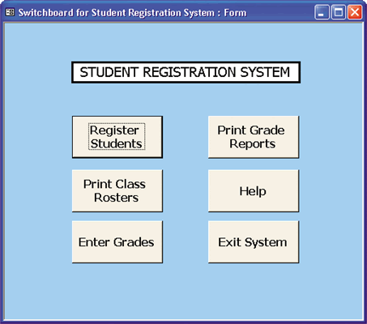
User Interface Design
Basic Principles of User-Centered Design
Design a comprehensive interface
Continue the feedback process
Document the interface design
Switchboard

Slide 4
User Interface Design
Guidelines for User Interface Design
Follow eight basic guidelines
Focus on basic objectives
Build an interface that is easy to learn and use
Provide features that promote efficiency
Make it easy for users to obtain help or correct errors
Minimize input data problems
Provide feedback to users
Create an attractive layout and design
Use familiar terms and images

Slide 5
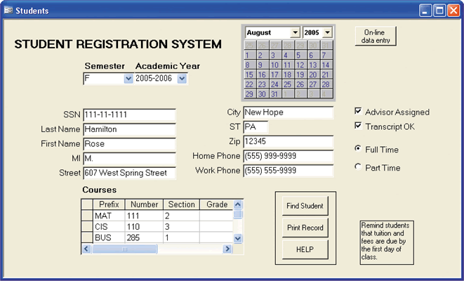
User Interface Design
User Interface Controls
Menu bar
Toolbar
Command button
Dialog box
Text box
Toggle button
Scroll bar
Drop-down list box
Option button
Check box
Command button
Calendar control
Notes:
Menu bar: The main menu options display at the top of the screen in a menu bar. Some software packages allow you to create customized menu bars and toolbars.
Toolbar: A toolbar contains icons or buttons that represent shortcuts for executing common commands. The commands might be navigation shortcuts or can trigger other actions.
Dialog box: A dialog box allows a user to enter information about a task that the system will perform.
Text box: A text box can display messages or provide a place for a user to enter data.
Toggle button: A toggle button is used to represent on or off status — clicking the toggle button switches to the other status.
List box: A list box displays a list of choices that the user can select.
Scroll bar: A scroll bar allows the user to move through the available choices when they do not all fit on the screen.
Drop-down list box: A drop-down list box displays the current selection. When the user clicks the arrow, a list of the available choices displays.
Option button: Option buttons, or radio buttons, represent groups of options. The user can select only one option at a time; selected options contain a black dot
Check box: A check box is used to select one or more choices from a group. A checkmark or an X represents selected options.
Command button: Command buttons initiate an action such as printing a form or requesting Help.
Calendar control: A calendar control allows the user to select a date that the system will display and store as a field value

Slide 6
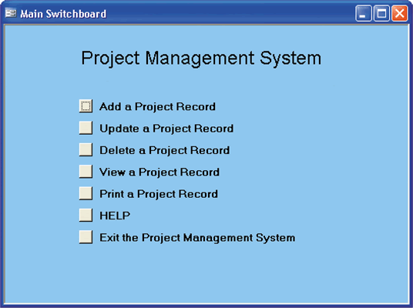
User Interface Design
User Interface Controls
List box – scroll bar
Drop-down list box
Option button, or radio button
Check box
Calendar control
Switchboard

Slide 7
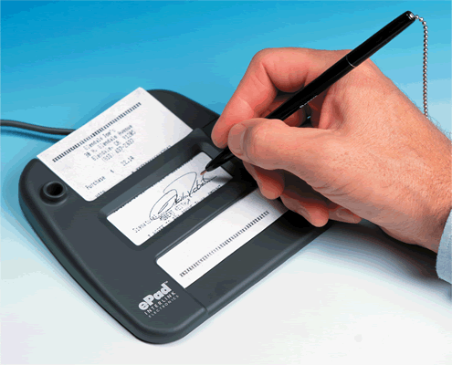
Input Design
Input technology has changed dramatically in recent years
The quality of the output is only as good as the quality of the input
Garbage in, garbage out (GIGO)
Data capture
Data entry

Slide 8
Input Design
Input and Data Entry Methods
Batch input
Batch
Online input
Online data entry
Source data automation
RFID tags or magnetic data strips
POS, ATMs

Slide 9
Input Design
Input and Data Entry Methods
Tradeoffs
Unless source data automation is used, manual data entry is slower and more expensive than batch input because it is performed at the time the transaction occurs and often done when computer demand is at its highest
The decision to use batch or online input depends on business requirements

Slide 10
Input Design
Input Volume
Guidelines will help reduce input volume
Input necessary data only
Do not input data that the user can retrieve from system files or calculate from other data
Do not input constant data
Use codes

Slide 11
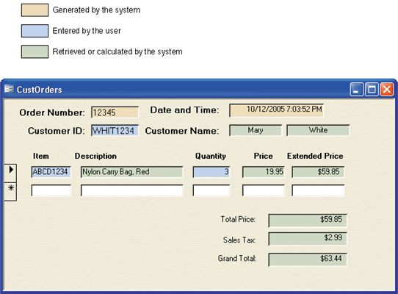
Input Design
Input Volume

Slide 12
Input Design
Designing Data Entry Screens
Most effective method of online data entry is form filling
Guidelines will help you design data entry screens
Restrict user access to screen locations where data is entered
Provide a descriptive caption for every field, and show the user where to enter the data and the required or maximum field size

Slide 13
Input Design
Designing Data Entry Screens
Guidelines will help you design data entry screens
Display a sample format if a user must enter values in a field in a specific format
Require an ending keystroke for every field
Do not require users to type leading zeroes for numeric fields
Do not require users to type trailing zeroes for numbers that include decimals

Slide 14
Input Design
Designing Data Entry Screens
Guidelines will help you design data entry screens
Display default values so operators can press the ENTER key to accept the suggested value
Use a default value when a field value will be constant for successive records or throughout the data entry session
Display a list of acceptable values for fields, and provide meaningful error messages

Slide 15
Input Design
Designing Data Entry Screens
Guidelines will help you design data entry screens
Provide a way to leave the data entry screen at any time without entering the current record
Provide users with an opportunity to confirm the accuracy of input data before entering it
Provide a means for users to move among fields on the form

Slide 16
Input Design
Designing Data Entry Screens
Guidelines will help you design data entry screens
Design the screen form layout to match the layout of the source document
Allow users to add, change, delete, and view records
Provide a method to allow users to search for specific information

Slide 17
Input Design
Input Errors
Reducing the number of input errors improves data quality
A data validation check improves input quality by testing the data and rejecting any entry that fails to meet specified conditions

Slide 18
Input Design
Input Errors
At least eight types of data validation checks
Sequence check
Existence check
Data type check
Range check – limit check
Reasonableness check
Validity check – referential integrity
Combination check
Batch controls – hash totals
Notes:
Sequence checks are used when the data must be in some predetermined sequence.
Existence checks are used for mandatory data items.
Data type checks test to ensure that a data item fits the required data type.
Range checks test data items to verify that they fall between a specified minimum and maximum value.
Reasonableness checks identify values that are questionable, but not necessarily wrong.
Validity checks are used for data items that must have certain values.
Combination checks are performed on two or more fields to ensure that they are consistent or reasonable when considered together.
Batch controls are totals used to verify batch input and might involve checking data items such as record counts and numeric field totals

Slide 19
Team Activity
Refer to the Seminar Management System (Context diagram on next slide)but assume that you are designing a desktop system rather than a Web based system
Create a switchboard design with control buttons that will lead the administrator to attendees, instructors, seminars, and seminar schedules and hotel venues.
Allow the administrator to add, update, or delete records in each area that you see as necessary.
Develop the storyboards that show the proposed screens
You may hand draw and present your designs on the flip chart or use software of your choice (Visio, Dreamweaver, Word etc).
Be prepared to present your prototypes in lab next week for critique.

Slide 20
eval_request
Print
Vendor
Attendee
Email Sys
completed_eval
seminar_notification
scheduled seminar
request_for_eval
instructor_reserved
Selected
Hotel
no_instructor_available
booking_confirmation
instructor_request
Proposed
Seminar
Management
System
SMS
booking_denied
booking_request
hotel_request
hotel_pmt_info
Accounts
Payable
Seminar
Administrator
hotel_reserved
hotel_options
instructor_pmt_info
hotel_choice
no_hotel_avail
class_roster
available_instrs
Seminar
Registration
System
final_roster
Instructor Info
inst_scheduled
hotels_available
inst_dates
scheduled
dates_avail & updates
email_addr
hotels Info*
roster_sign-in
Instructor
* Transfer/Maintenance TBD
final_roster
Attendee Info*

