Slide 1

PowerPoint Presentations
Some Things to Consider
With Emphasis on Things to Avoid!
R. L. Erion
South Dakota State University

Slide 2

PowerPoint provides a tremendous variety of special effects.
Of course, all that power is easily abused.

Slide 3
Areas to Be Covered
Really irritating effects
Ways to Make Text Hard to Read
Now That You’ve Prepared the
Presentation, What Else Can You
Do to Make it Unbearable?

Slide 4
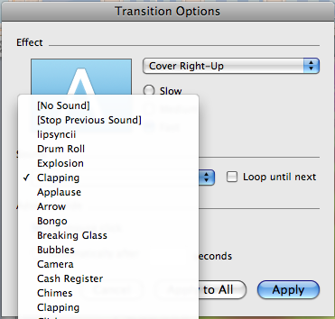
Really Irritating Effects
Sound Effects with Transitions
Cool Noises as Each Slide
Changes
(avoid by selecting “no sound” )

Slide 5
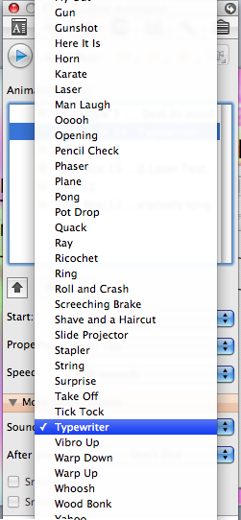
Really Irritating Effects
Noises as Animated Text Comes In
May be best to avoid
Typewriter
and Laser Text.
They are particularly bad when the text is relatively long and is brought in by letter.

Slide 6
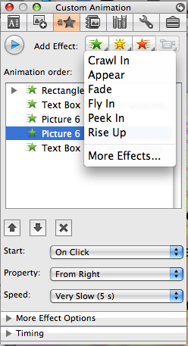
Really Irritating Effects
Visual Effects
“Drop In” is quite annoying with relatively long text segments.
Crawling under “Custom
Animation” can be excruciating.
Did Andy Rooney ever discover “Custom Animation?” There was a lot to complain about.

Slide 7

One wouldn’t want to leave out video that is too small and poorly conceived...
And ends up leaving you in the dark!
It is often better to make a link to a video file and have it
open in a media player.

Slide 8
Ways to Make Text Hard to Read
Poor Choice of Font
Mismatch with Background
Failure to Plan for Lighting
Too Small

Slide 9
Poor Choice of Font
PowerPoint offers the opportunity to use
WordArt. Not always a wise choice.
There are also a lot of fonts to choose from such as Brush Script MT, Herculanum, Stencil, Playbill, and Lucida Calligraphy. Many are hard to read.
Aren’t you glad that text can come in word by word
with Custom Animation?

Slide 10
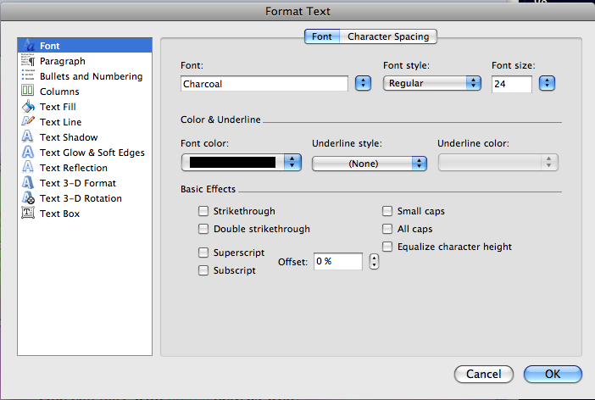
Other Ways to Make Text Difficult to Read
The “Font...” choice
under “Format”
provides several ways
to make text harder to
read.
Italics, glowing, and reflection can all cause some trouble.
One can play with colors here as well,
which brings us to...

Slide 11

Mismatch with Background
The choice of colors can make a big difference.
Backgrounds which have both light and dark areas can be particularly troublesome.

Slide 12
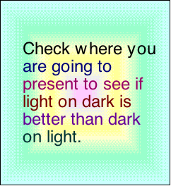
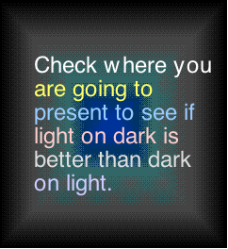
Failure to Plan for Lighting

Slide 13
Size of Text
Generally recommended that the text go no smaller than 18.
Making things smaller can create problems for some people.

Slide 14
Now That You’ve Prepared the Presentation, What Else Can You Do to Make it Unbearable?
Even if you have failed to use any really annoying things from PowerPoint, you can still make the presentation an unpleasant experience.

Slide 15
PowerPoint has given us something even worse than doing a presentation by reading a paper.
Reading the slides to people can be annoying. People will be unhappy if you have to read the slides (because the text is too small or the projector too dim).
People will be really annoyed if the slides are wonderfully legible and you read to them anyway.
Of course, you could read each slide at least twice...

