Slide 1
Information Economics, Big Data and the Art of the Possible with Analytics
Doug Laney
doug.laney@gartner.com
Twitter: @doug_laney

Slide 2
Gartner delivers the technology-related insight necessary for our clients to make the right decisions, every day.
Notes:
Placeholder for text (substitute your own text; delete when not used)

Slide 3
Who is Gartner?
There's an abundance of opinion on IT, but a shortage of advice you can rely on.
Gartner has been a trusted advisor since 1979, and for good reasons:
Our reputation for objective, independent and candid advice
Our unequaled breadth and depth of technology expertise
Our rigorous analytical methodologies
Clients | Research | Consulting | Events
60,000 clients from 11,000 client organizations in 85 countries 70% of the Fortune 1000; 80% of the Global 500 274,000 annual one- to-one client interactions 4,000 CIOs and IT executives | 750 analysts In-depth coverage in nine industries 99,000 searchable documents across 1,300 technology and business topics 12,000 annual vendor briefings | 450 consultants 1,500 annual engagements 5,500 benchmarks | 55 annual conferences worldwide 31,000 attendees 1,100 exhibitors
Notes:
Placeholder for text (substitute your own text; delete when not used)

Slide 4
Organized around 41 Key Initiatives
Vertical Industries & High Tech Markets (continued)
Vertical Industries
High-tech Markets
Financial Services
Energy and Utilities
Healthcare
Payers
Providers
Education
Insurance: Life, P&C
Investment Services
Manufacturing & Distribution
Media
Government
Retail
Communications
Hardware
IT Services
Semiconductors
Software
Vertical Market Services

Slide 5
Organized around 41 Key Initiatives, 10 Vertical Industries and 6 High-Tech Markets
Application Development
Application Governance
Application Integration
Application Overhaul
Business Process Management Technology and Tools
Business Process Management Program
Business Continuity Management
Business Intelligence Competency Center
Cloud Computing
Compliance
Corporate Performance Management
Customer Experience Management
Customer Relationship Management
Data Center Modernization and Consolidation
Key Initiatives
Master Data Management
Microsoft Windows 7 and Office
Mobile Enterprise Strategy
Negotiating Vendor Contracts
Outsourcing
PMO
Portal Strategy
SOA and Application Architecture
SharePoint for ECM
Strategic Planning
Supply Chain Management
Vendor Management
Virtualization
VoIP, Unified Communications and Collaboration
Data Management and Integration Maturity
ERP
Enterprise Architecture Program
Enterprise Architecture Stakeholder Engagement
Enterprise Social Software
IT Cost Optimization
IT Governance
IT Risk Management
ITIL and Process Improvement
Identity and Access Management
Information Governance
Information Security Program Management
Infrastructure, Application and Data Protection

Slide 6
The power of Gartner combines Consulting & Benchmarking, Research, Executive Programs and Events
Consulting & Benchmarking
Provides customized solutions to unique client needs through on-site, day-to-day support
1,500 engagements delivered each year by the 500+ Gartner consultants
Hundreds of millions of dollars in aggregate cost savings to clients
Improved business performance by benchmarking client spending and best practices; helps clients measure, understanding and manage performance
Largest IT performance repository in the industry, drawing on 5,500 IT benchmarks a year
Research
World leader in technology and industry coverage
730 analysts engage in 260,000 one-to-one client interactions each year
Web site alone includes 73,000 searchable documents across 1,000 technology and business topics
Executive Programs
High-level peer networking and information sharing
Annual CIO agenda developed from the responses of 1,500 CIOs in 30 countries, and then customized per client
3,700 CIOs and IT executives get customized advice and peer exchange opportunities
Events
Worldwide events that bring executives together to learn, compare experiences and solve problems
42,000+ people at 70 events annually

Slide 7
Information Economics, Big Data and the Art of the Possible with Analytics
Doug Laney
doug.laney@gartner.com
Twitter: @doug_laney

Slide 10
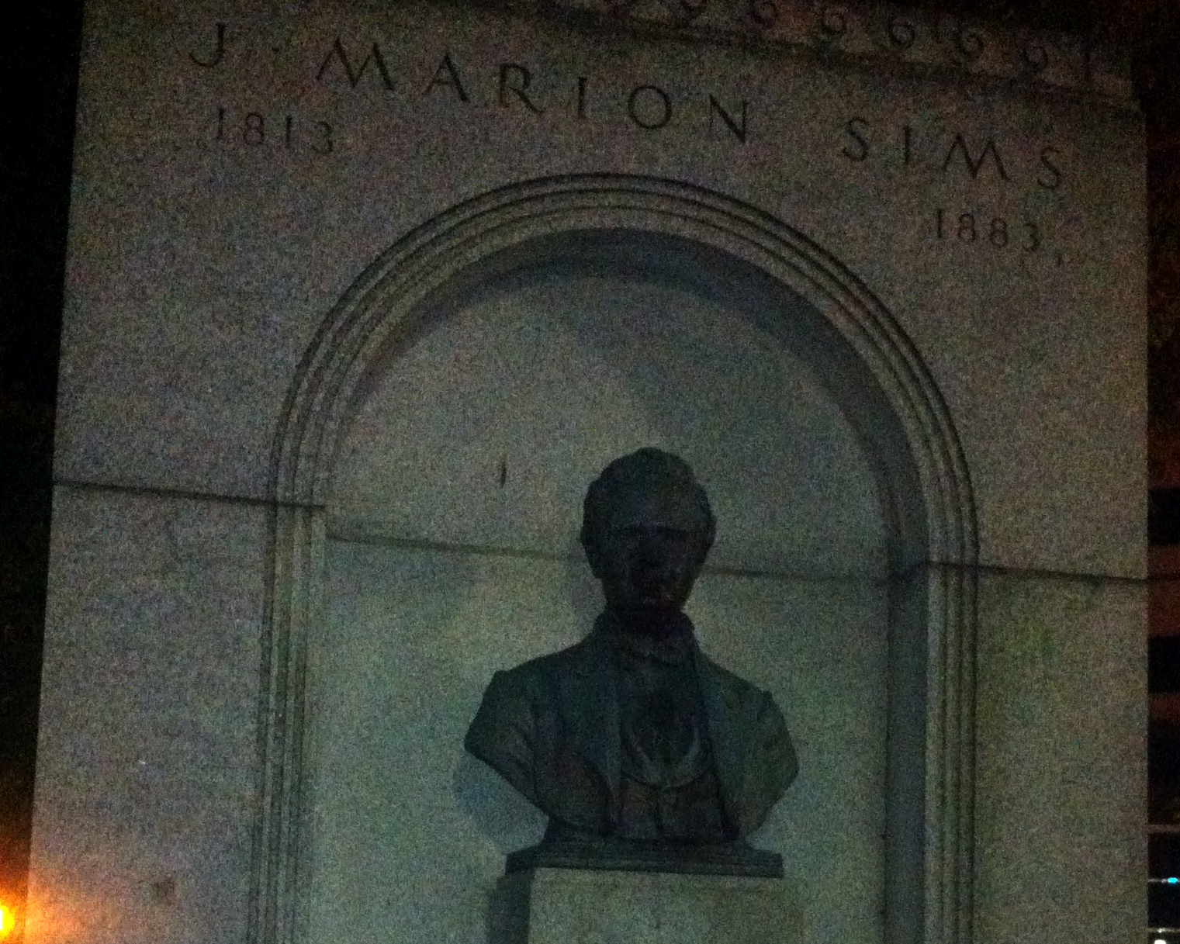

Slide 11
AGENDA
The Economics of Information
Big Data Challenges and Strategy
The Art of the Possible with Analytics

Slide 12
The Economics of Information

Slide 13
Everyone agrees. Nobody agrees.
Information is one of our greatest corporate resources.
Information is one of our greatest performance weapons.
CEO
COO
Information is one of our greatest enterprise risks.
Information is one of our greatest pains in the asset.
CFO
CIO
Notes:
Who cares about information? Of course everyone cares about information. However everyone’s perspective on information and what it means to them is quite different. For some it’s a critical resource, for others a performance fuel, for others an organizational risk, and for others a technology challenge. Regardless one’s perspective we find that nearly all people agree that information is a valuable asset to their organization….and increasingly so as business processes, customer & supplier relationships, cost reduction, innovation, and compliance all rely evermore on information each day.
We might also ask “what is information”? Is it a
Everyone has a different perspective on information--not only what it is, but what it means to them in as they perform their jobs. Some people see information as a tool or weapon, and others as a business by-product. Some see information as a performance fuel, and others as a hazard. And some see it as an actual asset, while others see it as a major annoyance.
Interestingly, it seems that those that deal with managing information in their jobs typically see less value in it than those that do not. This is ironic, because typically, these people are information stewards.
What’s more, business executives regularly spout that information is a major asset, yet the investments they make in managing it frequently pale in comparison to those they make in managing traditional assets.

Slide 14
Where are information assets on the balance sheet?
 | 2010 US$m | 2009 US$m
Noncurrent assets
Goodwill | 3,412 | 3,125
Other intangible assets | 1,233 | 1,189
Property, plant, and equipment | 451 | 479
Investments in associates | 243 | 332
Deferred tax assets | 176 | 13
Trade and other receivables | 8 | 5
Available-for-sale financial assets | 33 | 26
Other financial assets | 88 | 61
Current assets
Inventories | 3 | 4
Trade and other receivables | 800 | 738
Current tax assets | 4 | 17
Other financial assets | 27 | 21
Cash and cash equivalents | 175 | 129
Assets classified as held for sale | 25 | -
?
Notes:
OK, so accountants recognize all sorts of things as providing probable economic benefit. And they require us to count them and list them on the balance sheet.
If information provides probable economic value, then why is it left off the balance sheet?
It’s lumped under “goodwill” you say? The problem with this is that goodwill is really a fudge-factor that merely explains away the premium paid for acquiring something, e.g., another business. It’s certainly no rigorous inventory or valuation of anything. (Goodwill is more like Einstein’s, “cosmological constant,” meant to stabilize the universe to make his generalized theory of relativity work.) Moreover, If you didn’t purchase your information assets they they’re certainly not allowable under Goodwill.
Intangible assets then? Makes sense, but the closest items accountants to-date allow in this category are “customer lists.”
The answer is: they’re not. Information is not considered an asset (or a liability) so you won’t find it on any balance sheet.

Slide 15
What is an asset?
Webster
A single item of ownership having exchange value or convertible into cash. Total resources of a person or business such as cash, notes, and goodwill.
Any economic resources (tangible/intangible) that can be owned or produce value. Assets have a positive economic value.
American Institute of CPAs
A probable future economic benefit obtained or controlled by a particular entity as a result of past transactions or events.
Financial Accounting Standards Board
International Accounting Standards Board
A resource controlled by the enterprise as a result of past events and from which future economic benefits are expected to flow to the enterprise.
An asset is more than just “something of value.”
Notes:
Most people would say that an asset is something of value.
Actually, however, an asset is formally defined as something that provides a, “probable future economic benefit.” Not recognizing this distinction can get people hung-up over the fact that most data sitting in databases is stale, seldom used, or unused. And, the bulk of data is so remotely tied to generating business value that it’s hard to conceive of information the way we do other assets, e.g., auto parts, or pharmaceutical ingredients, or stock certificates.
Perhaps when we start to think of information in terms of a portfolio or think about probabilities more, we can begin to think about information as a true asset.
Note: The AICPA definition was updated in recent years to match the FASB definition.

Slide 16
Why even bother to think about and manage information as an asset?
Revenue
Growth
Expenses
Risk
Compliance
Valuation
Squeezing more value out of information
Optimizing and eliminating business processes
Improving business performance
Trading information for goods and services
Strengthening business relationships (partners, employees, customers, and suppliers)
Managing information effectively
Optimizing availability versus quality
Balancing accessibility versus security
Improving information supply chain performance and integration
Adhering to regulatory issues regarding information
An asset mindset about information leads to wringing more value from it

Slide 17
A brief history of accounting innovation
1953 - Arthur Andersen computerizes the payroll of a GE plant
1936-38 - SEC-chartered committee standardizes financial statements
1923 - General Motors’ controller develops ROI and ROE calculations
1845 - William Deloitte founds the first of the Big-8 accounting firms in London
Luca Pacioli
Father of Accounting
1772 - Darwin’s grandfather, Josiah Wedgwood, invents cost accounting
1494 - A Venetian merchant codifies double-entry accounting methods
2200 BC - The Code of Hammurabi. One of the earliest transaction legal codes
7th Century BC - Coins invented in Lydia
1979 - Dan Brinklin and Bob Frankston create VisiCalc for the Apple II
575 BC - Greek banks start to mint coins, accept deposits, make loans
1990’s - Rise of accounting packages and integrated financial systems, e.g., Peachtree, Quickbooks, Oracle, Peoplesoft, SAP
7500 BC - The first accounting records in Jericho & Sumerian cities

Slide 18
Infonomics is the economic theory of information as new asset class, and the discipline of accounting for, managing and deploying information just as any other enterprise asset.
Notes:
Placeholder for text (substitute your own text; delete when not used)

Slide 19
Principles of Infonomics
Information is an actual asset (if not a recognized asset class)
Information has both potential and realized value
Information’s value can be quantified
Information should be accounted for as an asset (internally)
Information’s realized value should be maximized
Information’s value should be used to help budget IT and business initiatives
Information should be managed as an asset
Notes:
Placeholder for text (substitute your own text; delete when not used)

Slide 20
Three Degrees of Information Value
If you applied info to all relevant business processes
Potential
Info
Value
Gap
Your expected capabilities and plans
Probable
Realized
Your current capabilities and solutions
The availability of Big Data dramatically widens the gap between the actual and possible value for most organizations. Strategies and initiatives to close that gap are paramount.

Slide 21
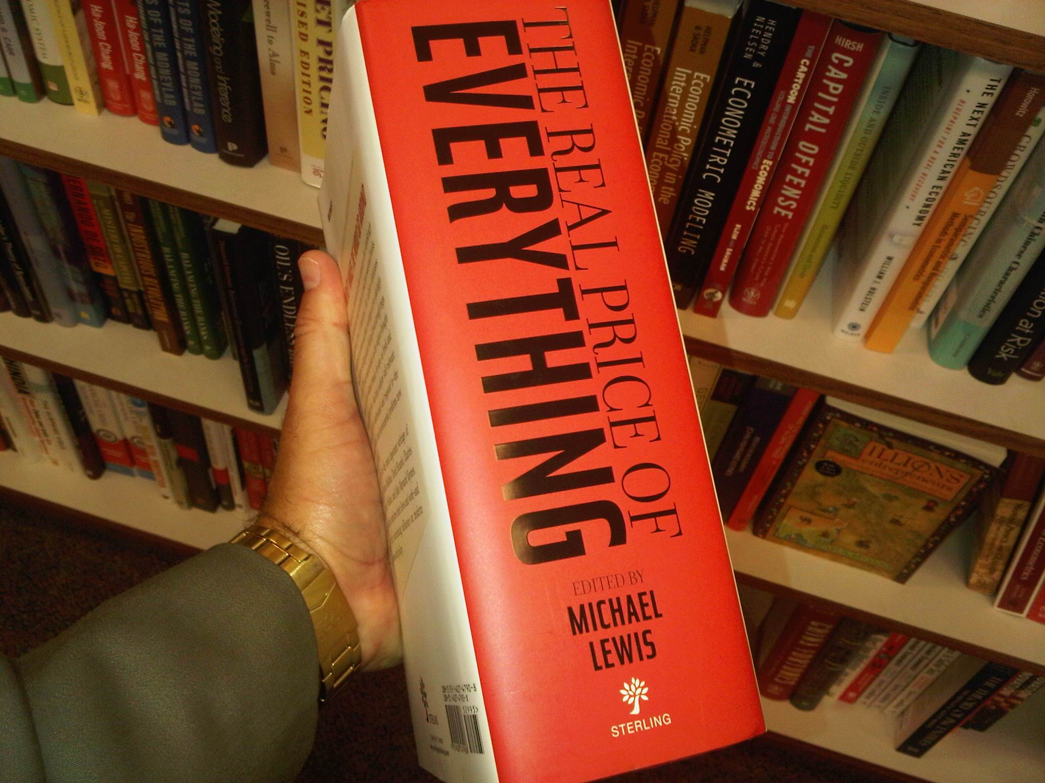

Slide 22
A variety of information valuation models
NON-FINANCIAL MODELS
Intrinsic Value of Information (IVI): How good and easy to use is the data versus how likely are others outside the organization to have it also?
Business Value of Information (BVI): How applicable to the business or a particular business process is it? How quickly can we get fresh data to the point of the business process?
Performance Value of Information (PVI): How much does having a unit of information incrementally contribute to moving closer toward all n KPI targets over a given period?
FINANCIAL MODELS
Cost Value of Information (LVI): What would it cost to replace the data, and what is the financial impact to the business if the data were lost over a given time period?
Market Value of Information (MVI): How much is a business partner (p) willing to pay for access to this information?
Economic Value of Information (EVI): The Performance Value of Information (PVI) for a revenue metric, less the cost of acquiring, administering, and applying the information.
$$EVI=\sum_{0}^{t}{(R_{i}}− R_{c})∗T/t−(AcqExp+AdmExp+AppExp)$$

Slide 23
Infocentric Corporate Valuation Premiums
e.g. Google, Yahoo, Moody’s Harte-Hanks, D&B, TripAdvisor
Infoproduct Companies (4.7)
4.0
3.0
2.0
1.0
0.0
e.g. Netflix, GlaxcoSmithKline, Nokia, Apple, Amex, Ford
Infocentric Companies (2.4)
Market caps eclipse asset value
Projected Average (1.1)
Tobin’s q*
2012 Market Average (0.96)
You are here?
1950 1960 1970 1980 1990 2000 2010
Financial markets see something in companies that are serious about information
*ratio of market value to tangible assets

Slide 24
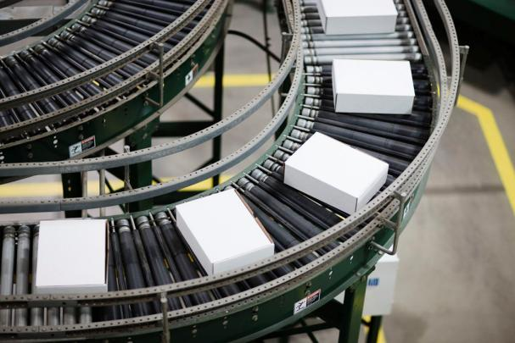
What we can borrow from traditional asset management practices?
Material
Raw materials Inventory Finished goods Unfinished goods Storage | Maintenance (planned & unplanned) Replacement Standardization | Transportation Resource training Safe handling Security Disposal
Financial
Accounting Investment Acquisition | Leverage Credit Valuation Portfolio | Factoring Liquidity Volatility
Workforce
Recruiting Hiring Training Staffing | Roles Teams Performance reviews | Reduction in force Termination Outsourcing Temporary workers
Apply your org’s expertise in asset management toward info asset mgt
Notes:
Exploring the wide range of specific asset management activities that exist for each of the traditional asset classes, we can understand, and begin to apply, these well-honed principles to our information assets as well.
To start with, making the distinction between raw materials, unfinished goods, and finished goods the way brick-and-mortar business do gives us a framework perhaps for thinking about and managing raw data, cleansed data. and integrated data.
Already we’ve seen where storage and distribution of information have taken a page out of the materials-management handbook. The data warehouse concept is a perfect example. Well, what else is there to learn? What epiphanies would we have about effectively storing, handling, and transporting information if we spent a day in the loading dock? Plenty.
For example, a critical—and highly topical—issue of material asset management cost savings revolves around maintenance. To what degree should we expend up-front costs for planned information maintenance (e.g., cleansing) versus more costly, unplanned maintenance (e.g., data prep)?
Our metadata managers and data administrators, too, could learn a lot about standardization from our brethren in hard hats. And, we could perhaps even get some tips about data governance from material asset management policies and practices around safe handling, security and disposal.
Financial assets, much like information assets, are representative in nature. That is, they represent something else. Financial assets-at their core—represent accepted, portable value, pure and simple. Information assets are reflective of activities, or things, including, of course, financial transactions and financial assets themselves.
Similar to material assets, we can, and should, borrow liberally from the age-old discipline of financial asset management.
Concepts from financial asset management that stand out in comparison to material asset management include, for one, the notion of a portfolio, or a collection of like assets. This will come into play when we discuss what level of information granularity makes the most sense for valuation. Also liquidity—the ability to convert a financial asset into cash—is analogous to information accessibility. Financial assets that are less liquid carry more risk and, therefore. are discounted. Similarly, information assets that are less accessible because they are archived or compressed or offline are valued lower than others.
Perhaps if we paid closer attention to the way money managers operate and the decisions they make regarding financial assets, then we could apply some of these principles to information asset management.
Finally, taking a look at human capital asset management, we can learn a lot about enrichment…and disposal. Human resource (HR) managers are consumed with ensuring the right employees are hired then trained, evaluated and, perhaps terminated, when their value falls below what you’re paying them.
Similarly, those managing information assets should be concerned with ensuring the right data is acquired, that it’s enhanced, profiled and cleansed, and disposed of when its value slips below its total cost of ownership.
In addition, the way functional managers organize employees into higher-functioning teams is a valid metaphor for how we organize and integrate data into higher-functioning data sets, or even data warehouses.
Perhaps there’s also something new to be learned about information management by witnessing and adapting how HR managers go about the recruiting, on-boarding and educating and dismissing employees, and how functional managers get more out of groups of employees than they could if those employees were individually dispersed.

Slide 25
Benefits of Infonomics
Improving the management of information
Creating a common language for IT, business leaders and CFO to communicate
Becoming a more info-centric business (optimizing, eliminating, innovating)
Justifying and proving benefits of IT initiatives
Leveraging one of the enterprise’s most underutilized resources
Driving improved corporate market valuations

Slide 26
Big Data Challenges and Strategy

Slide 27
Big Data is #1
on the 2012 list of most ambiguous terms
Global Language Monitor
most searched term among clients
on Gartner.com

Slide 28
Big Drama in Defining Big Data
Technology
NoSQL
Benefit
Hadoop
Decision-making
New type of processing
Hidden insights
Cloud or hosted data
Automate processes
Technology limits
Costly
Efficient
Extract intelligence
Exceeds capacity
Databases bigger than ___
Unprecedented business value
Volume
Velocity
High performance
A market phenomenon
Variety
Order of magnitude
A marketplace term
Unstructured data
Beyond typical
Semi-structured data
Awkward data sets
Information assets
Marketing fluff
Information
Business relevance
Marketing
Petabyte scale
Buzzword

Slide 29
Big Data Characteristics
Growing quantity of data
e.g. social media, behavioral, video
VOLUME
VARIETY
Quickening speed of data
e.g. smart meters, process monitoring
VELOCITY
Gartner, Feb 2001
Increase in types of data
e.g. app data, unstructured data

Slide 30
Which Big Data characteristic is the biggest issue for your organization?
Source: Getting Value from Big Data, Gartner Webinar, May 2012

Slide 31
Big Data Opportunities
Business Amplification
Making better informed decisions
e.g. strategies, recommendations
Discovering hidden insights
e.g. anomalies forensics, patterns, trends
Automating business processes
e.g. complex events, translation

Slide 32
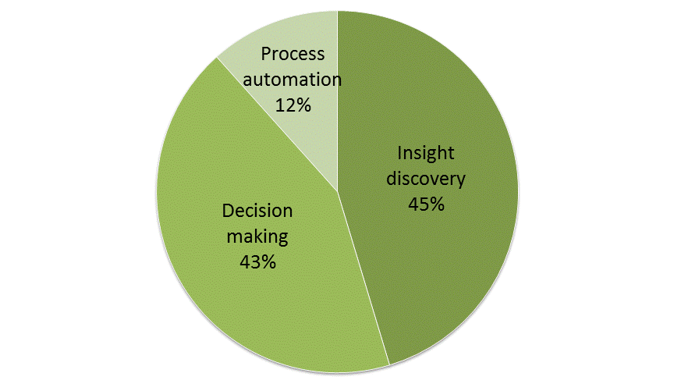
Which is the biggest opportunity for Big Data in your organization?
Source: Getting Value from Big Data, Gartner Webinar, May 2012

Slide 33
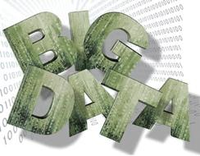
Big Data is Centered on Challenges and Opportunities
VOLUME
DECISIONS
VELOCITY
INSIGHTS
VARIETY
AUTOMATION

Slide 34
Big data are high volume, velocity and/or variety of information assets which require cost-effective, innovative forms of information processing to enable enhanced insight discovery, decision-making, and process optimization.
Notes:
Placeholder for text (substitute your own text; delete when not used)

Slide 35
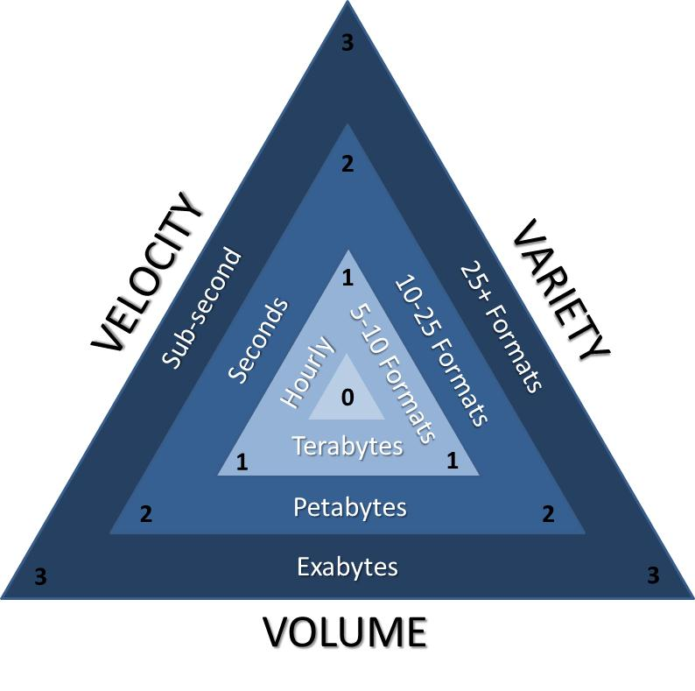
How Big is Big?
The Gartner Data Magnitude Index
Identify the scale of data you manage and process, for each dimension then sum them to determine your Data Magnitude Index (DMI).
Technology Class:
DMI 1-3: Prior generation
DMI 4-6: State of the art
DMI 7-9: Next generation

Slide 36
Where does Big Data come from?
Email
Transactions
Enterprise “Dark Data”
Partner, Employee Customer, Supplier
Contracts
Monitoring
Public
Commercial
Sensor
Credit
Weather
Social Media
Industry
Population
Sentiment
Economic
Network
Correlations and patterns from disparate, linked data sources yield the greatest insights and transformative opportunities

Slide 37
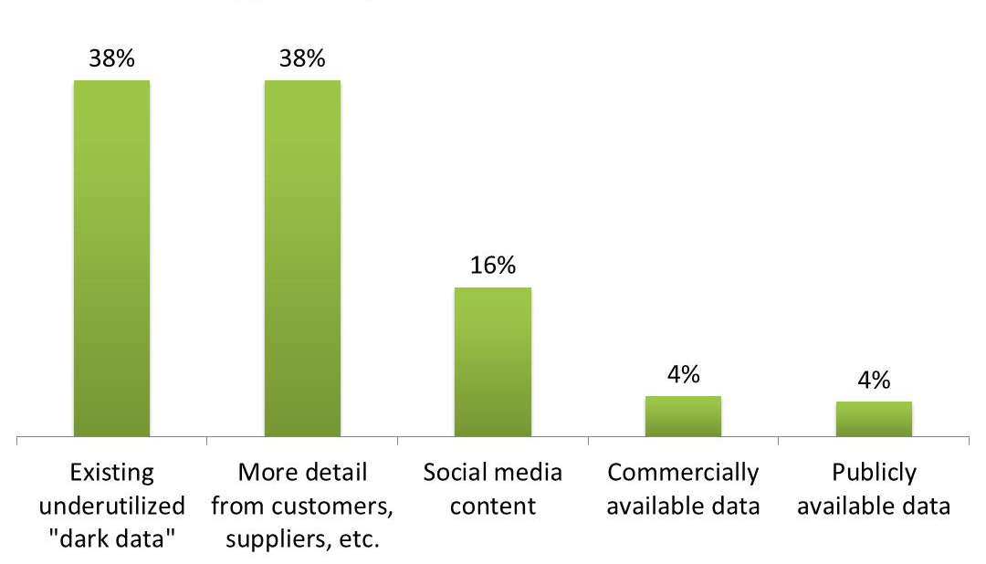
Which source of data represents the most immediate opportunity?
Source: Getting Value from Big Data, Gartner Webinar, May 2012

Slide 38
The Big Data Challenge: Putting Together the Pieces Quickly and Efficiently
I
N
E
R
T
I
A
Through 2015:
85% of Fortune 500 organizations will be unable to exploit big data for competitive advantage.
Business analytics needs will drive 70% of investments in the expansion and modernization of information infrastructure.
INFRASTRUCTURE
LEADERSHIP
R
I
S
K
S
S
K
I
L
L
S
ANALYTICS
INVESTMENT
ORGANIZATION
ARCHITECTURE

Slide 39
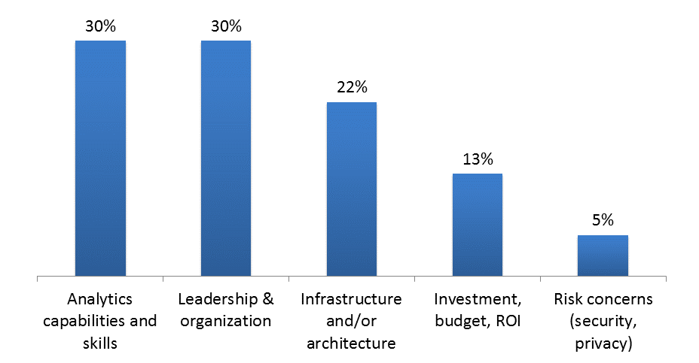
What is your organization's biggest inhibitor to benefiting from Big Data?
Source: Getting Value from Big Data, Gartner Webinar, May 2012

Slide 40
Big Data Strategy Essentials for IT
Ensure infrastructure adequacy
Consider alternate information architectures
Anticipate and govern risks
Expand your analytic capabilities
Assemble necessary skills
Alter IT organization structures

Slide 41
Big Data Strategy Essentials for Business
Acknowledge how Big Data initiatives are unique
Generate big ideas for Big Data
Identify potentially valuable data sources
Build business leadership belief in data
Become even more pragmatic about investments

Slide 42
The Art of the Possible

Slide 43
Gartner Analytic Ascendancy Model
How can we make it happen?
Prescriptive Analytics
What will happen?
Predictive Analytics
Why did it happen?
Optimization
VALUE
Diagnostic
Analytics
What happened?
Descriptive Analytics
Hindsight Insight Foresight
Information
DIFFICULTY

Slide 44
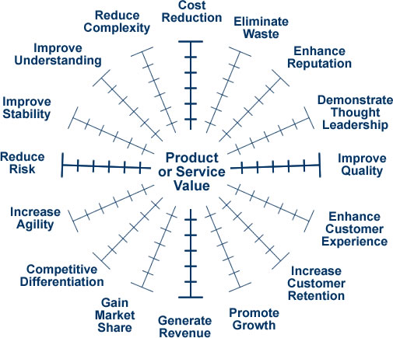
Targeting traditional business drivers
A focus on too many drivers can suboptimize overall business performance
A fixation only on traditional drivers can inhibit innovation and transformation

Slide 45
Grapes of Math
Opportunity
Advise vintners on Wine Spectator scores & competitions and how to improve winemaking
Data & Analytics
Database of hundreds of thousands of wines including chemical analysis of 100+ chemical compounds
Proprietary method (pattern matching, machine learning) for sampling and analyzing grapes
Results
Ability to predict Wine Spectator scores and simulate tasting notes
Winemakers improve wine scores, and optimize inventory, pricing and promotion
How can you break years or centuries of tradition by collecting and analyzing data in new ways?
Notes:
Gartner case study 1/2012: http://www.gartner.com/resId=1906915
Orbitz Worldwide Uses Hadoop to Unlock the Business Value of 'Big Data'
Published: 27 January 2012 ID:G00226454
Analyst(s): Merv Adrian | Debra Chamberlin

Slide 46
Sniffing and snuffing insurance fraud
Opportunity
Save and make money by reducing fraudulent auto insurance claims
Data & Analytics
Predictive analytics against years of historical claims and coverage data
Text mining adjuster reports for hidden clues, e.g. missing facts, inconsistencies, changed stories
Results
Improved success rate in pursuing fraudulent claims from 50% to 88%; reduced fraudulent claim investigation time by 95%
Marketing to individuals with low propensity for fraud
What “dark data” do you have just laying around that can transform business processes?

Slide 47
Making the grade by setting a new curve
Opportunity
Predict future financial performance, health, issues, risks better than industry standard methods
Data & Analytics
Continuously crunch over 5 dozen publically-available factors to generate a hundred-point FHR (financial health scale) vs. subjective quarterly financial analyst ABC grades
Result
Most financial analyst firms excited/blinded by MF Global hiring Jon Corzine, but RapidRatings saw its FHR score slide from 49 to 26, advising investors to run not hide
A+
How can you change the rules of the game with new measurements and new analyses?

Slide 48
Does this data make my buns look good?
Opportunity
Move from manual to automated inspection of burger bun production to ensure and improve quality
Data & Analytics
Photo-analyze over 1000 buns-per-minute for color, shape and seed distribution
Continually adjust ovens and process automatically
Result
Eliminate 1000s of pounds of wasted product per year; speed production; save energy; Reduce manual labor costs
Are you using all your “senses” to observe, measure and optimize business processes?

Slide 49
Steaking your reputation on it
Opportunity
Improve reputation, brand and buzz by tapping social media
Data & Analytics
Continually scanning twitterverse for mentions of their business
Integrating tweeters with their robust customer management system
Results
Saw tweet from a top customer lamenting late flight—no time to dine at Morton’s
Tuxedo-clad waiter waiting for him when he landed with a bag containing his favorite steak, prepared the way he normally likes it with all the fixin’s
How can you listen, analyze and respond in real-time?

Slide 50
Listening to United Voices
Opportunity
Evolving from reactive to proactive responses to global issues
Developing and guiding assistance programs
Data & Analytics
Mining social networks to predict job losses, spending reductions, or disease outbreaks within a region
Natural language deciphering
Result (TBD)
Early warning signals to guide assistance programs for preventing regions from slipping into poverty, epidemics, or war
How can you tap social media to be proactive to emerging global issues?

Slide 51
Projecting project success or failure
Opportunity
20 years of unused “dark data” (archived emails) incurring cost without benefit
Consulting project issues reported after the fact; no way to anticipate and address them
Data & Analytics
Identify project communications (emails) from prior successful vs unsuccessful projects
Mine emails for communication and sentiment patterns (time-of-day, CC/BCC, length, content)
Result (TBD)
Early warnings of scope, budget, technical, personnel issues → improved project success
Productized project indicator benchmarks
Global Systems Integrator
What “dark data” can you use to create and deploy patterns for early warning signals?

Slide 52
Improving the quality of product quality
Opportunity
Mandate to monetize years of unused “dark data” on product/component safety tests
Data & Analytics
Collaborate with major retailers and insurers to mashup and analyze data on product safety, returns and claims
Results (TBD)
Early stages of consortia formation
Prediction of product issues; recommendations for components and materials
Improve product quality and consumer safety
New high-margin revenue stream
Leading Product Safety Organization
Who can you partner with to combine data sources and redefine traditional metrics?

Slide 53
Blowing Away Competitors with Big Data
Opportunity
Grow revenue through improved targeting and cross-selling yard care products
Data & Analytics
Gartner recommended layering POS and warranty customer data with map data to identify customers that have large foliage coverage and large driveways
Identify new “DIY” customers to cross sell leaf & snow blowers or partner products
Results (TBD)
Improve direct marketing campaign performance by focusing on customers with actual needs and specific behaviors; form higher-value partnerships, e.g. Scotts, Home Depot
Lawn Care Products Co.
What public data can you integrate to creatively target customers and partners?

Slide 54
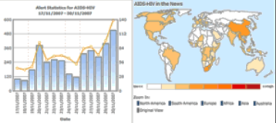
Tomorrow’s news, today
Opportunity
Identify systemic, related or mounting health, geopolitical or financial issues
Data & Analytics
Continually capture, translate, classify and analyze 40,000 local news reports in 43 languages from around the world
Custom charting, alerts, animated map visualization of categories or search terms
Predict and highlight emerging hot topics and trends
Results
Enable politicians, insurers, investors, disease control institutions and global support groups to respond quicker to local or global issues
What data is out there to help you see the future?

Slide 55
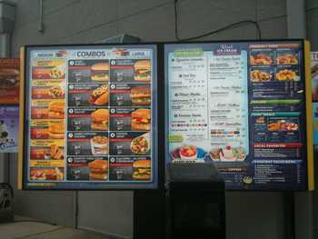
Yes, we know you want fries with that
Opportunity
Optimize customer margin and revenue
Data & Analytics
Continuously analyze video from drive-through lanes and on the street to identify customer “drive-by” behavior and situations
Outsource credit card data to analyze pre- and post-visit customer behavior (in aggregate)
Results
Update order boards as needed to feature more expedient versus higher margin items based on anticipated customer behavior
Dynamically updated pricing???
Major Fast-Food Company
How can you dynamically optimize your offering mix based on real-time customer behavior?

Slide 56
A tale of retailing retail data
Opportunity
Gain free strategic advice on promotions, stocking etc. from CPG partners
Data & Analytics
Place billions of rows of POS, inventory, promotion, and other data into a cloud-based data store for partners to analyze in an common spreadsheet-like format
Data hosting and analytic processing provided by 1010data
Results
CPG partners (e.g. P&G) now pay for access. As a result Dollar General has a self-funding enterprise data warehouse and was able to eliminate its complex, expensive RDBMS-based EDW.
How can you self-fund your analytic environment through sharing and monetizing it via partners?

Slide 57
Future, Summary and Recommendations

Slide 58
Keeping eyes wide open to the future of information
Information banking
Generally accepted information accounting principles (GAIAP)
Information & algorithmic product lines
Data science pools, executive companions and outsourcing
Inter-enterprise data federation
Intelligent linking and tagging
Syndicated behavioral and emotional profiles

Slide 59
Your Action Plan
Start valuing, managing and deploying information as an actual corporate asset
Understand that Big Data isn’t just about the size of data. Also recognize and address the challenges of data velocity and variety.
Put in place strategies and mechanisms to address all the non-technical challenges of Big Data as well
Identify under-utilized “dark data” opportunities including available public, commercial, social media and partner data
Beg, borrow and steal analytics and Big Data ideas from other industries
Notes:
Placeholder for text (substitute your own text; delete when not used)

Slide 60
Information Economics, Big Data and the Art of the Possible with Analytics
Doug Laney
doug.laney@gartner.com
@doug_laney

